Slide 1
The Bright Side of Signage®
from the global market leader in digital signage players
Aug 20, 2018

Slide 2
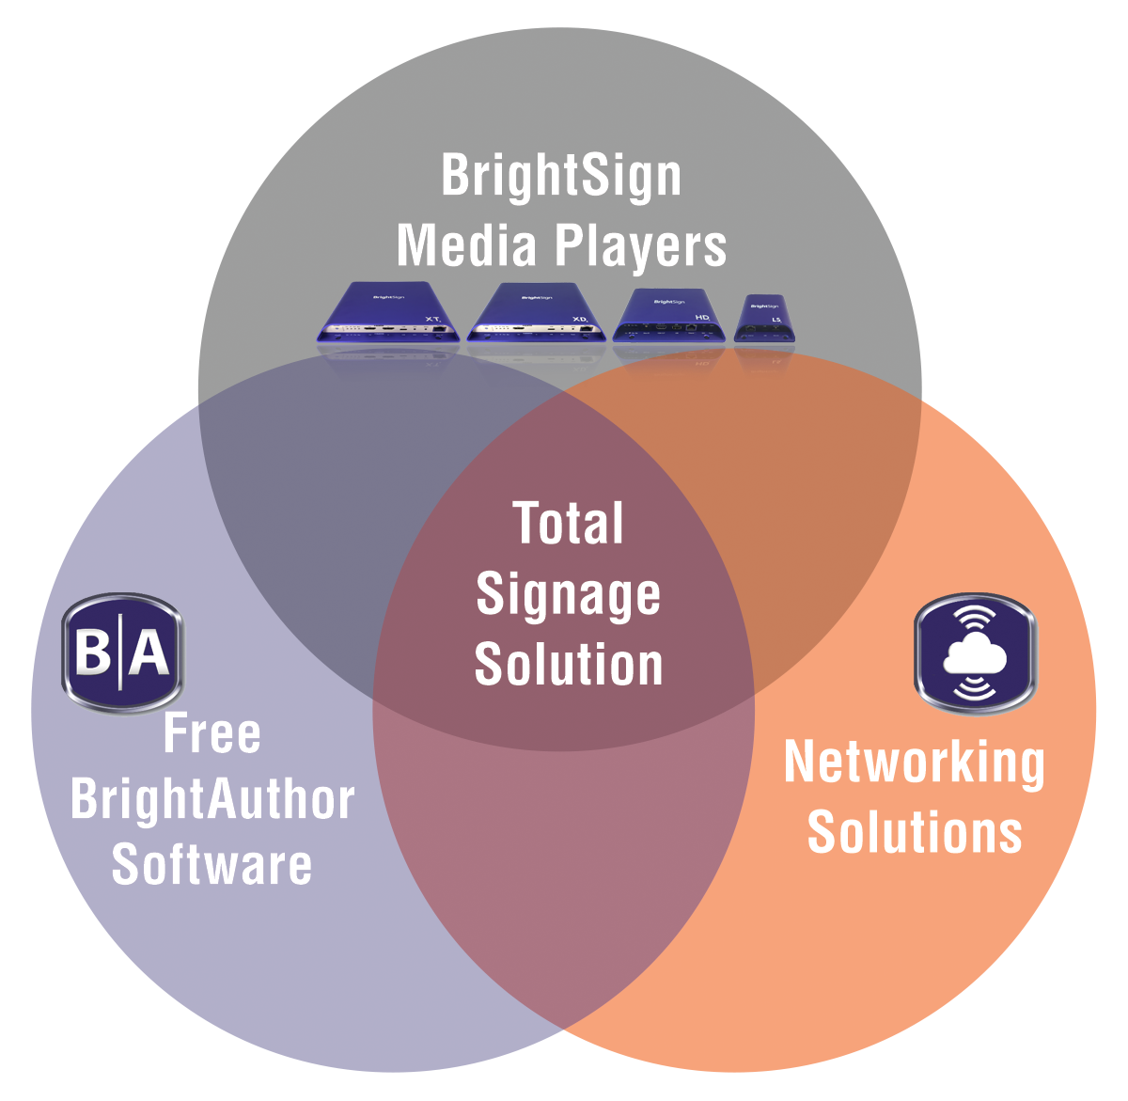
Agenda
1. Corporate Overview
2. Products
3. Features
4. BrightAuthor
5. BrightSign Network
6. Applications
7. BrightSign Partners

Slide 3
Corporate Overview
The Bright Side of Signage®

Slide 4
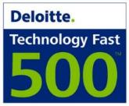
BrightSign corporate overview
The worldwide market leader in digital signage
What We Do
BrightSign manufactures media players, and provides free software and networking solutions for the commercial digital signage market worldwide
BrightSign is known for its signature reliability, affordability, ease-of-use, highest quality output and most powerful video engine
Who We Are
Founded in 2002 by Anthony Wood, inventor of the digital video recorder (DVR) & Roku
Jeff Hastings, CEO
Notes:
BrightSign has offices worldwide:
Our headquarters is in Silicon Valley, CA
We have R&D and support offices in Cambridge, UK & Odessa, Ukraine
Paris, France is our International Sales office
And we have shipping warehouses in Amsterdam and Hong Kong
With these worldwide locations, we offer around the globe sales, service and support, and our support is available virtually 24/7.

Slide 5
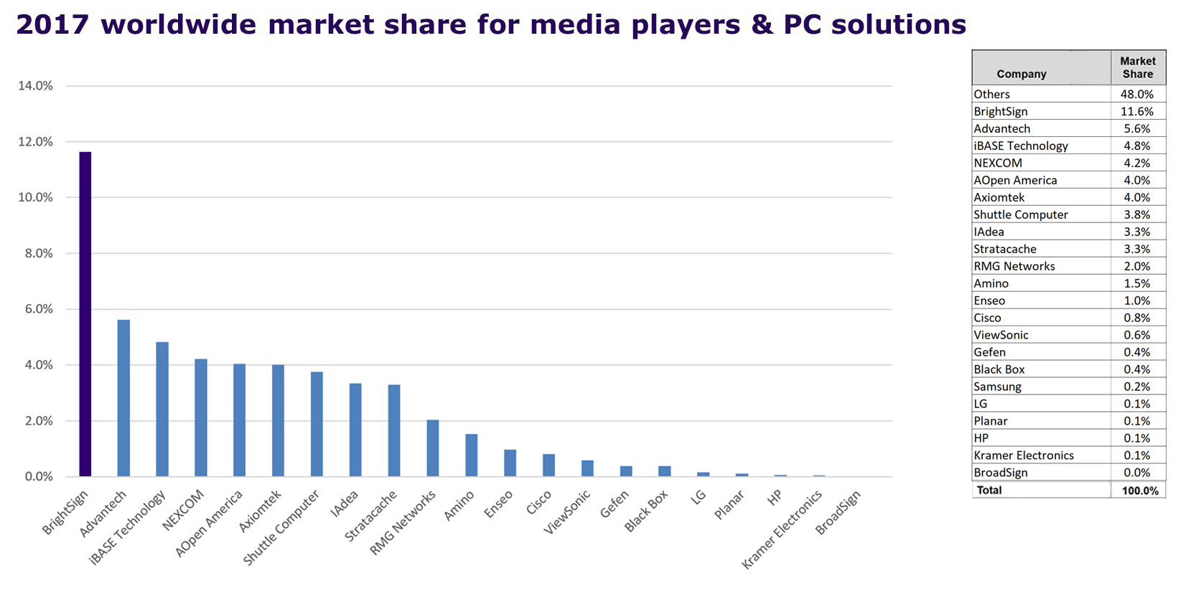
BrightSign is the Market Leader
2017 worldwide market share for media players & PC solutions
Data provided by the IHS “Digital Signage Industry Market Tracker” report
IHS (NYSE: IHS) is the leading source of information, insight and analytics in critical areas that shape today's business landscape. IHS has been in business since 1959 and became a publicly traded company on the New York Stock Exchange in 2005.
BrightSign has been the market leader in digital signage media players since 2011
BrightSign’s closest competitors are PCs
Notes:
BrightSign is the biggest solution provider that you may not easily see because we are behind the screen. BrightSign also partners with CMS providers who sell our media players.

Slide 6
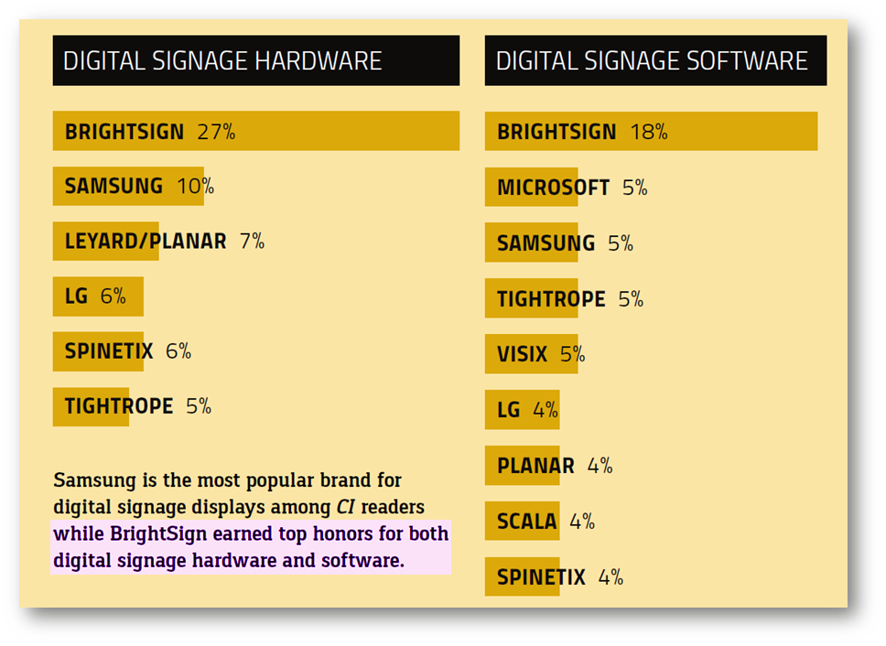
BrightSign Brand reigns supreme for digital signage
The clear choice among CI readers for majority of their digital signage needs
Commercial Integrator surveyed readers on which companies they recognize & embrace
BrightSign stands out as the clear leader in both digital signage hardware and software

Slide 7
World Market Forecast for Digital Signage
2017 is expected to have a 30.8% YoY increase in revenue, with displays & media revenue averaging nearly a 38% increase from 2016.
2018 is expected to have a greater focus on interactivity such as Interactive Whiteboards (IWB) for education, corporate and government markets, as well as NFC, motion sensor touch solution, voice and facial recognition technology in retail and wayfinding
Notes:
IHS Notes on Forecast
IHS Markit expects the overall digital signage industry to finish 2017 with a 30.8% YoY increase in revenue, with displays and media revenue averaging nearly a 38% increase from the previous year. Growth in DOOH advertising for 2018 is forecast to start the year strong, supported by major events such as the 2018 Winter Olympics in PyeongChang, South Korea and the 2018 FIFA World Cup Russia. The increase in DOOH advertising is also a result of the ample number of direct-view LED displays launched by many of the major LCD manufacturers in 2017.
Looking to 2018, there will be a greater focus for displays in interactivity and collaboration applications such as IWBs for education, along with the development of corporate and government markets. IHS Markit believes there will be an even greater shift in connected and integrated environments for digital signage displays with other technologies, such as NFC, motion sensor touch solutions, along with voice and facial recognition technology—aiding to drive the development for IWBs in new applications such as retail and wayfinding.
Increased momentum for DOOH advertising focuses on developments in collecting data, automated workflows, and metrics, which will be crucial to offering advertisers the benefits of creating more targeted campaigns among wider audiences. DOOH advertising is also anticipated to become more immersive in 2018, with instances of VR and AR incorporated with digital signage deployments, especially in public space verticals.

Slide 8
BrightSign Is the Right Choice
Everything you need for sophisticated digital signage
Digital Signage Players
Ultra-thin solid-state players that are purpose built for digital signage with powerful performance and very high reliability
BrightAuthor Software
Free, easy-to-use presentation authoring using simple to sophisticated features
Networked Content Management Solutions
Free local network & simple file networking solutions
Affordable, secure & scalable cloud-based BrightPlates™ and BrightSign Network services
BrightSign App to easily updates on-screen text and images from an iOS device
Integrates with a market leading CMS solutions
Total Signage Solution
Includes everything needed to run digital signs: players, software & networking options – just add content!
Notes:
BrightSign offers a total signage solution that includes the digital sign media players which deliver powerful performance and reliability. Our digital sign players are designed exclusively for digital signage with a slim operating system that delivers powerful performance, superior signage capabilities and exceptional Full HD and True 4K video quality on a solid-state platform you can depend on.
Our BrightAuthor software is free, easy to use and offers sophisticated features. This PC-based application helps you create, preview, publish and network your digital signage presentations without difficulty. BrightSign continually updates our software, so you’ll never be stuck with a product that isn’t keeping pace with current market demands.
BrightSign offers a variety of networking options. Simple file networking and local area networking solutions are offered for free and we have an option to subscribe to BrightSign Network, a cloud-based service that frees you from the complexities of hosting and maintaining your own network.
Everything you need to run your digital signage is provided by BrightSign – the players, the authoring software and networking options which are flexible and scalable to support size implementation. We can also connect you to BrightSign qualified content providers and integrators.

Slide 9
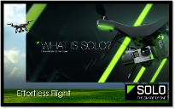
Content Management Options
BrightSign’s open platform allows CMS selection to be a separate process
BrightSign player’s open API’s allow for integration with virtually any CMS solution
CMS choice is independent of the digital signage player purchase
BrightSign players offer a flexible/scalable platform for digital signage applications with specific CMS requirements
Before making a long-term CMS decision, BrightSign players can be initially deployed using free BrightAuthor software
Content Management Options:
Market leading 3rd party digital signage CMS solutions
Free BrightAuthor and optional BrightSign Network service

Slide 10
The BrightSign Advantage
Highest Reliability
Very Affordable
Less than 0.25% failure rate!
Non-PC, solid-state device with no moving parts to fail
Won’t overheat
Ultra-thin form factor that’s easy to install on/near the display
Purpose-built OS for digital signage
Open standards to easily customize or integrate with POS
Includes software & networking options – no hidden fees!
Low power requirements
Simple to install & manage
High reliability results in little to no maintenance costs
Scalable – delivers simple & advanced features on a single platform
Plays industry standard content (H.265 & H.264 video, HTML5, jpegs, etc.)
Notes:
PC-based solutions cannot meet BrightSign’s high reliability and affordability

Slide 11
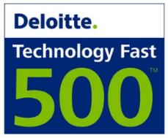
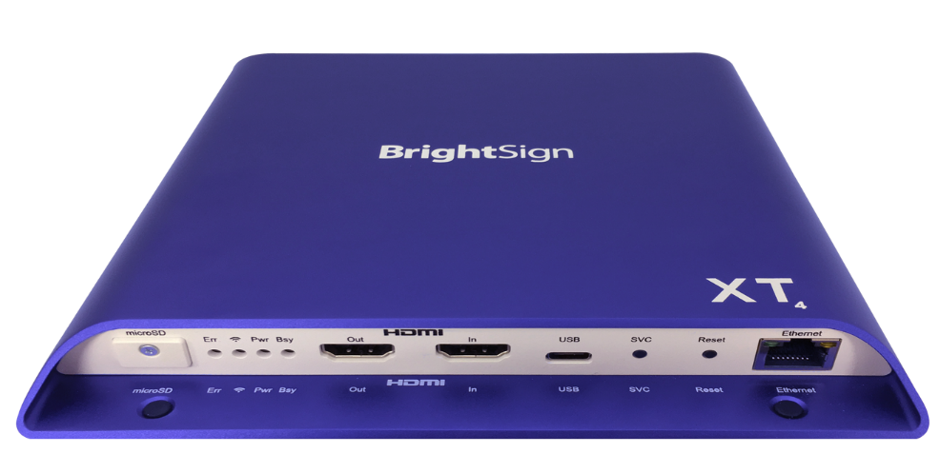
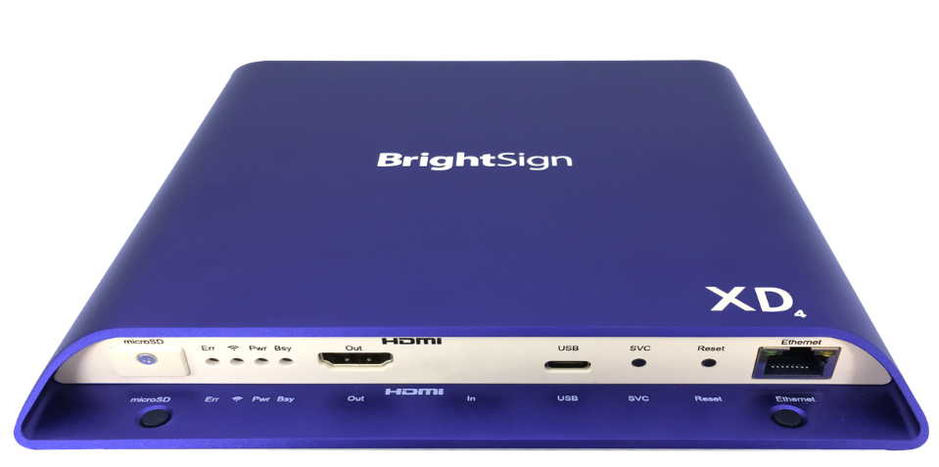
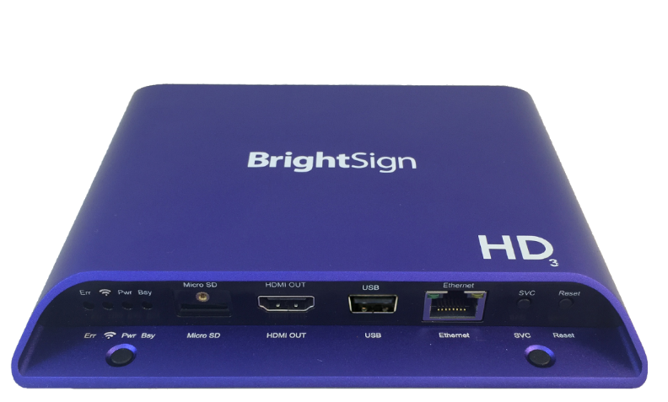
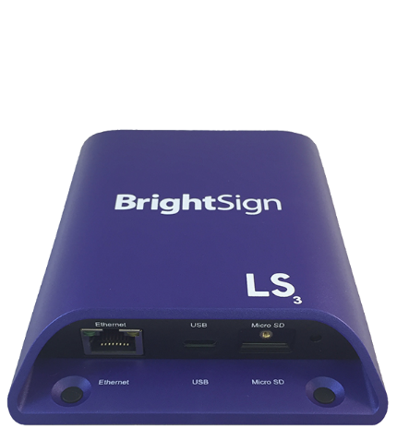
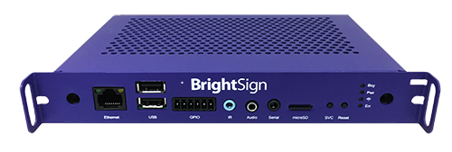
BrightSign awards
Corporate Awards:
Product Awards:
BrightSign App
BrightBeacon

Slide 12
Why Major Brands Chose BrightSign
Very cost effective for large-scale roll-outs
Highly reliable non-PC solution
Stellar Full HD video quality
Fully featured from basic to sophisticated applications
Scalable networking

Slide 13
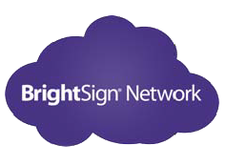
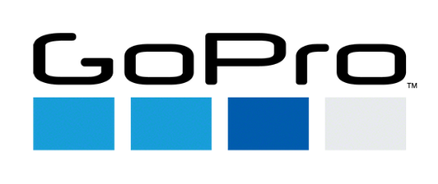
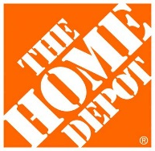
Major Brands On BrightSign Network
3800+ accounts running on BrightSign Network & BrightSign Network Enterprise Edition

Slide 14
BrightSign Products

Slide 15
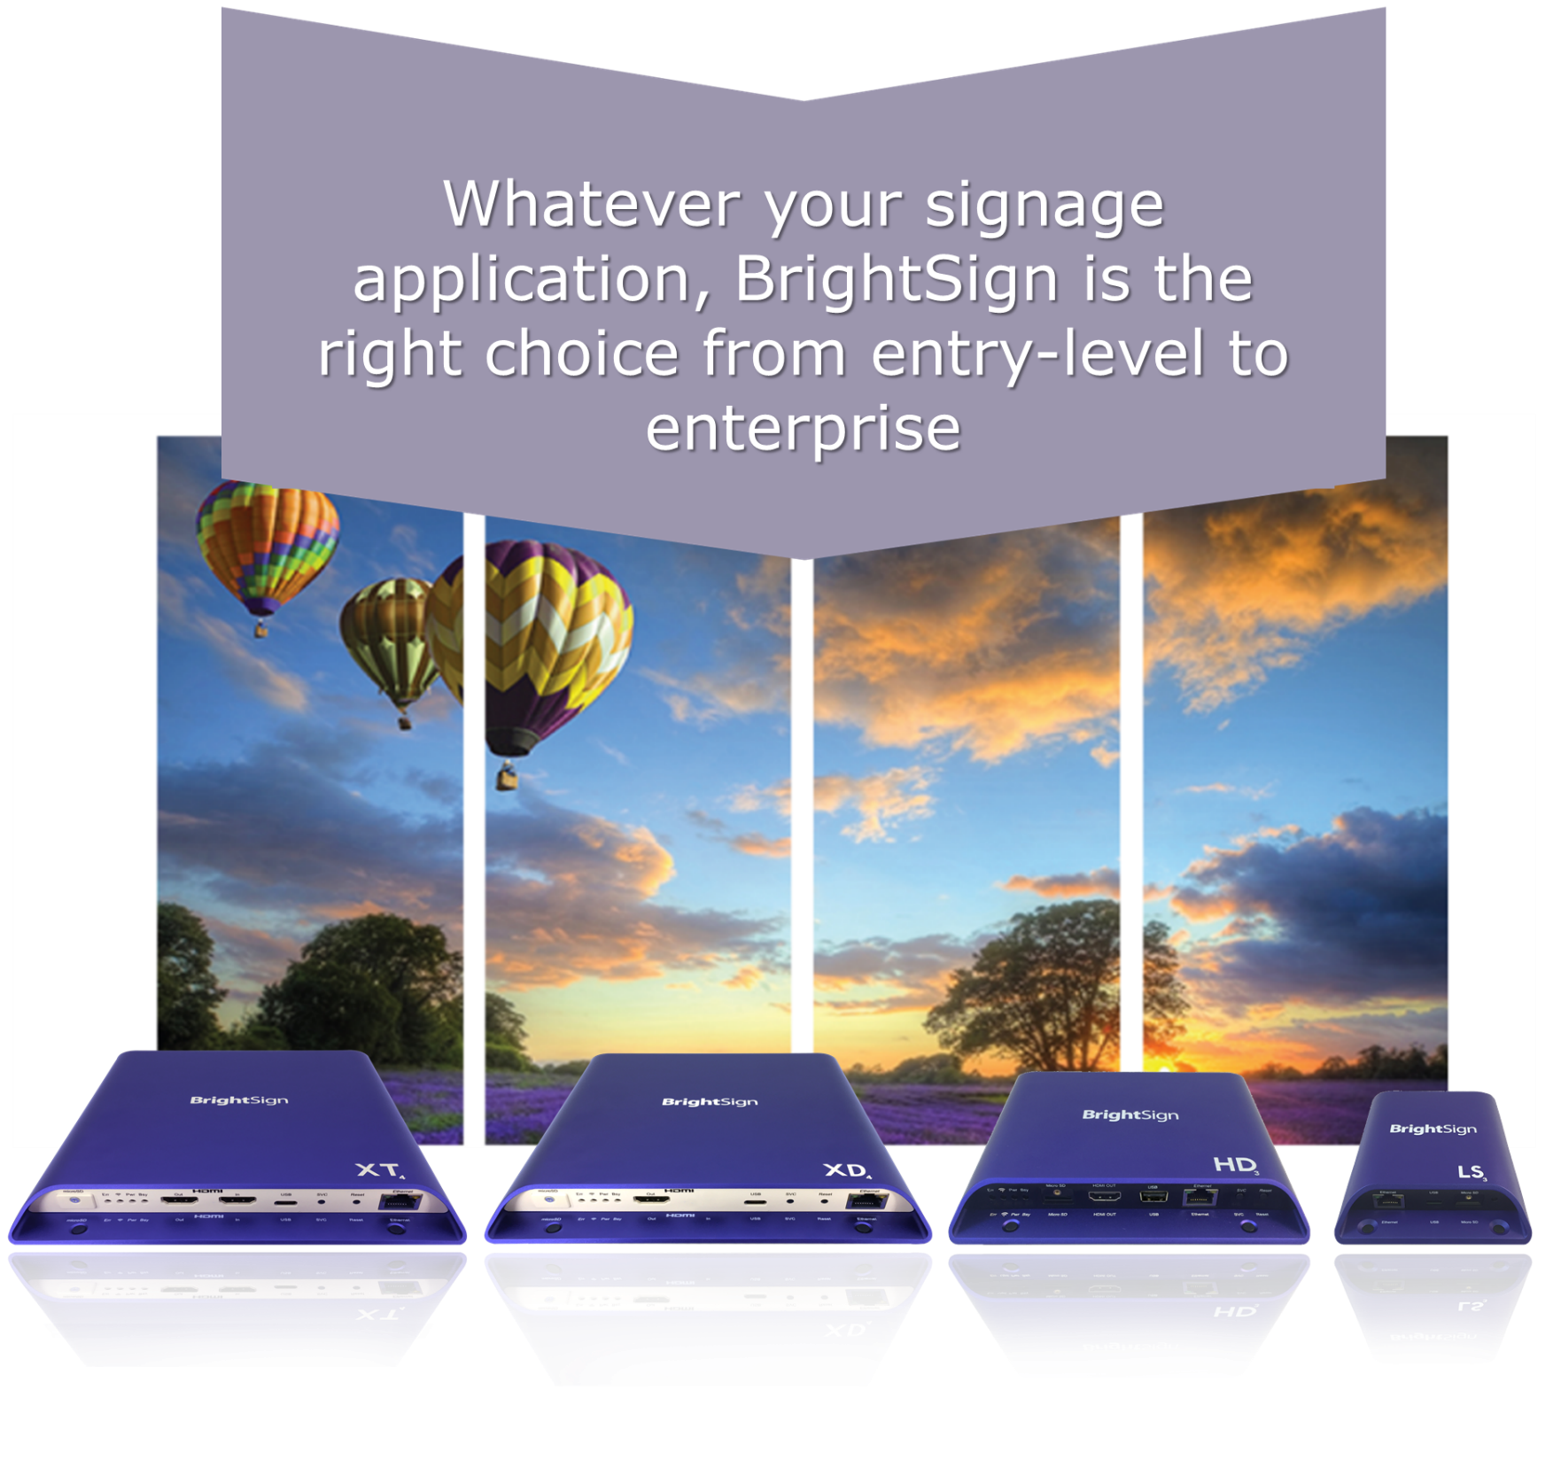
BrightSign Offers World-Class digital signage Media Players

Slide 16
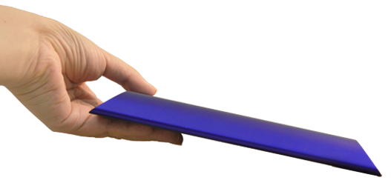
BrightSign Design
You won’t want to hide this player behind the display!
State-of-the-art industrial design with a sleek new look
Ultra-thin form factor that easily fits into any digital signage application
Efficient front and back port access

Slide 17
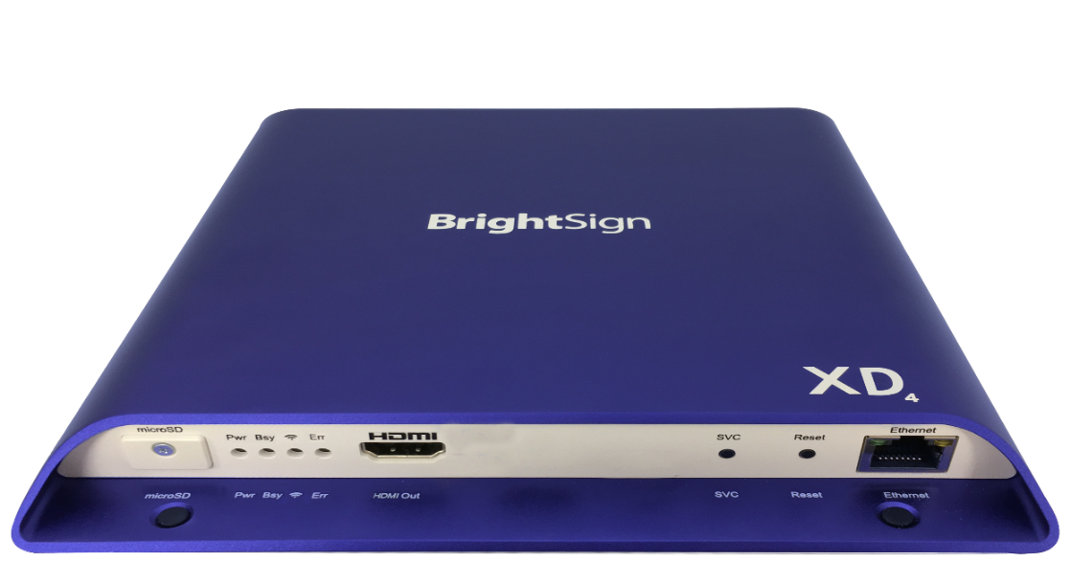
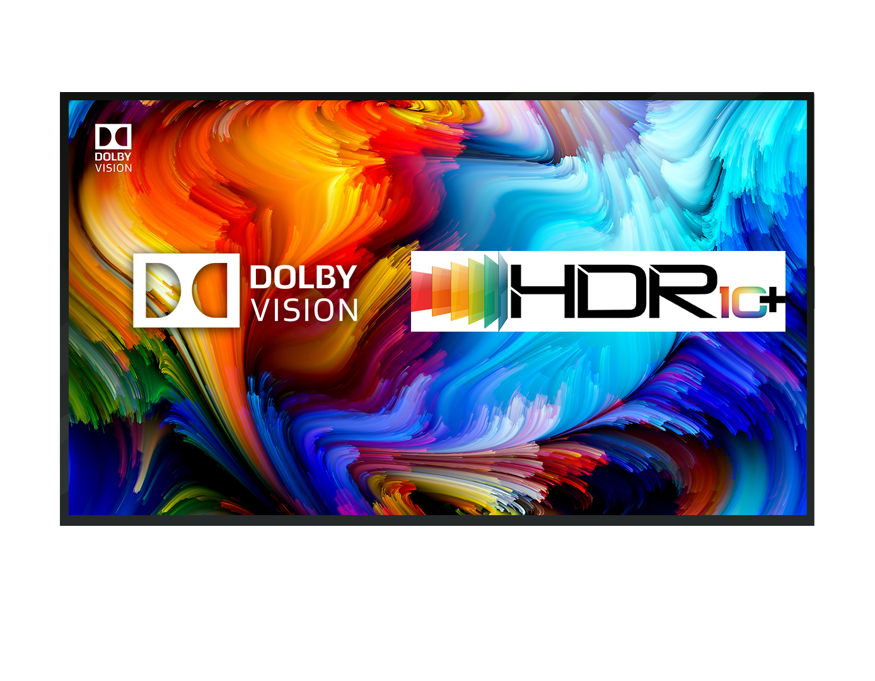
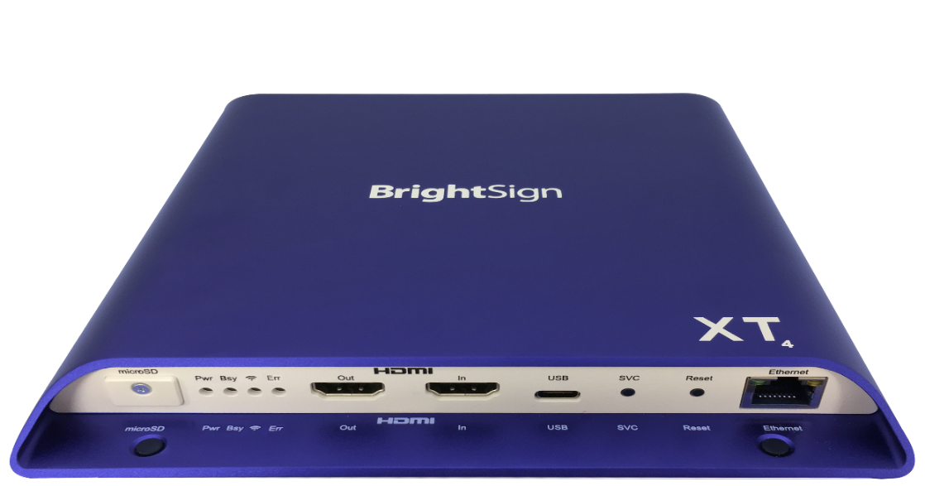
BrightSign XD4 & XT4
BrightSign is the first & only to offer commercial-grade players that support true 4K with Dolby Vision & HDR10+ support
XD234
Standard I/O Player
XT244
Standard I/O Player
XD1034
Expanded I/O Player
XT1144
Expanded I/O Player
TRUE 4K HDR PLAYBACK WITH DOLBY VISION & HDR10+.
ADVANCED PERFORMANCE.
STATE-OF-THE-ART 4K HDR TECHNOLOGY with DOLBY VISION & HDR10+.
PoE+ & Live TV.
ENTERPRISE PERFORMANCE.

Slide 18
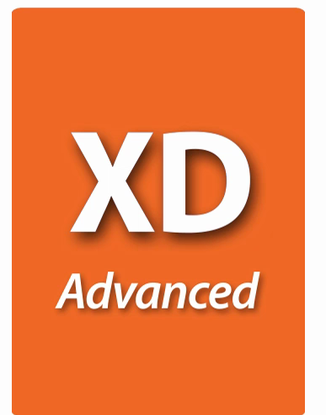
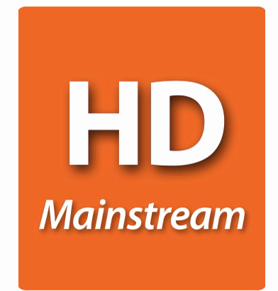
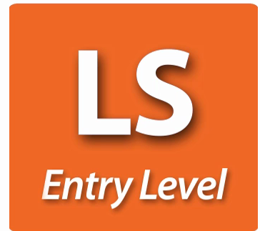
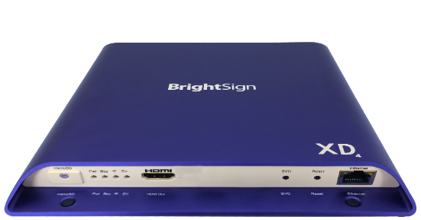
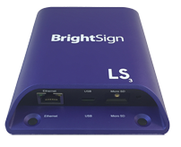
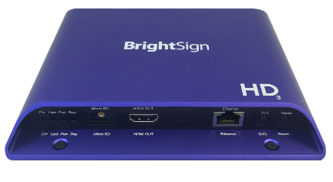
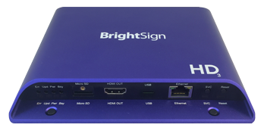
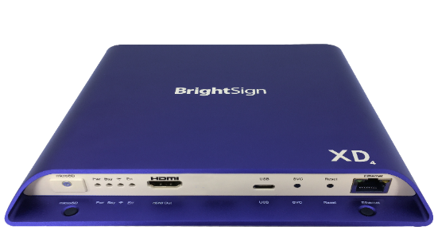
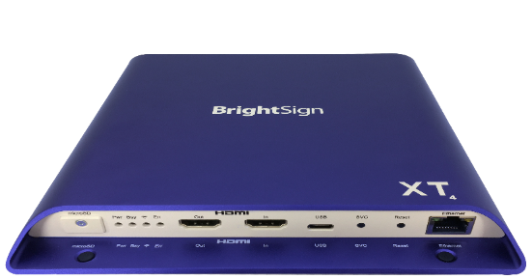
BrightSign Model Lineup
Four product lines based on performance
LS423
Entry-Level
Media Player
HD223
Standard I/O Player
XD234
Standard I/O Player
XT244
Standard I/O Player
HD1023
Expanded I/O Player
XD1034
Expanded I/O Player
XT1144
Expanded I/O Player
HO523
HD-OPS Player

Slide 19
Model Packages & Pricing
 | LS Entry-level | HD Mainstream | XD Advanced | XT Enterprise
 | H.265 1080p60 Entry-level HTML5 | H.265 1080p60 Mainstream HTML5 | H.265/H.264 4K60p Dolby Vision, HDR10+ & dual HD video decode Advanced HTML5 | H.265/H.264 4K60p Dolby Vision, HDR10+ & dual 4K video decode Enterprise HTML5
Standard I/O Package | LS423 Ethernet 100baseT USB Type C Analog audio via USB $250 | HD223 Gigabit Ethernet GPIO Analog & digital audio $350 | XD234 Gigabit Ethernet GPIO, IR Analog & digital audio M.2 SSD PCIe interface $450 | XT244 Gigabit Ethernet GPIO, IR Analog & digital audio M.2 SSD PCIe interface POE+ $550
Expanded I/O Package |  | HD1023 Gigabit Ethernet GPIO, Serial, USB (Type A) Analog & digital audio $450 | XD1034 Gigabit Ethernet GPIO, IR, Serial, Dual USB (Type A & C) Analog & digital audio M.2 SSD PCIe interface $550 | XT1144 Gigabit Ethernet GPIO, IR, Serial, Dual USB (Type A & C) Analog & digital audio M.2 SSD PCIe interface POE+ & HDMI In $650
OPS |  | HO523 Ethernet 100baseT GPIO (4pin), IR, Serial, Dual USB (Type A) Analog & digital audio JAE TX25 plug (OPS compatible) $400
Note: The optional Wi-Fi/Bluetooth module is available for all models & includes an external antenna

Slide 20
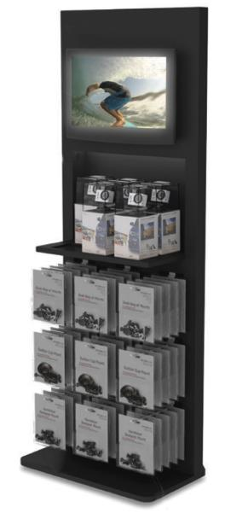
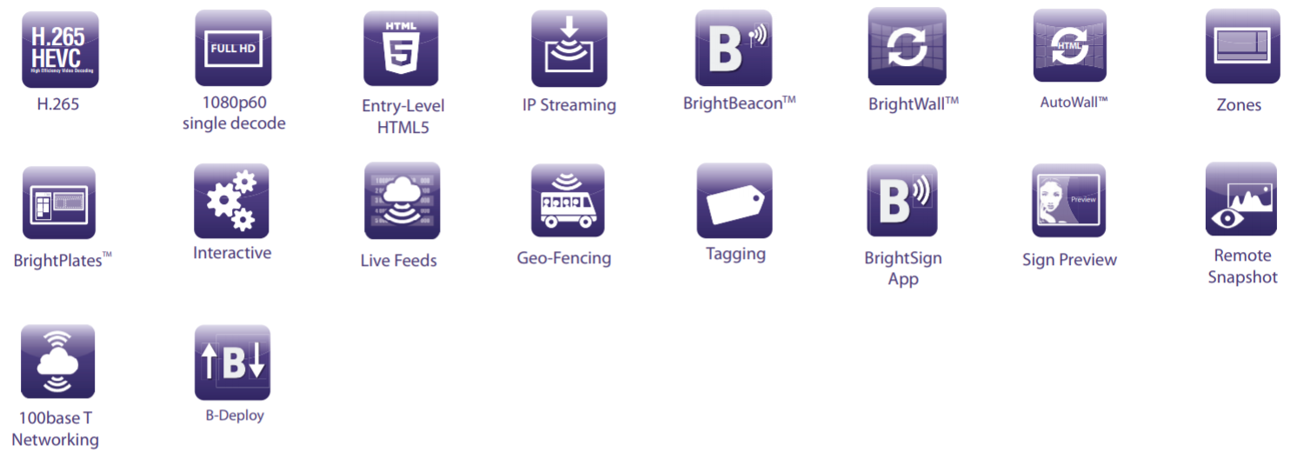
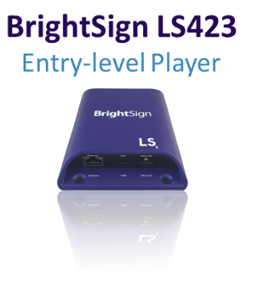
BrightSign LS
Signature BrightSign reliability.
Affordable, entry-level performance.
Commercial-grade, highly reliable and fully-featured digital signage media player in a very small form factor
A superior alternative to consumer devices sometimes chosen for price-sensitive installations
Offers networking, H.265, 1080p60 video playback, entry-level HTML5 performance and USB 2.0 interactivity
Perfect for simple video and streaming applications, menu boards, video walls and large deployments of common content

Slide 21
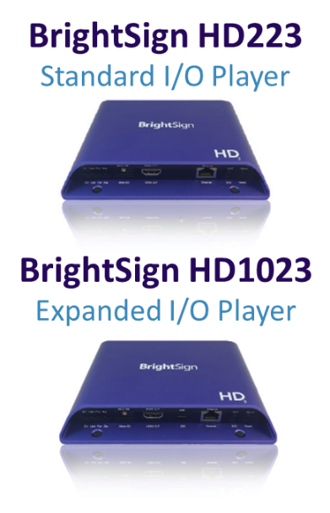
BrightSign HD
An affordable classic. Mainstream performance.
Ideal for mainstream Full HD and HTML5 applications that require high reliability and ease of use
Offers H.265 decoding, mainstream performance HTML5 performance, and Gigabit Ethernet
Robust interactive controls, live content features, BrightWall™ and Mosaic Mode

Slide 22
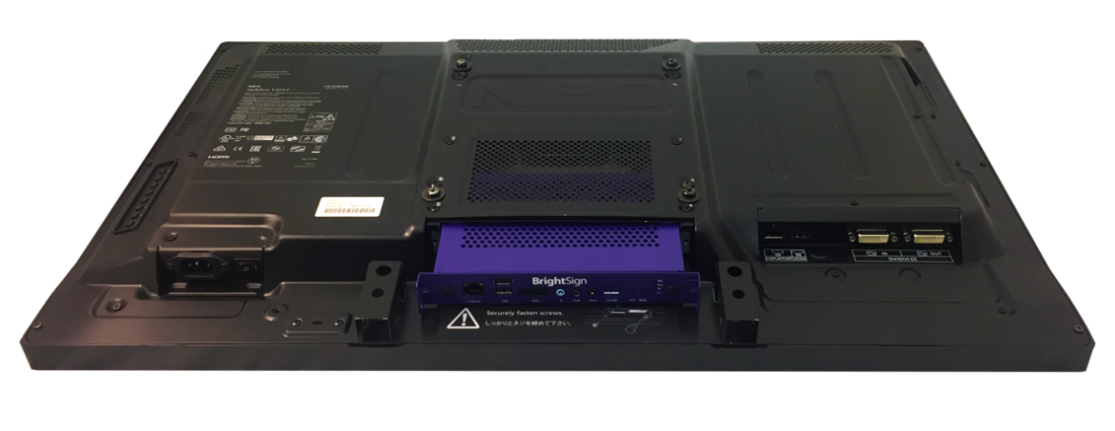
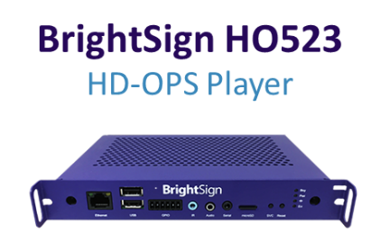
BrightSign HD-OPS
OPS compatible player.
Mainstream performance.
The HO523 is BrightSign’s first OPS compatible digital signage player based on the HD3 series
The inside edge features a JAE TX25 plug for connecting to interior display components (video, USB, serial, etc.)
The outside edge has industry-standard connectors, as well as specialized device control and feedback interfaces.
BrightSign HO523 easily connects to an OPS display without the need for external video or power cables

Slide 23
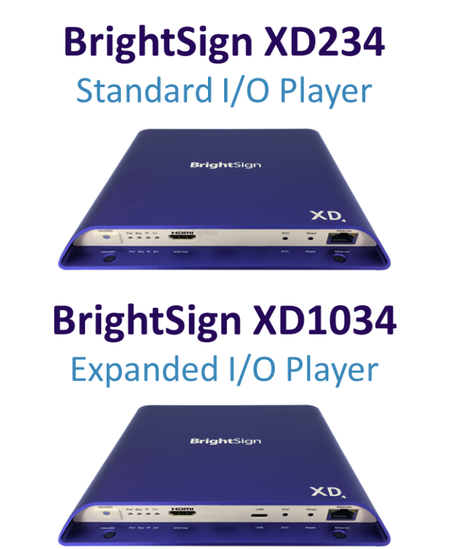
BrightSign XD
True 4K Dolby Vision™ & HDR10+ playback.
Advanced performance.
Powerful 4K video engine that supports all the technology standards of the True 4K ecosystem:
H.265/H.264 encoded native 4K content at 60p, Dolby Vision & HDR10+ via HDMI 2.0a for stunning playback quality
4K upscaling & dual video decoding of two 1080p60 videos at once
All models include Gigabit Ethernet and offer a hardware-accelerated HTML5 engine with advanced performance

Slide 24
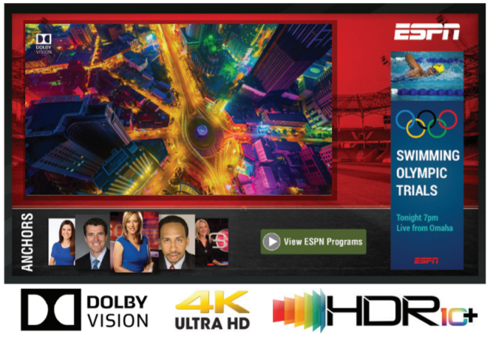
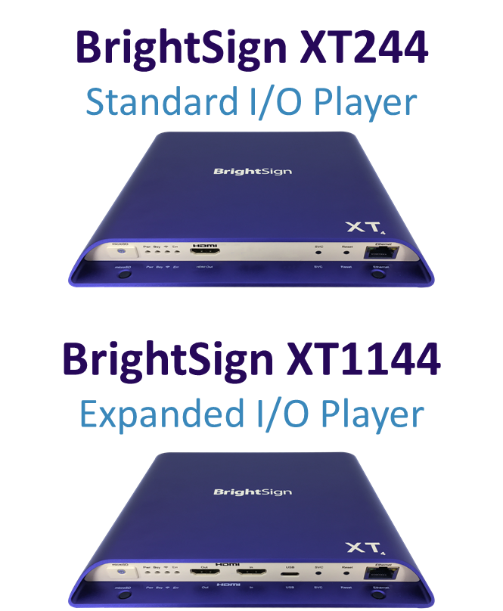
BrightSign XT
State-of-the-art technology, Dolby Vision™ and HDR10+.
Enterprise performance.
Includes a powerful 4K video engine with H.265/H.264 decoding, Dolby Vision and HDR10+
Supports 4K full resolution graphics, 4K upscaling & dual decoding of two 4Kp60 videos at once
Offers our fastest HTML5 and graphics engine and most powerful CPU to deliver unsurpassed performance for enterprise applications
XT is the only product line offering 4K full resolution graphics, PoE+ and HDMI In for Live TV playback

Slide 25
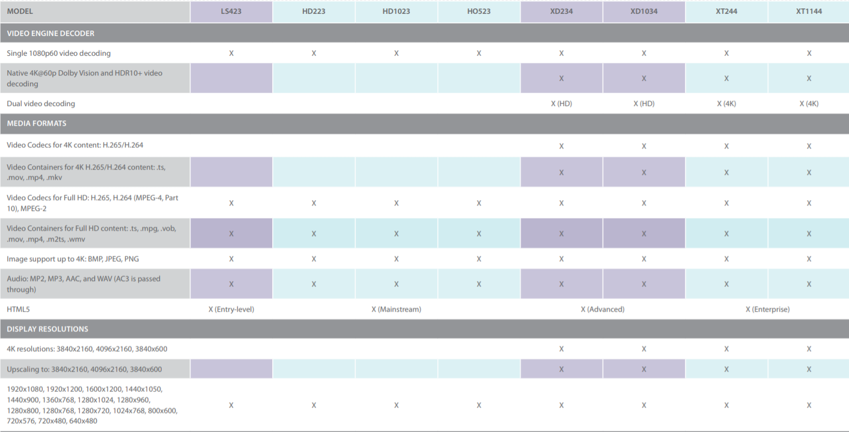
Product Compare Matrix

Slide 26
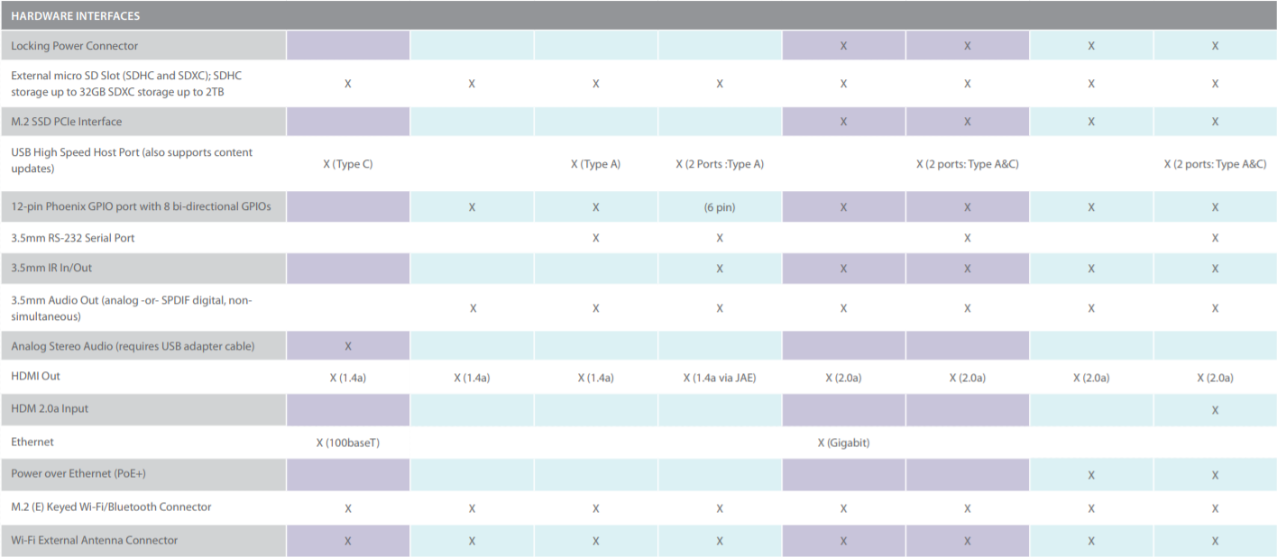
Product Compare Matrix Continued

Slide 27
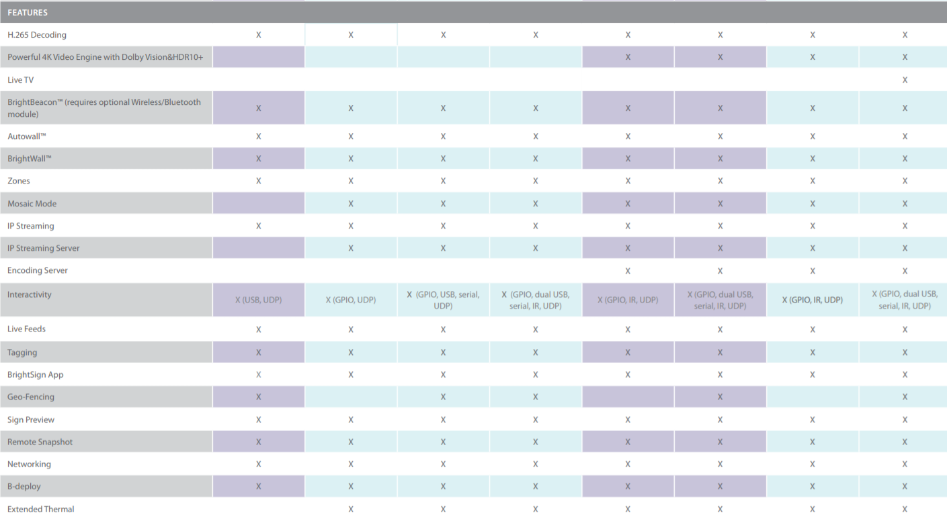
Product Compare Matrix Continued

Slide 28
Product Compare Matrix Continued

Slide 29
BrightSign Accessories
Easily expand BrightSign functionality
USB Button Panels (BP200 / BP900)
Add interactivity with this thin, USB connected board design offering 4 or 11 capacitive touch buttons with embedded LEDs
Easily programmed using BrightAuthor
Compatible with any BrightSign player that has a USB port
Wireless/Bluetooth Module
Easy to implement wireless and Bluetooth 4.0 functions with this embedded module
Supports 802.11a/b/g/n protocols
M.2 Interface
Compatible with all Series 3/4 models
Class 10 MicroSD Cards
Delivers reliable and quality performance on all Series 3/4 models
Capacities offered for each: 8GB, 16GB, 32GB
Specialty Cables
Range of cable solutions for unique applications

Slide 30
BrightSign Features

Slide 31
Features
Sophisticated capabilities. Infinite possibilities.

Slide 32
H.265 Decoding
Get more efficient, stellar quality playback using H.265
All BrightSign players support H.265 decoding
Play both 4K and Full HD content encoded with H.265
Get half the file size and double the bandwidth and memory savings
Achieve better video quality with H.265 vs. H.264 at the same bit rate
Only H.265 supports 10-bit color and high dynamic range of color
1/3

Slide 33
H.265/HEVC – the new standard
The importance of proper video compression
Smaller File
Advanced compression efficiencies from larger block sizes
Up to 50% efficiency gain in coding translates to lower bitrates
Better Picture Quality
Increased intra prediction modes and higher encoding computation allows for soft blur effect rather than macro-blocking
2/3

Slide 34
H.265 Compression Solutions
Various encoding solutions are becoming available
FFmpeg – a free command line tool to convert multimedia files between formats
MainConcept – SDK, application and plug-in solutions
VideoLAN – a free software library and application solution
Avid – a very high-end solution
Elemental – for broadcast streaming content
V.265 from Vanguard Video – software-based encoder and decoder SDK
Note: H.265 is not limited to 4K content (i.e.: HD content, Netflix, other streaming video)
3/3
Notes:
H.265 can be used for HD content to create much smaller file sizes equivalent in quality to H.264
Netflix: they are the first company offering 4K content commercially. The video streams are H.265 and they're not charging more for 4K video content because they're now paying less to deliver data overall by using H.265 for not only the 4K content but also the HD content. Netflix is using Vanguard and they built a full ecosystem to use that codec.

Slide 35
Full HD Video
Superior quality Full HD video with highly reliable playback
All BrightSign players offer robust hardware video decoding to play exceptional quality Full HD 1920x1080 video at 60fps
BrightSign XD & XT include support for dual video decoding of two Full HD 1920x1080p60 videos simultaneously
Supports Full HD content encoded with H.265, H.264, MPEG-1, MPEG-2 & WMV
Offers highly reliable and flawless playback
BrightSign XD & XT Dual video decode
1/1

Slide 36
Powerful 4K Video Engine
True 4K, Dolby Vision, HDR 10+, dual decoding & superior scaling
True 4K via HDMI 2.0a at 60fps for stellar video playback
XT4 & XD4 players also support 4K Dolby Vision, HDR10+ & H.264 decoding of 4K video
Dual video decoding:
XT4 players: two 4K (3840x2160p60) videos simultaneously
XT3 players: one 4K (3840x2160p60) video & one Full HD (1080p60) video simultaneously
XD4/XD3 players: two Full HD 1080p60 videos simultaneously
Superior scaling technology delivering pristine video quality for any screen or zone size including upscaling of Full HD video to 4K
NEW 4K Full-resolution graphics: XT4 models can render graphics at resolutions up to 3840x2160x60p and XT3 models support graphics up to 3840x2160x30p
Accelerated JPEG decompression for instant image display and high-speed transitions
Simultaneous playback of content from local, streaming and live content sources
1/2

Slide 37
4K Playback – standards
Optimal playback of native 4K content
New 4K Standards
True 4K: 3840x2160 resolution @ 60fps frame rate
H.265 HEVC (high efficiency video coding): enables delivery of high-quality 4K content at about the same file size and data rate as HD content at H.264
HDMI 2.0a: only the HDMI 2.0a standard supports 60 fps playback, Dolby Vision and HDR10+ encoded video
2/2

Slide 38
4K Dolby Vision & HDR10+
High Dynamic Range (HDR)
4K HDR provides bright, detailed and vibrant colors in highlights and shadows using a much wider brightness range and color palette
There are 2 main HDR standards:
HDR10+ (High Dynamic Range) with 10-bit color depth is an open standard approach for delivering HDR content with dynamic metadata
Dolby Vision with up to 12-bit color depth is Dolby’s proprietary approach to delivering HDR content with dynamic metadata
SDR HDR10+
HDR10+ | Dolby Vision
supports up to 4,000 nits peak brightness, with a current 1,000 nit peak brightness target | supports up to 10,000 nits peak brightness, with a current 4,000 nit peak brightness target
Supports up to 10-bit color depth | supports up to 12-bit color depth
uses the wide-gamut Rec. 2020 color space | uses the wide-gamut Rec. 2020 color space
Dolby Vision SDR
1/1

Slide 39
Live TV
Engage your audience with Live TV
HTML5 animating logo
Live TV
Play any broadcast content, even protected HDCP content via the HDMI Input
BrightSign XT1144 includes an HDMI 2.0a input to play Live HD or 4K content
Automatically scale the playback from any zone size to full screen with pristine quality
Live Text Feed
L-shaped Video
1/1

Slide 40
HTML5
Hardware-accelerated HTML5 rendering engine
Play industry standard HTML5 content including JavaScript, CCS animations, transitions, WebGL video support, dedicated GL compositor & JavaScript API supporting many BrightScript functions
BrightSign XT Enterprise HTML5 Engine
Play highly complex & memory intensive HTML5 content such as swipe/pinch/zoom interactive, streaming social media, multiple modular HTML5 assets layered with live TV and video & 4K full resolution graphics
BrightSign XD Advanced HTML5 Engine
Play advanced HTML5 content such as swipe/pinch/zoom interactive, streaming social media & multiple modular HTML5 assets alongside video
BrightSign HD Mainstream HTML5 Engine
Play mainstream HTML5 content in full screen and several modular HTML5 assets alongside video playback
BrightSign LS Entry-Level HTML5 Engine
Play entry-level HTML5 content in full screen or as a modular asset alongside video playback
1/1

Slide 41
Mosaic Mode
Create highly dynamic displays
Play a multitude of smaller resolution videos simultaneously that add up to the maximum video resolution of the player
BrightSign XT supports simultaneous decode of 4 Full HD videos (via BrightScript)
Play an HTML feed containing multiple videos in a single zone as long as the HTML feed resolution matches the player's maximum resolution
1/1

Slide 42
BrightWall™
Create impressive video walls with perfect synchronization
BrightWall is a powerful drag-and-drop BrightAuthor tool that makes building looping video walls in any size and layout very simple.
Perfectly synchronize separate videos per display or stretch a single video across all displays using the BrightSign player’s Ethernet port and a common clock
Build video walls by simply choosing the number of displays, specifying the configuration of the video wall and dragging the video(s) into BrightAuthor
The Synchronization event tool in BrightAuthor is used to synchronize the playback of multiple screens for basic video walls and also can be used in conjunction with interactive events for creating interactive video walls.
Achieve perfect video wall synchronization and edge blending in projection mapping with genlock frame-accurate synchronization (via BrightScript)
1/1

Slide 43
AutoWall™
HTML-based video walls that supports more than just video
Powerful BrightAuthor Plugin Kit using HTML5 to create unique multimedia video walls supporting video, images, tickers, live feeds & virtually any HTML5 content
Landscape multimedia video walls with HTML-based layouts
automatically scales based on the number of players/screens in the wall
frame accurate synchronization & support for interactivity via HTML
Video content populated from BrightSign Network Dynamic Playlists or MRSS feeds
Multiscreen ticker option with content populated from BSN or RSS feeds
Support for any publishing method (Local File Networking, BrightSign Network, etc.)
A-1 A-2 A-3
B-1 B-2 B-3
C-1 C-2 C-3
A-1 A-2
B-1 B-2
1/1

Slide 44
Zones
Multiply your content delivery with multi-zone layouts
Playback multiple content files on a single screen with zones – even dual videos on BrightSign XD and XT
Abundant content support including Full HD video, images, HTML5, Live TV, audio, text tickers, Live Text, RSS feeds, date/time widgets and more!
Control each zone with its own playlist
Play video and audio independently from a single player
Synchronize zones together and link to lighting and other displays to create an immersive experience
1/1

Slide 45
Interactivity
Engage your audience with interactive devices and controls
Trigger playback from virtually any type of interactive device you can dream up using Interactive Playlists in BrightAuthor or HTML5:
Touch screens, barcode scans, motion sensors, RFID, UDP controls, GPIO and USB button controls, IR remote controls, serial devices, keyboards, mice and much more
Grab attention, demo product operations, deliver coupons & pricing on demand
Control the show with UDP or serial controls to power and manage media playback, control AV devices such as projectors, lighting, audio systems and integrate with other show controllers (AMX, Crestron, Alcorn, etc.)
1/1

Slide 46
Live Feeds
Link to virtually any live media feed to display in your signage.
Live Text
Integrate these real-time text fields to your signage and instantly update messaging without republishing the presentation. Perfect for menu board pricing, waitlists, transportation schedules and more
MRSS feeds keep your signage up to date
Link to and display popular news, finance, weather, sports feeds and more
Social media feeds
Link to social media feeds such as twitter and Flickr or playback animating, aggregated social media feeds to keep your signage relevant and fresh
3rd party schedule and data feeds
Connect to virtually any database to display up to the minute details. Perfect for flight timetables, event schedules, corporate statistics and more
1/1

Slide 47
IP Streaming
IP streaming on all BrightSign players
All BrightSign players support Full HD, BrightSign XD/XT support 4K video streams
MJPEG and audio streaming including these formats:
HLS (the standard for public internet streaming: i.e. YouTube)
UDP/RTP/RTSP streaming from head-end real-time encoders
HTTP including SHOUTcast
BrightSign XD/XT players support multiple video streams simultaneously
BrightSign supports SRT (Secure Reliable Transport) technology on both 1080p & 4K content which optimizes streaming performance even across unpredictable networks
Customize buffering and latency to improve media streaming performance
Play streaming media in HTML5 assets or in BrightAuthor’s video, audio or MJPEG stream states
Stream, buffer and play back content from IP cameras supporting the RTSP unicast streaming protocol
Value of SRT Technology
1/1

Slide 48
IP Streaming Server
Securely serve IP video streams from BrightSign players
BrightSign HD: streams files on local storage
BrightSign XD: transcodes (decodes & re-encodes) files on local storage allowing you to change the bitrate or resize content
BrightSign XT: transcodes files on local storage and from the HDMI Input
1/2

Slide 49
IP Streaming Server
Serve IP video streams from BrightSign HD, XD & XT
Securely distribute video to a set of displays without downloading the content to display
Serve IP video streams from a BrightSign player’s local storage to distribute video to a network of clients
Supports MPEG transport stream (*.ts) video files
Clients can be networked BrightSign players, PCs, Macs, mobile devices, etc.
Supports RTP unicast & UDP multicast
Stream two separate videos at once as long as BrightSign is not playing video on the screen
2/2

Slide 50
Digital Audio
Crystal clear digital sound
Playback high-quality digital audio on BrightSign HD, XD & XT
Easily add audio playlists to your presentations
Synchronize audio with video playback
Create and play interactive retail audio product demonstrations
Advanced audio routing with quality support for mixing of PCM sources with audio outputs including sample rate mixing & volume leveling (via BrightScript)
1/1

Slide 51
Extended Thermal Operation
Safely operate at extended thermal temperatures
BrightSign HD, XD & XT players are designed for ambient temperatures between 0° and 70° C at 90% maximum relative humidity, non-condensing
Players have low power consumption and are designed to efficiently dissipate heat, allowing them to be installed in virtually any environment with confidence
1/1

Slide 52
M.2 interface
New expansion slot for add-on peripherals
All models have an M.2 interface to support a Wireless/Bluetooth module
BrightSign XD4 & XT4 offer an additional low-profile M.2 SSD PCIe interface connector for added internal storage
Supports small form factor solid-state drives with faster transfer rates
Offers additional content storage in place of microSD cards
Stick of gum
SSD
1/1

Slide 53
Power over Ethernet
More convenience with PoE+
Use PoE+ (Type 2) to power your XT players
Eliminates the power cord with support up to 25 watts of power
XT players will not exceed 25 watts when running a standard presentation, an HDMI cable and 1-2 other outputs at most
When XT is powered by PoE+, there is approximately 1A available for all other connectors
1/1
Notes:
PoE+ Support on 4K & XD Explained
4K & XD PoE+ is type 2 which supports 25 watts of power (PoE+ type 1 supports 12 watts)
BrightSign XD & 4K can be powered by Ethernet alone as long as they don’t exceed 25 watts of power which is when 4K is running a standard presentation, an HDMI cable and 1 or 2 other outputs at most.
If BrightSign 4K players are powering more than 2 outputs and a resource intensive presentation, they could require up to 60 watts of power and similarly BrightSign XD could require up to 36W
If the 4K or XD player is being powered by PoE+, approximately 1A is available for all other connectors

Slide 54
Geo-Fencing
Moving signage to play content based on current location
BrightSign plays specific audio and/or video content when located within a defined geographical radius*
Applications:
Shuttles, taxis, public transportation and moving billboards: Advertise and promote local businesses
Tour buses and boats: Inform and educate riders with video and audio relevant to the area
An on-board entertainment solution that also provides relevant and timely content specific to upcoming stops using BrightSign's geo-fencing feature
* Requires a USB GPS device
1/1

Slide 55
Sign Preview
Get a sneak peek at how your signage will display
Preview your presentation playback in BrightAuthor before publishing
Speed up presentation authoring by reviewing the final look of your digital signage
1/1

Slide 56
BrightSign App
Signage updates have never been so easy
BrightSign App offers a simple and secure interface on your iPad or iPhone to select any BrightSign player connected to a local network
easily update on-screen text instantly
trigger video playback & change images via UDP commands
Customize the app’s user interface to match your presentation
Access diagnostic tools & Remote Snapshot of your player
Secure your displays with a password
Perfect for: menu boards, retail merchandising, emergency messaging and more!
1/3

Slide 57
How it works…
Edit a user variable
User variables such as a menu item or price can be updated
Change a user variable, press ‘Set Values’, and the display instantly updates
Edit values
Price changes instantly
2/3

Slide 58
How it works…
Trigger UDP Events
UDP controls can be used to:
Change a daily special
Switch menus from breakfast to lunch to dinner
Offer a promotion
Etc…
Special image changes instantly
Tap UDP Event
3/3

Slide 59
Network Solutions Overview
Versatile solutions to meet any need
1/1

Slide 60
B-Deploy
Setup and deploy a multitude of players at once
B-Deploy is a powerful setup and provisioning feature that allows customers to setup and deploy a multitude of players all at once.
Eliminates the need to save setup files to an SD card and duplicate the SD card for every player in the network
B-Deploy can be used with BrightSign Network, BrightSign Partner CMS, or on premise secure corporate LAN
How It Works:
Upload a batch of player serial numbers and player setup instructions using B-Deploy
Power up players for automatic setup:
Players connect to B-Deploy for instructions
B-Deploy applies the assigned setup to the players
Assigned presentation is downloaded & playback begins
1/1

Slide 61
BrightSign Network Tagging
Tagging is incorporated throughout the BrightSign Network service
Media Tags: tags assigned to individual and groups of content
Tagged Playlists: playlists that are automatically created by setting media tag criteria
Player Tags: tags assigned to individual or groups of players for media playback and network management
Matching Tags: the ability to match media & player tags to enable playback of a subset of content from a single playlist
1/1

Slide 62
BrightPlates™
Turnkey deployment of signage presentations
Online, template-based sign creation service accessible from any PC or Mac
Ready to use templates in landscape or portrait orientation for a variety of verticals: menus, education, retail & corporate
Easily customizable to match your brand
Deliver finished presentations and content updates to any networked BrightSign player on your BrightPlates account
Connect with content designers to create, upload and deploy original HTML templates
Can be linked to a BrightSign Network account to access content and publish to network groups
1/2

Slide 63
BrightPlates™
Simple steps to build your BrightPlates presentation online
Select from an array of templates
Customize with your images, video, text, live media feeds, etc.
Network publish the presentation with ease
2/2

Slide 64
Remote Snapshot
Get a glimpse of what your sign is playing
Remotely view an image of your running presentation
View snapshots using:
Local networking via the BrightSign App and Diagnostic Web Server
BrightSign Network via BrightAuthor or the Web UI
1/1

Slide 65
BrightBeacon™ Overview
Integrated BLE Beacon Technology
BrightBeacon delivers unique mobile device engagement using integrated BLE beacon technology and a mobile app
BrightBeacon enhances engagement between the digital sign and mobile device via:
1-way location-based communication: sending notifications, coupons, etc. based on proximity to digital sign
2-way communication: adds the ability to control the digital sign via a mobile device
 | 1-Way Communication | 2-Way Communication
External BLE Beacon | BLE Beacon
Integrated BLE Beacon | BrightBeaconTM | BrightBeaconTM
1/3

Slide 66
BrightBeacon™ Features
Highly targeted, bi-directional engagement between signage & mobile devices
Integrated BLE beacon technology available on all BrightSign Series 3 players which is used to promote mobile engagement
Offers dual screen exposure on both large digital signage screen and mobile device display
Delivers location-based mobile engagement to deliver highly targeted content based on proximity to the beacon – no batteries required
Supports 2-way communication between mobile devices and digital signage to control digital sign playback
Offers remotely programmable solution with multiple beacon UUIDs supported
Far proximity
‘far’ message invites user to visit digital sign
Near proximity
‘near’ message controls playback & gives coupon
2/3

Slide 67
BrightBeacon™ Requirements
BrightSign
Player
All Series 3 players support BrightBeacon
BrightSign Wireless/Bluetooth Module (higher power, greater range)
or Generic BLE 4.0 dongle http://plugable.com/products/usb-bt4le
Secondary BLE beacon “puck” for 2-way communication
Presentation built with BrightAuthor version 4.6.0.18 or later
BrightBeacon plugin to enable beacons within Presentation Properties
Development application template: https://github.com/brightsign/brightsign-ble-commands
BrightPlex Cinemas sample demo and app: https://www.brightsign.biz/support/demos/overview
BLE Beacon
or
BrightSign presentation with beacons enabled
Mobile app on smartphone
3/3

Slide 68
BrightAuthor
Hassle-free Sign Creation.

Slide 69
BrightSign Presentation Creation Process
Simple process with sophisticated results
Free BrightAuthor Software
Content
Prolific content types supported using industry standard formats
Author
Easily create, preview, schedule and publish presentations using a vast array of simple to sophisticated features
Play
Confidently play presentations and manage your network
1/5

Slide 70
BrightAuthor Overview
Free PC software to easily create presentations that flawlessly run on BrightSign players
Simple steps to get a presentation up and running on BrightSign
Author. Easily create layouts & playlists for simple to sophisticated presentations.
Play. Preview, publish and play presentations with confidence.
Manage. Readily update, monitor and manage your BrightSign Network.
2/5
Notes:
BrightAuthor is a free PC-based software application that easily creates, previews and publishes presentations to run on BrightSign. It also offers an interface to manage your BrightSign Network
Build. access all BrightSign features and functions that can be implemented into presentations. Design Full HD and 4K upscaled looping and interactive presentations in full-screen or multi-zone layouts.
Preview. Review presentation playback before publishing.
Publish. Automatically build and distribute a complete presentation packet ready to play on BrightSign including content, playlists, controls and scheduling. Published presentations can be distributed to SD cards or network connected BrightSign units.
Manage. Easily and securely update, monitor and manage your network of BrightSign digital signs right from the BrightAuthor application. A web UI is also available.

Slide 71
Presentation Authoring
Using Free BrightAuthor Software
Create full-screen or multi-zone layouts
Select zone type based on content: video, images, tickers, live feeds, clocks, etc.
Customize zone size & placement on screen
Drag/drop content into each zone to build playlists
Non-Interactive Playlist: A playlist of content that plays in a continuous loop
Interactive Playlist: A playlist that plays particular content based on a trigger such as a button push, screen touch, network command, etc.
BrightWall™: A frame-accurate synchronized playlist of content that is displayed as a video wall.
3/5

Slide 72
Flawless playback you can rely on
Confidently preview, publish and play
Preview
Preview your presentation in BrightAuthor before publishing
Publish
Set your presentation’s playback schedule
Publish completed presentation to players (SD card, network, etc.)
Play
Confidently play presentations without interruption and with powerful performance
Players offer high reliability with less than a 0.25% failure rate
4/5

Slide 73
Playback Management made easy
Tools to keep your presentation running and relevant
Monitor your presentation playback via snapshots using RemoteView
Update content and presentations with ease
Manage your content library
Administer your network of BrightSign players remotely (firmware & network setting updates, etc.)
5/5

Slide 74
Networking Solutions
Versatile networking options deliver remote content with ease

Slide 75
Network Solutions Overview
Versatile solutions to meet any need
1/9

Slide 76
Local SD Card Publishing
An alternative to networked content publishing & updates
BrightSign players require a micro SD card for storage – players have no internal storage
As an alternative to networking, presentations can be published directly to a micro SD card and manually insert it into a player
BrightSign offers a line of industrial grade class 10 micro SD cards that are approved for digital signage applications
USB device storage can be used for players that have a USB port
Note: storage devices FAT32 formatted. To play files larger than 4GB, format for NTFS which is only compatible with non-networked players.
2/9

Slide 77
Local Network Publishing
Free solution designed for small networks within a single building using a local subnet
Easy and free, this option is ideal for basic, low-maintenance situations where simplicity is key
Send files and updates to remote networked units over the Internet or LAN (local area network).
Use BrightAuthor to publish directly to the player over the LAN
Perform basic polling status checks of connected units using BrightAuthor
LAN
Connection
3/9

Slide 78
Simple File Networking
Free solution designed for small networks
Distribute presentations to BrightSign units through a web folder
Supported file locations must be accessible via http
Requires a simple Internet connection to send basic content files for remote BrightSign units to download
Allows bandwidth throttling and convenient for managing players beyond the limited area of a local network
Specify network checks for updated content
Internet
Connection
Internet
Connection
Web Folder
4/9

Slide 79
BrightPlatesTM
Easy template-based sign creation service
Online, template-based sign creation service for turnkey deployment of signage presentations and delivery of updates to networked BrightSign units. Select from our template collection or connect with content partners to craft your own look.
20% off winter coats
5/9

Slide 80
BrightSign Network
Secure, scalable and affordable cloud-based digital sign network service
Delivers the complete infrastructure to serve, manage & support your digital sign network
Frees you from hosting and maintaining your own network
Scalable service for any size network – any number of players guaranteed
Remotely manage and update content, firmware and schedules using BrightAuthor or Web UI
Divide players into groups for ease of presentation publishing and management
Assign tags to media and players to build tagged playlists and highly target playback
Monitor, manage and diagnose network health, view presentation playback & generate reports
Perform network admin functions & assign user roles and permissions for conditional access
Includes BrightPlates™ and options of Content Encryption and Monitor Only services
6/9
Notes:
BrightSign Network is a secure cloud-based solution for managing your network of BrightSign digital signs. It offers a complete infrastruction to serve, manage and support your network and frees you from the complexity of hosting and maintaining your own network.
BrightSign Network offers a complete set of tools and interfaces to easily and successfully manage your network. An it is scalable to any size network.
The BrightSign Network management can be done via the BrightAuthor PC software application or the Web UI which primarily allows network subscribers to access administrative functions such as user roles, permissions, etc. as well as monitor the health of your network.

Slide 81
BrightSign Network Features
Flexible, easy to use features to remotely manage your network
Administer user accounts including roles and permissions
Setup BrightSign units for networking and assign a network group
Create networked presentation elements such as Dynamic Playlists, Live Data, and Live Media feeds
Build, upload and manage your presentation and content libraries
Upload pure HTML presentations
Schedule and publish presentations
Monitor and manage your entire digital signage network
7/9

Slide 82
BrightSign Network Enterprise Edition
Installable software version of BrightSign Network
Host your own network with access to all BrightSign Network features
Sell subscriptions for the use of your hosted network
Manage your network within the security of your own server and firewall
Recommended for large networks with special hosting requirements, advanced technical skills, and a dedicated IT staff
8/9
Notes:
The BrightSign Network Enterprise Edition is available only to pre-approved customers of large networks that have special hosting requirements.

Slide 83
Network Solutions Comparison
Features | Simple File Networking | Local Area Networking | BrightPlatesTM | BrightSign Network | BrightSign Network Monitoring Only | BrightSign Network Enterprise Edition
Setup New Device |  |  | X | X |  | X
Secure Login |  |  | X | X
Presentation Creation |  |  | X (HTML templates) | X
Create tagged playlists |  |  |  | X |  | X
Remote Content Updates | X | X | X | X | Optional Fee per Update | X
Assign player and content tags |  |  |  | X |  | X
Content Upload and Management |  |  | X | X |  | X
Content encryption |  |  |  | X (optional) |  | X
Scheduling | X | X |  | X | X | X
Enhanced Scheduling |  |  |  | X | X | X
Single Player Publishing | X |  | X
Publish to Network Group | X | X |  | X | X | X
Create, Manage and Monitor Network Groups |  |  |  | X | View-only Access | X
View Player Details (firmware version, etc.) |  |  | X | X | X | X
Remote Firmware Updates | X | X |  | X | Optional Fee per Update | X
Health Status Updates & Notification |  |  |  | X | X | X
Device Recovery |  |  |  | X | X | X
Network Unit Management |  |  |  | X | View-only Access | X
Network Administration |  |  |  | X |  | X
Scalable | X | X | X | X | X | X
Reporting | X (Log file access only) | X (Log file access only) |  | X | X | X
Permission-based User Access |  |  |  | X | X | X
Browser-based Access |  |  | X | X | X | X
Internet Connection Required | X |  | X | X | X
Compatible with 4K, XD, HD and LS Players | X | X | X (Except LS) | X | X | X
Pricing | Free | Free | Subscription | Subscription | Subscription | Server License
9/9

Slide 84
BrightSign Market Applications

Slide 85
Sophisticated Solutions for Any Application
Corporate & Exhibits
Education
Finance
Museums & Attractions
Casinos & Stadiums
Hospitality
Retail
Restaurants & Bars
Transportation
Healthcare

Slide 86
BrightSign Corporate & Exhibit Solutions
Improve corporate communication, elevate branding, and create engaging company exhibits
Elevate branding by creating a unique immersive experience with multi-screen displays, audio and lighting
Engage visitors with mobile and touch screen interactivity for corporate directories, product listings, etc.
Improve corporate communications with targeted messaging, events, news and real-time stats that can be changed on the fly or scheduled
Make wayfinding simple with interactive displays built with HTML5
Reduce costs by eliminating static, printed signage and by implementing a green solution
BrightWallTM
Interactivity
Touch
BrightSign App
Networking
Zurich Film Festival: 70 BrightSign driven displays throughout the city
HTML5
20 BrightSign players synchronized and projected
1/2

Slide 87
Utrecht City Council Case Study
Digital Signage Improves Customer Service and the Working Environment
The Solution
34 BrightSign XD players and BrightAuthor CMS
23 46-inch displays on each of the 22 floors providing staff information
Six 70-inch displays in departmental reception areas directing visitors
Two 80-inch screens in the public atrium public information
Three 32-inch screens in the public area, providing tourist information
Benefits
Appreciable positive effect on customer service, as well as the information available for staff to help improve performance and quickly become familiar with their new surroundings
Speedy implementation: the entire project, took only four months
The equipment is very easy to use, and council departments are easily able to manage content independently
2/2

Slide 88
BrightSign Education Solutions
Improve campus-wide communications and education with state-of-the-art digital signage
Facilitate campus communications and update it easily to inform students of department news, events and office hours
Broadcast emergency messages instantly to campus-wide displays along with instructions and evacuation plans
Make wayfinding simple with interactive displays built with HTML5 using touch and swipe interactivity
Recognize donors with displays that highlight donor stories and recognizes gifts
Further student education with live video content or interactive quizzes and games
Networking
Live Text
BrightSign App
HTML5
Touch
Powerful Video Engine
Interactivity
Live TV
1/2

Slide 89
UC Irvine Case Study
College campus digital signage delivers directory information, school news, RSS feeds and inspiring alumni stories
Implementations:
1 BrightSign HD displays looping content of alumni success stories
4 BrightSign HDs deliver school news and RSS feeds from Reuters and The Wall Street Journal through a subscription with SignChannel
1 BrightSign HD drives a touch screen school directory of more than 200 faculty & staff offices
BrightSign Benefits
Controllers are compact and can be discretely mounted out of sight
Solid-state platform enhances reliability while lowering operational costs
Content can be easily managed and updated remotely via secure network
Content can be easily created and uploaded by non-technical staff, supplied by subscription service, or a combination of both
2/2

Slide 90
BrightSign Finance Solutions
Boost financial product sales and improve customer service
Reduce perceived wait time with in-branch promotions of your brand, products and services
Display real-time rates, quotes and stock market prices using RSS feeds and Live Text
Deliver targeted messages to regional branches from a central location using BrightSign Network groups
Create a virtual, interactive banker to boost sales with an interactive kiosks detailing product and service benefits
Make a dynamic impression with multi-screen video walls
HTML5
Powerful Video Engine
HTML5
Live Feeds
Networking
Touch
BrightWallTM
1/2

Slide 91
Western Union Case Study
Instant exchange rate updates, Live TV and scheduled ads
58 BrightSign XD1230s across 40 German and Austrian Branches
BrightSign’s solid-state players keep support issues to a minimum & BrightAuthor easily configures and programs the players
Testing and configuration took just one day to complete
Exchange rate information is updated automatically every 30 seconds
BrightSign Network schedules ads during the work day & switches to exclusively displaying ads during off-hours
Players open the potential to sell advertising to third parties
Ad are customized for each branch based on geographic location and business hours
Integrates with Western Union’s point-of-sale system
2/2

Slide 92
BrightSign Museums & Attractions Solutions
Elevate retail brands and maximize sales with engaging digital signage
Engage and educate visitors in unique ways with interactive exhibits using motion sensors, touch, audio controls and more
Give visitors a clear view of live demonstrations and animal feedings using Live HDTV
Control the show including video, imagery, lighting and audio with BrightSign’s vast I/O ports
Upsell with ease in restaurants and gift shops while easily updating menus and promotions instantly
Immerse visitors in the experience with dynamic video walls supporting portrait, landscape and angled orientations
Touch
Interactivity
Live TV
Networking
Interactivity
BrightSign App
HTML5
BrightWallTM
1/2

Slide 93
Why Museums & Attractions Choose BrightSign
Sophisticated museums create interactive exhibits and unique art displays worldwide
Very cost effective
Highly reliable, non-PC solution with virtually no environmental restrictions
Infinite and unique interactive capabilities that bring exhibits to life
Stellar Full HD video quality
17 XD1230’s playing Lady Gaga in the Louvre
140+ BrightSign players installed
100 BrightSign players installed
150+ BrightSign players installed
2/2

Slide 94
BrightSign Hospitality Solutions
Engage, inform and enhance guests’ stay while maximizing sales
Connect and inform visitors of conference schedules, real-time news and weather forecasts.
Create an experience with eye-catching multi-screen displays and dual Full HD video for branding and ambiance.
Give recommendations & directions with interactive concierge kiosks and efficient wayfinding signage.
Advertise an array of amenities to maximize sales using HTML5 content
Keep signage fresh and manage resort-wide signage with BrightSign Network
Reach guests in-room with promotion channel advertising
HTML5
Live Feeds
BrightWallTM
Powerful Video Engine
Touch
HTML5
Networking
1/2

Slide 95
Hospitality Case Study
BrightSign Powers World’s Largest Mosaic Video Wall at Miami Hotel
Installation:
The world’s largest (4-story) mosaic video wall in hotel reception
20 Planar Mosaic AD55 tile displays powered by 20 BrightSign XDs
Unique herringbone pattern for striking visual interest
The Solution
CMA integrated the software, hardware, displays and mounts, as well as provided the installation, content development, project management and training
BrightSign’s solid-state architecture delivers market-leading reliability with zero downtime
Planar’s Mosaic displays bring this complex installation to life, featuring HD content on all 20 screens
Custom content was created to meet local regulations – written content was abandoned in favor of impressive thematic underwater visuals featuring fish, turtles, scuba divers and coral reefs complete with animation
2/2

Slide 96
BrightSign Restaurant Solutions
BrightSign adds flavor to your signage
Live TV
Improve sales with dynamic, persuasive menu boards with videos, images, Live Feeds & HTML content
Make mobile menu updates and switch specials using the BrightSign App on your iPad or iPhone along with Live Text and UDP controls
Grab attention with live HDTV content alongside your promotions, specials and branding
Create an stylish ambiance with multi-screen video walls
Seamlessly integrate with your point-of-sale system to streamline menu item updates (may require development)
HTML5 animating logo
HTML5
Powerful Video Engine
L-Bar video, image or HTML5 content
Live Text or RSS Media Feeds
Live Text
BrightSign App
Live TV
BrightWallTM
Networking
1/3

Slide 97
Why Major QSRs Choose BrightSign
Very cost effective
Highly reliable non-PC solution
Custom zone layouts
Simple menu and pricing updates
Versatile HQ network updates
180+ units installed in Europe & 300+ units in Mexico
2 to 3-screen menu boards installed at every location
41+ locations with menu boards & Rockbot innovative music-delivery platform
In-store menu boards in 38+ stores, 6 with 2-way A/V drive-thru signs
3 to 4-screen menu boards installed in over 50 Costa Coffee stores in Dubai
6-screen menu boards installed in more than 50 USA locations
2 to 6-screen menu boards installed nationwide
2/3

Slide 98
Starbucks
Reinventing the Drive Thru Customer Experience
Key Facts
Project: Starbucks Coffee drive-thru & in-store menu boards
Location: 38+ USA locations including 6 with 2-way A/V drive-thru signage
Integrator: OSM Solutions
The Solution
Drive-thru “digital barista” screens powered by BrightSign
Multi-zoned menu board displaying menu, promotions & unique 2-way live video feed of in-store barista & customer
2-way video & audio signage allows customers to interact in real-time via PoE & IP streaming of HD video over 150 feet away
In-store digital menu boards display attractive & dynamic menus and specials
Remote media content management
Starbucks corporate content is managed by the franchisee and served remotely to BrightSign players via OSM Solutions’ Menuboard Manager®
Benefits
Personalized drive-thru 2-way A/V approach provides customers with same Starbucks experience enjoyed inside the store & improved order accuracy
Franchisee has ability to customize content & distribute it remotely, while adhering to Starbucks’ corporate standards
Starbucks barista communicating via American Sign Language with a deaf drive-thru customer using 2-way A/V solution
3/3

Slide 99
BrightSign Healthcare Solutions
Improve patient relations and promote specialized services
Provide valuable health and wellness information in an engaging format with interactive kiosks
Automate patient check-in process
Improve the waiting area experience with Live HDTV alongside branding and service promotions
Target messaging based on clinic, department or specialty with BrightSign Networking
Direct patients and visitors through medical facilities with interactive building information and physician directories
Communicate wait times with real-time data
Touch
HTML5
Live HDTV
Networking
Interactivity
BrightSign App
Live Text
1/2

Slide 100
HealthCare Case Study Combines BrightSign with Wovenmedia Place-based Media Service
Bi-cultural Pharmacy Chain
Medical Clinic Waiting Room
4 locations in San Francisco bay area
Each pharmacy has up to 3 networked BrightSign HD210 players
BrightSign & Wovenmedia deliver health videos from leading TV networks along with the pharmacy’s own content
21 locations in Dallas and Houston, TX
Each clinic has one or two networked BrightSign HD210 players
BrightSign & Wovenmedia deliver affordable and engaging HD-quality video content over a network that both informs and entertains patients
2/2

Slide 101
BrightSign Transportation Solutions
Keep travelers on time and informed
Keep travelers up-to-date on arrival and departure times
Provide an advertising vehicle for shops, restaurants and hotels
Broadcast safety instructions and traveler messages instantly using familiar tools and mobile devices
Direct travelers to venue-wide destinations with interactive way finding
Improve waiting experience with Live HDTV while promoting terminal services on the same screen
Geo-Fencing to play content triggered by the physical location of your moving digital sign
HTML5
BrightWall
Powerful Video Engine
BrightSign App
Live Text
Networking
Touch
Zones
Live TV
Geo-Fencing
1/2

Slide 102
Shell Gas Station Case Study
BrightSign media players boost Shell’s non-fuel sales
Requirements:
Total confidence in performance and reliability of the network
Increase sales of convenience food, tobacco products, DVDs, and motoring essentials
Selling advertising airtime and publish the content
Solution:
Digital signage installed in over 1,000 Shell petrol stations nationwide in Turkey
Installed BrightSign Network Enterprise Edition to host content on Linova’s own servers, which is cost-effective and gives them complete control
“BrightSign presented us with the ideal solution at two levels. The BrightSign players themselves are cost effective and totally reliable. Behind them, the BrightSign Network provides a comprehensive tool for managing the network, including reporting to Shell and paying advertisers on exactly what content was played back when and where.”
- Tolga Sözen, Linova’s CEO
2/2

Slide 103
BrightSign Retail Solutions
Elevate retail brands and maximize sales with engaging digital signage
Elevate branding by creating a unique immersive experience with multi-screen displays, audio and lighting
Engage visitors with mobile and touch screen interactivity – shoppers that engage are more likely to purchase!
Increase sales with targeted promotions that can be changed on the fly and scheduled
Make wayfinding simple with interactive displays built with HTML5
Reduce costs by eliminating static, printed signage and by implementing a green solution
BrightWall
Interactivity
Touch
BrightSign App
Networking
HTML5
1/6

Slide 104
Why Major Retail Brands Chose BrightSign
Very cost effective for large-scale roll-outs
Highly reliable non-PC solution
Stellar Full HD video quality
Fully featured with interactivity & networking
LG: 15,000+ BrightSign players powering all of their retail TV video wall displays inside all 1,058 Best Buy stores
Sonos: 6000 unit installs
Beats: 7,000+ BrightSign HS123s installed in Best Buy & Target
GoPro: 150,000 + units globally installed in Best Buy, REI, Target, Sports shops
DROID: 600+ units in VZW stores
Roku: 1000+ unit installs
Samsung: Over 20,000 BrightSign players powering all Samsung retail TV displays at all 1,058 Best Buy stores
2/6

Slide 105
Retailers with over 1,000 installed BrightSign players
Samsung: Over 20,000 BrightSign players powering all Samsung retail TV displays at all 1,058 Best Buy stores
LG: 15,000+ BrightSign players powering all retail TV video wall displays inside all 1,058 Best Buy stores
Roku: 1000+ unit installs
Blokker: 2,900 units installed in 400 stores
GoPro: 150,000 + units globally installed
Sonos: 2200 units worldwide & growing
3/6
Notes:
FNAC: 2,100 BrightSign networked controllers in all 82 FNAC stores in France and Belgium

Slide 106
Major Retail Brands Using BrightSign
4/6

Slide 107
Retail Case Study
LG TV Experience at Best Buy
Project: LG OLED & Super UHD TV Wall Experience
Integrator: Design Phase, (www.dphase.com), IL-based P.O.P display firm
Solution: over 15,000 BrightSign players powering all retail TV displays at all Best Buy stores
Flawlessly synchronized 5-TV screen LG Experience display
Center ELO touchscreen encourages customer engagement with an “assisted selling” experience to trigger playback videos highlighting each TV’s features & 3 connected sound systems
Uses sophisticated and reliable interactivity including touch, pushbuttons and UDP commands
Results:
Customer’s experience dramatically improved with engagement resulting in increased dwell time
LG Best Buy sales lifted from 4th to 2nd place in the first year of installing the LG Experience Wall
LG’s lift in sales and market share is directly related to the effectiveness of the LG Experience Wall display
LG realized significant ROI saving of over $100,000 due to reliability - zero BrightSign unit returns!
BrightSign’s efficient, remote network management of all players reduced maintenance costs
LG used cost savings & confidence in BrightSign’s reliability to expand into 150 additional regional and non-technical outlets that otherwise would not have deployed which further increased sales
5/6

Slide 108
Retail Case Study
Mercedes Benz Pop-up Store
Project: Two Mercedes Benz pop-up stores set up for two months this summer in high-end shopping malls in Miami and Chicago
Integrators: Gorilla Production Group & Red Dot Digital Media
Solution:
60 displays in each store creating visual interest & excitement in small spaces
All content running on BrightSign players and using BrightWall
4x4 video walls showcasing videos, vehicle specs & branding
Two video walls in vertical & horizontal orientations, mounted at various depths to create a unique 3D look & synch’d to create a single piece of art and branding
Watch Video
“Creating three video walls in a relatively small space required that we space the individual displays just right, and that the content displayed perfectly on each screen to create the impact we desired. BrightSign’s hardware and software works seamlessly and are essential to perfecting high-visibility projects like our latest collaboration with Mercedes Benz.”
- Darryl Kuder, President of Red Dot Digital Media
6/6

Slide 109
BrightSign Casino & Stadium Solutions
Vibrant, visually stimulating digital signage that gets noticed
Automatically trigger scores, replays and jackpot celebrations across all digital signs venue-wide
Create user-friendly 3D map displays for guest to easily navigate your stadium or casino floor
Automate signage scheduling for stadium events, casino table signs, slot toppers
Stream live HDTV of the game throughout the area
Inform visitors of poker room wait lists, news, scores, etc.
Promote venue-wide restaurants, events and amenities
Interactivity
Powerful Video Engine
Networking
Live TV
Live Feeds
HTML5
1/2

Slide 110
Station Casino Case Study
Live HDTV and sports scores delivered reliably
150+ networked BrightSign XD1230 players
BrightSign players are networked and integrated with an array of technology components to drive HD content, IP streaming and live TV via DirecTV
Technicolor’s QAM modulators enable sports book/race book staff to select a channel by feeding the channel into an IP encoder, which sends the signal to a secure BrightSign Network-enabled webpage whereby employees preview the channel before pushing it to the venue’s displays
The casino’s dedicated AV control and signage network feeds live local TV, satellite TV & IP over existing coax; the network is capable of splitting a variety of outputs, including HDMI, component, composite and VGA
Utilizes BrightSign Network to enable seamless management of 150+ players
2/2

Slide 111
BrightSign Partners
BrightSign qualified CMS solutions and content providers

Slide 112
BrightSign Partners
CMS partners
Content partners
For more information on our partners, visit www.brightsign.biz/partners/overview

Slide 113
22 Miles + BrightSign
22 Miles take ideas and turns them into well designed, feature rich, all-in-one digital signage solutions. This belief in innovation and constant improvement is what drives 22 Miles to be a forward-thinking digital leader in the industry. The cross-platform solution of 22 Miles provides Cloud to Enterprise based total digital WYSIWYG applications for any vertical market.
With the new DSB AdSLide HTML5 BrightSign Player package, the Digital Sign Builder as a division of 22MILES and built for our channel partners, specializes in simple, single-SKU turnkey package options with all initial content setup and project services included.
Website: www.22miles.com
1/1

Slide 114
AERVA + BrightSign
Aerva’s cloud digital signage software transforms any digital display into an interactive, real-time messaging platform for audience engagement and brand marketing. We empower customers to present stunning video, images and dynamic content in a scalable and secure manner, while being centrally managed from a cloud infrastructure.
We specialize in future-proof solutions for:
• Higher-Ed
• Retail
• Out-of-Home
• Transportation
• Corporate Communications
Aerva was born at MIT and raised in Cambridge, MA’s Central Square.
Website: www.aerva.com
1/1

Slide 115
Appspace + BrightSign
What is Appspace?
A simple and scalable platform for sharing information on TVs, computers, and mobile devices. We help organizations communicate with their workforce through digital signage, video walls, IPTV, kiosks, room booking, dashboards, and an app on mobile devices.
How does it work?
Content managers use our cloud-based management system to bring together images, videos, website links, and live streams to create informative channels. These are then viewed through our easy-to-use app. And because our app is compatible with every major operating platform, you can share your channels practically anywhere.
Content authors can create brand-consistent announcements using our built-in HTML cards feature, as well as develop their own to incorporate content and data from third-party systems. Meanwhile, system administrators have all the necessary tools baked in to seamlessly integrate and manage Appspace as part of their existing infrastructure.
Appspace is the #1 choice for enterprise workforce communications.
Website: https://appspace.com
1/1

Slide 116
Comqi + BrightSign
Key Verticals: Retail, Food Services, Automotive, Healthcare, Sports/Entertainment Venue and Corporate Communications
Value-Add:
ComQi is a world-class solutions provider with over 15 years of real-world experience and a proven track record of delivering cost-effective highly successful digital signage deployments.
Industry-leading, easy-to-use software platform, EnGage Content Management System, can support simple to complex deployments and provide a powerful set of software tools such as On Site Manager, Video on Demand, Data Triggers, Store Take Over and Social Media integration to maximize the potential of each network.
Internet of Things (IoT) capabilities enhance the customer journey through RFID triggers, Beacons, barcode readers, Panasonic LinkRay, cameras, PoS integration, video analytics, etc.
A full-service system integrator, our team of industry experts can help ensure the highest level of design deployment, custom development, content management and on-going network maintenance.
Website: http://comqi.com/
1/1

Slide 117
Deneva + BrightSign
DENEVA is the ICON Multimedia’s Digital Signage comprehensive solution. The fourth version of our software combines every solution specifically designed to solve all our clients needs along the last 25 years. A robust, steady, mature and living technology that daily grows, helping our clients to increase their sales, supporting them every day, and enhancing their digital communication experience all around the world.
Website: http://www.denevads.es/en/player-brightsign/
1/1

Slide 118
DISE + BrightSign
Start using DISE, it just works!
Perfect for conference rooms, restaurants, cafes, info boards and much more. Regardless of what you want to show, it’s a job for DISE.
Website: www.dise.com
Be flexible – get the most out of your message
Be secure – Extremely reliable software
Be creative – Inspire and make a point
1/1

Slide 119
EaseScreen + BrightSign
Key Verticals: Retail, corporate, hospitality, medical, entertainment
Value-Add:
easescreen offers uncomplicated scheduling, editing and distribution of multimedia content suitable for all purposes from 'Stand-Alone-Solutions' to branch network solutions
The combination of easescreen software and BrightSign units allows the setup of powerful heterogeneous digital signage systems.
Use one easescreen BrightSign Servers to include Brightsign controllers, and operate your network as smoothly and intuitively with easescreen’s Screen-Manager editorial tool
The interface of this editing module manages all displays, triggers content, creates schedules, transfers data to monitoring devices and manages and controls BrightSign devices
website: http://www.easescreen.com/
1/1
Notes:
easescreen stands for the uncomplicated scheduling, editing and distribution of multimedia contents. Available in several versions and suitable for all purposes, the possibilities extend from 'Stand-Alone-Solutions' to branch network solution.

Slide 120
Four Winds + BrightSign
The Four Winds Interactive (FWI) Content Player for Web software operates as an independent client-side application that allows sign publishing to supported browser-based devices. When paired with BrightSign hardware, you get a high-quality, low-cost solution that enables reliable content publishing across your entire Visual Communications network, including content caching which can help with network bandwidth. With BrightSign hardware, you’ll be able to create a standalone BrightSign platform solution or add to an existing mixed platform solution including Windows, Android, iOS, etc.
Powered by FWI’s Content Player for Web, BrightSign hardware is most commonly found powering non-interactive digital signage applications in the retail, QSR, gaming, hospitality, manufacturing, transportation and higher education and more.
Top Use Cases for BrightSign Hardware
• Entertainment Venues
• Advertising & Promotions
• Employee Communications
Website: https://www.fourwindsinteractive.com/
1/1

Slide 121
Industry Weapon + BrightSign
Key Verticals: Essentially all vertical markets
Value-Add:
Industry Weapon is a secure and scalable hybrid-cloud SaaS solution
Enables subscribers to use the software, CommandCenterHD, to design, schedule and publish content
24/7 free live support and training
Integrates with a variety of data sources, from RSS feeds to progressive slot data
Provides customers with secure and reliable distribution of content, code and data, with no limits on media storage and end users
Mediabridge keeps this important data secure and local to the network, while still making content updates in the cloud
Industry Weapon is unique in their commitment to security, maintaining PCI compliancy and undergoing rigorous SOC 2 audits
https://www.industryweapon.com/
1/1

Slide 122
Mvix + BrightSign
What is XhibitSignage by Mvix?
It’s content-rich digital signage software for managing digital signs, video walls and kiosks. XhibitSignage is unique for its extensive library of content apps and widgets that make adding and updating content an easier process.
How does it work?
Content authors and managers start by uploading content via apps and widgets which include, but are not limited to:
Enterprise HTML5 | Metrics dashboards | Event listings | Emergency and CAP alerts
Live TV | Social media | Live traffic & public transit | Dynamic weather | RSS/MRSS feeds
MS Office | Slack | YouTube | Vimeo | Web URLs | Inspirational quotes
This makes the platform flexible and scalable i.e. multiple display with different content, targeting different audiences can be managed from one platform.
System admins then create multi-zone layouts to playback multiple content files on a single screen. Last, the scheduler is used to schedule content to play at different times of the day or different days of the week.
Manage 1 to 1000s of screens from the same XhibitSignage platform.
Web: www.mvixdigitalsignage.com
1/1

Slide 123
ONELAN + BrightSign
Key Verticals: Retail, Quick Service Restaurants, Education & Corporate
Value-Add:
Scalable Enterprise Content Management System (CMS) for managing networks from 10’s to 10,000’s of players from a central location
CMS can be hosted as a virtual machine or on premise
Sophisticated Enterprise level Role and Permissions management giving global, multi-level and local control
Hyper targeted play listing using Meta Data tagging allows unique content per display
Fail over mechanism for QSR applications ensures content is played on an alternate screen if the display or player fails
Easy to install and configure. Content can be created directly in the CMS without any additional tools
Supports 2nd and 3rd generation BrightSign players in a mixed network
Flexible licensing plans: 1 Zone full screen or Multizone over 1, 3 and 5 year terms
Web: https://onelan.com/
1/1

Slide 124
Onsign TV + BrightSign
Value-Add:
Featuring a software specially designed to run on BrightSign players, OnSign TV enables complex content management, real-time remote player view, monitoring and much more!
With screens installed in over 100 countries, OnSign TV is a professional Digital Signage platform used to power screens in shopping malls, airports, stadiums, universities, restaurants, etc.
Get started with a free trial account!
Website: https://onsign.tv
1/1

Slide 125
PingHD + BrightSign
EngagePHD™ by Ping HD is an infinitely scalable web based content management platform designed to enable users to quickly and easily manage their digital signage content on displays anywhere in the world from any laptop, desktop, tablet or smart phone. Integrated with POS, EMS systems and an open Widget Editor, EngagePHD™ provides the flexibility needed regardless of your Digital Signage requirements be it Digital Menu Boards, Ad Screen Networks, Wayfinding, Transport Information etc...
Website: www.pinghd.com
1/1

Slide 126
Reach + BrightSign
Value-Add:
Operating over 2,500 digital solutions, our flexible, fast-growing network is located across the North America and United Kingdom
Connect, communicate, and engage with your audience using our award-winning web-based software solution
Our software will power to all of your digital communication products through one easy-to-use platform
Our products include: digital signage, touchscreens, mobile apps, room schedulers, web calendars, video walls, and menu boards
Website: http://www.reachmedianetwork.com
1/1

Slide 127
Reflect + BrightSign
Reflect offers comprehensive services for network design, digital strategy, installation, content creation, scheduling, monitoring, and more. ReflectView is the CMS at the heart of our services, but we are much more than a software only provider.
ReflectView is a proven, Enterprise class CMS
ReflectView drives over 300,000 displays daily
Easily manage, monitor, and schedule large, complex networks
ReflectView is designed to easily integrate with existing IT networks
Reflect offers convenient SaaS deployment models that get you up and running with ease
We have successfully deployed thousands of networked, managed BrightSign players running ReflectView
Reflect’s CMS tools for content and assignment management are unsurpassed
We have a team of experienced experts that are now also BrightSign experts for deployment, support, and management
Reflect offers more than just a CMS. We have complementary offerings such as content streams, content creation, custom application development, and more.
AdLogic is a powerful new software tool developed by Reflect that brings a very powerful advertising distribution tool to the place based media world. This new software platform works with ReflectView, but is a completely new platform that gives ad networks new tools that are needed to optimized place-based networks.
For our training, we will do a review on the specific features we support on our BrightSign player software, how they tie into ReflectView, how our complementary products like AdLogic tie into our ecosystem, and talk about where and why to make a case for using ReflectView as your CMS with BrightSign players.
Web: http://www.reflectsystems.com
1/1

Slide 128
Revel Digital + BrightSign
Digital Signage Evolved. Revel Digital is a next generation platform for digital signage and media distribution. Combining a modern web-based CMS with a highly adaptable player architecture, Revel Digital is able to provide robust solutions for verticals ranging from QSR to interactive Smart Retail. Real-time monitoring and Smart Scheduling simplifies the management of any size digital signage network. Flexible design tools, support for scripting, and dynamic content widgets allow for complete creative freedom.
Web: www.reveldigital.com
1/1

Slide 129
SignageLive + BrightSign
Key Verticals: Retail, QSR, Corporate Communications, Education, Healthcare, and many other industries.
Value Add:
Scalable, global cloud-based management platform
20 years delivering digital signage solutions
Web Triggers - control and send triggered events from and to any BrightSign device
Unlimited number of users
Unlimited storage
FREE support
FREE updates
FREE content inc. Widgets
Offline support of media playback
Website: https://signagelive.com/
1/1

Slide 130
Tightrope + BrightSign
Key Verticals: Education, hospitality, corporate, government
Value-Add:
Tightrope’s Carousel is a cost-effective enterprise digital signage solution with a full suite of tools to effectively power video walls and large out-of-home networks on a tightly integrated, scalable and robust signage architecture
Data integration: Accepts 3rd-party data & integrates it with signage displays
Fully web-based UI: All content creation, scheduling, & admin is done via web
Advanced permissions: Complete integration with Active Directory (offered on BSNEE only); permissions can be set for each content file, presentation, and presentation zone
Emergency Notifications: Supports CAP protocol and full-screen or zone based interrupts
Pre-made templates: Available upon purchasing Carousel & others can be bought from content store
Tightrope places an emphasis is in giving everyday users the tools to do their own content creation and signage management
Website: www.trms.com
1/1
Notes:
Long-term integration began two years ago. Long list of happy customers using this integrated solution.
Tightrope Media Systems is a leading manufacturer of digital signage systems, video servers and channel automation. Tightrope’s Carousel digital signage platform provides all the tools required for an enterprise deployment while maintaining a simple, straight-forward user experience.

Slide 131
TriplePlay + BrightSign
Key Verticals: enterprise, sports, arena, hospitality, retail, education, maritime, F&B and healthcare
Value-Add:
Tripleplay is a market leading single platform digital signage and IPTV solution
TripleSign CMS offers enterprise grade digital signage and IPTV with the power of BrightSign Media Players
TripleSign Digital Signage CMS Features:
Website: https://www.tripleplay.tv/brightsign-media-players/
3Create Visual Layout Editor
Integrated IPTV
User Rights Management
Content Scheduling
Default Playlist Support
Playlist Creation
Templates
Playlist in Playlist
Display Groups
Content Tagging
Full Content Management
Event Triggers
Workflow Management
720p, 1080p and 4K UHD
High Availability Clustering
LDAP/Active Directory
Content Playout Reporting
Simple Hierarchy Management
Remote Monitoring
1/1

Slide 132
WovenMedia + BrightSign
A unique CMS that combines a powerful suite of advanced programming and delivery tools, with a library of premium content from over 135 providers. Wovenmedia powered networks engage 120 million viewers per month in over 6,000 locations in the US and Canada.
Value-Add
Fully integrated with BrightSign's suite of 4K & HD media players
Combines video delivery to networked players with web & mobile streaming
Complete tool-kit for network monitoring, remote player management and reporting
Website: Wovenmedia.com
1/1
Notes:
Wovenmedia is led by a team of technologists and media professionals, on a mission to redefine the way enterprises use video to engage their customer base across multiple viewing platforms.

Slide 133
Zynchro + BrightSign
Value-Add:
Zynchro is a powerful and easy to use content management system & top monitoring and analytics tool developed by Digiworks for BrightSign
monitoring features allow users to geo-locate all of the BrightSign players on a map and get real time status for each of them
analytics features include real time data on a number of KPI’s such as the number of playbacks, events, page views and user sessions
grouping capabilities allow users to group their BrightSign players by geographic location, name or serial numbers
features the easiest and most powerful interface to upload interactive presentations and to create content playlists for content management
TV control feature allows users to schedule the TV Screens to turn on and off on a specific hour and minute and to select the screen input as needed
Website: www.zynchro.tv
1/1

Slide 134
C3MS + BrightSign
Key Verticals:
Restaurants, automotive, retail, healthcare, corporate, education, fitness
Value-Add:
Completely Customized Content
We can provide a complete suite of creative services, thanks to our in-house creative team. We’ll produce original content or share a strategic road map to assist your own team of creatives.
Supplemental Services
c3ms is an end-to-end solution. We tackle reporting, analytics, project management, consultancy and advertising support.
Hardware & Software Support
With extensive experience with BrightSign players.
Assistance from Start to Finish
c3ms provides the hardware, software, site installation, creative content development, daily operation and maintenance – plus the training and technical support needed to keep your network running.
1/1
Notes:
tem

Slide 135
C&G Partners + BrightSign
Value-Add:
C&G Partners is a multi-specialty creative studio, dedicated to design for culture. We believe in the untapped value of culture, the institutions that enrich it, and the smart companies that cultivate it.
As a BrightSign design partner, we conceive digital signage, plan media installations, and give digital content new life with strong design.
Our design work powered by BrightSign encompasses interactive, motion, and video — for employee communications, cultural institutions, public spaces, and more.
Website: http://www.cgpartnersllc.com/digitalinstallations
1/1

Slide 136
Creating Margin + BrightSign
Value-Add:
Creating Margin specializes in content planning, content creation, and ongoing management for digital signage installations of all sizes.
We help optimize investments in hardware and software by handling the content layer.
Planning and aligning near and long term strategies to continuously improve customer engagement, Creating Margin can also augment internal content administration teams through our managed services program.
Creating Margin provides bespoke content services as well. Incorporating a customer's unique brand and marketing presence is a first step for any digital signage network.
Content will be optimized to ensure effective use and customer engagement.
Creating Margin provides the full range of content creation services: from documentary-style video to 3D map design for wayfinding applications, and everything in between.
With a quick call we can get end users up to speed by customizing a BrightPlates template with a transparent logo and branded background.
Website: http://www.creatingmargin.com
1/1

Slide 137
CrowdBuzzer + BrightSign
Value-Add:
Crowdbuzzer creates compelling video wall content designed to engage viewers, hold their attention, and create conversions. Our creative team produces Brand Specific Programming, which is key to driving customer engagement. Custom video production resources include; cinematic storytelling and video capture at up to 8K resolution as well as vibrant motion graphics.
As a BrightSign Content Partner, we help you maximize the potential of your video screen application with a custom BrightSign content solution.
Video Walls
Interactive Touch Screens
Digital Menu Boards
Custom Content for Single or Multi-Screen Applications
Complete Video Campaigns For Web and Social Marketing
Website: brightsign.crowdbuzzer.com
1/1

Slide 138
CSI Group + BrightSign
Key Verticals:
Retail, restaurants, video walls and more
Value-Add:
Offers complete support services for the full-line of BrightSign products
Specialize in content development for all digital signage applications, interactive video walls and point-of-sale installations for displays and kiosks including custom technology solutions and specialized configurations
Offer custom programming, integration, and remote content management by implementation of BrightSign Network, as well as training and support
Website: http://thecsigroup.com/brightsign
1/1

Slide 139
DigiWorks + BrightSign
Key Verticals: any industry
Value-Add:
More than 20 years of experience in digital development
Specialized in HTML5, Java & custom 3D animation content development through their CGI production services
Provides the support to BrightSign customers with monitoring, content update and authoring capabilities through their Web Based Development services
Offers Zynchro, a powerful and easy to use content management system as well as the top monitoring and analytics tool developed by Digiworks for BrightSign
1/1

Slide 140
INSTEO + BrightSign
Key Verticals:
Restaurant, retail, education, lobby
Value-Add:
HTML5 content design and development for signage
Small to medium size customers looking for affordable full service solutions
Apps: cloud-based content design & scheduling system
Customize backgrounds, colors and more
Better than a “CMS” as they are editable
Easy field-level content editing: ability to edit line items in a menu, lobby directory, etc., using only a web browser
Custom data integration – connecting to inventory management and event listings for live data updates (even for smaller budget projects)
website: http://insteo.com
1/1
Notes:
Insteo creates HTML5 digital signage content designed to educate, entertain and engage, with editable Menu Boards, Catalogs, Social Media Screens and more, powered by their Content Design System

Slide 141
Miappi + BrightSign
Value-Add:
MIAPPI and BrightSign have partnered to make highly valuable social media available for display on digital signage.
The social proof provided by user-generated content is shown to increase customer engagement and conversions. MIAPPI collects this content from Facebook, Twitter, Instagram, Pinterest, YouTube and other networks.
Clients can then curate and moderate the content in the MIAPPI dashboard for display via a series of animating, customizable templates that work beautifully with BrightSign players!
Website: https://miappi.com
Datasheet: Find out more
1/1
Notes:
Insteo creates HTML5 digital signage content designed to educate, entertain and engage, with editable Menu Boards, Catalogs, Social Media Screens and more, powered by their Content Design System

Slide 142
nvincy + BrightSign
Value-Add:
A pioneer in Digital Signage Solutions building custom immersive interactive experiences that connect people, solve challenges, improve information sharing and entertains
Provides dynamic, eye catching and custom content creation services for BrightSign players
Professional, award-winning designers
Experience in digital design, video production and coding
Templated or custom designs tailored to your identity
Dynamic, eye-catching content for engagement
A consultative approach to client partnerships
Website : www.nvincy.com
Wayfinding
Customer facing retail advertising
Touch screen / interactive media
Till point dynamic advertising
Exhibitions… and much more
1/1

Slide 143
Openeye Global + BrightSign
Value-Add:
OpenEye Global is an experienced design agency with specialties including experiential and interactive design, content development & management across a multitude of markets including financial, retail, themed entertainment & transportation.
As a BrightSign Partner, we utilize the full suite of products to create adaptive brand experiences, which integrate the art & technology of smart strategy, beautifully designed creative to help companies evolve in the era of experience.
Website: www.openeyeglobal.com
1/1
Notes:
Insteo creates HTML5 digital signage content designed to educate, entertain and engage, with editable Menu Boards, Catalogs, Social Media Screens and more, powered by their Content Design System

Slide 144
Postano + BrightSign
Key Verticals:
Any market vertical
Value-Add:
Animated, HTML social media engagement solution for digital signage
Enables brands to find and curate the best social fan or brand content and publish that content as stunning visualizations
How it works with BrightSign:
Use a Postano account to select from a wide array of animating visualizations and add your social media feeds
Customize the visualization style to match your brand and launch your Postano to create a URL
Add the Postano URL to a BrightSign HTML5 presentation as either full screen or within a zone
Animated new social media posts appear automatically on your digital sign and posts can be moderated through the Postano account
1/1

Slide 145
Red Dot + BrightSign
Key Verticals:
Restaurant menu boards, retail, hospitality, corporate
Value-Add:
Full service design and installation firm with more than 10 years of experience
Provides an extensive Customer Support Program, nationwide installation and top of the line graphic design
Partner with AV integration and POS firms to provide custom digital signage solutions that extend beyond their traditional scope of work
Our in-house design team delivers high-level content compatible with all BrightSign players.
Design and deliver easy-to-use templates created with HTML5 that are turnkey compatible with BrightPlates and the BrightSign Network allowing for easy updates to content, images and much more.
website: http://www.reddotdm.com/
1/1
Notes:
Insteo creates HTML5 digital signage content designed to educate, entertain and engage, with editable Menu Boards, Catalogs, Social Media Screens and more, powered by their Content Design System

Slide 146
Screenfeed + BrightSign
Key Verticals: any industry wanting ready-made content delivery
Value-Add:
Attract an audience and keep screens fresh by licensing 50+ beautiful, affordable, ready-made content channels designed for digital signage to your playlist
1/1

Slide 147
SiriusXM + BrightSign
Value-Add:
SiriusXM Music for Business is the music you already love, made for your business.
With the SiriusXM Music for Business internet player by Brightsign you can connect to over 100 channels, including music and content made specifically for business use.
You can also benefit from custom overhead messaging, message on hold for your phone system, dual music zones, and access advanced enterprise features.
Website: http://business.dynamicmediamusic.com/
1/1

Slide 148
SocialWall Pro + BrightSign
Value-Add:
SocialWall Pro provides social walls to reach, engage, and connect live audiences at events, meetings, conferences, brand activations and online.
Our full-featured solution boosts your social strategy and gets results with powerful tools including gamification, sponsorship options, custom design, moderation, curation, and analytics.
SocialWall Pro supports Twitter, Instagram, Facebook, SMS, Mails and web messages.
Walls can be displayed on TVs/LED panels/Beamers and are compatible with the BrightSign Series 3 devices.
Website : https://www.socialwallpro.com
1/1

Slide 149
Sports Bar Networks + BrightSign
Value-Add:
Sports Bar Networks is a BrightSign content partner that seamlessly substitutes preferred content during commercial breaks on the TVs folks are watching during Live TV broadcasts.
Website: www.sportsbarnetworks.com
1/1

Slide 150
Tagboard + BrightSign
Key Verticals:
Any market vertical
Value-Add:
Animated, HTML social media engagement solution for digital signage
Enables brands to find and curate the best social fan or brand content and publish that content as stunning visualizations
How it works with BrightSign:
Use a Tagboard account to create a social media based on a hashtag
Select the posts you want to show in your feed and choose an layout display type such as ‘isolated’ or ‘grid’
Customize the feed style to match your brand and choose how posts animate on the screen: flip, swing, fade, etc.
Add the Tagboard social media feed URL to a BrightSign HTML5 presentation as either full screen or within a zone
Tagboard social media posts appear automatically on your digital sign and posts can be curated through the Tagboard account
1/1

Slide 151
TINT + BrightSign
Key Verticals:
Any market vertical
Value-Add:
TINT and BrightSign have partnered to bring world class content management and sourcing together.
TINT is a content marketing platform that allows BrightSign to source authentic community content from social media, news, review sites, sms, etc. and display it dynamically onto any digital asset in the BrightSign network to drive conversions. Now there is a simple and effective way to deploy live community content to any screen. Over 5,000+ brands in 172 countries use an trust TINT everyday.
1/1

Slide 152
WovenContent + BrightSign
Value-Add:
WovenContent™ is the unparalleled content library from Wovenmedia® that gives you access to over 5,000 rights-cleared HD and 4K videos from 135 top providers including all the major broadcast and cable networks, movie studios and sports leagues.
This easy-to-use application features smart-search functionality for quick access to the content most relevant to your audience, and clip-bin organization for efficient downloading, ready for any CMS —including BrightAuthor.
When you want content that leads to true viewer engagement, check-out WovenContent.
Website: Wovenmedia.com
1/1

Slide 153
Thank You!

