Slide 1
The Bright Side of Signage®
from the global market leader in digital signage players
January 2019

Slide 2
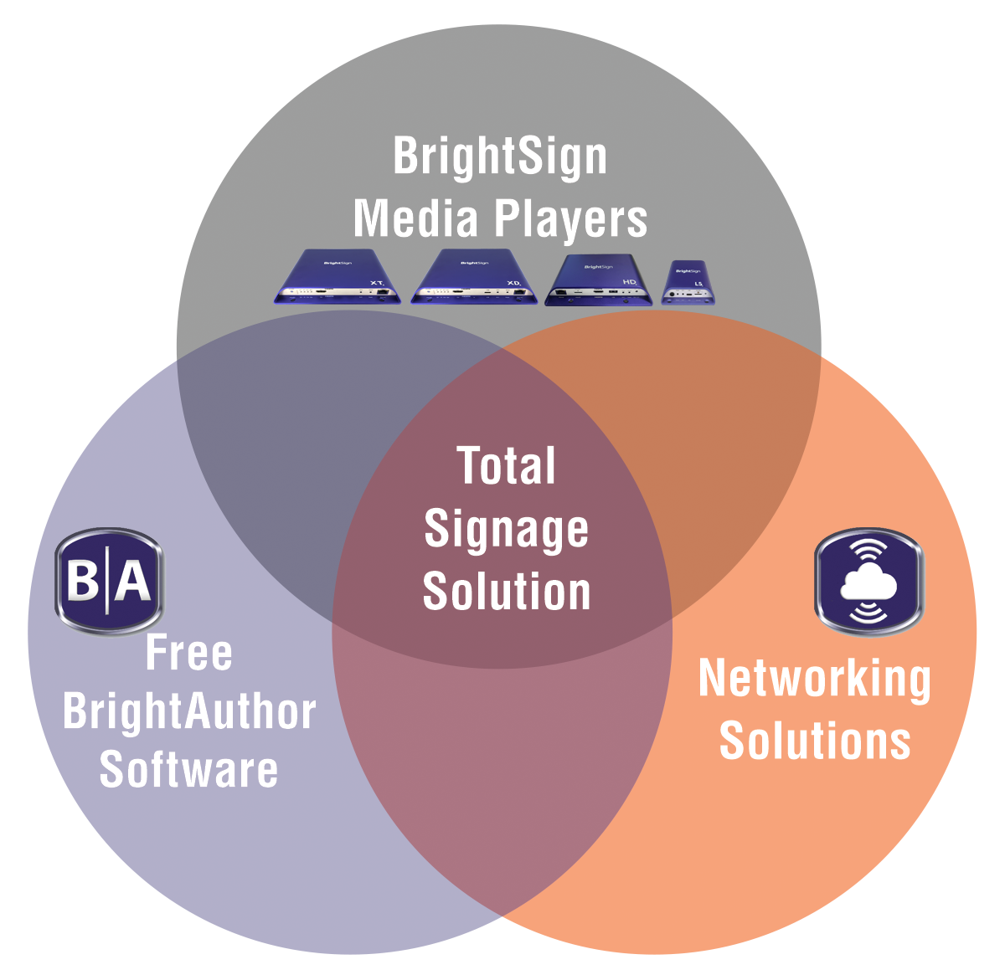
Agenda
1. Corporate Overview
2. Products
3. Features
4. BrightAuthor
5. BrightSign Network
6. Applications
7. BrightSign Partners

Slide 3


Corporate Overview
The Bright Side of Signage®

Slide 4




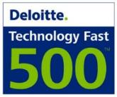
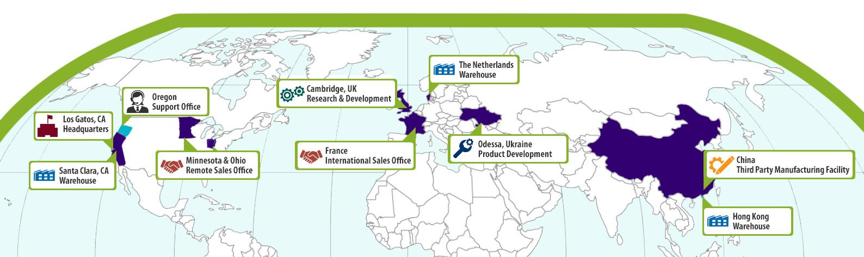


BrightSign corporate overview
The worldwide market leader in digital signage
What We Do
BrightSign manufactures media players, and provides free software and networking solutions for the commercial digital signage market worldwide
BrightSign is known for its signature reliability, affordability, ease-of-use, highest quality output and most powerful video engine
Who We Are
Founded in 2002 by Anthony Wood, inventor of the digital video recorder (DVR) & Roku
Jeff Hastings, CEO
Notes:
BrightSign has offices worldwide:
Our headquarters is in Silicon Valley, CA
We have R&D and support offices in Cambridge, UK & Odessa, Ukraine
Paris, France is our International Sales office
And we have shipping warehouses in Amsterdam and Hong Kong
With these worldwide locations, we offer around the globe sales, service and support, and our support is available virtually 24/7.

Slide 5
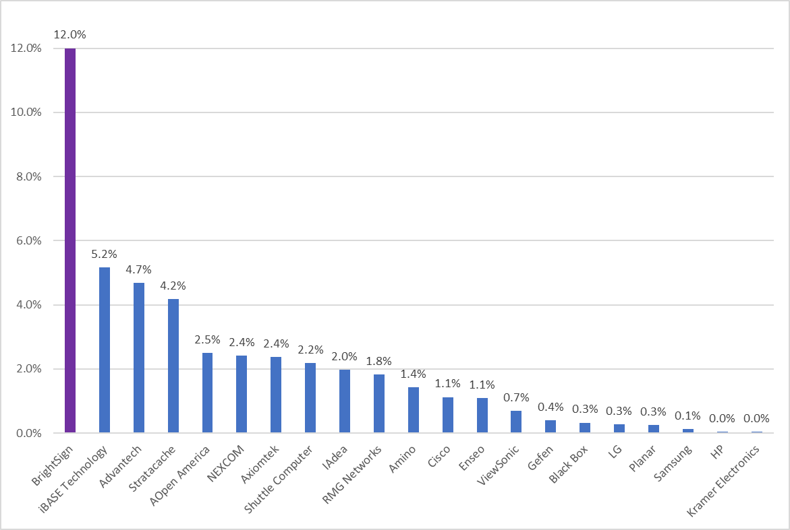
BrightSign is the Market Leader
Q1-Q3 2018 worldwide market share for media players & PC solutions
Data provided by the IHS “Digital Signage Industry Market Tracker” report
IHS (NYSE: IHS) is the leading source of information, insight and analytics in critical areas that shape today's business landscape. IHS has been in business since 1959 and became a publicly traded company on the New York Stock Exchange in 2005.
BrightSign has been the market leader in digital signage media players since 2011
BrightSign’s closest competitors are PCs
Notes:
BrightSign is the biggest solution provider that you may not easily see because we are behind the screen. BrightSign also partners with CMS providers who sell our media players.

Slide 6
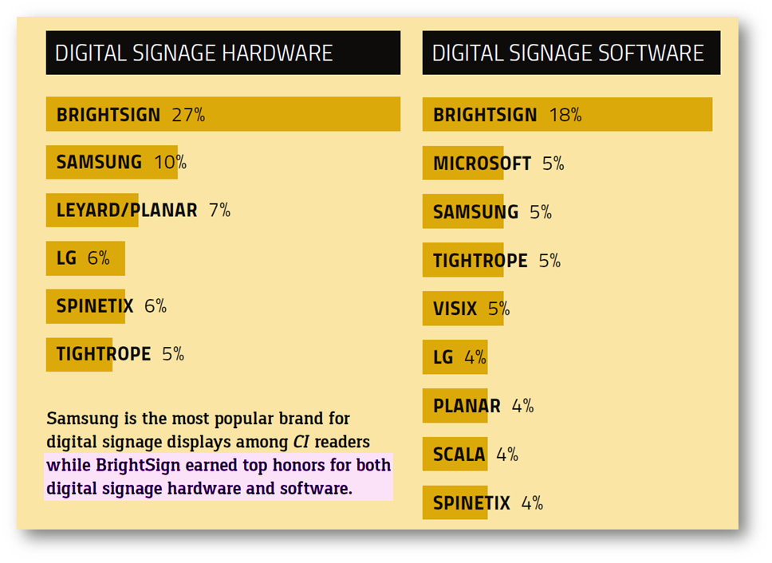


BrightSign Brand reigns supreme for digital signage
The clear choice among CI readers for majority of their digital signage needs
Commercial Integrator surveyed readers on which companies they recognize & embrace
BrightSign stands out as the clear leader in both digital signage hardware and software

Slide 7
World Market Forecast for Digital Signage
2017 is expected to have a 30.8% YoY increase in revenue, with displays & media revenue averaging nearly a 38% increase from 2016.
2018 is expected to have a greater focus on interactivity such as Interactive Whiteboards (IWB) for education, corporate and government markets, as well as NFC, motion sensor touch solution, voice and facial recognition technology in retail and wayfinding
Notes:
IHS Notes on Forecast
IHS Markit expects the overall digital signage industry to finish 2017 with a 30.8% YoY increase in revenue, with displays and media revenue averaging nearly a 38% increase from the previous year. Growth in DOOH advertising for 2018 is forecast to start the year strong, supported by major events such as the 2018 Winter Olympics in PyeongChang, South Korea and the 2018 FIFA World Cup Russia. The increase in DOOH advertising is also a result of the ample number of direct-view LED displays launched by many of the major LCD manufacturers in 2017.
Looking to 2018, there will be a greater focus for displays in interactivity and collaboration applications such as IWBs for education, along with the development of corporate and government markets. IHS Markit believes there will be an even greater shift in connected and integrated environments for digital signage displays with other technologies, such as NFC, motion sensor touch solutions, along with voice and facial recognition technology—aiding to drive the development for IWBs in new applications such as retail and wayfinding.
Increased momentum for DOOH advertising focuses on developments in collecting data, automated workflows, and metrics, which will be crucial to offering advertisers the benefits of creating more targeted campaigns among wider audiences. DOOH advertising is also anticipated to become more immersive in 2018, with instances of VR and AR incorporated with digital signage deployments, especially in public space verticals.

Slide 8
BrightSign Is the Right Choice
Everything you need for sophisticated digital signage
Digital Signage Players
  Ultra-thin solid-state players that are purpose built for digital
  signage with powerful performance and very high reliability
BrightAuthor Software
  Free, easy-to-use presentation authoring using simple to sophisticated features
Networked Content Management Solutions
  Free local network & simple file networking solutions
  Affordable, secure & scalable cloud-based BrightPlates™
  and BrightSign Network services
  BrightSign App to easily updates on-screen text and images
  from an iOS device
  Integrates with a market leading CMS solutions
Total Signage Solution
  Includes everything needed to run digital signs: players, software
  & networking options – just add content!
Notes:
BrightSign offers a total signage solution that includes the digital sign media players which deliver powerful performance and reliability. Our digital sign players are designed exclusively for digital signage with a slim operating system that delivers powerful performance, superior signage capabilities and exceptional Full HD and True 4K video quality on a solid-state platform you can depend on.
Our BrightAuthor software is free, easy to use and offers sophisticated features. This PC-based application helps you create, preview, publish and network your digital signage presentations without difficulty. BrightSign continually updates our software, so you’ll never be stuck with a product that isn’t keeping pace with current market demands.
BrightSign offers a variety of networking options. Simple file networking and local area networking solutions are offered for free and we have an option to subscribe to BrightSign Network, a cloud-based service that frees you from the complexities of hosting and maintaining your own network.
Everything you need to run your digital signage is provided by BrightSign – the players, the authoring software and networking options which are flexible and scalable to support size implementation. We can also connect you to BrightSign qualified content providers and integrators.

Slide 9
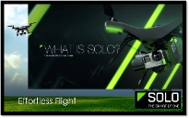
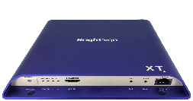



Content Management Options
BrightSign’s open platform allows CMS selection to be a separate process
BrightSign player’s open API’s allow for integration with virtually any CMS solution
CMS choice is independent of the digital signage player purchase
  BrightSign players offer a flexible/scalable platform for digital signage applications with specific CMS requirements
  Before making a long-term CMS decision, BrightSign players can be initially deployed using free BrightAuthor software
Content Management Options:
  Market leading 3rd party digital
  signage CMS solutions
  Free BrightAuthor and optional
  BrightSign Network service

Slide 10
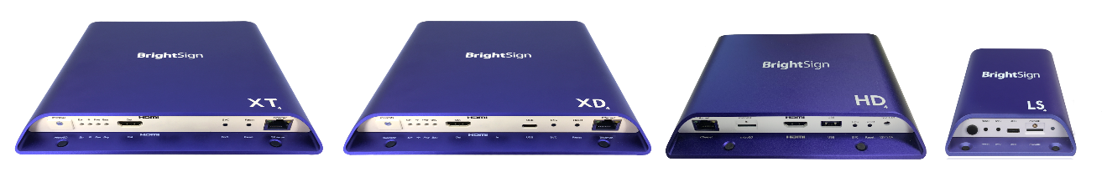
The BrightSign Advantage
Highest Reliability
Very Affordable
Less than 0.25% failure rate!
Non-PC, solid-state device with no moving parts to fail
Won’t overheat
Ultra-thin form factor that’s easy to install on/near the display
Purpose-built OS for digital signage
Open standards to easily customize or integrate with POS
Includes software & networking options – no hidden fees!
Low power requirements
Simple to install & manage
High reliability results in little to no maintenance costs
Scalable – delivers simple & advanced features on a single platform
Plays industry standard content
(H.265 & H.264 video, HTML5, jpegs, etc.)
Notes:
PC-based solutions cannot meet BrightSign’s high reliability and affordability

Slide 11


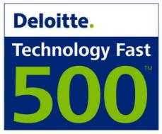










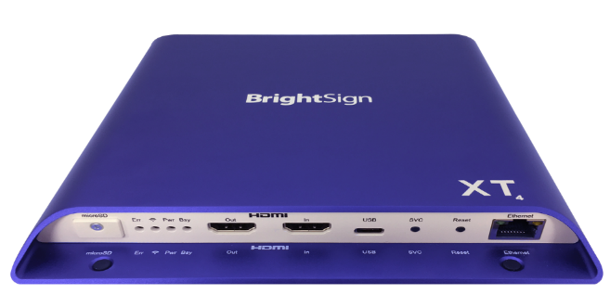
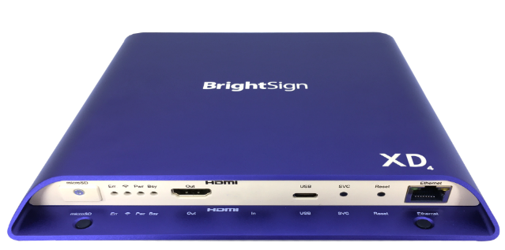


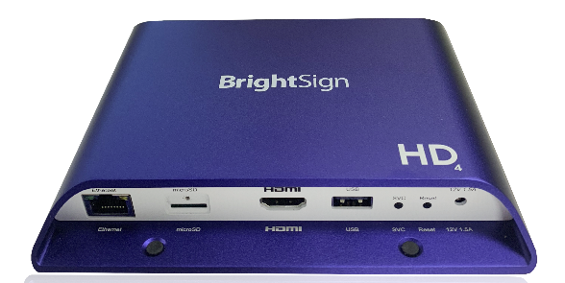
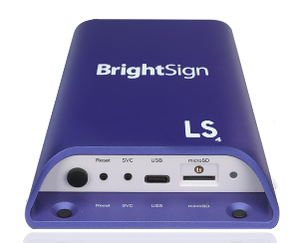
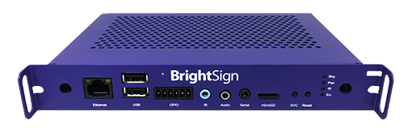
BrightSign awards
Corporate Awards:
Product Awards:
BrightSign App
BrightBeacon

Slide 12

Why Major Brands Chose BrightSign
Very cost effective for large-scale roll-outs
Highly reliable non-PC solution
Stellar Full HD video quality
Fully featured from basic to sophisticated applications
Scalable networking

Slide 13
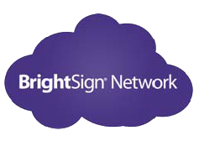






































Major Brands On BrightSign Network
3800+ accounts running on BrightSign Network &
BrightSign Network Enterprise Edition

Slide 14
BrightSign Products

Slide 15
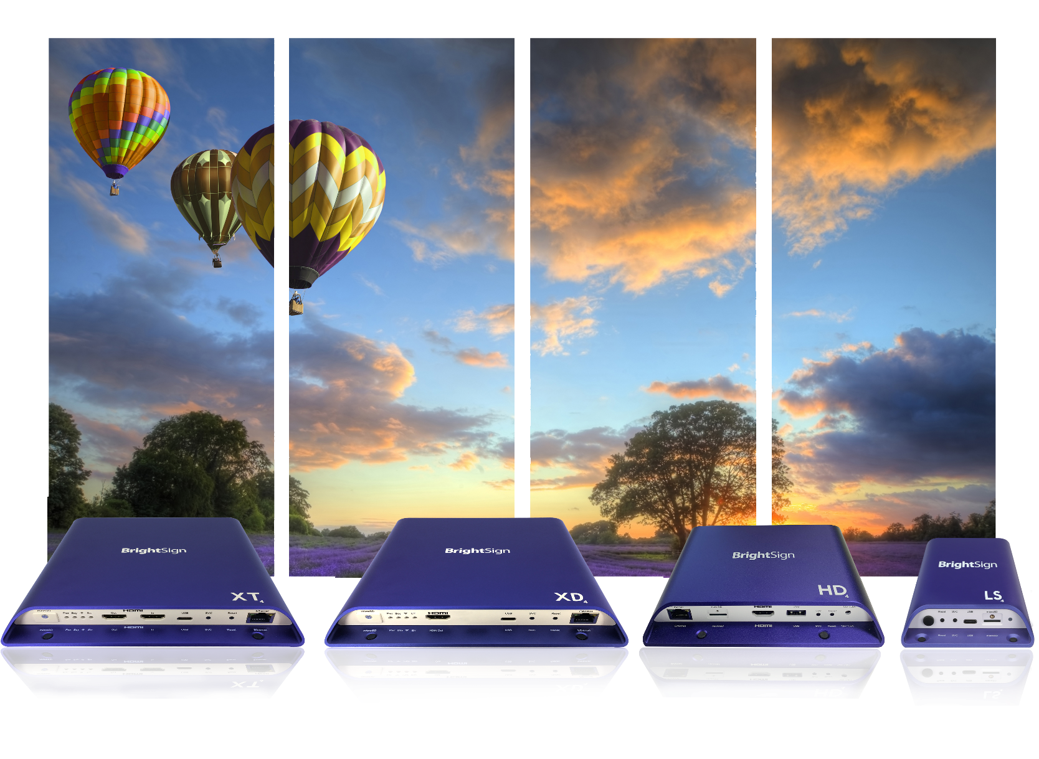
BrightSign Offers World-Class digital signage Media Players
Whatever your signage application, BrightSign is the right choice from
entry-level to enterprise

Slide 16
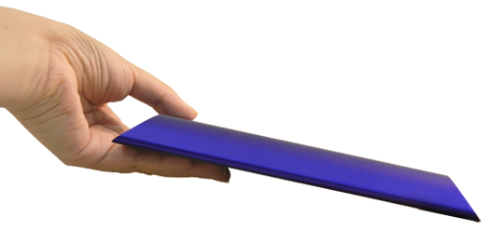
Designed exclusively for digital signage
Providing the absolute highest reliability & functionality without the PC hassles
Purpose-built for digital signage running on a slim, robust and efficient BrightSign OS
Signature reliability with a solid-state platform
State-of-the-art technology and performance
Scalable & future-proof platform
Sleek industrial design with an ultra-thin form factor
Easily fits into any digital signage application with efficient front and back port access
You won’t want to hide this player behind the display!

Slide 17

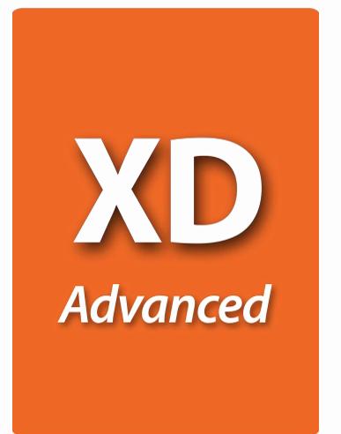
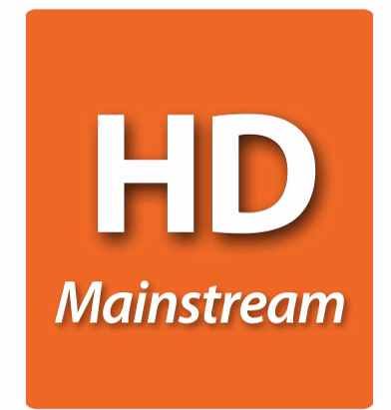
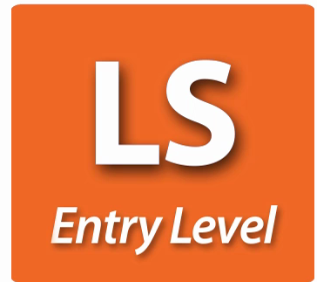
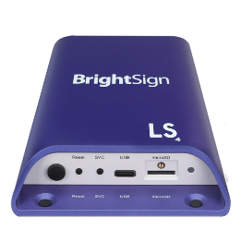
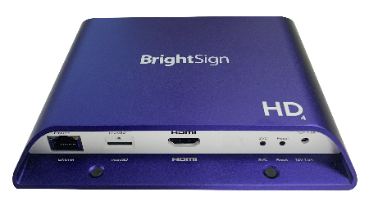
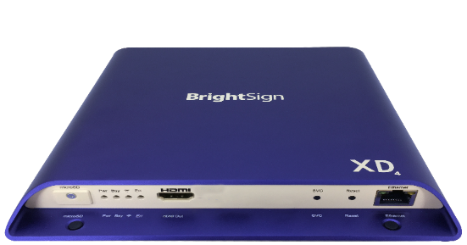


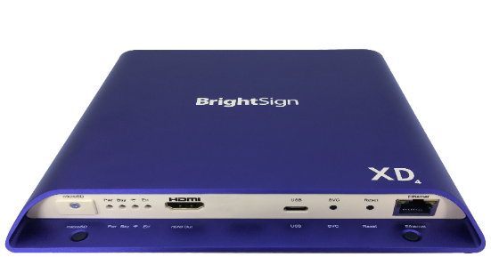
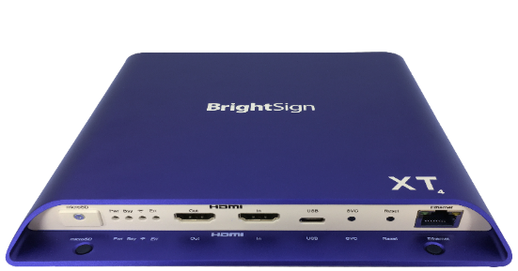
BrightSign Model Lineup
Four product lines based on performance
LS424
Entry-Level
Media Player
HD224
Standard I/O Player
XD234
Standard I/O Player
XT244
Standard I/O Player
HD1024
Expanded I/O Player
XD1034
Expanded I/O Player
XT1144
Expanded I/O Player
HO523
HD-OPS Player
XT1144-T
TAA-Approved Player

Slide 18
Model Packages & Pricing
 | LS Entry-level | HD Mainstream | XD Advanced | XT Enterprise
 | H.265 1080p60 Entry-level HTML5 | H.265 4K60p & 1080p60 Mainstream HTML5 | H.265/H.264 4K60p Dolby Vision, HDR10+ & dual HD video decode Advanced HTML5 | H.265/H.264 4K60p Dolby Vision, HDR10+ & dual 4K video decode Enterprise HTML5
Standard I/O Package | LS424 Ethernet 100baseT USB Type C Analog audio via USB $250 | HD224 Gigabit Ethernet GPIO Analog & digital audio $350 | XD234 Gigabit Ethernet GPIO, IR Analog & digital audio M.2 SSD PCIe interface $450 | XT244 Gigabit Ethernet GPIO, IR Analog & digital audio M.2 SSD PCIe interface POE+ $550
Expanded I/O Package |  | HD1024 Gigabit Ethernet GPIO, Serial, USB (Type A) Analog & digital audio $450 | XD1034 Gigabit Ethernet GPIO, IR, Serial, Dual USB (Type A & C) Analog & digital audio M.2 SSD PCIe interface $550 | XT1144 Gigabit Ethernet GPIO, IR, Serial, Dual USB (Type A & C) Analog & digital audio M.2 SSD PCIe interface POE+ & HDMI In $650
Other |  | HO523 Full HD video, Mainstream HTML Ethernet 100baseT GPIO (4pin), IR, Serial, Dual USB (Type A) Analog & digital audio JAE TX25 plug (OPS compatible) $400 |  | XT1144-T TAA-Approved Expanded I/O with the same specs as the XT1144 $850
Note: The optional Wi-Fi/Bluetooth module is available for all models & includes an external antenna

Slide 19
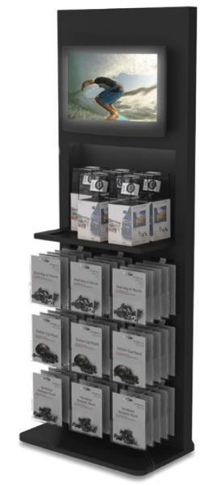
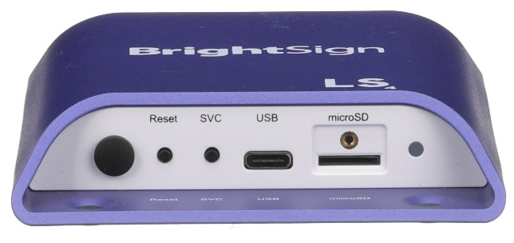
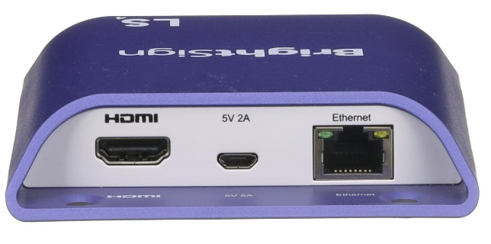
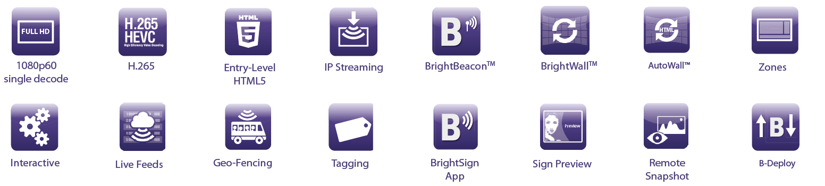
New BrightSign LS424
Signature BrightSign reliability.
Affordable, entry-level performance.
Commercial-grade, highly reliable and fully-featured digital signage media player in a very small form factor
A superior alternative to consumer devices sometimes chosen for price-sensitive installations
Offers networking, H.265, 1080p60 video playback, entry-level HTML5 performance and USB 2.0 interactivity
Perfect for simple video and streaming applications, menu boards, video walls and large deployments of common content
NEW: Easier port access with power, HDMI & Ethernet on back
NEW: Improved power efficiency
Front view
Back view
BrightSign LS424
Entry-Level Player

Slide 20


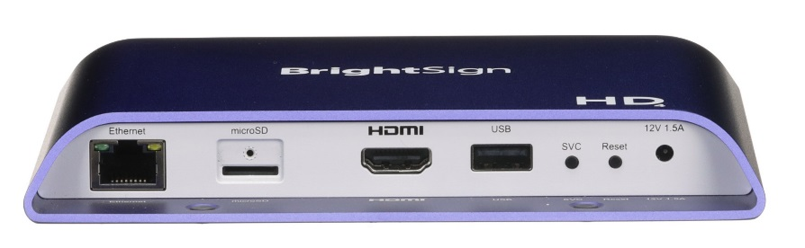
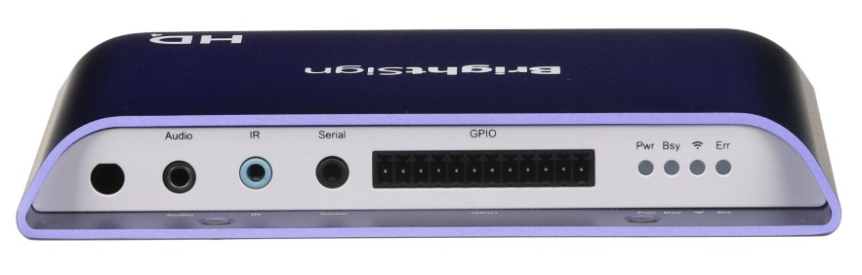
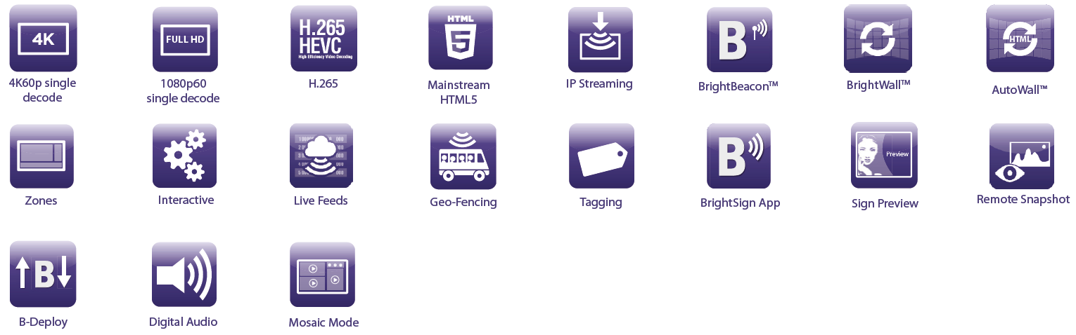
New BrightSign HD4
An affordable classic now with Mainstream 4K.
Mainstream performance.
Ideal for mainstream 4K, Full HD & HTML5 applications that require high reliability and ease of use
Offers H.265 decoding, gigabit ethernet & digital audio
Robust interactive controls, BrightWall™ & Mosaic Mode
NEW: Mainstream 4K60p single video playback
NEW: Easier port access with power, HDMI & Ethernet on front
NEW: Improved power efficiency
Front view
Back view
BrightSign HD224
Standard I/O Player
BrightSign HD1024
Expanded I/O Player

Slide 21
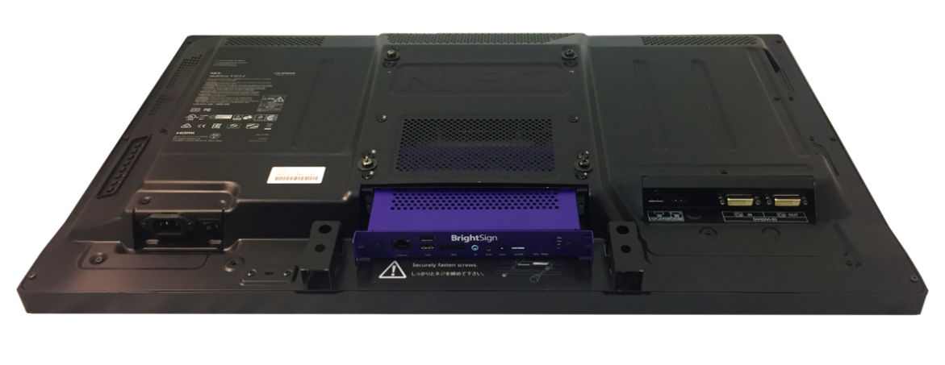

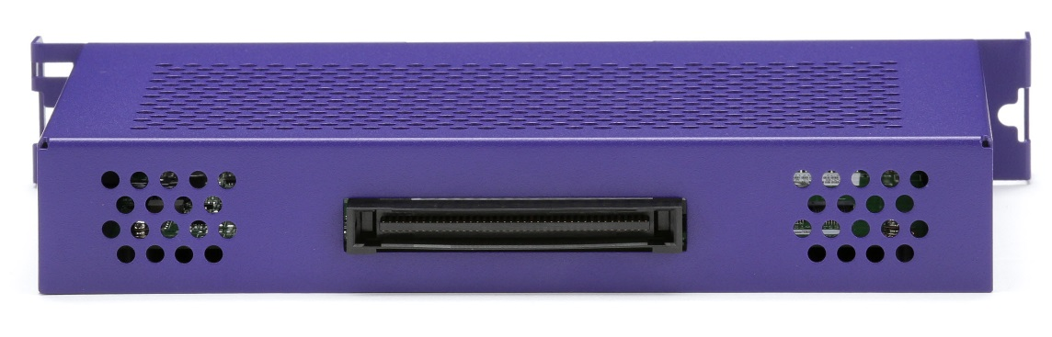
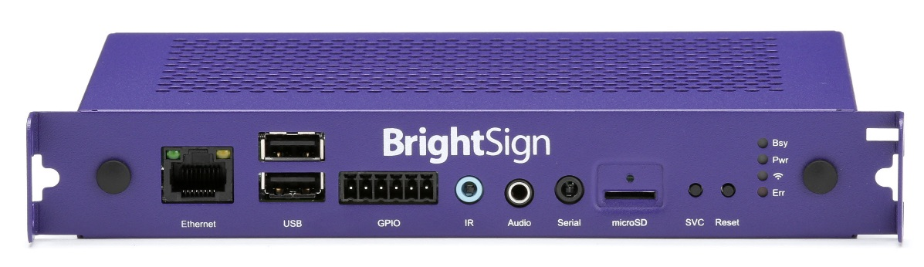
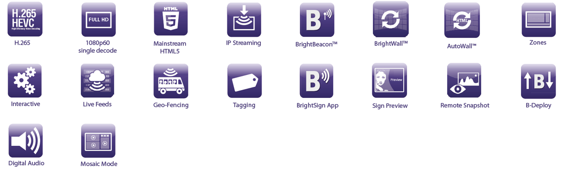
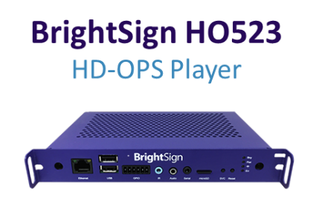
BrightSign HD-OPS
OPS compatible player.
Mainstream performance.
The HO523 is BrightSign’s first OPS compatible digital signage player based on the HD3 series
The inside edge features a JAE TX25 plug for connecting to interior display components (video, USB, serial, etc.)
The outside edge has industry-standard connectors, as well as specialized device control and feedback interfaces.
BrightSign HO523 easily connects to an OPS display without the need for external video or power cables

Slide 22


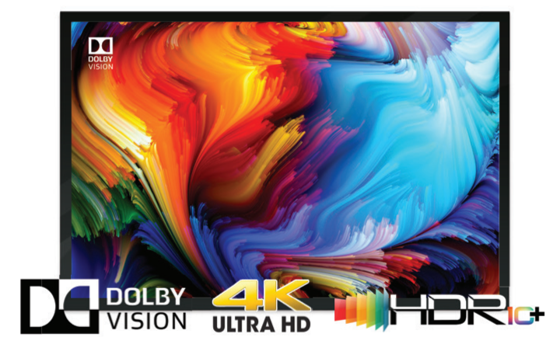
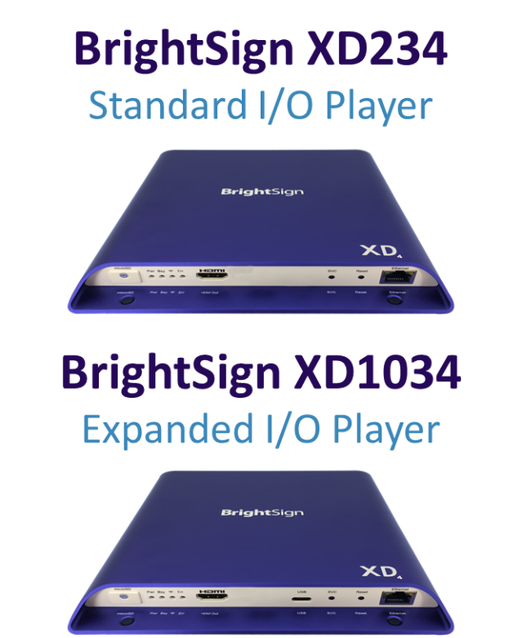
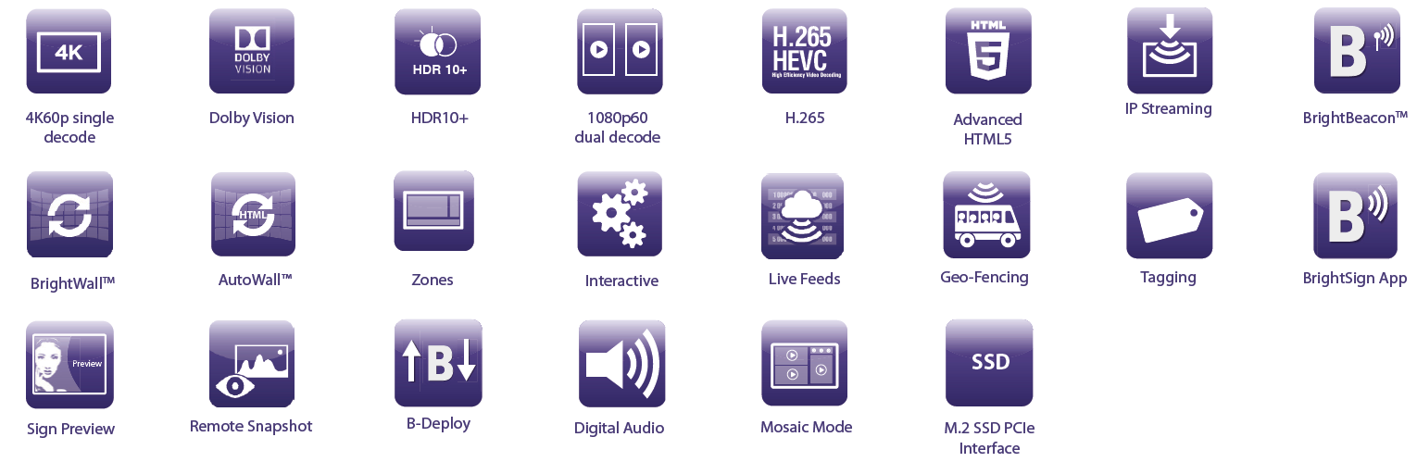
BrightSign XD
True 4K Dolby Vision™ & HDR10+* playback.
Advanced performance.
Advanced 4K video playback that supports all the technology standards of the True 4K ecosystem:
  H.265/H.264 encoded native 4K content at 60p via HDMI 2.0a
  Dolby Vision & HDR10+ for stunning playback quality
Dual video decoding of two 1080p60 videos at once
All models include Gigabit Ethernet and offer a hardware-accelerated HTML5 engine with advanced performance
* HDR10+ functionality is planned to be released in 2019 on Series 4 players but is currently not available.

Slide 23



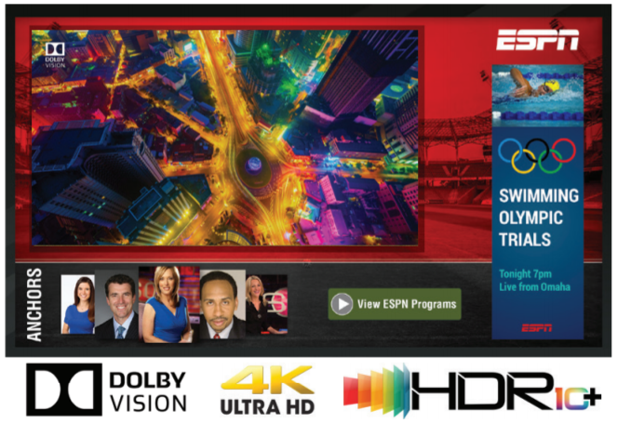
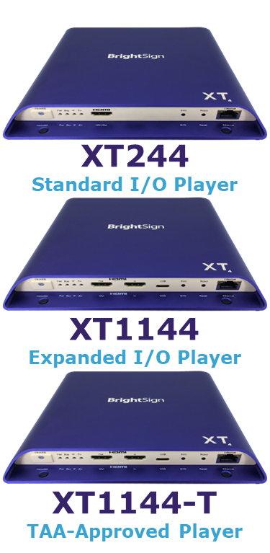
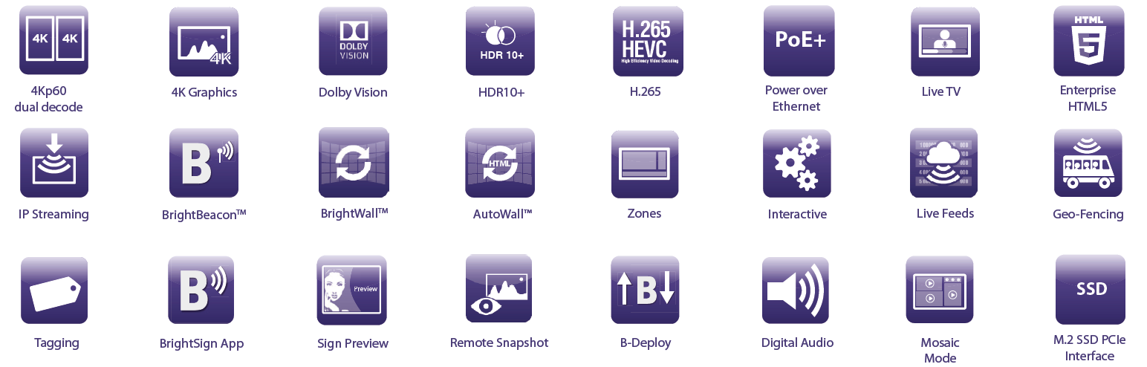
BrightSign XT
State-of-the-art technology & Dolby Vision™.
Enterprise performance.
Unsurpassed performance for enterprise applications with a powerful 4K video engine, our fastest HTML and graphics engine and our most powerful CPU
Hardware-accelerated enterprise-level HTML5 rendering engine that enables flawless playback of multiple modular HTML5 assets including JavaScript, CSS animations, WebGL and even swipe/gesture interactivity.
XT is the only product line offering dual 4K video decoding, 4K full resolution graphics, PoE+ and HDMI In for Live TV playback
NEW: XT1144-T player complies with the Trade Agreements Act (TAA) and is approved for sale to the Federal Government.

Slide 24
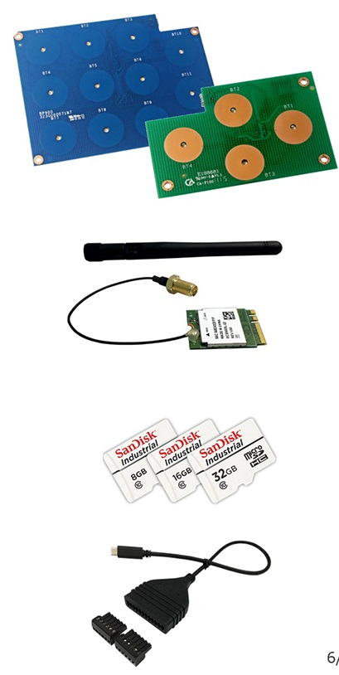
BrightSign Accessories
Easily expand BrightSign functionality
USB Button Panels (BP200 / BP900)
  Add interactivity with this thin, USB connected board design offering 4 or 11
  capacitive touch buttons with embedded LEDs
  Easily programmed using BrightAuthor
  Compatible with any BrightSign player that has a USB port
Wireless/Bluetooth Module
  Easy to implement wireless and Bluetooth 4.0 functions with this embedded module
  Supports 802.11a/b/g/n/ac protocols
  M.2 Interface
  Compatible with all Series 3 & 4 models
Class 10 MicroSD Cards
  Delivers reliable and quality performance on all Series 3 & 4 models
  Capacities offered for each: 8GB, 16GB, 32GB
Specialty Cables
  Range of cable solutions for unique applications

Slide 25
BrightSign Features

Slide 26

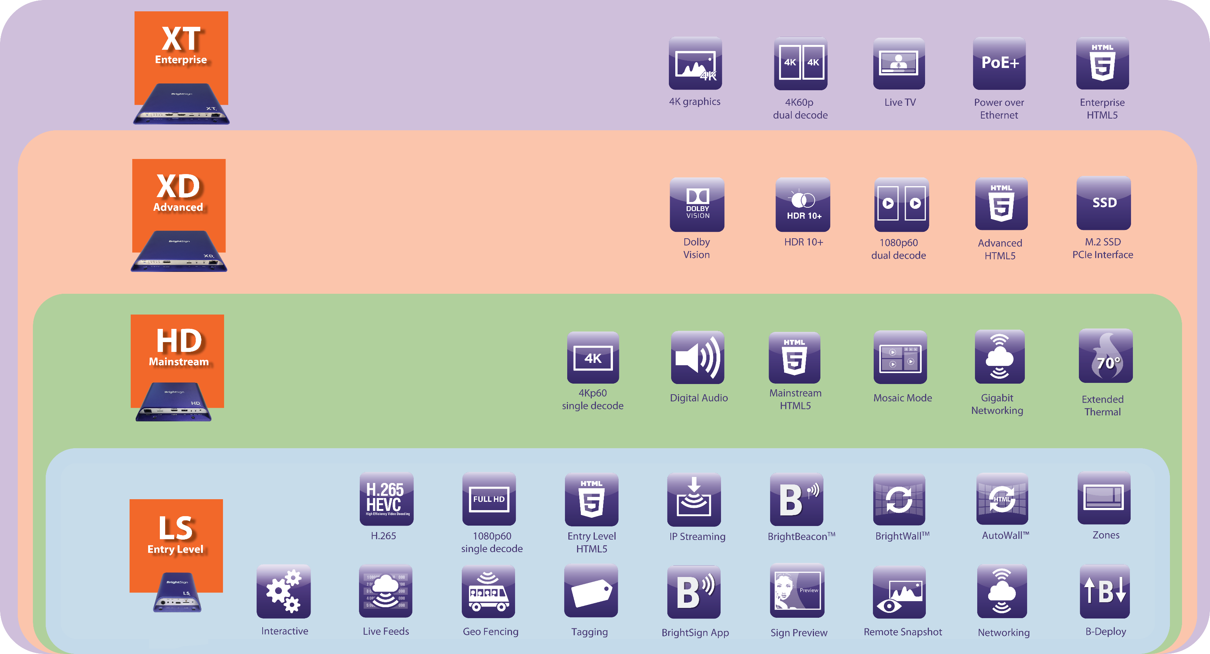
Features
Sophisticated capabilities. Infinite possibilities.

Slide 27


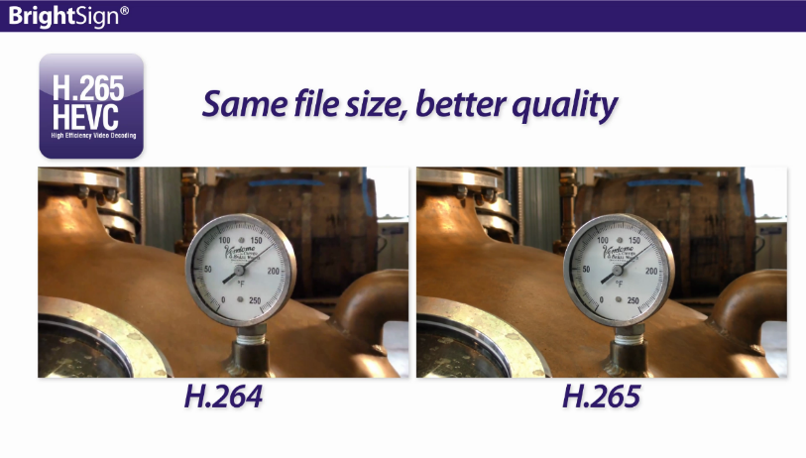
H.265 Decoding
Get more efficient, stellar quality playback using H.265
All BrightSign players support H.265 decoding
Play both 4K and Full HD content encoded with H.265
Get half the file size and double the bandwidth and memory savings
Achieve better video quality with
H.265 vs. H.264 at the same bit rate
Only H.265 supports 10-bit color and
high dynamic range of color
1/3

Slide 28
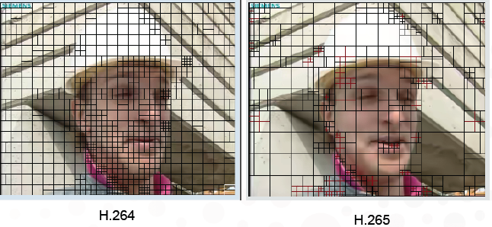
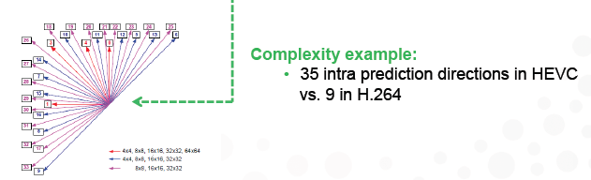
H.265/HEVC – the new standard
The importance of proper video compression
Smaller File
Advanced compression efficiencies from larger block sizes
Up to 50% efficiency gain in coding translates to lower bitrates
Better Picture Quality
Increased intra prediction modes and higher encoding computation allows for soft blur effect rather than macro-blocking
2/3

Slide 29
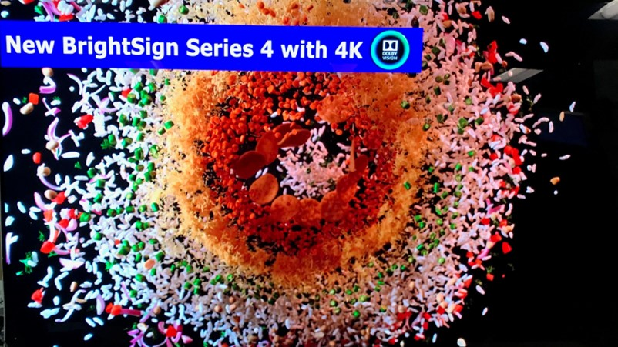
H.265 Compression Solutions
Various encoding solutions are becoming available
FFmpeg – a free command line tool to convert multimedia files between formats
MainConcept – SDK, application and plug-in solutions
VideoLAN – a free software library and application solution
Avid – a very high-end solution
Elemental – for broadcast streaming content
V.265 from Vanguard Video – software-based encoder and decoder SDK
Note: H.265 is not limited to 4K content (i.e.: HD content & streaming video)
3/3
Notes:
H.265 can be used for HD content to create much smaller file sizes equivalent in quality to H.264
Netflix: they are the first company offering 4K content commercially. The video streams are H.265 and they're not charging more for 4K video content because they're now paying less to deliver data overall by using H.265 for not only the 4K content but also the HD content. Netflix is using Vanguard and they built a full ecosystem to use that codec.

Slide 30

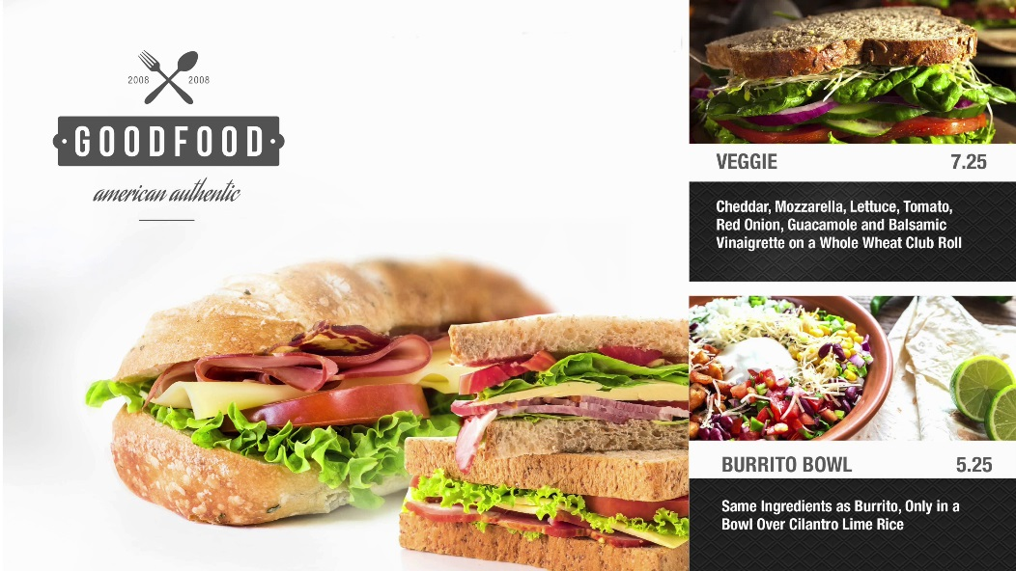

Full HD Video
Superior quality Full HD video with highly reliable playback
All BrightSign players offer robust hardware video decoding to play exceptional quality Full HD 1920x1080 video at 60fps
Supports Full HD content encoded with
H.265, H.264, MPEG-1, MPEG-2
Offers highly reliable and flawless playback
1/1

Slide 31





True 4K video
BrightSign HD4, XD4 & XT4 support True 4K
True 4K playback: 3840x2160 resolution @ 60fps frame rate
H.265 HEVC (high efficiency video coding): enables delivery of high-quality 4K content at about the same file size and data rate as HD content at H.264
HDMI 2.0a: only the HDMI 2.0a supports 60 fps playback
Superior scaling: delivers pristine video quality for any screen or zone size including upscaling Full HD video to 4K
1/1

Slide 32




4K Dolby Vision & HDR10+*
High Dynamic Range (HDR) delivers vibrant brightness, contrast & color
HDR provides bright, detailed and vibrant colors in highlights and shadows of 4K video using a much wider brightness range and color palette
There are 2 types of HDR implementations available:
  Dolby Vision: offers 12-bit color depth & is Dolby’s proprietary approach to delivering HDR content with dynamic metadata
  HDR10+: 10-bit color depth & is an open standard approach for delivering HDR content with dynamic metadata
SDR HDR10+
Dolby Vision | HDR10+
supports up to 10,000 nits peak brightness, with a current 4,000 nit peak brightness target | supports up to 4,000 nits peak brightness, with a current 1,000 nit peak brightness target
supports up to 12-bit color depth | Supports up to 10-bit color depth
uses the wide-gamut Rec. 2020 color space | uses the wide-gamut Rec. 2020 color space
Dolby Vision SDR
* HDR10+ functionality is planned to be released in 2019 on Series 4 players but is currently not available.
1/1

Slide 33







Dual Video Decoding
Powerful tool to play two full resolution videos simultaneously
XT244 & XT1144 players:
Dual decode of two 4K (3840x2160p60) videos simultaneously
Dual decode of two 1080p videos simultaneously
XD234 & XD1034 players:
Dual decode of two Full HD (1920x1080p60) videos simultaneously
1/1

Slide 34




4K Full Resolution Graphics
Display eye-catching graphics and HTML content in 4K resolution
Only BrightSign XT4 players can render graphics at resolutions up to 3840x2160x60p
Display crystal clear small-sized text in images and HTML content
1/1

Slide 35




Live TV
Engage your audience with Live TV
HTML5 animating logo
Live TV
Play any broadcast content, even protected HDCP content via the HDMI Input
  BrightSign XT1144 includes an HDMI 2.0a input to play Live HD or 4K content
Automatically scale the playback from any zone size to full screen with pristine quality
Live Text Feed
L-shaped Video
1/1

Slide 36





HTML5
Hardware-accelerated HTML5 rendering engine
Play industry standard HTML5 content including JavaScript, CCS animations, transitions, WebGL video support, dedicated GL compositor & JavaScript API supporting many BrightScript functions
BrightSign XT Enterprise HTML5 Engine
Play highly complex & memory intensive HTML5 content such as swipe/pinch/zoom interactive, streaming social media, multiple modular HTML5 assets layered with live TV and video & 4K full resolution graphics
BrightSign XD Advanced HTML5 Engine
Play advanced HTML5 content such as swipe/pinch/zoom interactive, streaming social media & multiple modular HTML5 assets alongside video
BrightSign HD Mainstream HTML5 Engine
Play mainstream HTML5 content in full screen and several modular HTML5 assets alongside video playback
BrightSign LS Entry-Level HTML5 Engine
Play entry-level HTML5 content in full screen or as a modular asset alongside video playback
1/1

Slide 37








Mosaic Mode
Create highly dynamic displays
Play a multitude of smaller resolution videos simultaneously that add up to the maximum video resolution of the player
  BrightSign XT supports simultaneous decode of 4 Full HD videos (via BrightScript)
Play an HTML feed containing multiple videos in a single zone as long as the HTML feed resolution matches the player's maximum resolution
1/1

Slide 38


BrightWall™
Create impressive video walls with perfect synchronization
BrightWall is a powerful drag-and-drop BrightAuthor tool that makes building looping video walls in any size and layout very simple.
  Perfectly synchronize separate videos per display or stretch a single video across all displays using the BrightSign player’s Ethernet port and a common clock
  Build video walls by simply choosing the number of displays, specifying the configuration of the video wall and dragging the video(s) into BrightAuthor
The Synchronization event tool in BrightAuthor is used to synchronize the playback of multiple screens for basic video walls and also can be used in conjunction with interactive events for creating interactive video walls.
  Achieve perfect video wall synchronization and edge blending in projection mapping with genlock frame-accurate synchronization (via BrightScript)
1/1

Slide 39



AutoWall™
HTML-based video walls that supports more than just video
Powerful BrightAuthor Plugin Kit using HTML5 to create unique multimedia video walls supporting video, images, tickers, live feeds & virtually any HTML5 content
Landscape multimedia video walls with HTML-based layouts
  automatically scales based on the number of players/screens in the wall
  frame accurate synchronization & support for interactivity via HTML
Video content populated from BrightSign Network Dynamic Playlists or MRSS feeds
Multiscreen ticker option with content populated from BSN or RSS feeds
Support for any publishing method (Local File Networking, BrightSign Network, etc.)
A-1 A-2 A-3
B-1 B-2 B-3
C-1 C-2 C-3
A-1 A-2
B-1 B-2
1/1

Slide 40


Zones
Multiply your content delivery with multi-zone layouts
Playback multiple content files on a single screen with zones – even dual videos on BrightSign XD and XT
Abundant content support including Full HD video, images, HTML5, Live TV, audio, text tickers, Live Text, RSS feeds,
date/time widgets and more!
Control each zone with its own playlist
Play video and audio independently from a
single player
Synchronize zones together and link
to lighting and other displays to create an
immersive experience
1/1

Slide 41








Interactivity
Engage your audience with interactive devices and controls
Trigger playback from virtually any type of interactive device you can dream up using Interactive Playlists in BrightAuthor or HTML5:
  Touch screens, barcode scans, motion sensors, RFID, UDP controls, GPIO and USB button controls, IR remote controls, serial devices, keyboards, mice and much more
Grab attention, demo product operations, deliver
coupons & pricing on demand
Control the show with UDP or serial controls to power
and manage media playback, control AV devices such
as projectors, lighting, audio systems and integrate
with other show controllers (AMX, Crestron, Alcorn, etc.)
1/1

Slide 42









Live Feeds
Link to virtually any live media feed to display in your signage.
Live Text
Integrate these real-time text fields to your signage and instantly update messaging without republishing the presentation. Perfect for menu board pricing, waitlists, transportation schedules and more
MRSS feeds keep your signage up to date
Link to and display popular news, finance, weather, sports feeds and more
Social media feeds
Link to social media feeds such as twitter and Flickr or playback animating, aggregated social media feeds to keep your signage relevant and fresh
3rd party schedule and data feeds
Connect to virtually any database via MRSS or HTML to display up to the minute details. Perfect for flight timetables, event schedules, corporate statistics and more
1/1

Slide 43



IP Streaming
IP streaming on all BrightSign players
All BrightSign players support Full HD, BrightSign XD/XT support 4K video streams
MJPEG and audio streaming including these formats:
  HLS (the standard for public internet streaming: i.e. YouTube)
  UDP/RTP/RTSP streaming from head-end real-time encoders
  HTTP including SHOUTcast
BrightSign XD/XT players support multiple video streams simultaneously
BrightSign supports SRT (Secure Reliable Transport) technology on both 1080p & 4K content which optimizes streaming performance even across unpredictable networks
Customize buffering and latency to improve media streaming performance
Play streaming media in HTML5 assets or in BrightAuthor’s video, audio or MJPEG stream states
Stream, buffer and play back content from IP cameras supporting the RTSP unicast streaming protocol
Value of SRT Technology
1/1

Slide 44


Digital Audio
Crystal clear digital sound
Playback high-quality digital audio on BrightSign HD, XD & XT
Easily add audio playlists to your presentations
Synchronize audio with video playback
Create and play interactive retail audio product demonstrations
Advanced audio routing with quality support for mixing of PCM sources with audio outputs including sample rate mixing & volume leveling (via BrightScript)
1/1

Slide 45


Extended Thermal Operation
Safely operate at extended thermal temperatures
BrightSign HD, XD & XT players are designed for ambient temperatures between 0° and 70° C at 90% maximum relative humidity, non-condensing
Players have low power consumption and are designed to efficiently dissipate heat, allowing them to be installed in virtually any environment with confidence
1/1

Slide 46




M.2 interface
New expansion slot for add-on peripherals
All models have an M.2 interface to support a Wireless/Bluetooth module
BrightSign XD4 & XT4 offer an additional low-profile M.2 SSD PCIe interface connector for added internal storage
  Supports small form factor solid-state drives with faster transfer rates
  Offers additional content storage in place of microSD cards
Stick of gum
SSD
1/1

Slide 47




Power over Ethernet
More convenience with PoE+
Use PoE+ (Type 2) to power your XT players
Eliminates the power cord with support up to 25 watts of power
  XT players will not exceed 25 watts when running a standard presentation, an HDMI cable and 1-2 other outputs at most
  When XT is powered by PoE+, there is approximately 1A available for all other connectors
1/1
Notes:
PoE+ Support on 4K & XD Explained
4K & XD PoE+ is type 2 which supports 25 watts of power (PoE+ type 1 supports 12 watts)
BrightSign XD & 4K can be powered by Ethernet alone as long as they don’t exceed 25 watts of power which is when 4K is running a standard presentation, an HDMI cable and 1 or 2 other outputs at most.
If BrightSign 4K players are powering more than 2 outputs and a resource intensive presentation, they could require up to 60 watts of power and similarly BrightSign XD could require up to 36W
If the 4K or XD player is being powered by PoE+, approximately 1A is available for all other connectors

Slide 48





Geo-Fencing
Moving signage to play content based on current location
BrightSign plays specific audio and/or video content when located within a defined geographical radius*
Applications:
  Shuttles, taxis, public transportation and moving billboards: Advertise and promote local businesses
  Tour buses and boats: Inform and educate riders with video and audio relevant to the area
An on-board entertainment solution that also provides relevant and timely content specific to upcoming stops using BrightSign's geo-fencing feature
  * Requires a USB GPS device
1/1

Slide 49


Sign Preview
Get a sneak peek at how your signage will display
Preview your presentation playback in BrightAuthor before publishing
Speed up presentation authoring by reviewing the final look of your digital signage
1/1

Slide 50




BrightSign App
Signage updates have never been so easy
BrightSign App offers a simple and secure interface on your iPad or iPhone to select any BrightSign player connected to a local network
easily update on-screen text instantly
trigger video playback & change images
via UDP commands
Customize the app’s user interface to match
your presentation
Access diagnostic tools & Remote Snapshot
of your player
Secure your displays with a password
Perfect for: menu boards, retail merchandising, emergency messaging and more!
1/3

Slide 51



How it works…
Edit a user variable
User variables such as a menu item or price can be updated
Change a user variable, press ‘Set Values’, and the display instantly updates
Edit values
Price changes instantly
2/3

Slide 52


How it works…
Trigger UDP Events
UDP controls can be used to:
  Change a daily special
  Switch menus from breakfast to lunch to dinner
  Offer a promotion
  Etc…
Special image changes instantly
Tap UDP Event
3/3

Slide 53


Network Solutions Overview
Versatile solutions to meet any need
1/1

Slide 54


B-Deploy
Setup and deploy a multitude of players at once
B-Deploy is a powerful setup and provisioning feature that allows customers to setup and deploy a multitude of players all at once.
Eliminates the need to save setup files to an SD card and duplicate the SD card for every player in the network
B-Deploy can be used with BrightSign Network, BrightSign Partner CMS, or on premise secure corporate LAN
How It Works:
Upload a batch of player serial numbers
and player setup instructions using B-Deploy
Power up players for automatic setup:
  Players connect to B-Deploy for instructions
  B-Deploy applies the assigned setup to the players
  Assigned presentation is downloaded & playback begins
1/1

Slide 55





BrightSign Network Tagging
Tagging is incorporated throughout the BrightSign Network service
Media Tags: tags assigned to individual and groups of content
Tagged Playlists: playlists that are automatically created by setting media tag criteria
Player Tags: tags assigned to individual or groups of players for media playback and network management
Matching Tags: the ability to match media & player tags to enable playback of a subset of content from a single playlist
1/1

Slide 56





Remote Snapshot
Get a glimpse of what your sign is playing
Remotely view an image of your running presentation
View snapshots using:
  Local networking via the BrightSign App and Diagnostic Web Server
  BrightSign Network via BrightAuthor or the Web UI
1/1

Slide 57







BrightBeacon™ Overview
Integrated BLE Beacon Technology
BrightBeacon delivers unique mobile device engagement using integrated BLE beacon technology and a mobile app
BrightBeacon enhances engagement between the digital sign and mobile device via:
  1-way location-based communication: sending notifications, coupons, etc. based on proximity to digital sign
  2-way communication:
  adds the ability to control the digital sign via a mobile device
 | 1-Way Communication | 2-Way Communication
External BLE Beacon | BLE Beacon
Integrated BLE Beacon | BrightBeaconTM | BrightBeaconTM
1/3

Slide 58








BrightBeacon™ Features
Highly targeted, bi-directional engagement between signage & mobile devices
Integrated BLE beacon technology available on all BrightSign Series 3 players which is used to promote mobile engagement
Offers dual screen exposure on both large digital signage screen and mobile device display
Delivers location-based mobile engagement to deliver highly targeted content based on proximity to the beacon – no batteries required
Supports 2-way communication between mobile devices and digital signage to control digital sign playback
Offers remotely programmable solution with multiple beacon
UUIDs supported
Far proximity
‘far’ message invites user to visit digital sign
Near proximity
‘near’ message controls playback & gives coupon
2/3

Slide 59






BrightBeacon™ Requirements
BrightSign
Player
All Series 3 players support BrightBeacon
BrightSign Wireless/Bluetooth Module (higher power, greater range)
or Generic BLE 4.0 dongle http://plugable.com/products/usb-bt4le
Secondary BLE beacon “puck” for 2-way communication
Presentation built with BrightAuthor version 4.6.0.18 or later
BrightBeacon plugin to enable beacons within Presentation Properties
Development application template: https://github.com/brightsign/brightsign-ble-commands
BrightPlex Cinemas sample demo and app: https://www.brightsign.biz/support/demos/overview
BLE Beacon
or
BrightSign presentation with beacons enabled
Mobile app on smartphone
3/3

Slide 60
BrightAuthor
Hassle-free Sign Creation.

Slide 61







BrightSign Presentation Creation Process
Simple process with sophisticated results
Free BrightAuthor Software
Content
Prolific content types supported using industry standard formats
Author
Easily create, preview, schedule and publish presentations using a vast array of simple to sophisticated features
Play
Confidently play presentations and manage your network
1/5

Slide 62

BrightAuthor Overview
Free PC software to easily create presentations that flawlessly run on BrightSign players
Simple steps to get a presentation up and running on BrightSign
Author. Easily create layouts & playlists for simple to sophisticated presentations.
Play. Preview, publish and play presentations with confidence.
Manage. Readily update, monitor and manage your BrightSign Network.
2/5
Notes:
BrightAuthor is a free PC-based software application that easily creates, previews and publishes presentations to run on BrightSign. It also offers an interface to manage your BrightSign Network
Build. access all BrightSign features and functions that can be implemented into presentations. Design Full HD and 4K upscaled looping and interactive presentations in full-screen or multi-zone layouts.
Preview. Review presentation playback before publishing.
Publish. Automatically build and distribute a complete presentation packet ready to play on BrightSign including content, playlists, controls and scheduling. Published presentations can be distributed to SD cards or network connected BrightSign units.
Manage. Easily and securely update, monitor and manage your network of BrightSign digital signs right from the BrightAuthor application. A web UI is also available.

Slide 63


Presentation Authoring
Using Free BrightAuthor Software
Create full-screen or multi-zone layouts
  Select zone type based on content: video, images, tickers, live feeds, clocks, etc.
  Customize zone size & placement on screen
Drag/drop content into each zone to build playlists
  Non-Interactive Playlist: A playlist of content that plays in a continuous loop
  Interactive Playlist: A playlist that plays particular content based on a trigger such as a button push, screen touch, network command, etc.
  BrightWall™: A frame-accurate synchronized playlist of content that is displayed as a video wall.
3/5

Slide 64




Flawless playback you can rely on
Confidently preview, publish and play
Preview
Preview your presentation in BrightAuthor before publishing
Publish
Set your presentation’s playback schedule
Publish completed presentation to players (SD card, network, etc.)
Play
Confidently play presentations without interruption and with powerful performance
Players offer high reliability with less than a 0.25% failure rate
4/5

Slide 65

Playback Management made easy
Tools to keep your presentation running and relevant
Monitor your presentation playback via snapshots using RemoteView
Update content and presentations with ease
Manage your content library
Administer your network of BrightSign players remotely (firmware & network setting updates, etc.)
5/5

Slide 66
Networking Solutions
Versatile networking options deliver remote content with ease

Slide 67

Network Solutions Overview
Versatile solutions to meet any need
1/9

Slide 68





Local SD Card Publishing
An alternative to networked content publishing & updates
BrightSign players require a micro SD card for storage – players have no internal storage
As an alternative to networking, presentations can be published directly to a micro SD card and manually insert it into a player
BrightSign offers a line of industrial grade class 10 micro SD cards
that are approved for digital signage applications
USB device storage can be used for players that have a USB port
Note: storage devices FAT32 formatted. To play files larger than 4GB, format for NTFS which is only compatible with non-networked players.
2/9

Slide 69
Local Network Publishing
Free solution designed for small networks within a single building using a local subnet
Easy and free, this option is ideal for basic, low-maintenance situations where simplicity is key
Send files and updates to remote networked units over the Internet or LAN (local area network).
Use BrightAuthor to publish directly to the player over the LAN
Perform basic polling status checks of connected units using
BrightAuthor
LAN
Connection
3/9

Slide 70



Simple File Networking
Free solution designed for small networks
Distribute presentations to BrightSign units through a web folder
  Supported file locations must be accessible via http
Requires a simple Internet connection to send basic content files for remote BrightSign units to download
Allows bandwidth throttling and convenient for managing players beyond the limited area of a local network
Specify network checks for updated content
Internet
Connection
Internet
Connection
Web Folder
4/9

Slide 71

BrightSign Network
Secure, scalable and affordable cloud-based digital sign network service
Delivers the complete infrastructure to serve, manage & support your digital sign network
Frees you from hosting and maintaining your own network
Scalable service for any size network – any number of players guaranteed
Remotely manage and update content, firmware and schedules using BrightAuthor or Web UI
Divide players into groups for ease of presentation publishing and management
Assign tags to media and players to build tagged playlists and highly target playback
Monitor, manage and diagnose network health,
view presentation playback & generate reports
Perform network admin functions & assign user
roles and permissions for conditional access
6/9
Notes:
BrightSign Network is a secure cloud-based solution for managing your network of BrightSign digital signs. It offers a complete infrastruction to serve, manage and support your network and frees you from the complexity of hosting and maintaining your own network.
BrightSign Network offers a complete set of tools and interfaces to easily and successfully manage your network. An it is scalable to any size network.
The BrightSign Network management can be done via the BrightAuthor PC software application or the Web UI which primarily allows network subscribers to access administrative functions such as user roles, permissions, etc. as well as monitor the health of your network.

Slide 72

BrightSign Network Features
Flexible, easy to use features to remotely manage your network
Administer user accounts including roles and permissions
Setup BrightSign units for networking and assign a network group
Create networked presentation elements such as Dynamic Playlists, Live Data, and Live Media feeds
Build, upload and manage your presentation and content libraries
Upload pure HTML presentations
Schedule and publish presentations
Monitor and manage your entire
digital signage network
7/9

Slide 73


BrightSign Network Enterprise Edition
Installable software version of BrightSign Network
Host your own network with access to all BrightSign Network features
Sell subscriptions for the use of your hosted network
Manage your network within the security of your own server and firewall
Recommended for large networks with special hosting requirements, advanced technical skills, and a dedicated IT staff
8/9
Notes:
The BrightSign Network Enterprise Edition is available only to pre-approved customers of large networks that have special hosting requirements.

Slide 74
Network Solutions Comparison
Features | Simple File Networking | Local Area Networking | BrightSign Network | BrightSign Network Monitoring Only | BrightSign Network Enterprise Edition
Setup New Device |  |  | X |  | X
Secure Login |  |  | X
Presentation Creation |  |  | X
Create tagged playlists |  |  | X |  | X
Remote Content Updates | X | X | X | Optional Fee per Update | X
Assign player and content tags |  |  | X |  | X
Content Upload and Management |  |  | X |  | X
Content encryption |  |  | X (optional) |  | X
Scheduling | X | X | X | X | X
Enhanced Scheduling |  |  | X | X | X
Single Player Publishing | X
Publish to Network Group | X | X | X | X | X
Create, Manage and Monitor Network Groups |  |  | X | View-only Access | X
View Player Details (firmware version, etc.) |  |  | X | X | X
Remote Firmware Updates | X | X | X | Optional Fee per Update | X
Health Status Updates & Notification |  |  | X | X | X
Device Recovery |  |  | X | X | X
Network Unit Management |  |  | X | View-only Access | X
Network Administration |  |  | X |  | X
Scalable | X | X | X | X | X
Reporting | X (Log file access only) | X (Log file access only) | X | X | X
Permission-based User Access |  |  | X | X | X
Browser-based Access |  |  | X | X | X
Internet Connection Required | X |  | X | X
Compatible with 4K, XD, HD and LS Players | X | X | X | X | X
Pricing | Free | Free | Subscription | Subscription | Server License
9/9

Slide 75
BrightSign Market Applications

Slide 76











Sophisticated Solutions for Any Application
Corporate & Exhibits
Education
Finance
Museums & Attractions
Casinos & Stadiums
Hospitality
Retail
Restaurants & Bars
Transportation
Healthcare

Slide 77










BrightSign Corporate & Exhibit Solutions
Improve corporate communication, elevate
branding, and create engaging company exhibits
Elevate branding by creating a unique immersive experience with multi-screen displays, audio and lighting
Engage visitors with mobile and touch screen interactivity for corporate directories, product listings, etc.
Improve corporate communications with targeted messaging, events, news and real-time stats that can be changed on the fly or scheduled
Make wayfinding simple with interactive displays
built with HTML5
Reduce costs by eliminating static, printed signage
and by implementing a green solution
BrightWallTM
Interactivity
Touch
BrightSign App
Networking
Zurich Film Festival: 70 BrightSign driven displays throughout the city
HTML5
20 BrightSign players synchronized and projected
1/2

Slide 78





Utrecht City Council Case Study
Digital Signage Improves Customer Service and the Working Environment
The Solution
  34 BrightSign XD players and BrightAuthor CMS
  23 46-inch displays on each of the 22 floors providing staff information
  Six 70-inch displays in departmental reception areas directing visitors
  Two 80-inch screens in the public atrium public information
  Three 32-inch screens in the public area, providing tourist information
Benefits
  Appreciable positive effect on customer service, as well as the
  information available for staff to help improve performance and quickly
  become familiar with their new surroundings
  Speedy implementation: the entire project, took only four months
  The equipment is very easy to use, and council departments are easily
  able to manage content independently
2/2

Slide 79






BrightSign Education Solutions
Improve campus-wide communications and education with state-of-the-art digital signage
Facilitate campus communications and update it easily to inform students of department news, events and office hours
Broadcast emergency messages instantly to campus-wide displays along with instructions and evacuation plans
Make wayfinding simple with interactive displays
built with HTML5 using touch and swipe interactivity
Recognize donors with displays that highlight donor stories and recognizes gifts
Further student education with live video content or interactive quizzes and games
Networking
Live Text
BrightSign App
HTML5
Touch
Powerful Video Engine
Interactivity
Live TV
1/2

Slide 80




UC Irvine Case Study
College campus digital signage delivers directory information, school news, RSS feeds and inspiring alumni stories
Implementations:
1 BrightSign HD displays looping content of alumni success stories
4 BrightSign HDs deliver school news and RSS feeds from Reuters and The Wall Street Journal through a subscription with SignChannel
1 BrightSign HD drives a touch screen school directory of more than 200 faculty & staff offices
BrightSign Benefits
Controllers are compact and can be discretely mounted out of sight
Solid-state platform enhances reliability while lowering operational costs
Content can be easily managed and updated remotely via secure network
Content can be easily created and uploaded
by non-technical staff, supplied by subscription
service, or a combination of both
2/2

Slide 81


BrightSign Finance Solutions
Boost financial product sales and improve customer service
Reduce perceived wait time with in-branch promotions of your brand, products and services
Display real-time rates, quotes and stock market prices
using RSS feeds and Live Text
Deliver targeted messages to regional branches from a central location using BrightSign Network groups
Create a virtual, interactive banker to boost sales with an interactive kiosks detailing product and service benefits
Make a dynamic impression with multi-screen video walls
HTML5
Powerful Video Engine
HTML5
Live Feeds
Networking
Touch
BrightWallTM
1/2

Slide 82


Western Union Case Study
Instant exchange rate updates, Live TV and scheduled ads
58 BrightSign XD1230s across 40 German and Austrian Branches
BrightSign’s solid-state players keep support issues to a minimum & BrightAuthor easily configures and programs the players
  Testing and configuration took just one day to complete
Exchange rate information is updated automatically every 30 seconds
BrightSign Network schedules ads during the work day & switches to exclusively displaying ads during off-hours
  Players open the potential to sell advertising to third parties
  Ad are customized for each branch based on geographic location and business hours
Integrates with Western Union’s point-of-sale system
2/2

Slide 83



BrightSign Museums & Attractions Solutions
Elevate retail brands and maximize sales with engaging digital signage
Engage and educate visitors in unique ways with interactive exhibits using motion sensors, touch, audio controls and more
Give visitors a clear view of live demonstrations and animal feedings using Live HDTV
Control the show including video, imagery, lighting and audio with BrightSign’s vast I/O ports
Upsell with ease in restaurants and gift shops while easily updating menus and promotions instantly
Immerse visitors in the experience with dynamic video walls supporting portrait, landscape and angled orientations
Touch
Interactivity
Live TV
Networking
Interactivity
BrightSign App
HTML5
BrightWallTM
1/2

Slide 84











Why Museums & Attractions Choose BrightSign
Sophisticated museums create interactive exhibits and unique art displays worldwide
Very cost effective
Highly reliable, non-PC solution with virtually no environmental restrictions
Infinite and unique interactive capabilities that bring exhibits to life
Stellar Full HD video quality
17 XD1230’s playing Lady Gaga in the Louvre
140+ BrightSign players installed
100 BrightSign players installed
150+ BrightSign players installed
2/2

Slide 85





BrightSign Hospitality Solutions
Engage, inform and enhance guests’ stay while maximizing sales
Connect and inform visitors of conference schedules,
real-time news and weather forecasts.
Create an experience with eye-catching multi-screen displays and dual Full HD video for branding and ambiance.
Give recommendations & directions with interactive concierge kiosks and efficient wayfinding signage.
Advertise an array of amenities to maximize sales using HTML5 content
Keep signage fresh and manage resort-wide signage with BrightSign Network
Reach guests in-room with promotion channel advertising
HTML5
Live Feeds
BrightWallTM
Powerful Video Engine
Touch
HTML5
Networking
1/2

Slide 86




Hospitality Case Study
BrightSign Powers World’s Largest Mosaic Video Wall at Miami Hotel
Installation:
  The world’s largest (4-story) mosaic video wall in hotel reception
  20 Planar Mosaic AD55 tile displays powered by 20 BrightSign XDs
  Unique herringbone pattern for striking visual interest
The Solution
  CMA integrated the software, hardware, displays and mounts, as well
  as provided the installation, content development, project management
  and training
  BrightSign’s solid-state architecture delivers market-leading reliability
  with zero downtime
  Planar’s Mosaic displays bring this complex installation to life, featuring HD content on all 20 screens
  Custom content was created to meet local regulations – written content was abandoned in favor of impressive thematic underwater visuals featuring fish, turtles, scuba divers and coral reefs complete with animation
2/2

Slide 87




BrightSign Restaurant Solutions
BrightSign adds flavor to your signage
Live TV
Improve sales with dynamic, persuasive menu boards with videos, images, Live Feeds & HTML content
Make mobile menu updates and switch specials using the BrightSign App on your iPad or iPhone along with Live Text and UDP controls
Grab attention with live HDTV content alongside your promotions, specials and branding
Create an stylish ambiance with multi-screen video walls
Seamlessly integrate with your point-of-sale system to streamline menu item updates (may require development)
HTML5 animating logo
HTML5
Powerful Video Engine
L-Bar video, image or HTML5 content
Live Text or RSS Media Feeds
Live Text
BrightSign App
Live TV
BrightWallTM
Networking
1/3

Slide 88














Why Major QSRs Choose BrightSign
Very cost effective
Highly reliable non-PC solution
Custom zone layouts
Simple menu and pricing updates
Versatile HQ network updates
180+ units installed in Europe & 300+ units in Mexico
2 to 3-screen menu boards installed at every location
41+ locations with menu boards & Rockbot innovative music-delivery platform
In-store menu boards in 38+ stores, 6 with 2-way A/V drive-thru signs
3 to 4-screen menu boards installed in over 50 Costa Coffee stores in Dubai
6-screen menu boards installed in more than 50 USA locations
2 to 6-screen menu boards installed nationwide
2/3

Slide 89




Starbucks
Reinventing the Drive Thru Customer Experience
Key Facts
  Project: Starbucks Coffee drive-thru & in-store menu boards
  Location: 38+ USA locations including 6 with 2-way A/V drive-thru signage
  Integrator: OSM Solutions
The Solution
  Drive-thru “digital barista” screens powered by BrightSign
    Multi-zoned menu board displaying menu, promotions & unique 2-way live video feed of in-store barista & customer
    2-way video & audio signage allows customers to interact in real-time via PoE & IP streaming of HD video over 150 feet away
  In-store digital menu boards display attractive & dynamic menus and specials
  Remote media content management
    Starbucks corporate content is managed by the franchisee and served remotely to BrightSign players via OSM Solutions’ Menuboard Manager®
Benefits
  Personalized drive-thru 2-way A/V approach provides customers with same Starbucks experience enjoyed inside the store & improved order accuracy
  Franchisee has ability to customize content & distribute it remotely, while adhering to Starbucks’ corporate standards
  Starbucks barista communicating via American Sign Language
  with a deaf drive-thru customer using 2-way A/V solution
3/3

Slide 90



BrightSign Healthcare Solutions
Improve patient relations and promote specialized services
Provide valuable health and wellness information in an engaging format with interactive kiosks
Automate patient check-in process
Improve the waiting area experience with Live HDTV alongside branding and service promotions
Target messaging based on clinic, department or specialty with BrightSign Networking
Direct patients and visitors through medical facilities with interactive building information and physician directories
Communicate wait times with real-time data
Touch
HTML5
Live HDTV
Networking
Interactivity
BrightSign App
Live Text
1/2

Slide 91



HealthCare Case Study
Combines BrightSign with Wovenmedia Place-based Media Service
Bi-cultural Pharmacy Chain
Medical Clinic Waiting Room
4 locations in San Francisco bay area
Each pharmacy has up to 3 networked BrightSign HD210 players
BrightSign & Wovenmedia deliver health videos from leading TV networks along with the pharmacy’s own content
21 locations in Dallas and Houston, TX
Each clinic has one or two networked BrightSign HD210 players
BrightSign & Wovenmedia deliver affordable and engaging HD-quality video content over a network that both informs and entertains patients
2/2

Slide 92




BrightSign Transportation Solutions
Keep travelers on time and informed
Keep travelers up-to-date on arrival and departure times
Provide an advertising vehicle for shops, restaurants and hotels
Broadcast safety instructions and traveler messages instantly using familiar tools and mobile devices
Direct travelers to venue-wide destinations with interactive way finding
Improve waiting experience with Live HDTV while promoting terminal services on the same screen
Geo-Fencing to play content triggered by the physical location of your moving digital sign
HTML5
BrightWall
Powerful Video Engine
BrightSign App
Live Text
Networking
Touch
Zones
Live TV
Geo-Fencing
1/2

Slide 93



Shell Gas Station Case Study
BrightSign media players boost Shell’s non-fuel sales
Requirements:
Total confidence in performance and reliability of the network
Increase sales of convenience food, tobacco products, DVDs, and motoring essentials
Selling advertising airtime and publish the content
Solution:
Digital signage installed in over 1,000 Shell petrol stations nationwide in Turkey
Installed BrightSign Network Enterprise Edition to host content on Linova’s own servers, which is cost-effective and gives them complete control
“BrightSign presented us with the ideal solution at two levels. The BrightSign players themselves are cost effective and totally reliable. Behind them, the BrightSign Network provides a comprehensive tool for managing the network, including reporting to Shell and paying advertisers on exactly what content was played back when and where.”
- Tolga Sözen, Linova’s CEO
2/2

Slide 94



BrightSign Retail Solutions
Elevate retail brands and maximize sales with engaging digital signage
Elevate branding by creating a unique immersive experience with multi-screen displays, audio and lighting
Engage visitors with mobile and touch screen interactivity – shoppers that engage are more likely to purchase!
Increase sales with targeted promotions that can be changed on the fly and scheduled
Make wayfinding simple with interactive displays
built with HTML5
Reduce costs by eliminating static, printed signage
and by implementing a green solution
BrightWall
Interactivity
Touch
BrightSign App
Networking
HTML5
1/6

Slide 95







Why Major Retail Brands Chose BrightSign
Very cost effective for large-scale roll-outs
Highly reliable non-PC solution
Stellar Full HD video quality
Fully featured with interactivity & networking
LG: 15,000+ BrightSign players powering all of their retail TV video wall displays inside all 1,058 Best Buy stores
Sonos: 6000 unit
installs
Beats: 7,000+ BrightSign HS123s installed in Best Buy & Target
GoPro: 150,000 + units globally installed in Best Buy, REI, Target, Sports shops
DROID: 600+ units in VZW stores
Roku: 1000+ unit installs
Samsung: Over 20,000 BrightSign players powering all Samsung retail TV displays at all 1,058 Best Buy stores
2/6

Slide 96

























Retailers with over 1,000 installed BrightSign players
Samsung: Over 20,000 BrightSign players powering all Samsung retail TV displays at all 1,058 Best Buy stores
LG: 15,000+ BrightSign players powering all retail TV video wall displays inside all 1,058 Best Buy stores
Roku: 1000+ unit installs
Blokker: 2,900 units installed in 400 stores
GoPro: 150,000 + units globally installed
Sonos: 2200 units
worldwide & growing
3/6
Notes:
FNAC: 2,100 BrightSign networked controllers in all 82 FNAC stores in France and Belgium

Slide 97






































Major Retail Brands Using BrightSign
4/6

Slide 98

Retail Case Study
LG TV Experience at Best Buy
Project: LG OLED & Super UHD TV Wall Experience
Integrator: Design Phase, (www.dphase.com), IL-based P.O.P display firm
Solution: over 15,000 BrightSign players powering all retail TV displays at all Best Buy stores
  Flawlessly synchronized 5-TV screen LG Experience display
  Center ELO touchscreen encourages customer engagement with an “assisted selling” experience to trigger playback videos highlighting each TV’s features & 3 connected sound systems
  Uses sophisticated and reliable interactivity including touch, pushbuttons and UDP commands
Results:
  Customer’s experience dramatically improved with engagement resulting in increased dwell time
  LG Best Buy sales lifted from 4th to 2nd place in the first year of installing the LG Experience Wall
  LG’s lift in sales and market share is directly related to the effectiveness of the LG Experience Wall display
  LG realized significant ROI saving of over $100,000 due to reliability - zero BrightSign unit returns!
  BrightSign’s efficient, remote network management of all players reduced maintenance costs
  LG used cost savings & confidence in BrightSign’s reliability to expand into 150 additional regional and non-technical outlets that otherwise would not have deployed which further increased sales
5/6

Slide 99


Retail Case Study
Mercedes Benz Pop-up Store
Project: Two Mercedes Benz pop-up stores set up for two months this summer in high-end shopping malls in Miami and Chicago
Integrators: Gorilla Production Group & Red Dot Digital Media
Solution:
  60 displays in each store creating visual interest & excitement in small spaces
  All content running on BrightSign players and using BrightWall
  4x4 video walls showcasing videos, vehicle specs & branding
  Two video walls in vertical & horizontal orientations, mounted at various depths to create a unique 3D look & synch’d to create a single piece of art and branding
Watch Video
  “Creating three video walls in a relatively small space required that we space the individual displays just right, and that the content displayed perfectly on each screen to create the impact we desired. BrightSign’s hardware and software works seamlessly and are essential to perfecting high-visibility projects like our latest collaboration with Mercedes Benz.”
  - Darryl Kuder, President of Red Dot Digital Media
6/6

Slide 100




BrightSign Casino & Stadium Solutions
Vibrant, visually stimulating digital signage that gets noticed
Automatically trigger scores, replays and jackpot celebrations across all digital signs venue-wide
Create user-friendly 3D map displays for guest to easily navigate your stadium or casino floor
Automate signage scheduling for stadium events, casino table signs, slot toppers
Stream live HDTV of the game throughout the area
Inform visitors of poker room wait lists, news, scores, etc.
Promote venue-wide restaurants, events and amenities
Interactivity
Powerful Video Engine
Networking
Live TV
Live Feeds
HTML5
1/2

Slide 101



Station Casino Case Study
Live HDTV and sports scores delivered reliably
150+ networked BrightSign XD1230 players
BrightSign players are networked and integrated with an array
of technology components to drive HD content, IP streaming and live TV via DirecTV
  Technicolor’s QAM modulators enable sports book/race book staff to select a channel by feeding the channel into an IP encoder, which sends the signal to a secure BrightSign Network-enabled webpage whereby employees preview the channel before pushing it to the venue’s displays
  The casino’s dedicated AV control and signage network feeds live local TV, satellite TV & IP over existing coax; the network
  is capable of splitting a variety of outputs, including
  HDMI, component, composite and VGA
Utilizes BrightSign Network to enable
seamless management of 150+ players
2/2

Slide 102
BrightSign Partners
BrightSign qualified CMS solutions and content providers

Slide 103
Content Management Options
BrightSign’s open platform allows CMS selection to be a separate process
BrightSign player’s open API’s allow for integration with virtually any CMS solution
CMS choice is independent of the digital signage player purchase
  BrightSign players offer a flexible/scalable platform for digital signage applications with specific CMS requirements
  Before making a long-term CMS decision, BrightSign players can be initially deployed using free BrightAuthor software
Content Management Options:
  Market leading 3rd party digital
  signage CMS solutions
  Free BrightAuthor and optional
  BrightSign Network service

Slide 104


BrightSign Partners: Software
Learn more about each partner at: www.brightsign.biz/partners

Slide 105
























BrightSign Partners: Content
Learn more about each partner at: www.brightsign.biz/partners

Slide 106
Thank You!

