Slide 1
BSN.cloud Services
Player & network management solutions for connected digital signage
March 25, 2020

Slide 2
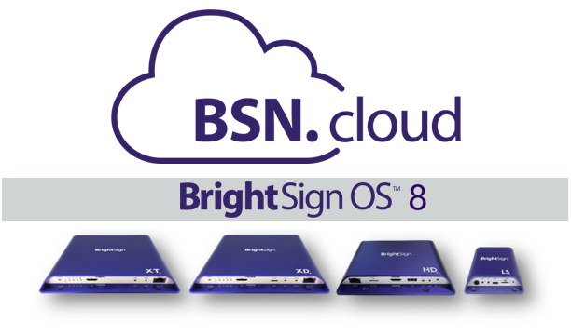
Cloud-Based Players Put you in Control
All BrightSign players include cloud-connectivity for free
BrightSign OS 8 enables the cloud-connected experience on all BrightSign players for real time player access anytime, anywhere
BSN.cloud is an innovative platform that delivers varying levels of player, network & content management services
Notes:
BrightSign has launched a revolutionary new solution that connects BrightSign players to the cloud giving users control over their players for free. BrightSign OS 8 is the required operating system that enables the BSN.cloud platform for a cloud-connected experience on all series 3, series 4 and 4K (top hat) BrightSign players using state-of-the-art web technology. BSN.cloud is the evolution of BrightSign Network, but has been completely rebuilt as a new innovative platform that delivers varying levels of services for player, network and content management to deliver a digital signage solution to meet your needs. The free baseline service that BSN.cloud provides is what delivers the crucial, direct access to real time player health and controls anytime, anywhere.

Slide 3
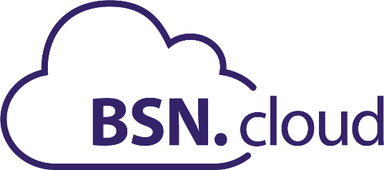
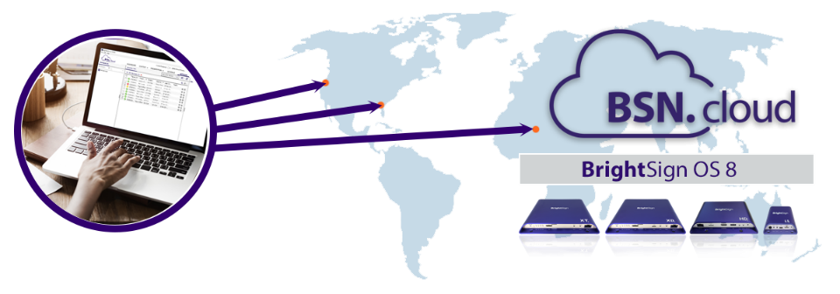
Cloud-based digital signage management
Connects players to the cloud for a total digital signage solution
Innovative platform enabling secure cloud-connectivity on all BrightSign players anytime, anywhere
Varying levels of secure & scalable services from real time player controls to robust network and content management
Begins with free Control Cloud subscription for real time player access and controls with your choice of CMS
Complete set of network and content management tools with the affordable Content Cloud annual subscription
Notes:
The innovative new BSN.cloud platform is uniquely built to elevate secure real time player access with cloud connectivity on all BrightSign players anytime, anywhere while delivering a total signage solution that gives users the power to operate their digital signage network in a way that best meets their needs. The BSN.cloud platform offers varying levels of secure, scalable services for basic to complex digital signage networks to provide a total signage solution that supports small single unit networks to those made up of thousands of players. It all begins with the free Control Cloud subscription that gives access to real time player health, diagnostics and controls at anytime, anywhere. This included level of service is also unique in that it allows you to independently manage your real time player network from your CMS solution. Users also have a choice of selecting the Content Cloud level of service which is an affordable annual subscription with content and network management tools in a cloud connected environment.

Slide 4
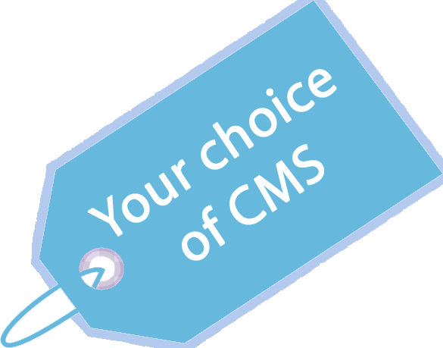
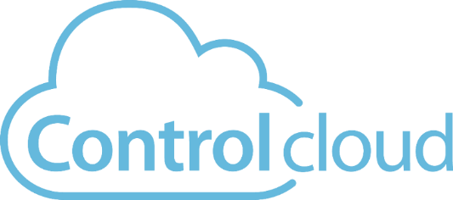

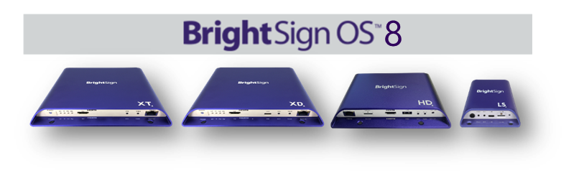
Subscriptions – choose your plan
Cloud-based subscription included with all BrightSign players
Streamlined player setup
Real time player health & controls
Your choice of CMS
Free subscription with player!
Annual subscription
Includes Control Cloud services
Adds a complete set of content & network management tools
Free 30-day trial
Then $99/player/year
Notes:
The BSN.cloud platform offers varying levels of services.
The crucial baseline level of service is the Control Cloud subscription which is included for free on all BrightSign players and truly does put users in control of their digital signage network. It delivers the real time access to player health, diagnostics and controls from any location at any time. Control Cloud also is unique in that it allows you to independently manage your real time player network from your CMS solution, thereby giving users the freedom to select a CMS solution that best meets their needs. Pick from a long list of integrated partner CMS solutions or choose our own BrightAuthor:connected.
The Content Cloud service is offered as an annual subscription and includes all of the Control Cloud services and adds a complete set of content, network management and administrative tools in a secure cloud environment. We offer a free trial for 30-days to experience it yourself and then the cost is $99/per player per year.

Slide 5

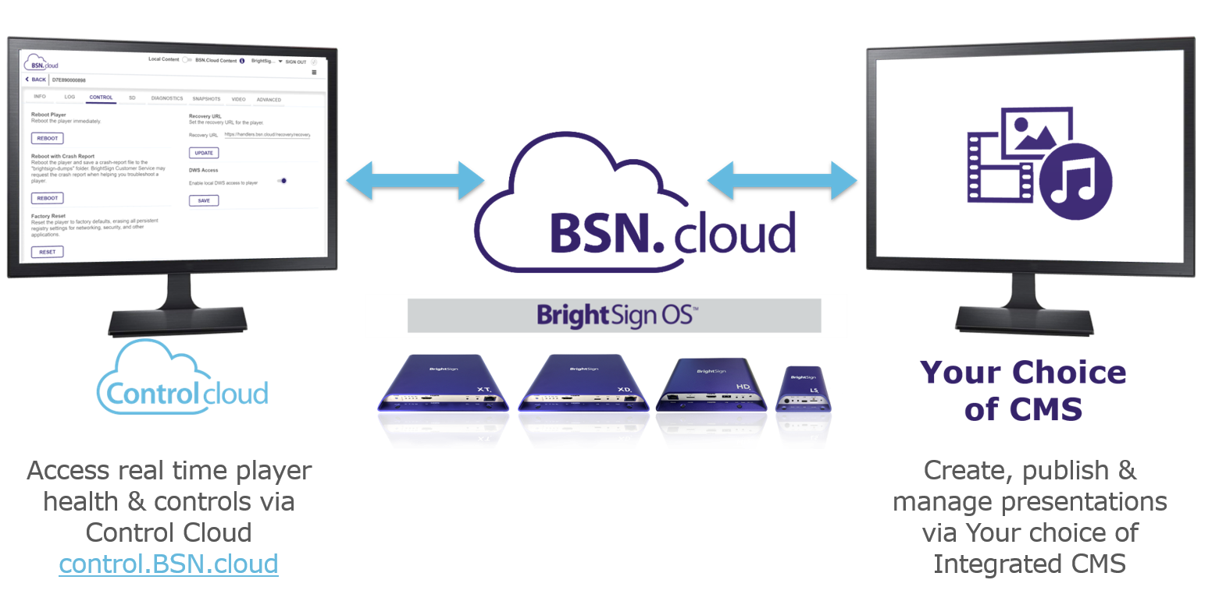
Free BSN.cloud Subscription for all Players
Cooperative digital signage solution offering real time player health & controls independently of your content management solution
control.BSN.cloud
Notes:
As we mentioned, the BSN.cloud platform puts users directly in control of their players and at the included Control Cloud level of service, it also puts users in control of how to operate their digital signage network by offering a cooperative foundation that gives users this unique flexibility. Control Cloud separates real time player health and controls from content management thereby giving users the best of both worlds. Manage your real time player network independently on Control Cloud while also utilizing your choice of CMS to create, publish and manage presentations & your media library.
If we take a look at what the user’s operating environment is in this situation, this diagram shows that the real time player access is accessible vis the BSN.cloud web UI which can be separate from the CMS user solution and user interface. Despite this separation, they still cooperatively run on the BrightSign players.
This secure & scalable Control Cloud service of is included for free on all BrightSign players running BrightSign OS8 and provides 3 main features:
It provides a new streamlined player setup process which easily provisions a BrightSign player for both your Control Cloud account and the integrated CMS of your choice. BrightSign supports a multitude of integrated CMS solutions to choose from - including our own BrightAuthor:connected solution if so desired. The streamlined setup also supports provisioning of single, multi or mass sets of players with ease.
In addition, Control Cloud provides real time access to players anytime, anywhere via the BSN.cloud Web UI. You can view a player’s health & monitor its status, as well as perform real time diagnostics and controls such as applying OS updates and taking snapshots of what’s currently playing on-screen.
At the same time users can create, publish & manage presentations to run on their connected BrightSign players using the CMS of their choice which once again shows how Control Cloud puts users in control of their digital signage solution.

Slide 6
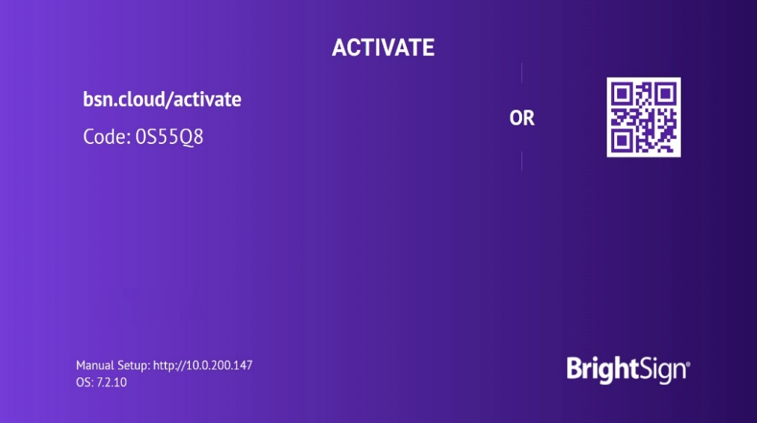

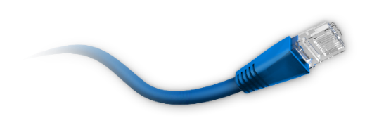

Streamlined setup Features
Easily provision single, multi or mass sets of players
Instantly sign up for a free Control Cloud subscription online
Activate your player following the simple on-screen instructions
  Simply apply power to an Internet connected player with a blank SD card
Easily provision single, multi or mass sets of players
Customize player setup for the CMS of your choice
Notes:
Let’s go into more detail on the major features of the free Control Cloud subscription starting with the Streamlined Setup features. You can instantly sign up for a free Control Cloud subscription online using our Quickstart process that walks you through all the steps. Activating a player is made very easy by following the on-screen instructions after you power up a player that is Internet connected and has a blank SD card installed. Our process is optimized so that you can easily provision not only a single player, but multiple players or even mass sets of players at once. By default, this setup process is configured to support authoring presentations using BrightAuthor:connected however it can easily be customized to connect a player to the integrated CMS of your choice.

Slide 7
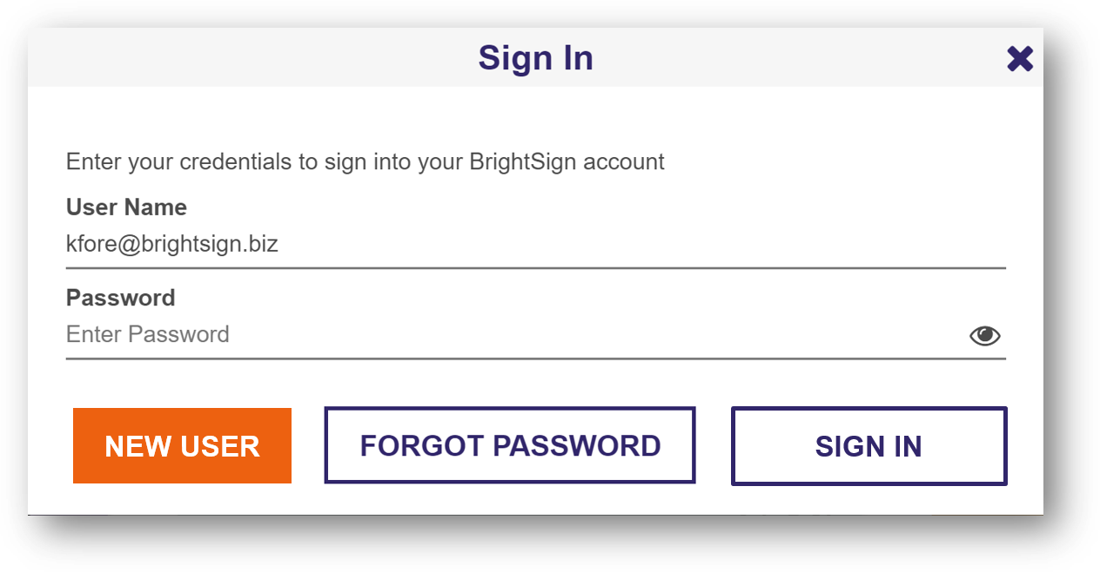
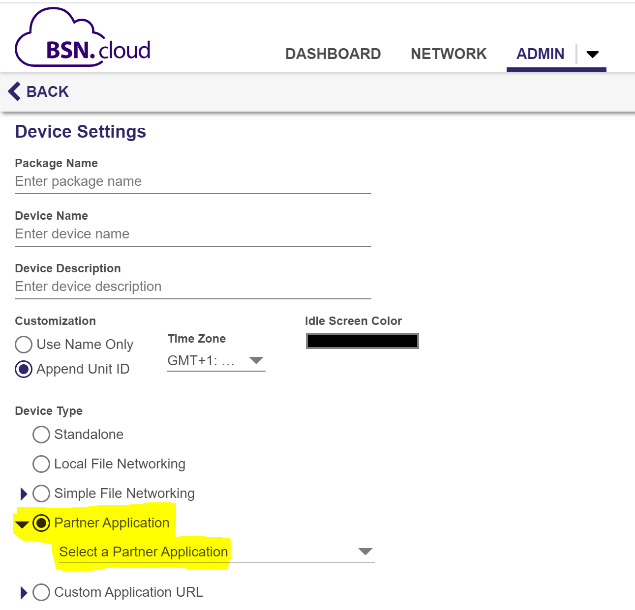
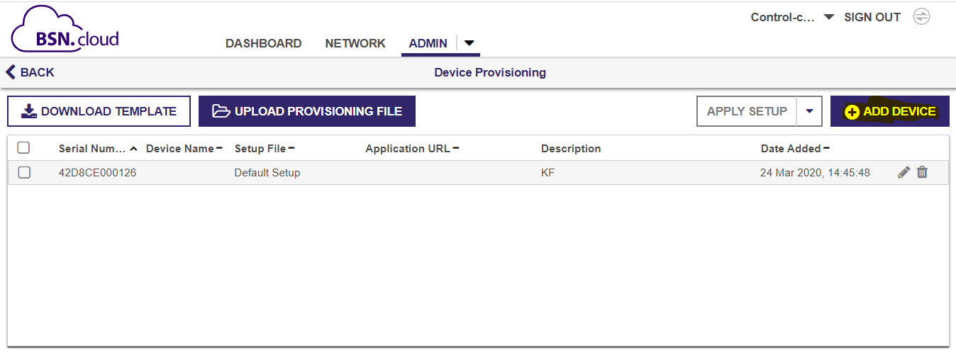
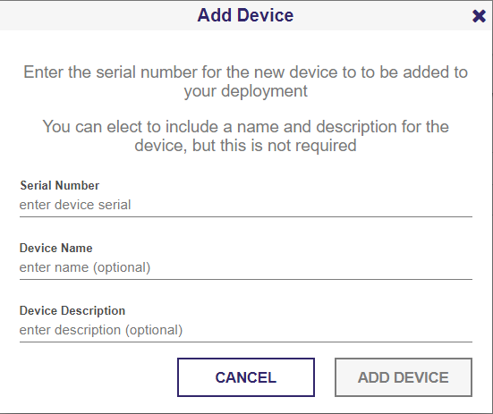
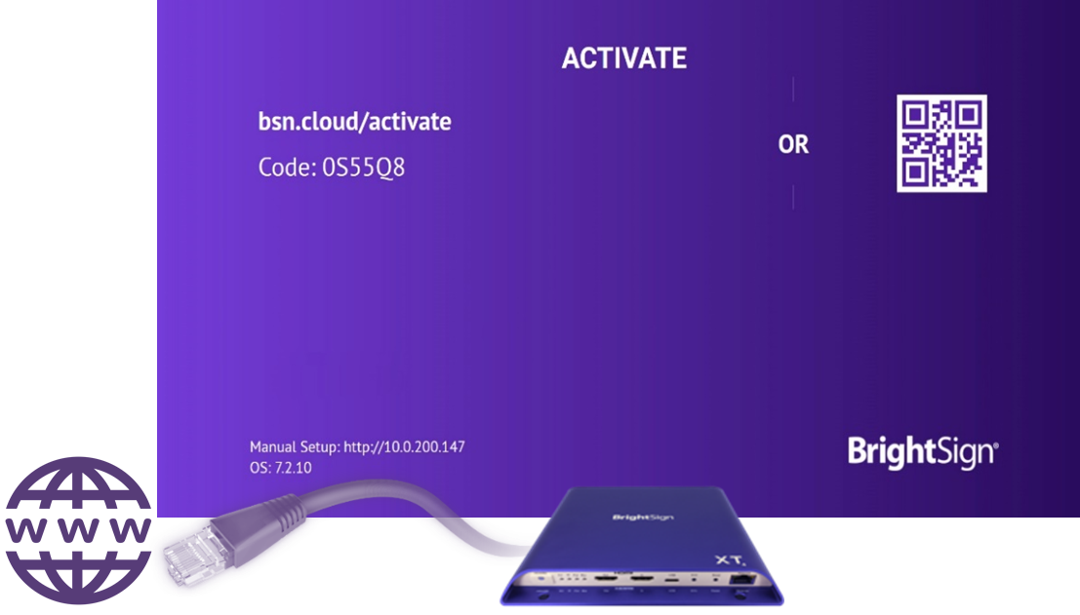
Streamlined setup Process for the CMS of your choice
Sign up for a free Control Cloud subscription at bsn.cloud or control.bsn.cloud selecting New User
Create a Default Device Setup package for the integrated CMS of your choice under the Admin Tab
Add your player(s) serial number to your account under the Device Provisioning section of the Admin Tab
Apply power to your Internet-connected player by with a blank SD card and follow the on-screen instructions to activate it
  This process will first activate your player for your Control Cloud account, and then a secondary CMS partner activation process will begin
1
2
3
4
Notes:
The process to get a player setup for the CMS of your choice is now made super easy and customizable through the Control Cloud Admin tab
Create your free Control Cloud account online at bsn.cloud or control.bsn.cloud by choosing the New User selection. Both websites point to the same BSN.cloud platform, but one is branded as BrightAuthor:connected vs. BSN.cloud (NOTE: control.bsn.cloud also removes the ability to upgrade to Content Cloud under the Admin tab and does not ask you to open the BrightAuthor:connected desktop app when you launch the url)
Next create a custom Device Setup package for the CMS of your choice, by navigating to the Admin section & choosing Device Setup. We currently have 18 integrated CMS partner solutions and counting who take advantage of this efficient and seamless setup feature.
Once you have created your setup package, apply it to your player using the Device Provisioning selection under Admin. The same setup package can be used to mass provision a large set of players for an even more streamlined approach.
Finally apply power to your internet connected BrightSign player with a blank SD card inserted, and follow the on-screen activation instructions which will first link your player to your Control Cloud account & then a secondary activation process will occur for the selected integrated Partner CMS solution. Once all activations are complete, the real time player health and controls are ready to be accessed online at control.bsn.cloud or bsn.cloud & you can publish your first presentation using the CMS you have selected

Slide 8
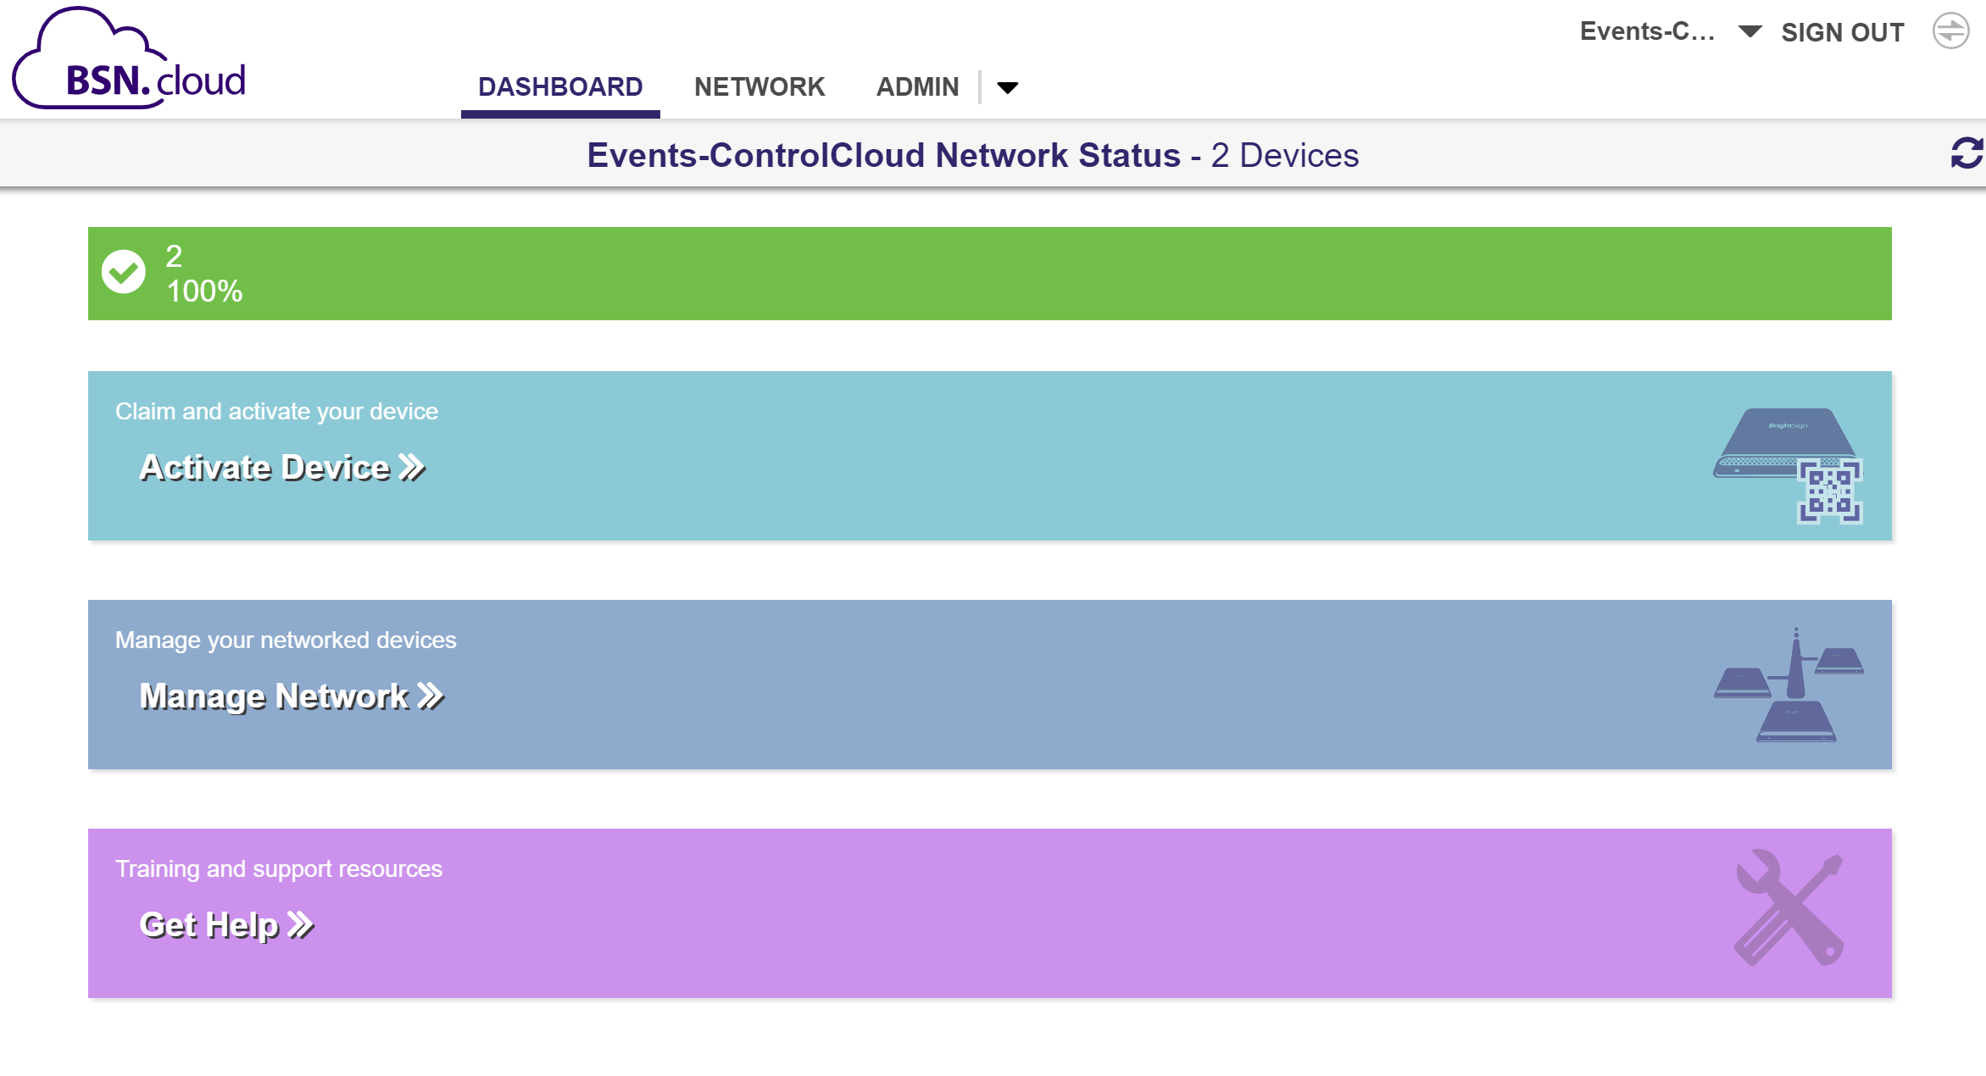
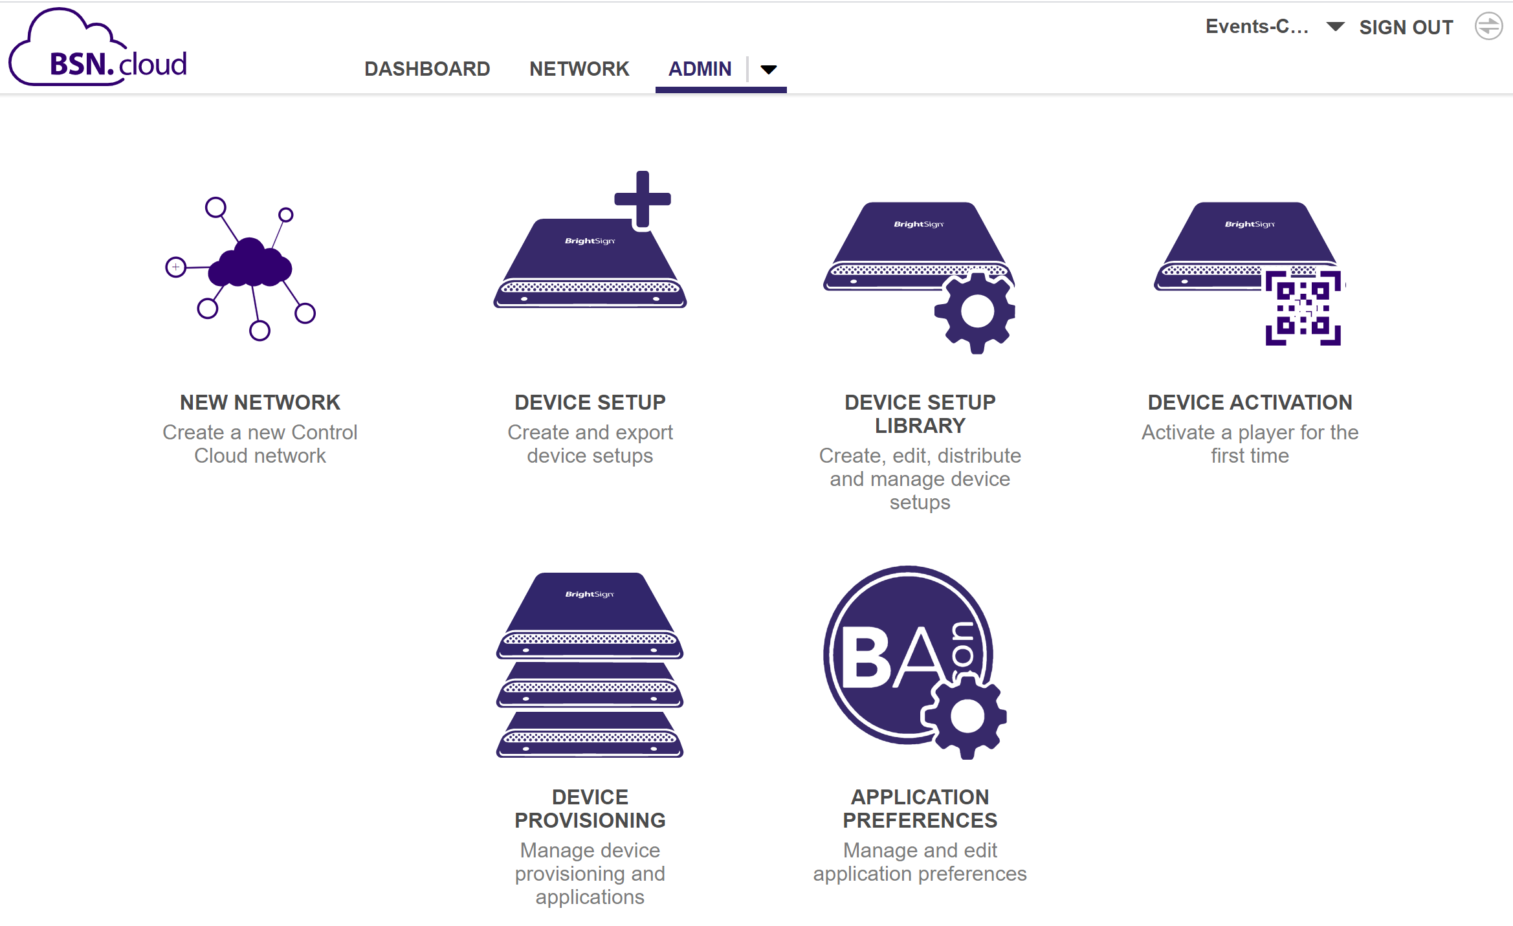
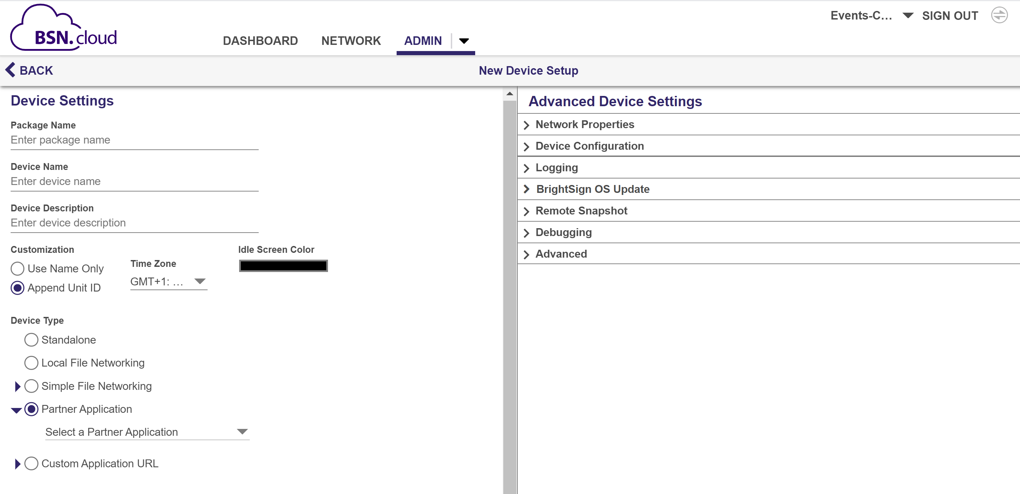
STREAMLINED PLAYER SETUP & ADMIN FUNCTIONS
Notes:
Here’s a closer look at what the user interface to Control Cloud. In the upper left you can see the Control Cloud dashboard which provides a quick look of your real time player health & provides quick access to key functions. On the right is a view of the administrative functions with includes the device setup we talked about. And in the middle we show the settings of that Device Setup function which is showing what’s available to provision a default setup file for an integrated partner CMS.

Slide 9
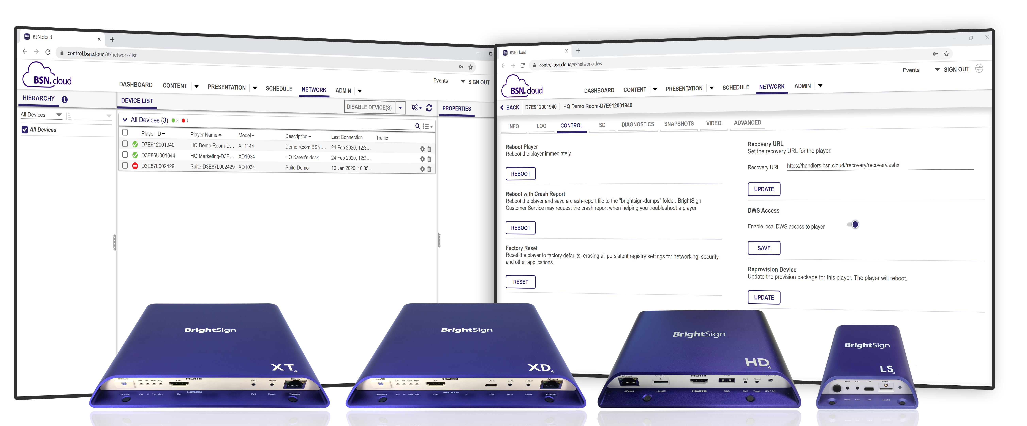
Real time Player access features
Monitor real time player health & control your player from anywhere, anytime
View and monitor real time player health from any location using the BSN.cloud Web UI
Access the remote diagnostic web server to view real time player data & log files & run diagnostics
Control players remotely by performing remote reboots, applying BrightSign OS updates, etc.
Initiate remote snapshots on demand to see what’s playing on-screen at that moment in time
Notes:
Now let’s take a closer look at the real time player features available with Control Cloud.
you can view & monitor player health from any location, at anytime using the BSN.cloud web UI.
You can also access a player’s remote diagnostic web server in real time without being on the same network and from any remote location! This is a huge improvement from our previous player access abilities before BSN.cloud was available. With Control Cloud you now can access detailed information on a player in real time – find out what OS version is running, what the player’s up-time is, the currently playing video resolution, the player IP address and more. You can also access log files and download them as well as run diagnostics to help troubleshoot any issues.
There are also many real time player controls that you can perform such as rebooting a player remotely, applying an updated BrightSign OS version, changing the video resolution playback and more.
And you can even use the Remote Snapshot feature which allows you to initiate an instant screen grab to see what’s playing at that moment in time on the player
The name of the service says it all – Control Cloud truly puts you in control of your player!

Slide 10
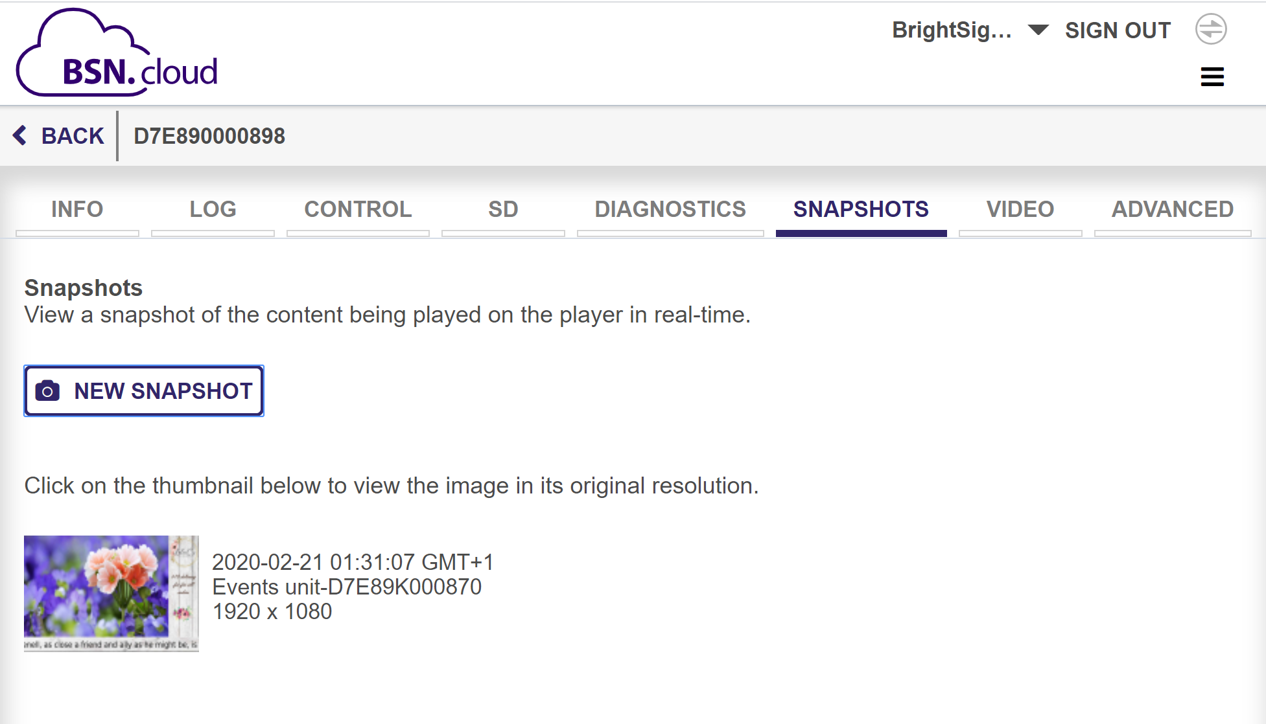
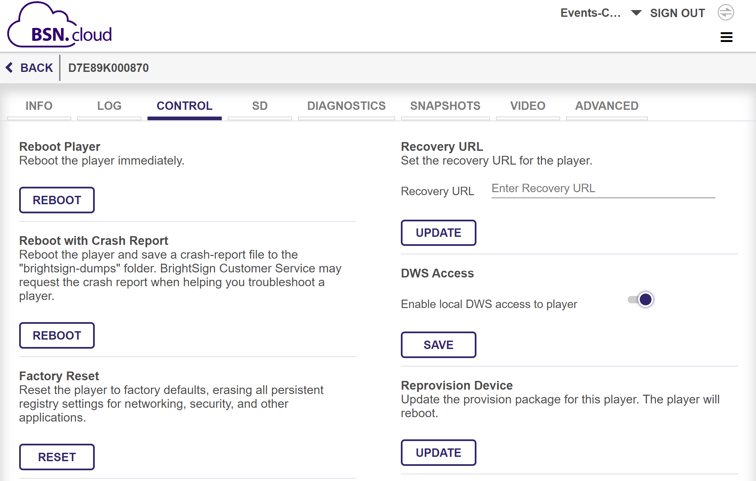
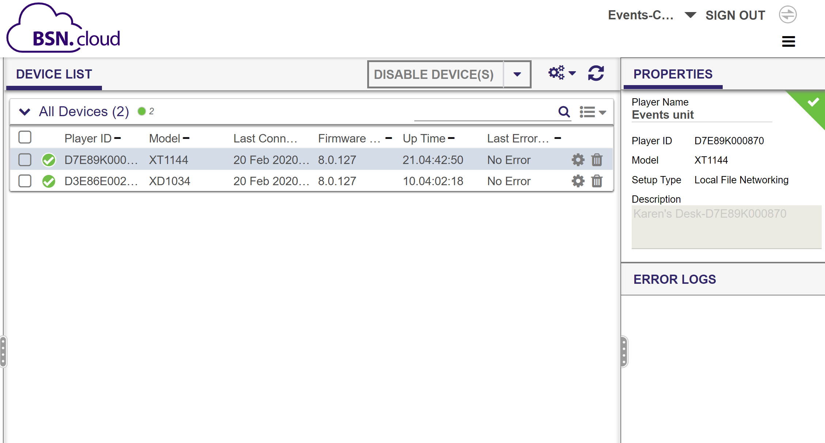
REAL TIME PLAYER HEALTH & CONTROLS
Notes:
Here is a closer look at the user interface for the real time player monitoring and control tools. The middle screenshot shows the player health at that particular moment in time, and if you select the cog icon next to a particular player, you can view its remote diagnostic webserver in real time as shown in the left and right screenshots. The left screenshot shows how you can take a snapshot of what’s playing right now on the player and on the right we have a view of the control functions such as rebooting the player.

Slide 11


YOUR CHOICE OF CMS
Cooperative solution puts you in control of your signage operations
Freedom to choose the integrated CMS that best fits your needs
Streamlined setup incorporates player provisioning for the integrated CMS of your choice
Create, publish & manage presentations to Control Cloud players using your choice of CMS
Supports multiple players connected to a mix of different CMS solutions on a single account
Opens the door to additional integration opportunities via APIs
control.BSN.cloud
Notes:
The third feature of Control Cloud is that you get to choose what CMS solution to use. The BSN.cloud platform uses WebSocket technology to provide the real time player access and controls that Control Cloud offers while also providing open APIs to CMS partners so that they can easily integrate with us at varying levels. Manage your real time player network independently on Control Cloud while also utilizing your choice of CMS to create, publish and manage presentations & your media library. Despite this separation, they still cooperatively run on the BrightSign players.
Integration of CMS partners at the Control Cloud level makes the provisioning process entirely seamless and uncomplicated as it both links the player to a Control Cloud account as well as to the CMS of your choice as we previously discussed. We currently have 18 integrated CMS partner solutions and counting, and a Control Cloud account can even support a fleet of BrightSign players connected to a mix of different CMS solutions for a truly versatile and custom solution. Our APIs even offer a way for our partners to integrate the real time player access and control tools found in Control Cloud within their own CMS user interface if so desired by the CMS partner. In addition, CMS partners can connect their content creation and distribution system to create unique workflows using our API set. BrightSign REST API’s will then issue the web calls so that the CMS partner doesn’t have to build the communications protocol from the cloud to the player.
As you can see there are many benefits to using the innovative new BSN.cloud platform who’s vital Control Cloud level of service truly puts users in control of their players and their digital signage network operation. Together with our integrated CMS partners, we deliver cooperative solutions that fit the varying and unique needs of our users. And it doesn’t stop there - BrightSign is known for continually improving upon and adding new capabilities to our products and services to ensure a highly reliable, best in class solution both now and into the future.

Slide 12


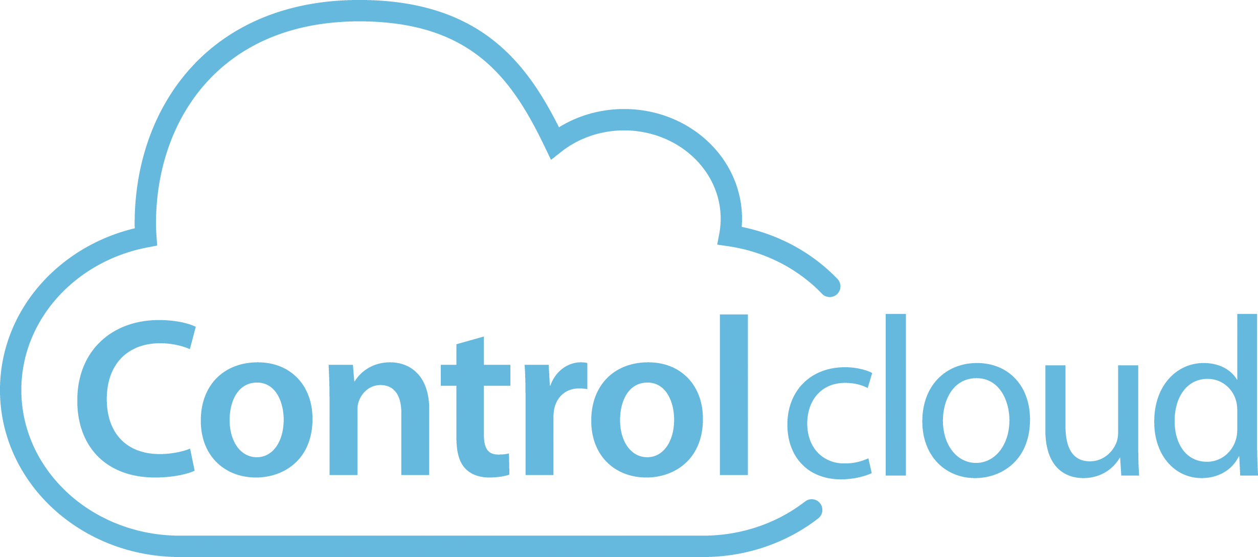
Exceptional Content & Network Management
Complete set of content & network management tools in a secure cloud environment
Includes real time player access and controls within Control Cloud
Adds exceptional content and network management tools
Provides an scalable, robust & secure cloud environment
Utilizes our BrightAuthor:connected as the primary CMS with a PC, MAC & web unified interface & workflow
Delivers a flawless experience to operate your BrightSign digital signage network with confidence
APIs for partners to build custom HTML applications
Notes:
The highest level of service the BSN.cloud platform offers is the Content Cloud annual subscription. Content cloud includes all that Control Cloud offers and adds exceptional Content and Network Management features and tools in a secure cloud environment that is scalable & robust. BrightAuthor:connected is the CMS solution for this subscription which is fully integrated with the BSN.cloud platform to deliver a seamless workflow of accessing real time player health & controls as well as presentation authoring, content management and network management tools. It is available as PC & MAC desktop applications and as a web UI via a Chrome browser, all of which have a unified workflow and interface to make our experience seamless regardless of which application you use. With Content Cloud you can operate your network flawlessly and with the utmost confidence that you are used to with our BrightSign players. In addition, BrightSign also offers APIs that our partners can take advantage of to build custom HTML applications such as wayfinders, digital concierge displays, and much more.

Slide 13
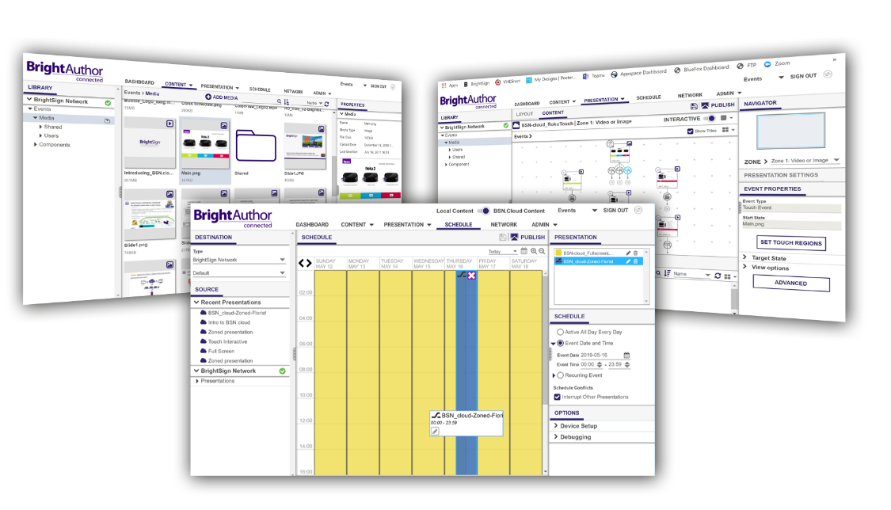
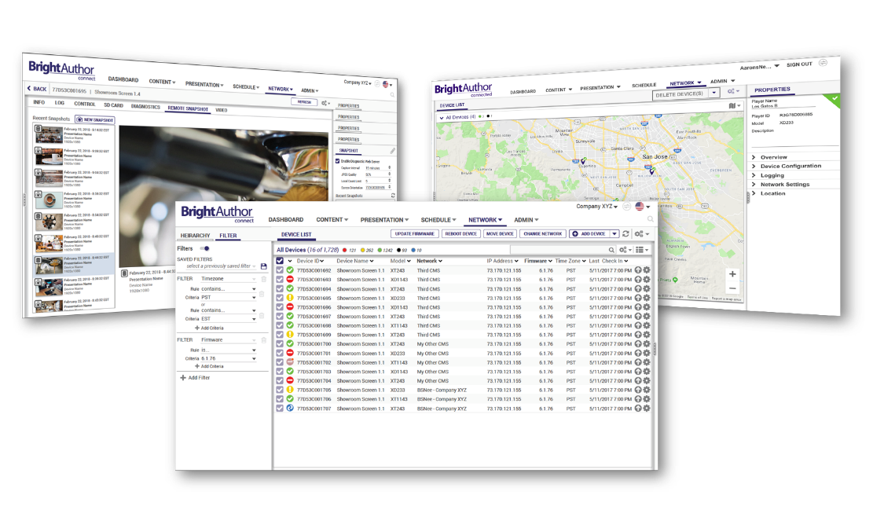


Exceptional Content & Network Management
Content Management
Host & manage your content library in the cloud
Authoring tools for simple to sophisticated presentations
Schedule, publish and manage content distribution
Update what’s playing anywhere, anytime
Network Management
Securely manage one player or tens-of-thousands
View player data over time and get detailed reporting
Push email notifications about player health, etc.
Organize players by groups or map locations
Notes:
Control Cloud offers both Content and Network Management features and tools in a secure cloud environment. For Content Management, this service operates totally in the cloud including your media library, content feeds, presentation management, scheduling and content distribution tools, and uses our BrightAuthor:connected application as the primary CMS. In terms of the network management tool, this service supports grouping players into network groups for mass content distribution and player management. It also collects and stores data about performance measures that are important to network managers. It also supports proof of play for the DOOH market, player performance and health, remote snapshot data over time. The administrative functions also push out email notifications about issues that are important to network managers such as a subscription that is about to expire, players that are reporting errors, etc…

Slide 14
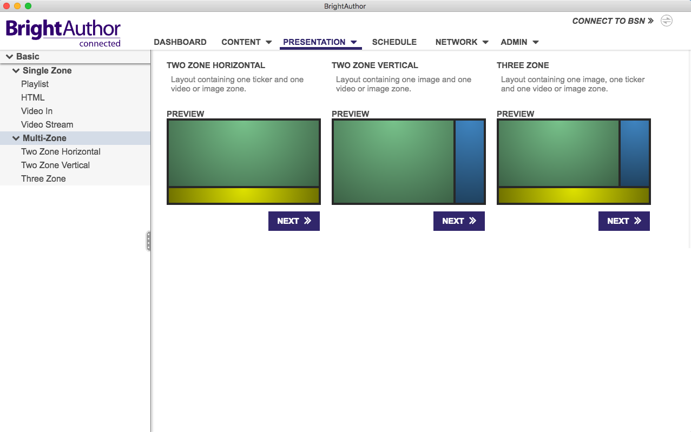
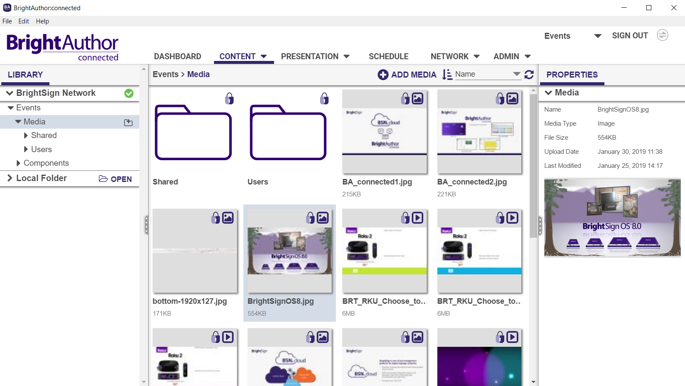
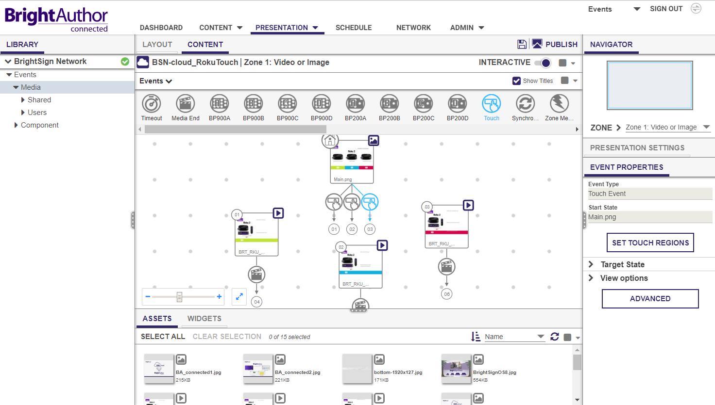
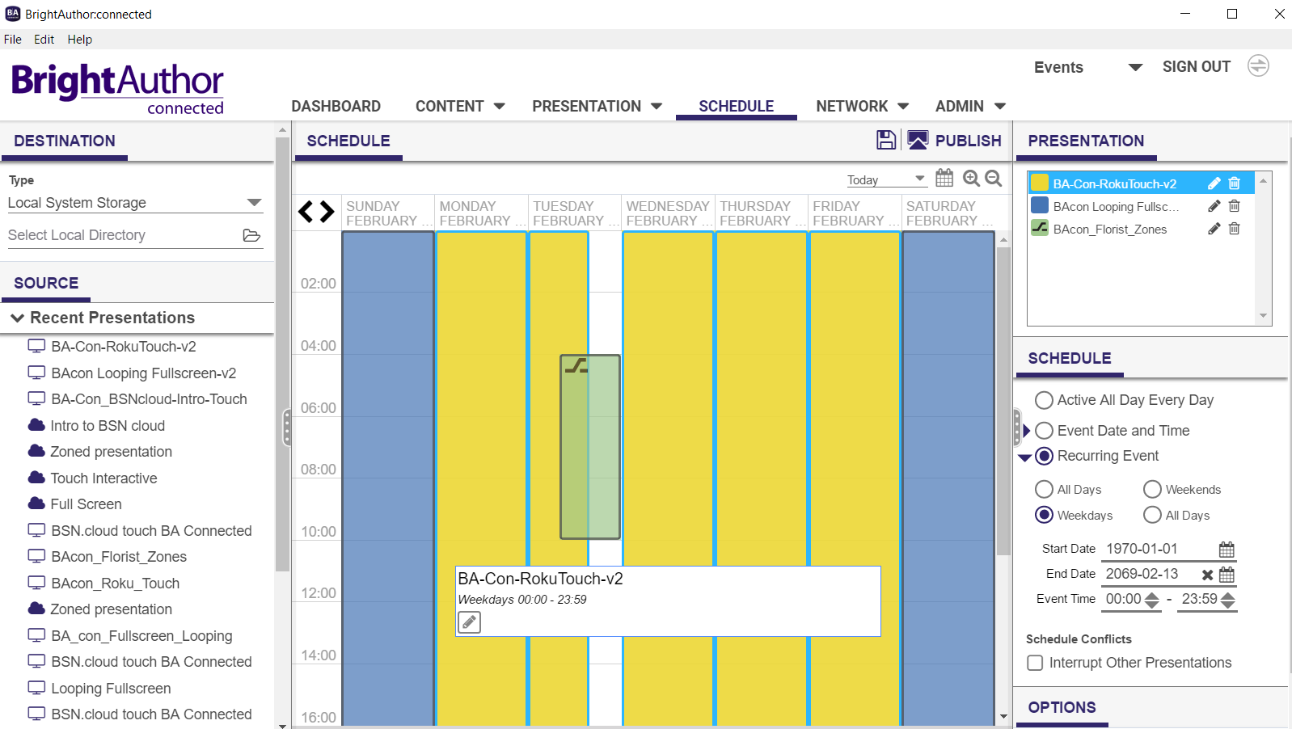
Content Cloud: Content Management
Notes:
Here’s a look at some of the Content Cloud functionality within BrightAuthor:connected.
The first one is a look at just some of the presentation templates available to choose from to build your digital sign presentation. In Content Cloud, all presentations are stored in your BSN.cloud account.
Next we have a look at a content library in Content Cloud. You can see and sort photos from videos and add new media and otherwise manage your content library in the cloud
Here we have a look at a touch interactive presentation using the content assets in Content Cloud.
And finally here’s a look at the presentation scheduling via Content Cloud showing one presentation scheduled for the weekends a different one for week days and an interruption in playback of a 3rd presentations at a particular day and time.

Slide 15
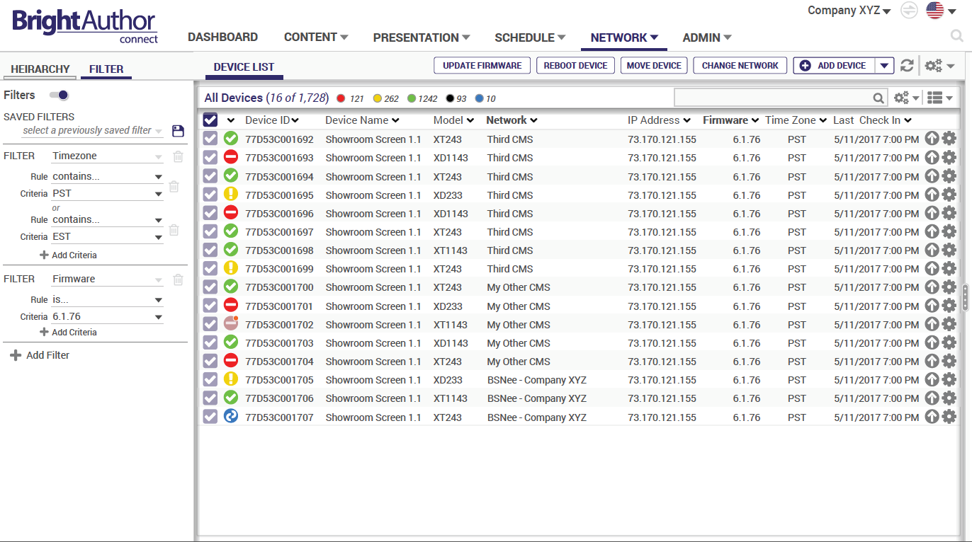
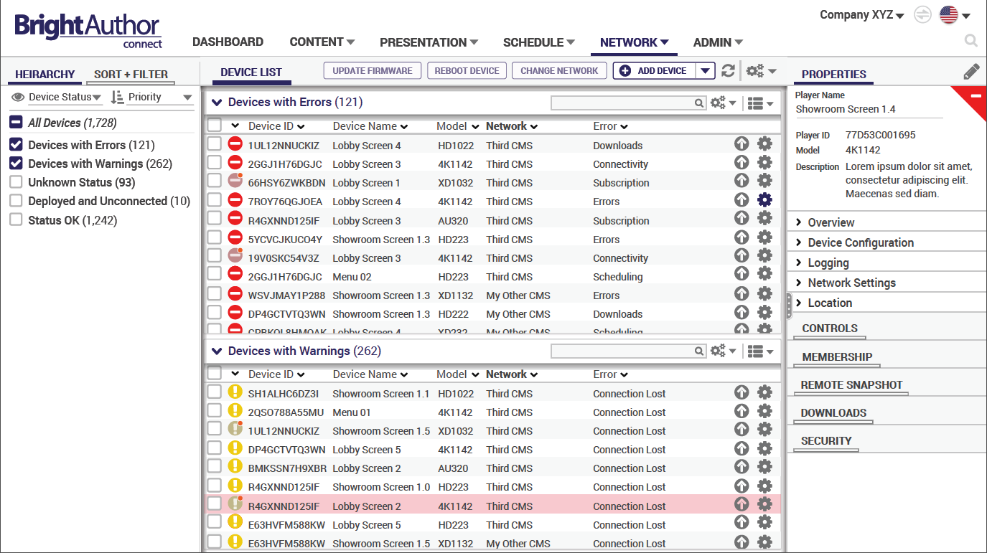
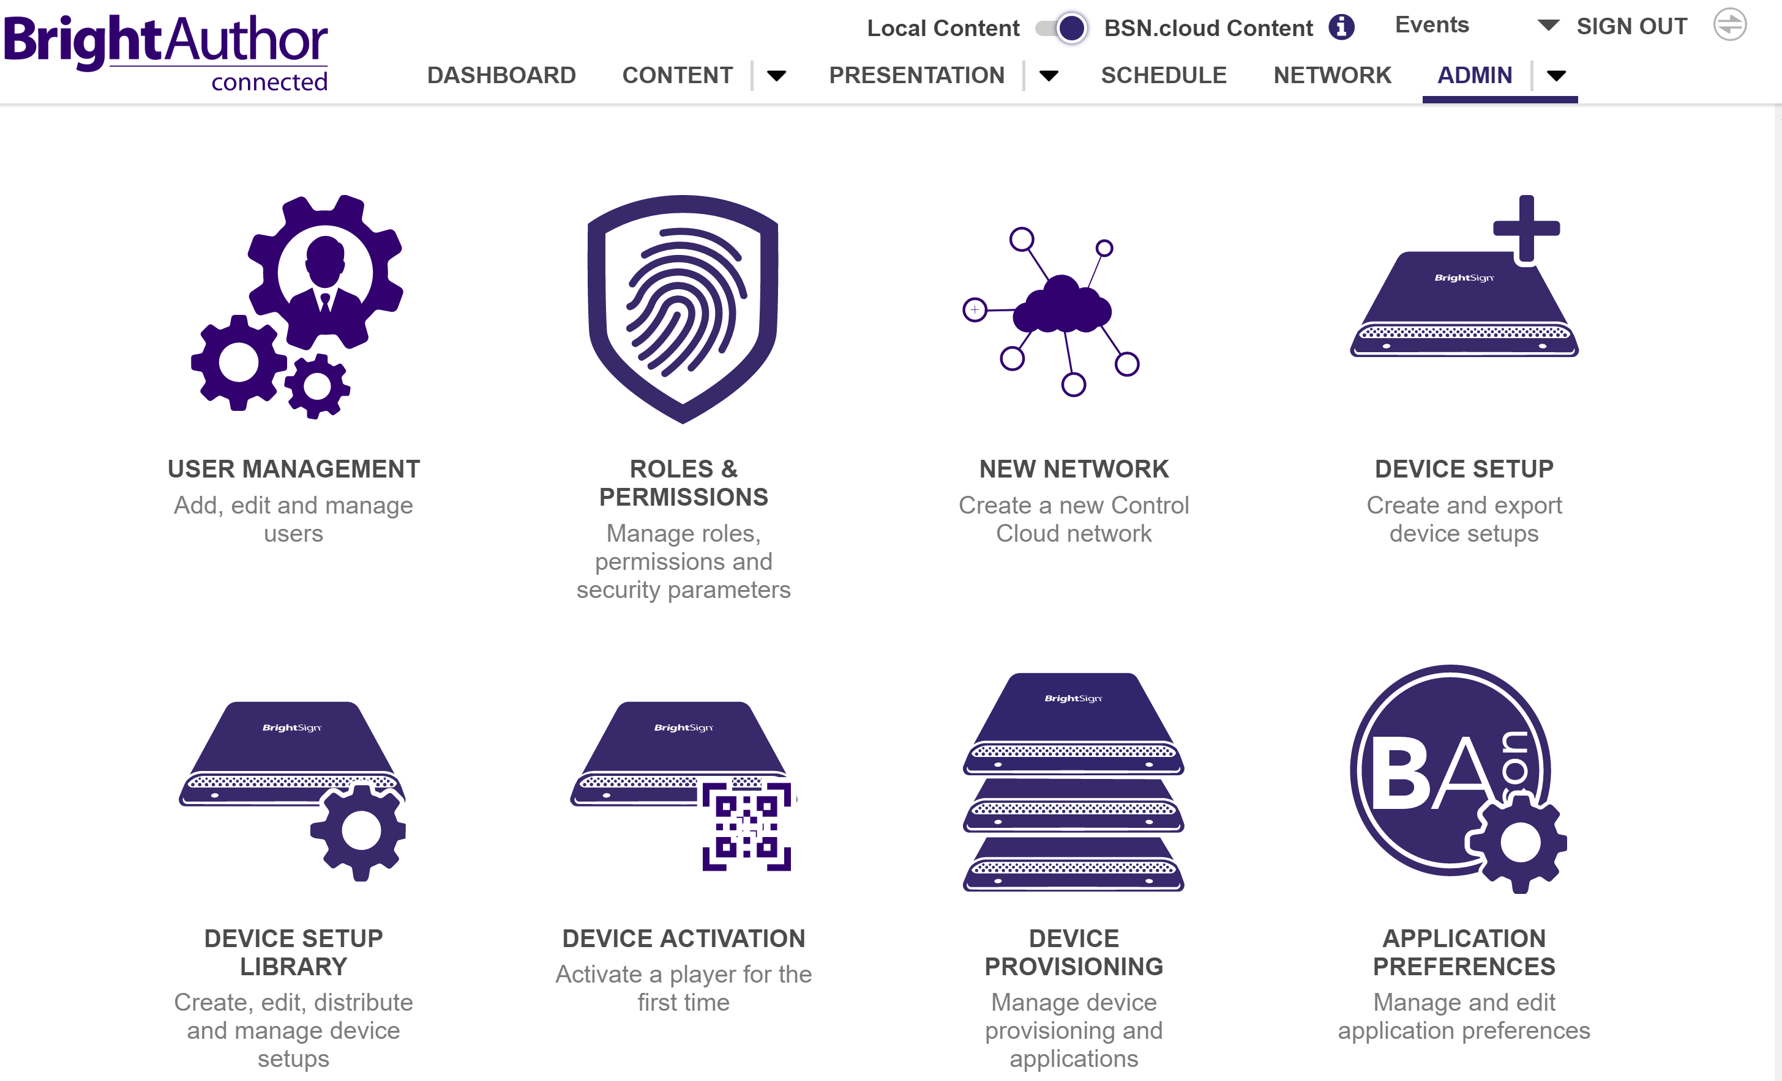
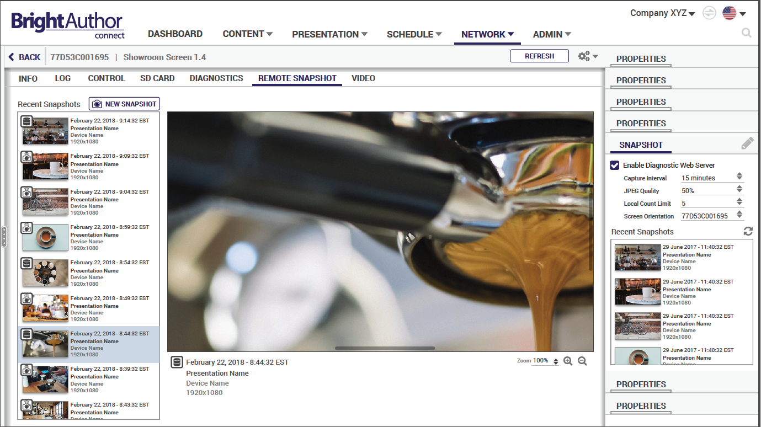
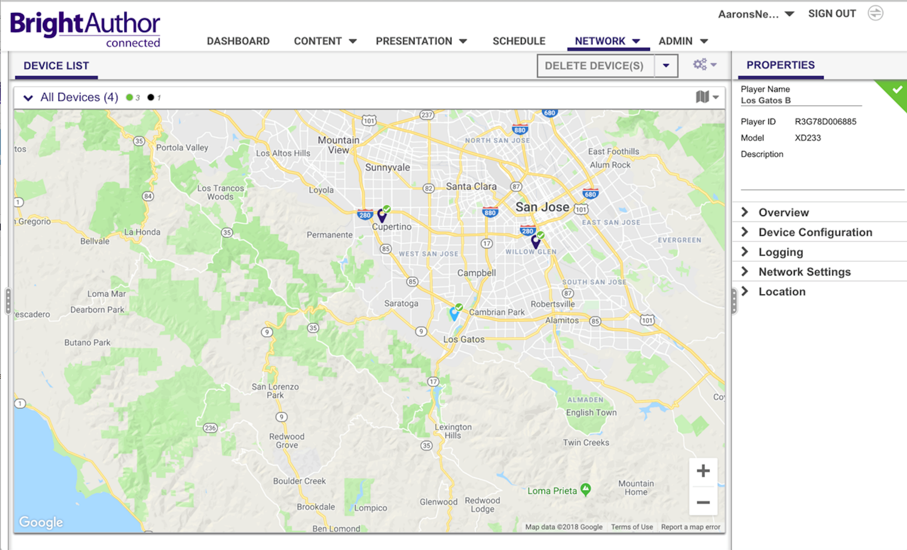
Content Cloud: Network Management
Notes:
These are just a few of the snapshots of what the Content Cloud network management service provides and will look like via BrightAuthor:connected.
You can view all connected devices and apply filters and sort for easy player management and a look at real-time player status.
Next you can look at player Hierarchy of devices with errors or warnings and view logs and data over time.
Here you can view the player locations on a map
and finally, here’s a look at Remote Snapshots culminated over time which is supported only in the Management Cloud.

Slide 16
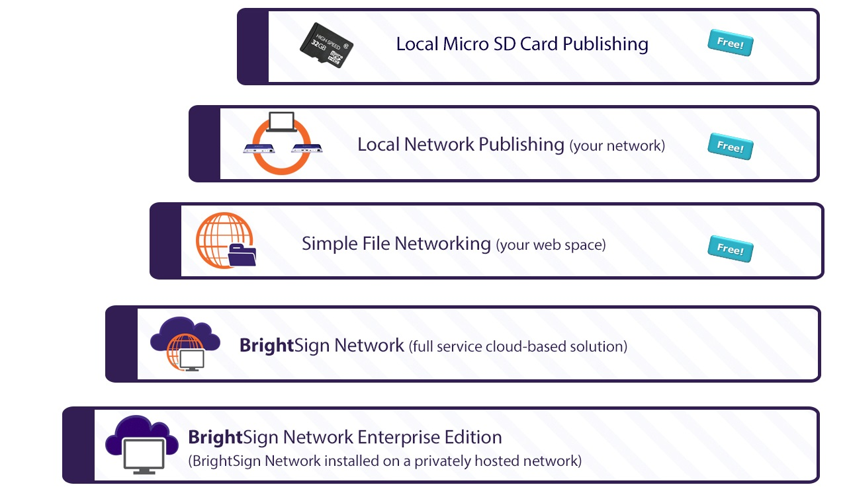
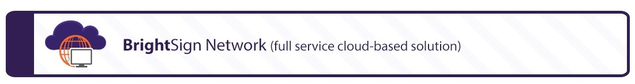



Networking solutions
Versatile solutions to meet any need
Real time player health and control subscription
Cloud-based content and network management subscription

Slide 17

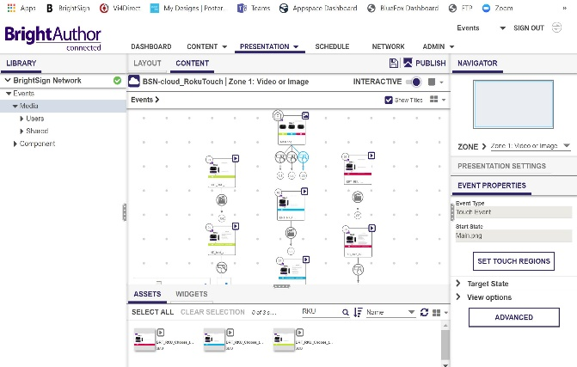

application
Available on PC, Mac and a Chrome browser
Free CMS solution with a universal interface and feature set available across the PC & Mac desktop applications and a Chrome web browser
Uses locally stored (Control Cloud) or cloud-hosted (Content Cloud) content to create looping and interactive playlists
Supports industry standard content formats for video, images, audio, HTML5, IP streams, live feeds, Live TV, Live Text, & more
Build simple looping to multi-zoned and sophisticated presentations using intuitive tools
Apply interactive events to trigger playback, from touch and button presses to UDP and zone messages to create rich, engaging experiences
Schedule & publish presentations with confidence via:
  Free Local storage publishing to a micro SD card
  Free Local network publishing
  Free Simple file network publishing
  Fee-based BSN.cloud publishing
Notes:
BrightAuthor:connected is our authoring software application that allows you to easily create, publish and manage digital signage presentations that run flawlessly on BrightSign players. It offers an enhanced and unified BrightSign experience with a common user interface, workflow and feature set available for PC, Mac and a Chrome web browser. BrightAuthor:connected offers an intuitive environment to create impactful presentations while adding the ability to securely connect to BSN.cloud enabled players to take advantage of new real time player controls as well as robust network and content management tools. Experience BrightAuthor:connected is offered at a free CMS solution for Control Cloud subscriptions & adds cloud-based content management tools in Content Cloud.

Slide 18


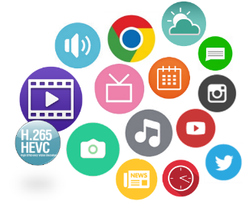

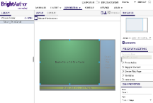
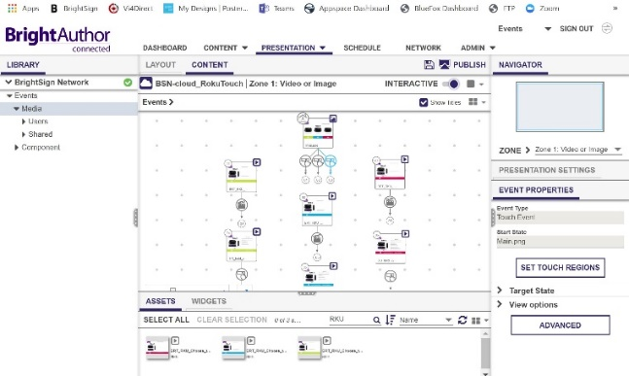
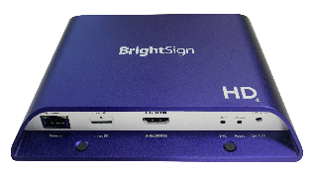
Presentation Creation Process
Simple process to author, schedule & publish presentations
Content
Prolific content types
supported and stored
locally for Control Cloud
or in your Content Cloud library
Author
Easily create, preview, schedule and publish presentations using a vast array of simple to sophisticated features
locally for Control Cloud or in your Content Cloud
account depending on your network environment
Play
Confidently play presentations, access real time player health & controls, and manage your content & network
Notes:
This diagram shows the process for creating, publishing and playing presentations on our BSN.cloud platform using BrightAuthor:connected. Since a Control Cloud subscription is included with every player, if you use BrightAuthor:connected as your CMS, authoring and publishing presentations are done locally using the PC or MAC desktop versions of BrightAuthor:connected. And you can take advantage of the real time player controls in a cloud-connected environment using the same desktop application or the Web UI at bsn.cloud.
Content Cloud subscribers soley use BrightAuthor:connected as the CMS of choice and it operates in a fully cloud-connected environment that host content media libraries as well as supports authoring, scheduling & publishing presentations in the cloud so you can work from any location at anytime. The BrightAuthor:connected workflow process in general is the same regardless of the level of service where you take content, author presentations and publish them to players using various player connected methods that meet your network environment & level of BSN.cloud service.

Slide 19
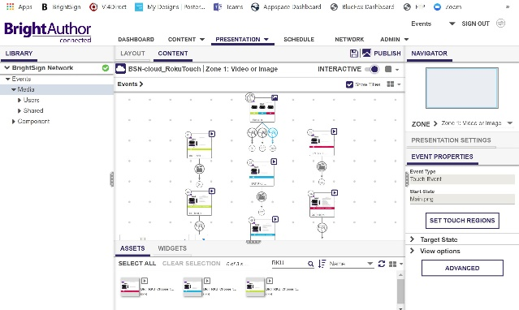
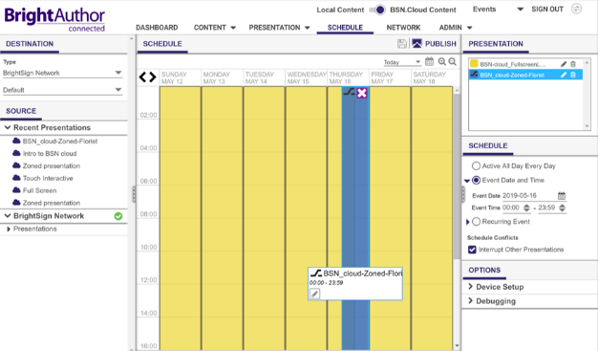

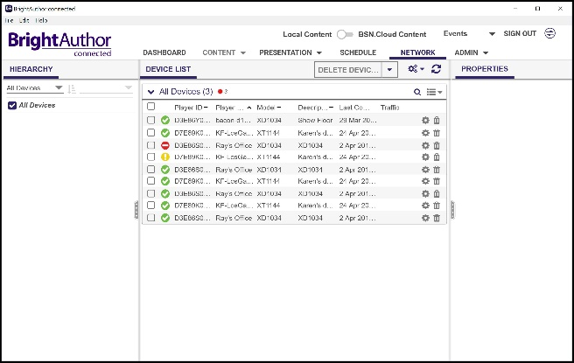
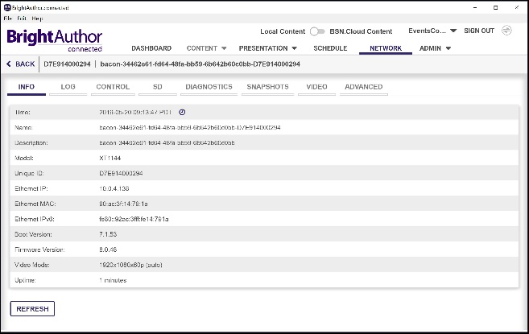
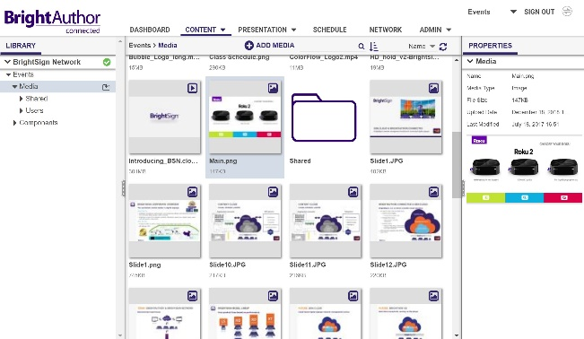
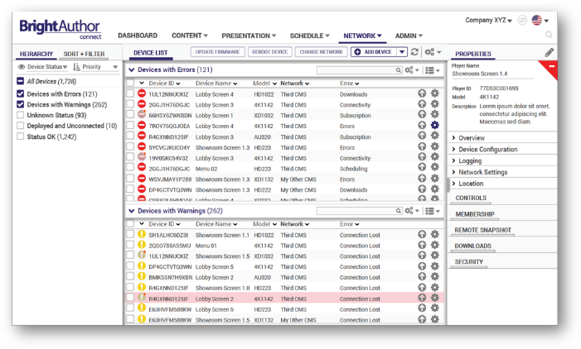
Workflow
Simple steps to author, play and control your signage
Author. Easily create presentation layouts & playlists for simple to sophisticated digital signs
Publish & Play. Use the intuitive calendar view to schedule & publish your presentations
Real Time Control. Securely access connected players to view real time health and control the player with a Control Cloud subscription
Manage. Manage, administer and monitor content, presentations, player groups & data over time with a Content Cloud subscription
Notes:
Author. Easily create presentation layouts & playlists for simple to sophisticated digital signs using content in your media library hosted on BSN.cloud or stored locally. BrightAuthor:connected supports a prolific array of content types and formats with unified experience, feature set and work ow for PC, Mac and a Chrome browser interface so you can work wherever and whenever with ease.
Publish & Play. Take the guess work out of playing your presentations on BrightSign. BrightAuthor:connected provides an intuitive calendar-view to easily schedule and daypart your presentation playback. Publishing your content is an automated process that packages up your content, playlist and controls to deliver flawless playback via your network connection of choice or as a standalone presentation
Real Time Control. Use BrightAuthor:connected to securely access, control and communicate in real time with cloud-based players from any remote location for free with Control Cloud. Get real time player health and access to the diagnostic web server to control players by performing remote reboots & deploying BrightSign OS updates. You can even initiate remote snapshots on demand to see what’s playing on-screen.
Manage. Network managers with Content Cloud subscriptions can remotely view compiled performance data over time including event logs and proof of play via reports, filters and queries. Access to a set of robust network management and administration tools are also available such as mapping player locations, network grouping, and email notifications to bring attention to specific network activities and subscription status.

Slide 20

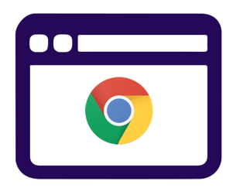

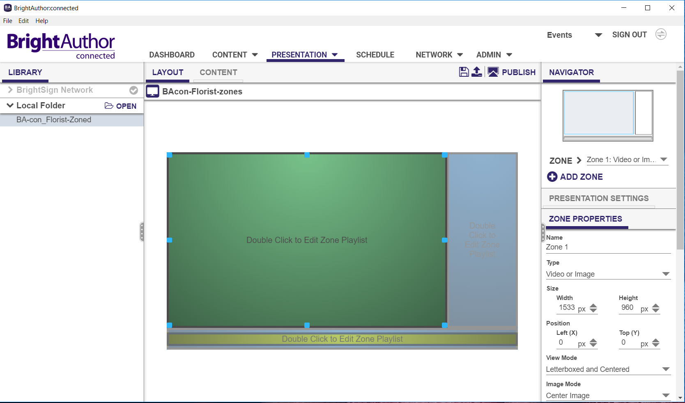
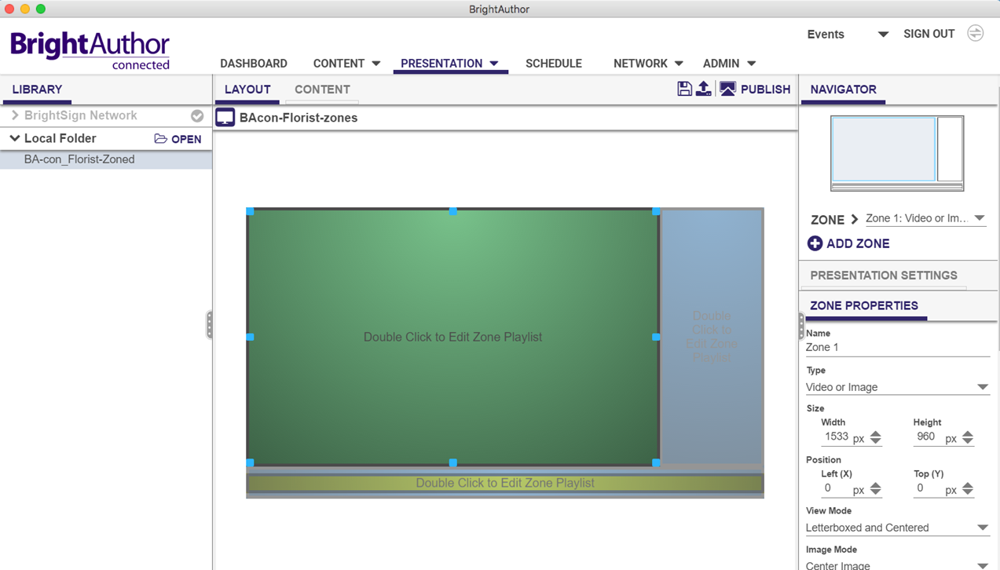
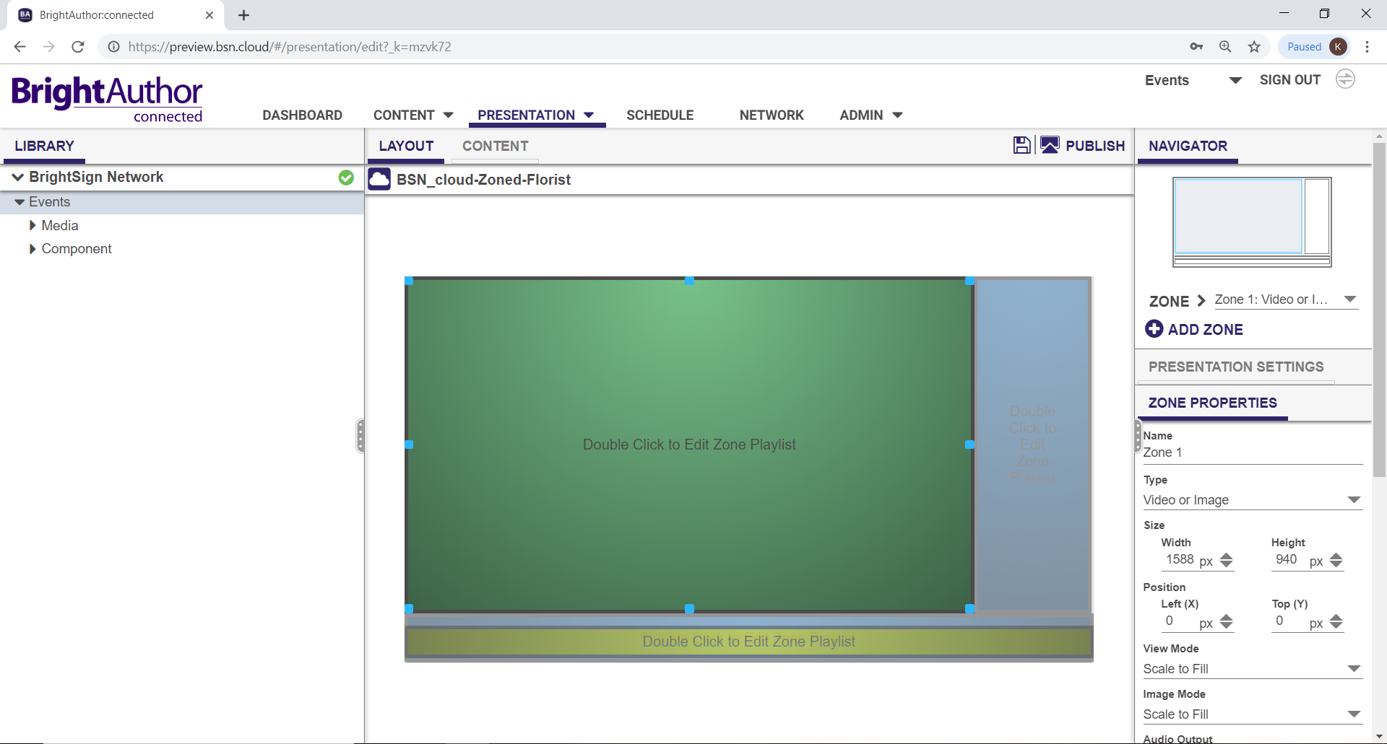
Provides a Unified Experience
Common feature set, workflow and interface across each application
PC Desktop App Web App MAC Desktop App

Slide 21
Thank you!

