Slide 1
Covid-19 solutions
BrightSign solutions for touchless interactivity and social distancing
June 15, 2020

Slide 2
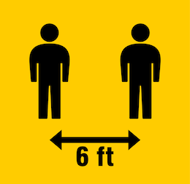
Out-of-home Engagement is changing
BrightSign’s solutions help businesses operate safely
Our new normal includes contact free interactions which changes how people interact with displays
BrightSign offers several social distancing & touchless engagement solutions to create a safe environments for customers & employees alike
Notes:
Our new normal is different but achievable with BrightSign’s new touchless control solutions the engage customers in a safe, hygienic way.

Slide 3
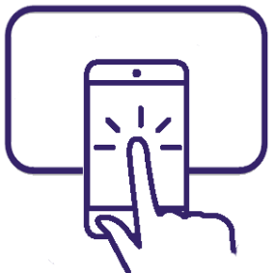
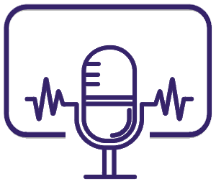
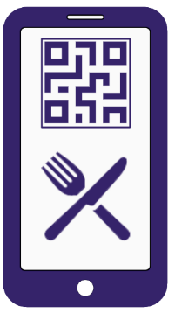
BrightSign covid-19 Solutions
Solutions to help businesses operate during the Pandemic
Phone assisted touchless engagement
Link to & control a display using a phone - no app or internet needed
Voice activated touchless engagement
Delivers a unique hands-free interactive experience
Phone assisted touchless menus
Eliminate the risk of sharing menus by simply scanning a QR code to view on your phone
Measure real time occupancy & trigger signage
Count people by sensing smartphones & trigger signage - no app or beacon needed
Notes:
Our new normal is different but achievable with BrightSign’s new touchless control solutions the engage customers in a safe, hygienic way.

Slide 4
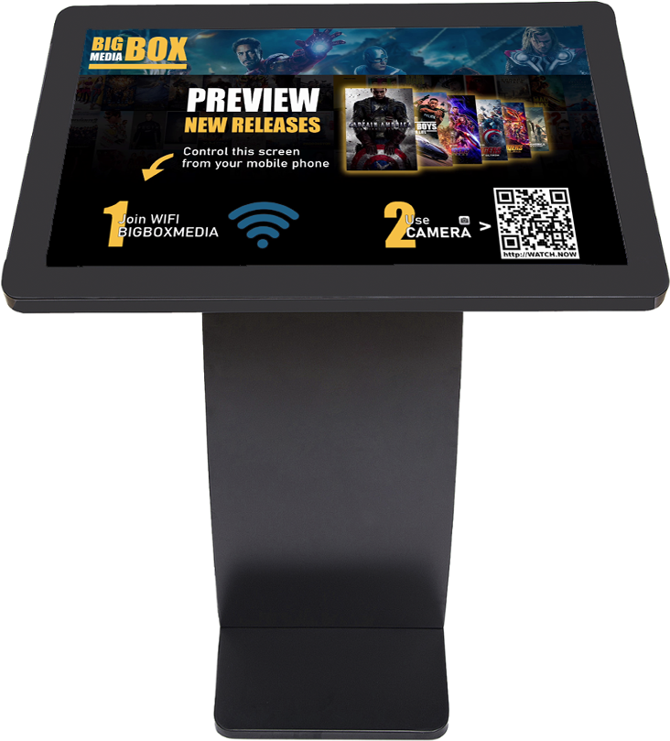
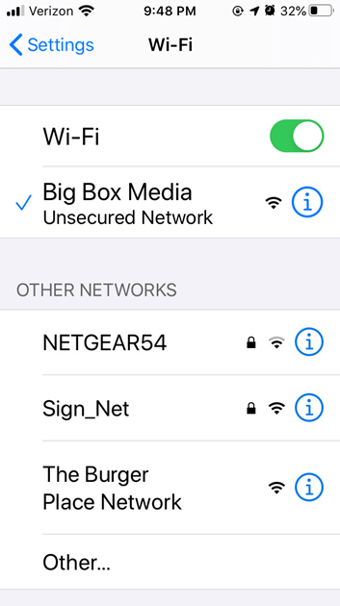
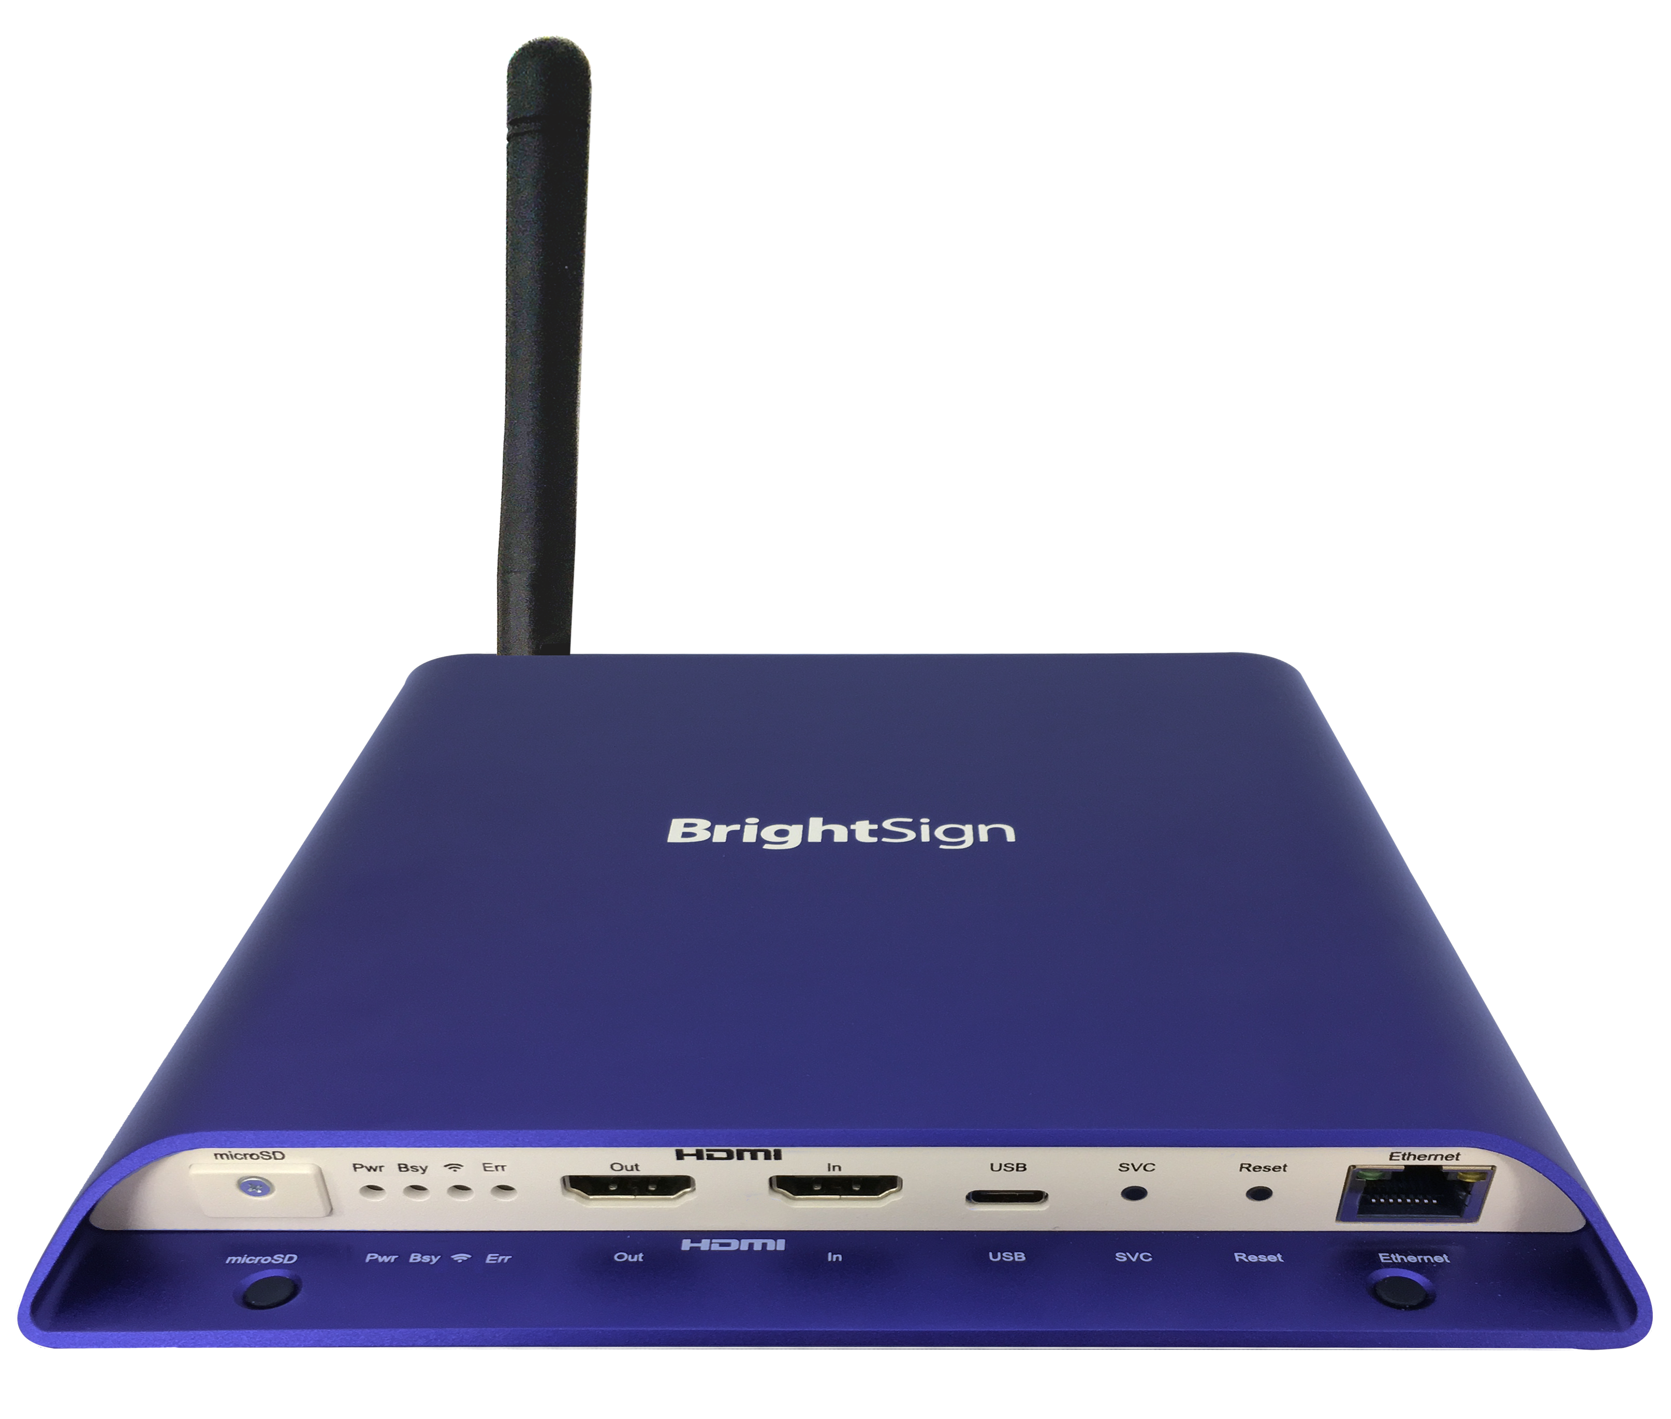
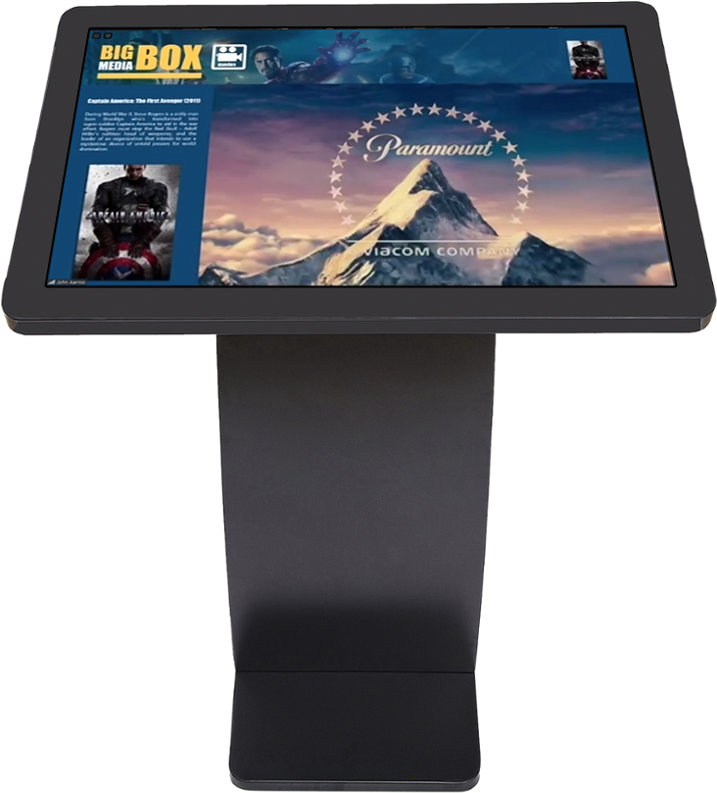
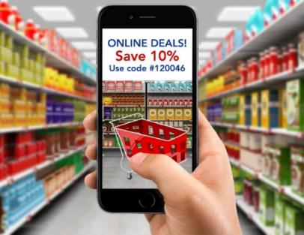
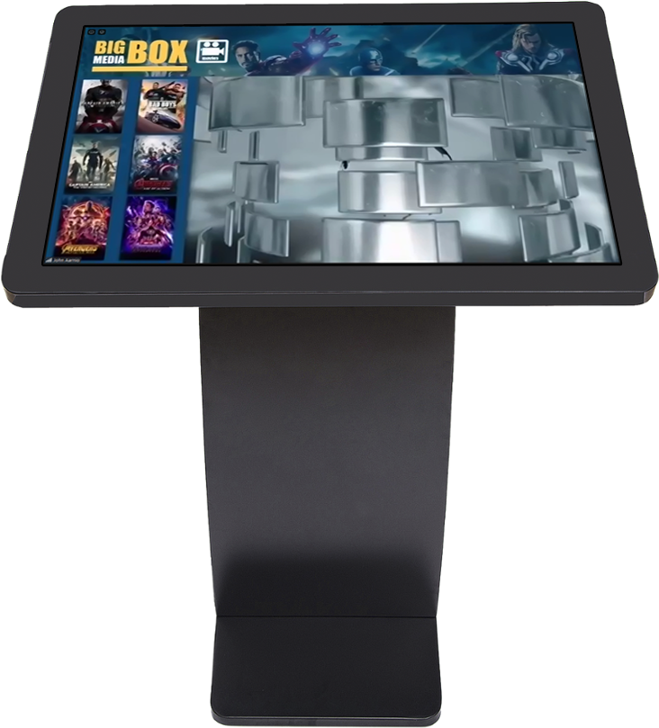
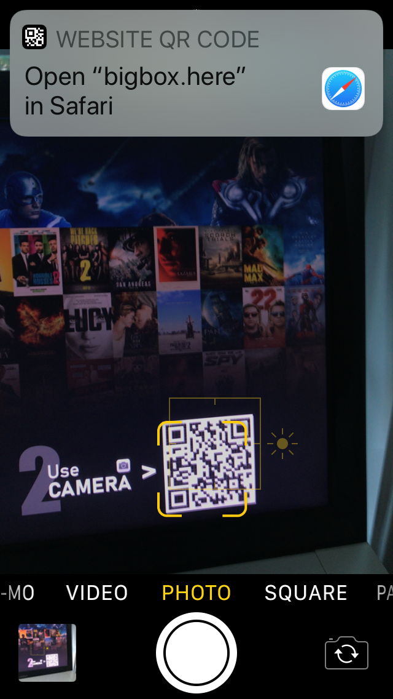
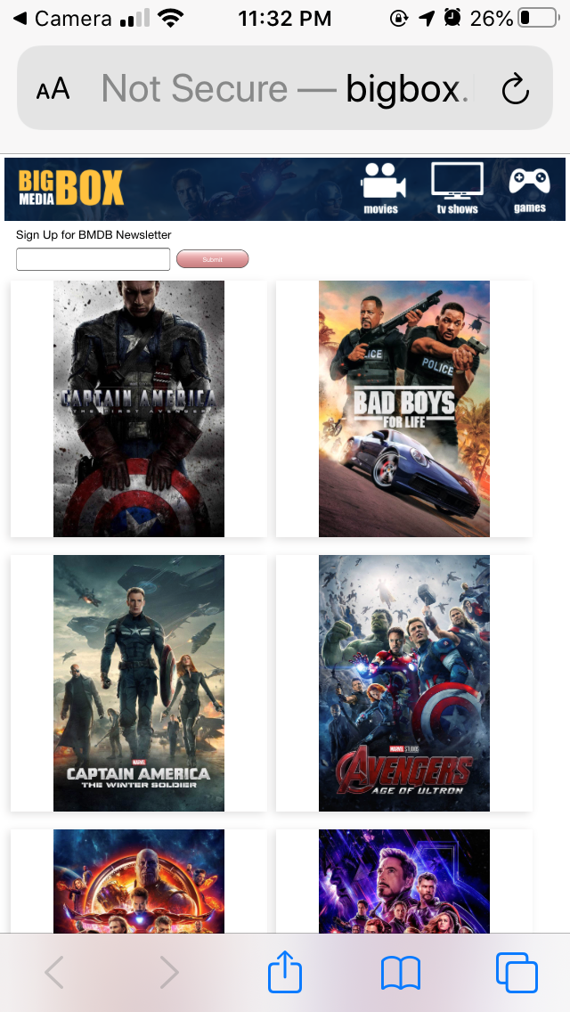
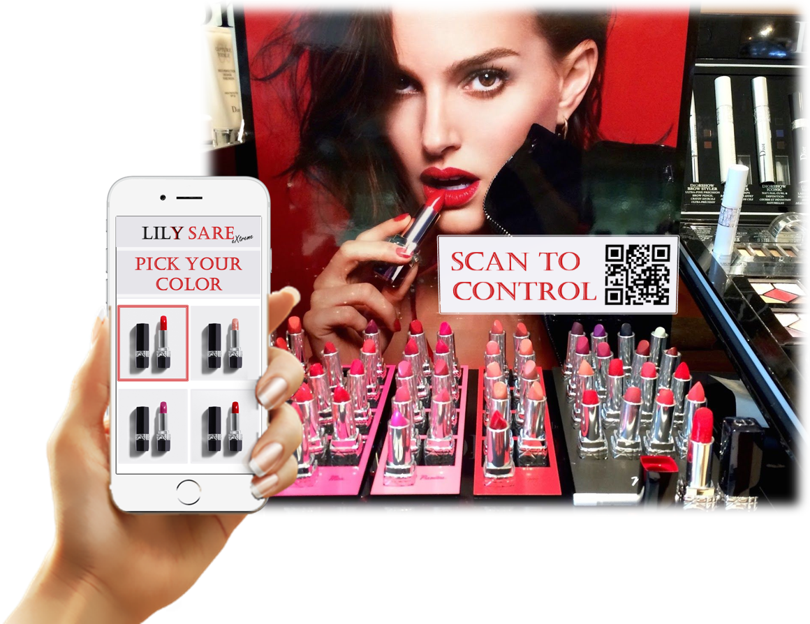
Join the Wi-Fi Network
Phone assisted touchless engagement
Links any phone to your signage for touchless engagement without internet or an app
Displays your content in a linked phone’s browser, making it a viewable digital sign or a sign controller
Provides an affordable, turnkey solution with a BrightSign player, an installed wireless module & your custom content
Uses proven BrightSign technology that can easily be deployed for new and existing installations with confidence
Scan the QR code & control the kiosk
1-way engagement: Makes your phone the digital sign – screen is optional!
2-way engagement: Turns your phone into a remote control to safely engage with interactive digital signs
Kiosk Demo

Slide 5
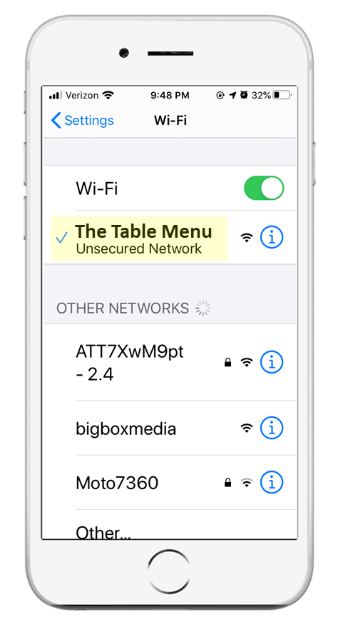
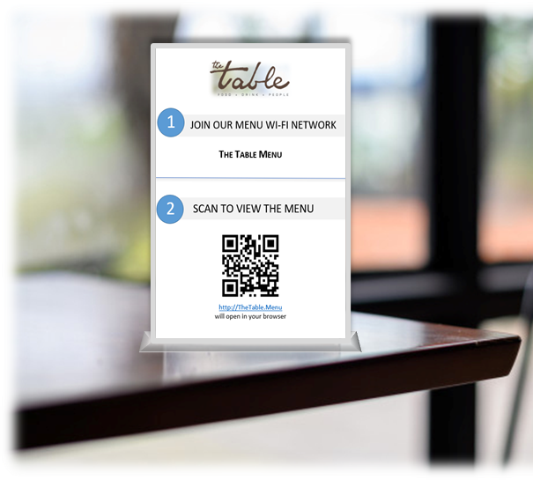
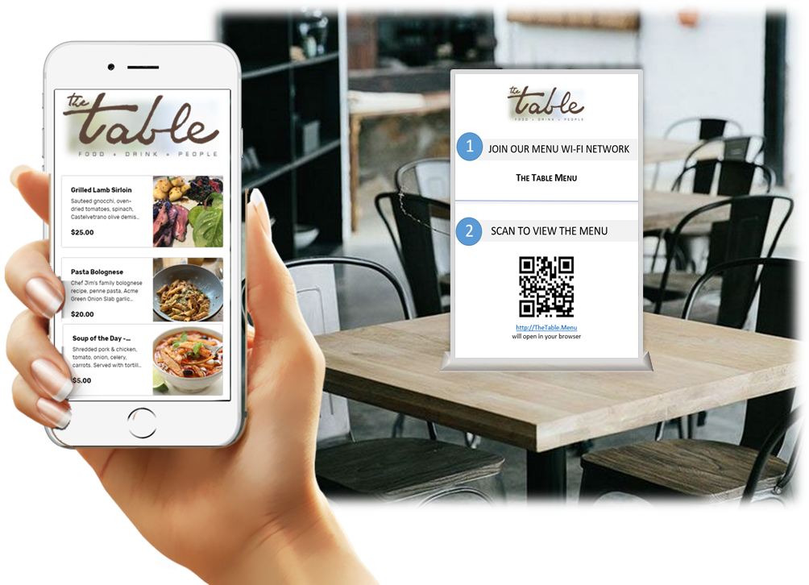
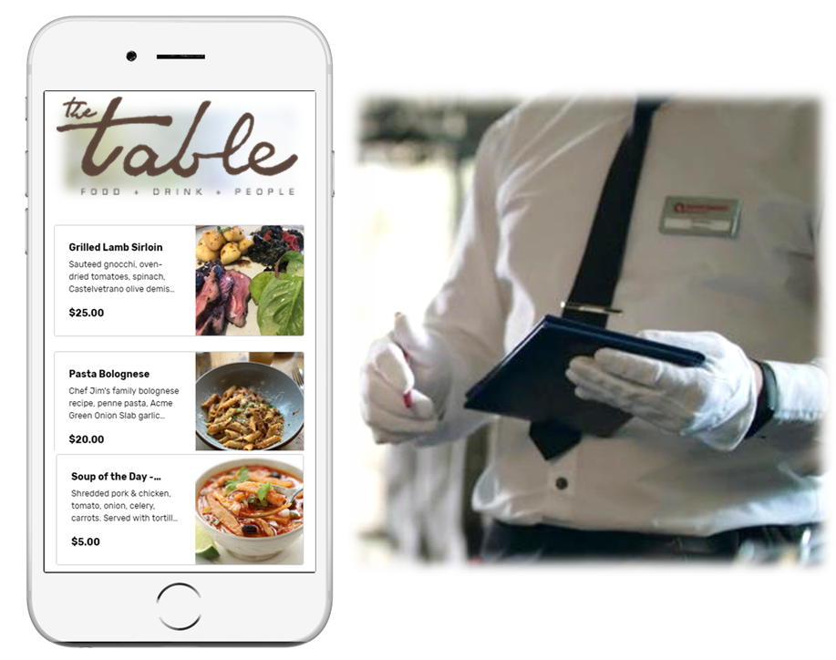
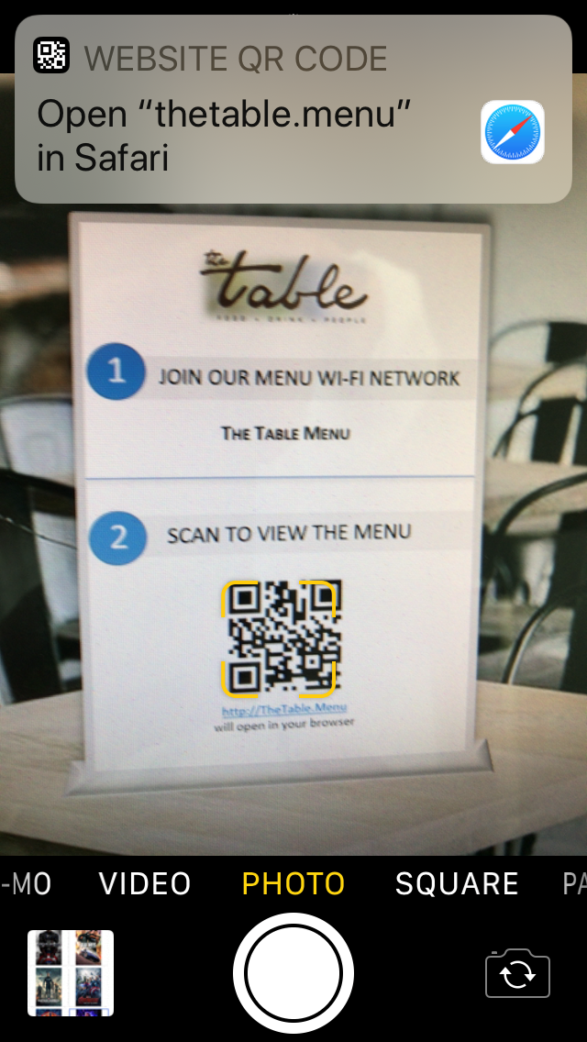
Join the Menu Wi-Fi Network
Touchless menu solution – no display needed!
Applications
Replace printed menus & instead display it on customer’s phones
Communicate specials
Provide discounts & coupons
Features
Delivers touchless menus to connected phones instantly with a simple QR code scan
Distributes your menu to hundreds of patrons from a single BrightSign player with an installed wireless module
Supports a variety of menu content from simple JPG & PNG menu images to more engaging menus with interactive HTML
Offers an Admin login to easily upload your menu and customize the names of the Wi-Fi network and menu webpage
Does NOT require an internet connection, an app or even a display
Scan the QR code & view the menu – all customers can view at once!

Slide 6
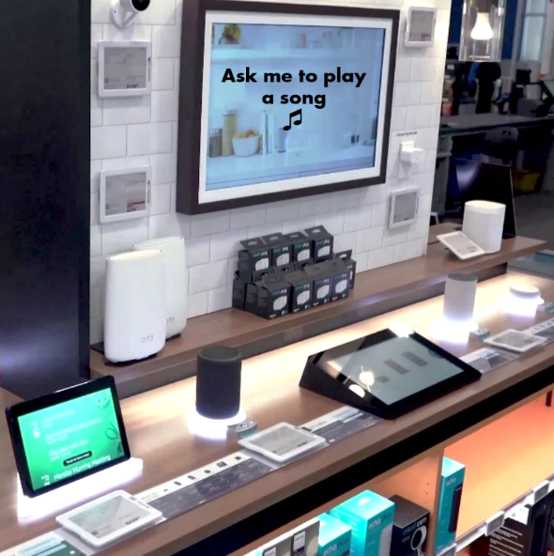
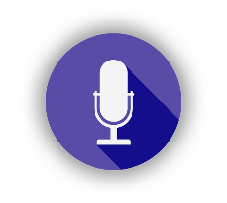
Overview
Voice activated digital signage solution
Enhances personal interaction with displays through natural, tailor made conversations
Delivers a highly engaging hands-free experience by using voice activated triggers to control digital signage playback
Listens to and interprets spoken commands that can mimic commercially available voice enabled devices
Activates when a wake word is heard followed by specific voice commands
Intelligently deciphers simple to complex phrasing to trigger a wide range of actions such as playback of on-screen content, music, lighting or even the operation of other devices
Operates securely and anonymously without recording or storing voice commands
Functions entirely offline without an internet connection for a controlled and reliable experience
BrightVoice™

Slide 7
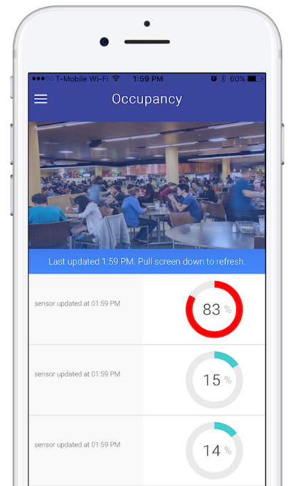
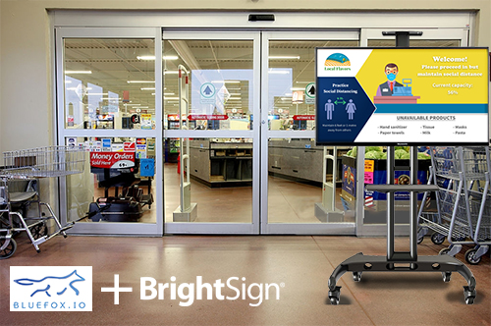
Measure real time occupancy to trigger sign playback
BlueFox’s foot traffic analytics solution supports a wide range of BrightSign media players.
BlueFox Count sends real-time alerts when a location meets its capacity and trigger signage to display “Please wait outside” messaging until it’s safe to enter.
Counts people by sensing smartphones - no app or beacon needed
Triggers digital signage playback to match occupancy levels
Sends real-time alerts to store managers when a location surpasses its capacity
Measures dwell times & analyzes occupancy trends

Slide 8
Thank You!

Slide 9
Phone assisted touchless engagement
BrightLink webpage
BrightLink Video

Slide 10
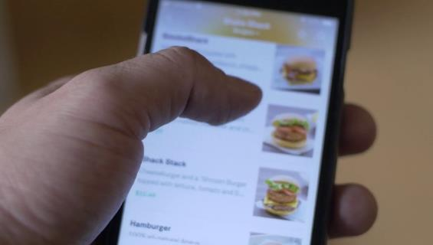
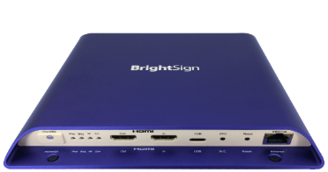
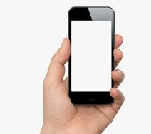
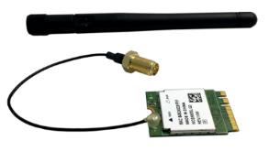
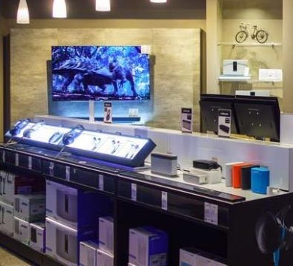
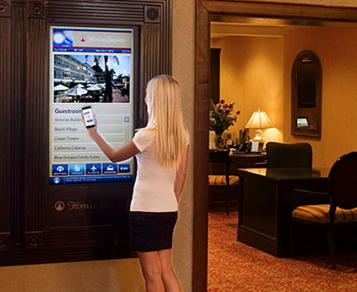
BrightLink
Phone assisted interactivity for touchless engagement
With a BrightSign player, wireless module and a phone customers can safely engage with signage
Enables users to actively engage with signage using a mobile phone
Displays your content in a linked phone’s browser, making it a viewable digital sign & sign controller – no internet or app needed
1-way engagement: plays your content on a personal phone making it the digital sign for users to view product info or pricing, a building directory, transportation schedules, museum exhibit info, etc.
2-way engagement: allows users to actively control a display like they would a touch screen using their own phone as a remote control

Slide 11
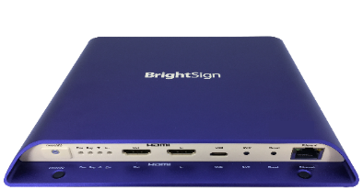
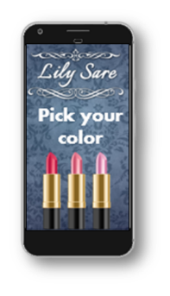
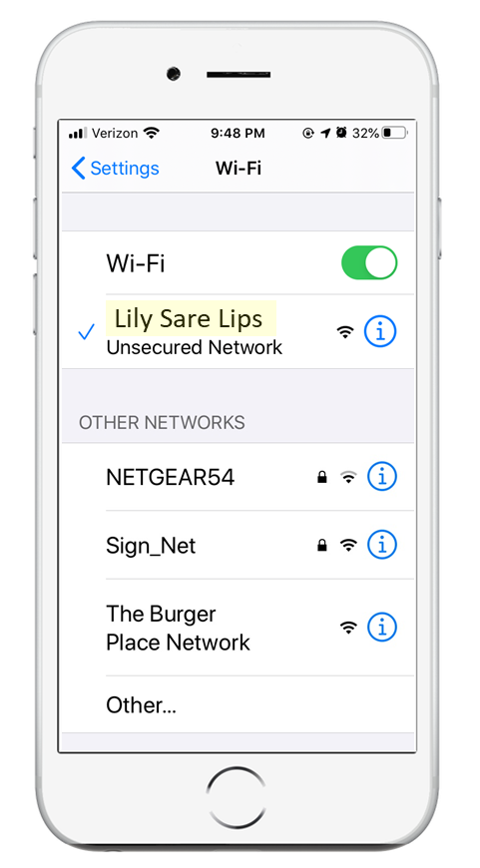
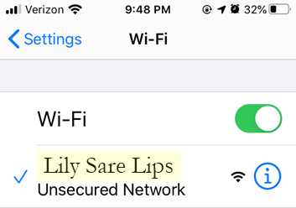
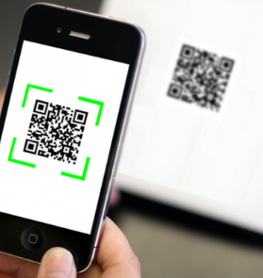
How BrightLink works
BrightSign player with a wireless module that acts as an access point for a phone to connect to & engage with – no internet required!
Users first connect to the Wi-Fi network access point running on BrightSign
Then a quick QR code scan allows a user to view & control the experience – no app needed!
BrightLink’s 1-way engagement: Simply view custom content and messaging
BrightLink’s 2-way engagement: Control the experience & choose what content to play on the digital sign using the phone as a remote control
Notes:
The BrightSign player is acting as a web server using the installed wireless module and is hosting a custom device web page. NO internet connection is needed. When the user scans the QR code with their phone it connects to the BrightSign player via a captive portal and displays the BrightSign player’s custom device web page in a browser on the connected phone.
When the BrightSign player’s custom device web page and digital sign presentation have been created for 2-way communication between the phone and the display, there will be interactive “buttons” the user can touch on their phone to control the playback of a connected display. In this implementation, only 1 phone can be connected at any one time in order for it to control the playback on the screen.
When the BrightSign player is not connected to a display and is only hosting a custom device web page without playing a digital sign presentation is has been created for 1-way communication between the phone and BrightSign player. In this instance an unlimited number of phones may connect to the BrightSign player and the custom device web page is viewable to all who have connected. In this case the custom device web page can be used to affordable communicate messaging or information such as menus, instructions, etc. quickly and easily without the need to install a screen or have an internet connection.

Slide 12
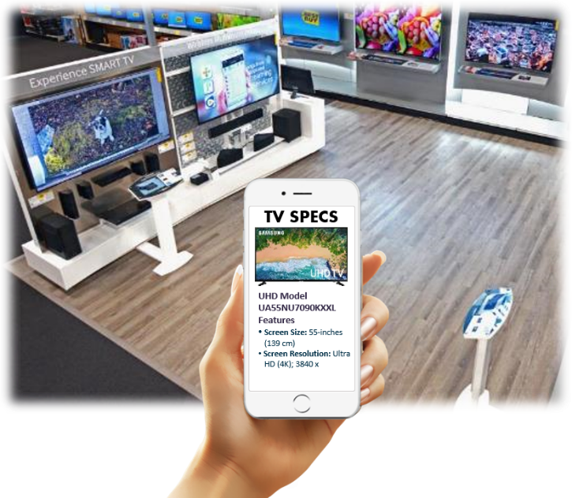
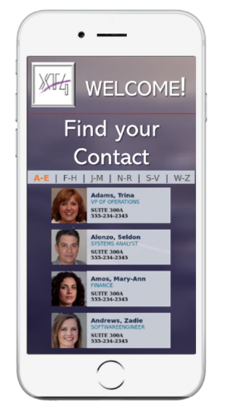
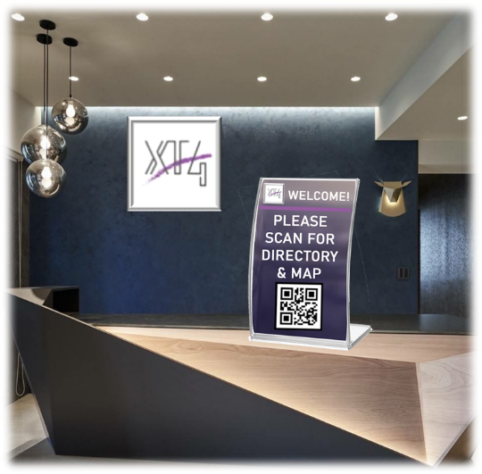
1-Way BrightLink Applications
Affordable touchless communication solution – no display required!
Provide visitors with a location map of your space from museums to malls, public buildings & beyond
Communicate contact directories to office visitors
Convey information on products & services
Distribute coupons, offers & discounts
Optional ability to link to loyalty programs, website & opt in offers using the phone's cell service

Slide 13
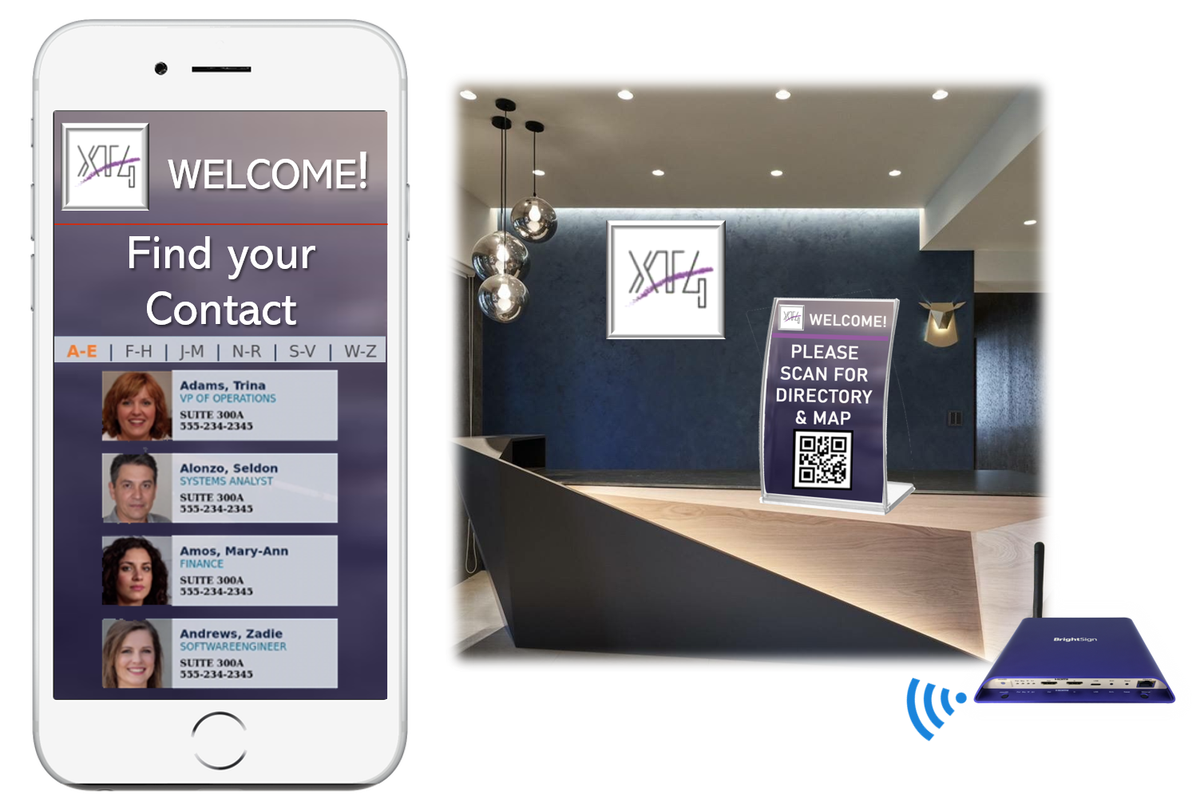
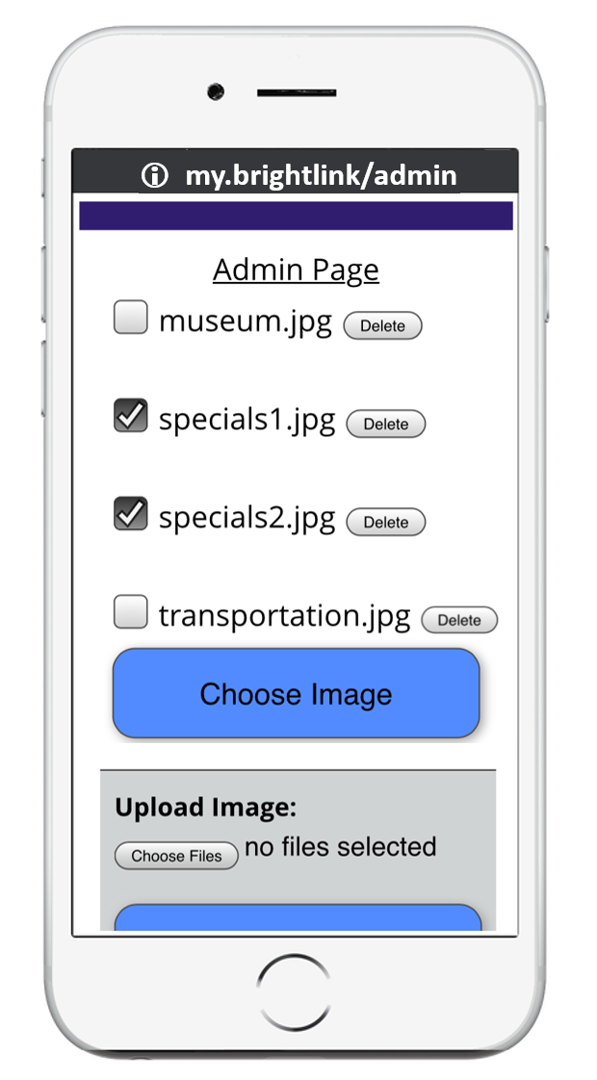
1-way BrightLink Features
Make a phone the digital sign
Easily displays your image or HTML content on a personal phone’s browser with a quick QR code scan
Supports a multitude of users linked to a single BrightSign player to distribute your content
Offers an Admin Portal to easily update image content displayed on a user's phone
Does NOT require:
An internet connection
An app
Or even a display (optional)
Notes:
Options to bundle with a content provider to create the custom device web page – Red Dot Digital Media, etc.
There is no limit on number of phone connections as the connection is 1-way

Slide 14
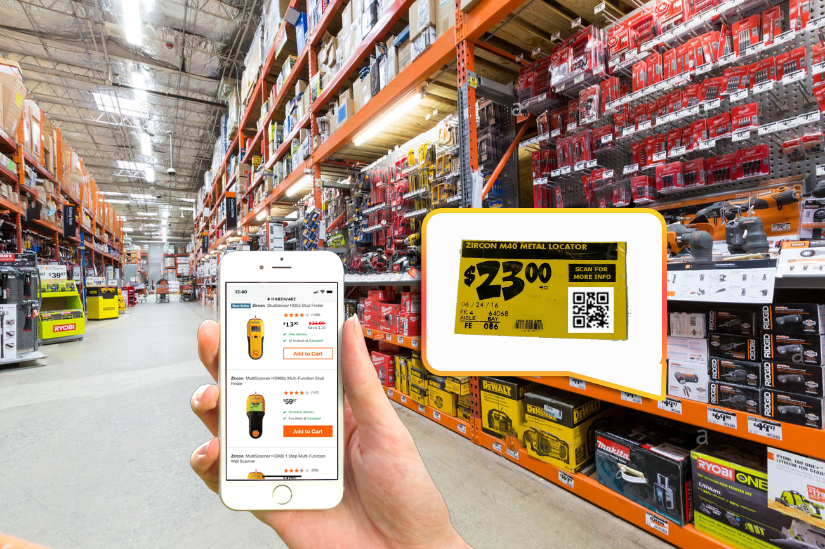
1-way BrightLink Application: Retail Shelf
Touchless product shelf engagement for info, discounts and more
Delivers instant product information with touchless engagement
A quick QR code scan from the product shelf provides additional product info
Custom interface on phone matches the product providing a seamless experience
Supports a hundreds of users at once
Supports a multitude of products tags & their content on a single BrightSign player
Offers a wide variety of content to display on a customer’s phone:
Product fact tag, features, specs, etc.
Product discounts, coupons & promos
Recommend accessories or complementary products
Notes:
Configurable wireless module power allows range to be set for your application

Slide 15
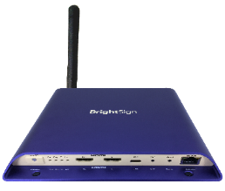
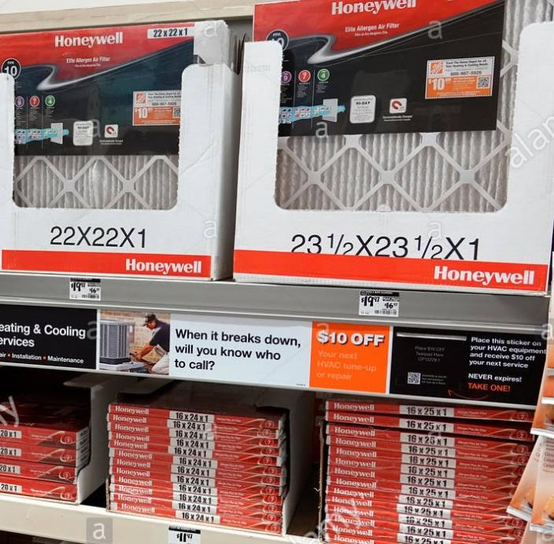
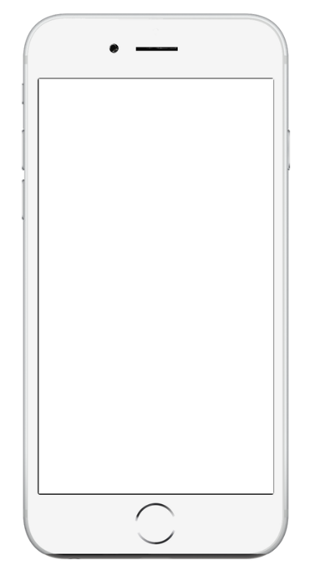
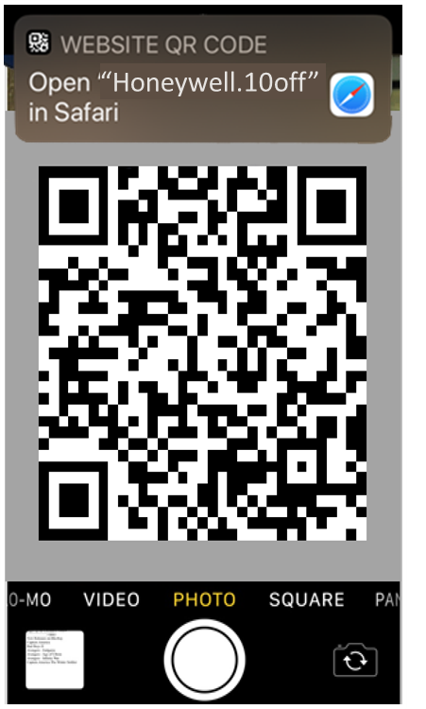
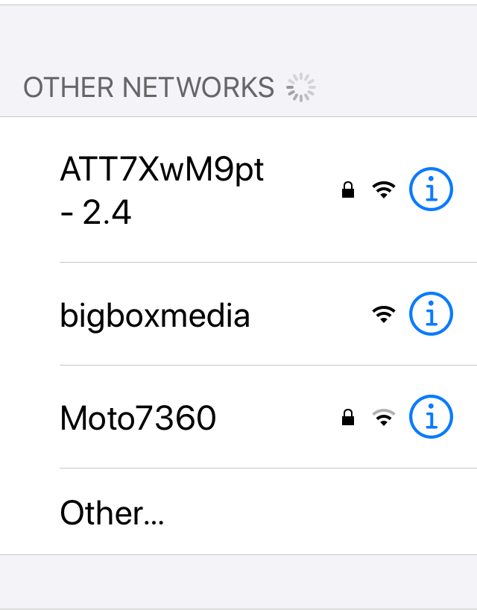
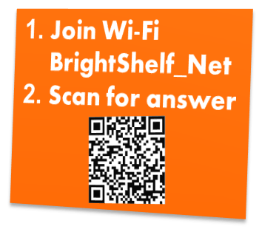
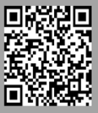
1-way BrightLink Application: Retail Product Shelf
How it works
Join ‘Honeywell’ Wi-Fi Network
SSID name is configurable to match your product, store name, etc.
Scan QR code to get coupon or product info
Did you know filters should be replaced every 3 months?
Honeywell
Want a discount?
1. Join Wi-Fi “Honeywell”
2. Scan QR code

Slide 16
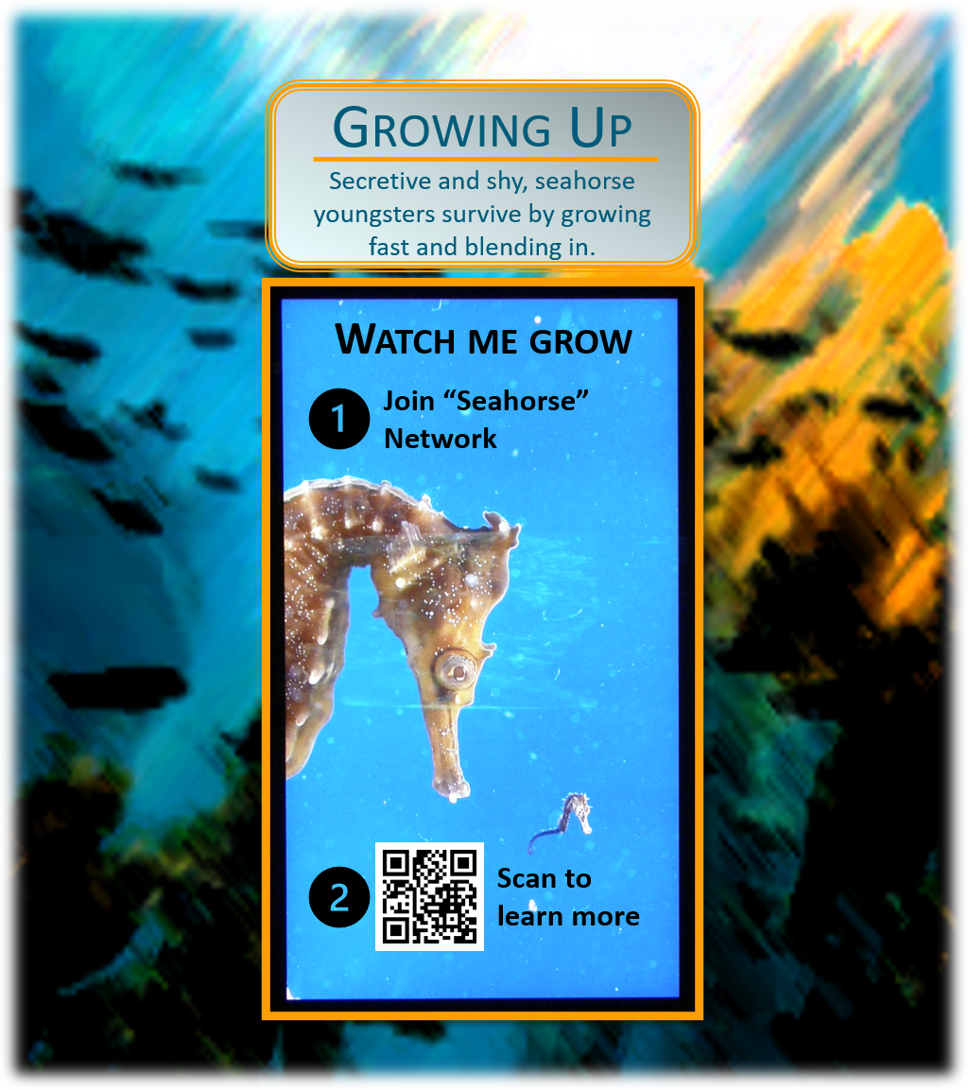
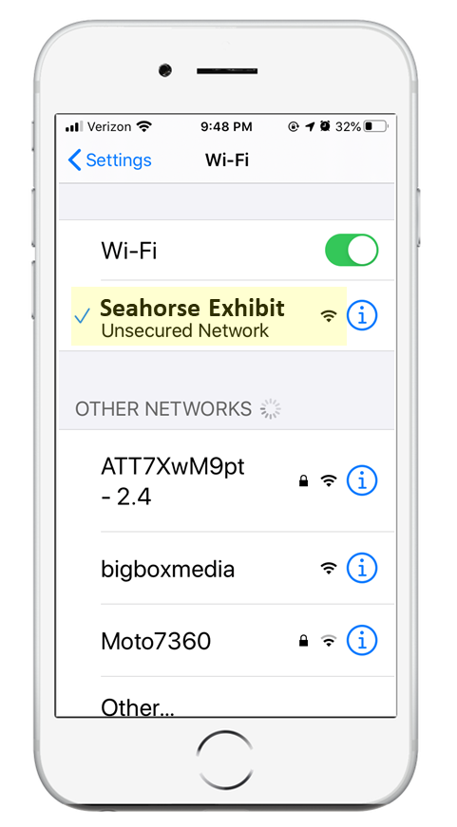
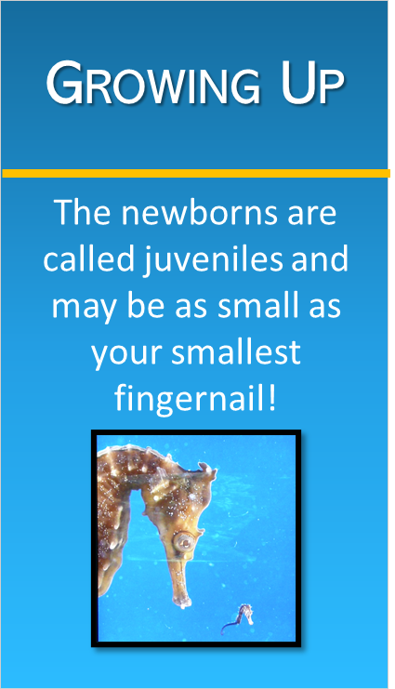
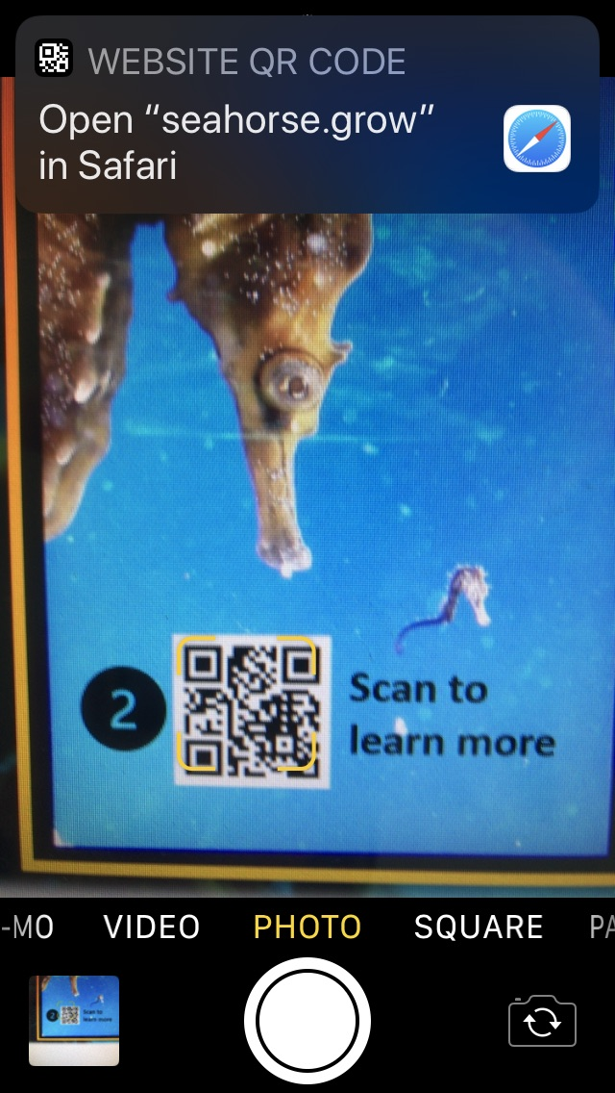
1-way BrightLink Application: Museum Engagement
How it works
Join the “Seahorse Exhibit” Wi-Fi Network
SSID name is configurable
Scan the QR code & learn more
all visitors can view at once!

Slide 17
2-way Engagement applications
Makes a phone the remote control for your signage – no app needed!
Ideal to avoid high-touch surfaces for remote control applications such as:
Touchless retail interactive product selectors & demos
Responsive retail inventory signage to instantly update content to let customers know what’s in stock
Hands-free interactive corporate directory & wayfinders
Contact-less engagement for museum exhibits and kiosks for transportation, hotels, healthcare & more
Inventory
Demo

Slide 18
2-way Engagement Features
Uses a phone as the touch screen to control the playback – no app needed!
Turns a personal phone into a remote control to actively control the playback of a display or kiosk
Gives a linked phone the controls with a quick scan of a QR code – no app or internet needed
Plays custom HTML content in a phone’s browser with an interactive interface to remotely control the display
Optionally provides the ability to visit online opt-in programs and buy now sites using the phone’s cell service
Links to a single phone at any one time with configurable & automatic disconnection options
Ideal to avoid high-touch surfaces for remote control applications

Slide 19
2-way BrightLink Application: Retail Kiosk
Kiosk Demo
Using a phone as the touch screen
Delivers a touchless solution to engage with digital signage
On screen QR code & instructions invites users to connect & control the display
Custom interface on phone matches signage & allows the user to remotely control the display
Allows users to engage in a product demo much like they would using a touchscreen
Provides a way to select products to learn more about them
Offers simple way to deliver product specs, specials and more
Optional ability to access to online links for opt in services, coupons, loyalty clubs & buy now sites using the phone’s cell service
Supports a single phone connection with configurable & automatic disconnections
Disconnect when phone is inactive, a time limit is reached, an end session button is pressed or simply when phone is out of range of the display
Link mode
Touchless Control Mode
Notes:
Configurable wireless module power allows range to be set for your application

Slide 20
2-way BrightLink Application: Retail Kiosk
How it works
Join the Wi-Fi Network ‘Big Box Media’
Scan to QR code & control the kiosk

Slide 21
BrightLink Implementation
What’s needed
Link
Obtain any Series 3 or 4 BrightSign player with an installed wireless module (WS103) running OS v8.1.69+
Create a BrightAuthor presentation using our example demo as a basis:
Include a custom device webpage whose content is optimized to run on a smartphone
Enable the 2 plugins required for BrightLink
Assign values to the BrightLink user variables to match your needs for the SSID, Hostname, etc.
Utilize the free, included HTML code to auto generate a QR code that matches your hostname
Build out the interactive BrightAuthor presentation to run on screen and link to your custom device webpage
Phone assisted touchless engagement
Please contact your sales rep or sales@brightsign.biz for details, example demo & user guide
Notes:
Specific details on creating a BrightAuthor presentation are available upon request to enable and customize the BrightLink experience. Basically a plugin, zip file are also needed to support enabling BrightLink in your presentation

Slide 22
Affordable touchless
menu solution
BrightMenu webpage

Slide 23
BrightMenu Applications
Affordable touchless menu solution – no display required!
Replace printed menus with digital menus displayed on customer’s phones
Communicate specials to your visitors
Provide discounts & coupons

Slide 24
BrightMenu Features
Touchless menus get businesses up and running quickly
Eliminates the risk of sharing menus by replacing printed menus with one that easily displays on customer phones
Delivers touchless menus to connected phones instantly with a simple QR code scan
Distributes your menu to hundreds of patrons from a single BrightSign player with an installed wireless module
Supports a variety of menu content from simple JPG & PNG menu images to more engaging menus with interactive HTML​
Offers an Admin login to easily upload your menu and customize the names of the Wi-Fi network and menu webpage
Does NOT require an internet connection, an app or even a display
Deploys easily to new and existing installations to get businesses up and running quickly
Notes:
Options to bundle with a content provider to create the custom device web page – Red Dot Digital Media, etc.
Optional ability to connect to online offers, loyalty programs, etc. using the customer’s cell service – requires development
There is no limit on number of phone connections as the connection is 1-way

Slide 25
BrightMenu operation
How it works using printed instructions on each dining table
Join the Menu’s Wi-Fi network
The network name (SSID) and website URL (hostname) can be customized to match your establishment
Scan the QR code & view the menu
All customers can view at once

Slide 26
BrightMenu Customization
How it works with the default BrightMenu presentation
Connect to the Admin Portal (my.menu/admin)
Upload & choose your Menu (Supports PNG or JPG menus)
Edit hostname & SSID for your restaurant
Save the auto generated QR code
Edit & print the placard template with the new hostname, SSID & QR code

Slide 27
BrightMenu Implementation Options
Purchase a plug & play BrightMenu solution online
Includes an LS424, an installed Wi-Fi Module WS103, & an inserted 8GB Micro SD card loaded with the default BrightMenu presentation
Follow the Quick Start Guide instructions to load your menu found at www.brightsign.biz/brightmenu
Create your own BrightMenu
Use any Series 3 or 4 BrightSign player with an installed wireless module (WS103) running OS v8.1.69+
Request our default BrightMenu demo to use as a basis for your own
Create a custom device webpage optimized to run on a smartphone
Enable the 2 plugins required for BrightMenu
Assign values to the BrightMenu user variables to match your needs for the SSID, Hostname, etc.
Utilize the free, included HTML code to auto generate a QR code that matches your hostname
Build out the interactive BrightAuthor presentation to run on screen and link to your custom device webpage
Please contact your sales rep or sales@brightsign.biz for details, example demo & user guide
Phone assisted touchless menus
Eliminate the risk of sharing menus by simply scanning a QR code to view on your phone
Notes:
Specific details on creating a BrightAuthor presentation are available upon request to enable and customize the BrightLink experience. Basically a plugin, zip file are also needed to support enabling BrightLink in your presentation

Slide 28
Voice activated touchless engagement
BrightVoice webpage
BrightVoice Video

Slide 29
Overview
Voice activated digital signage solution
Enhances personal interaction with displays through natural, tailor made conversations
Delivers a highly engaging hands-free experience by using voice activated triggers to control digital signage playback
Listens to and interprets spoken commands that can mimic commercially available voice enabled devices
Activates when a wake word is heard followed by specific voice commands
Intelligently deciphers simple to complex phrasing to trigger a wide range of actions such as playback of on-screen content, music, lighting or even the operation of other devices
Operates securely and anonymously without recording or storing voice commands
Functions entirely offline without an internet connection for a controlled and reliable experience
BrightVoice™

Slide 30
Benefits
Enhances your display with natural audience engagement
Offline - no internet connection needed
Intuitive – mimics voice enabled device experiences
Reliable –specific vocabulary triggers interactions for a controlled display
Private & secure – no voice recordings are made or stored
Hands-free – uses speech vs. touch for a sanitary display

Slide 31
Requirements
Components needed to deliver a complete solution
BrightSign XD1034 or XT1144 player activated for BrightVoice
BrightVoice USB microphone accessory
BrightVoice Command Model Service that consists of:
standard wake word (custom wake word creation is available upon request)
creation of a custom array of voice commands and their variants matched to specific player triggers, events and actions
BrightSign-delivered BrightVoice Command Model which is used to build presentations in BrightAuthor or integrated partner software solutions
BrightVoice™

Slide 32
Model
Custom solution to create a controlled voice interactive experience
Slot Names
Training Phrases
Speech Deciphering
""input": "show me the Nike watch", "slots": [ { "rawValue": “Nike", "value": { "kind": "Custom", "value": “Nike" }, "alternatives": [], "range": { "start": 23, "end": 25 }, "entity": “Wathcproducts", "slotName": “WatchProduct" } ], "alternatives": [], "intent": { "confidenceScore": 0.92764896, "intentName": “ShowMe" } }

Slide 33
BrightVoice Applications
Versatile solution for a wide-range of applications
Retail
“Alexa, please play jazz music on the Bose speaker”
Directories
“Directory, where is Nordstrom?”
QSR Drive Thru
“Cashier, I’d like to order the double burger meal”

Slide 34
Thank You!

