Slide 1
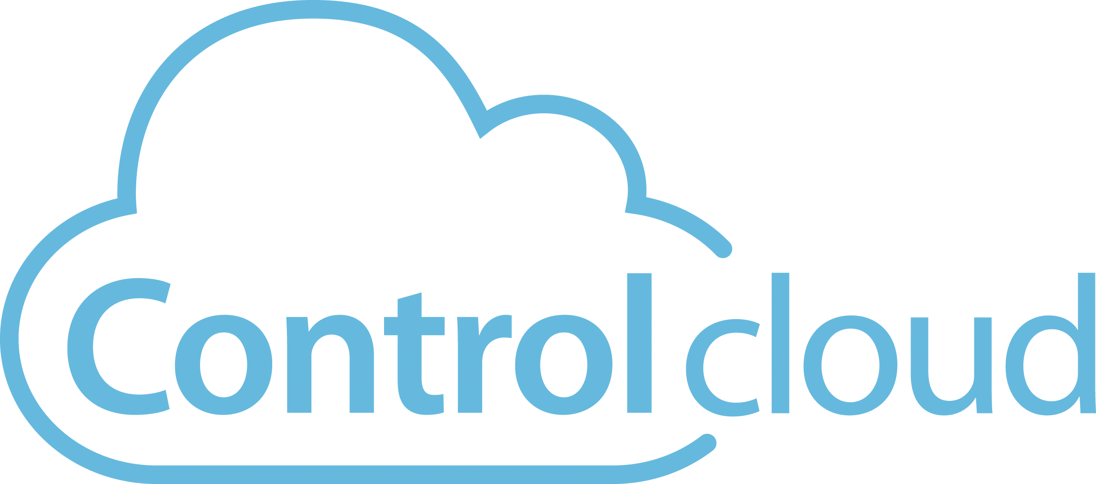
Real time player health & controls with your choice of CMS
March 25, 2020

Slide 2
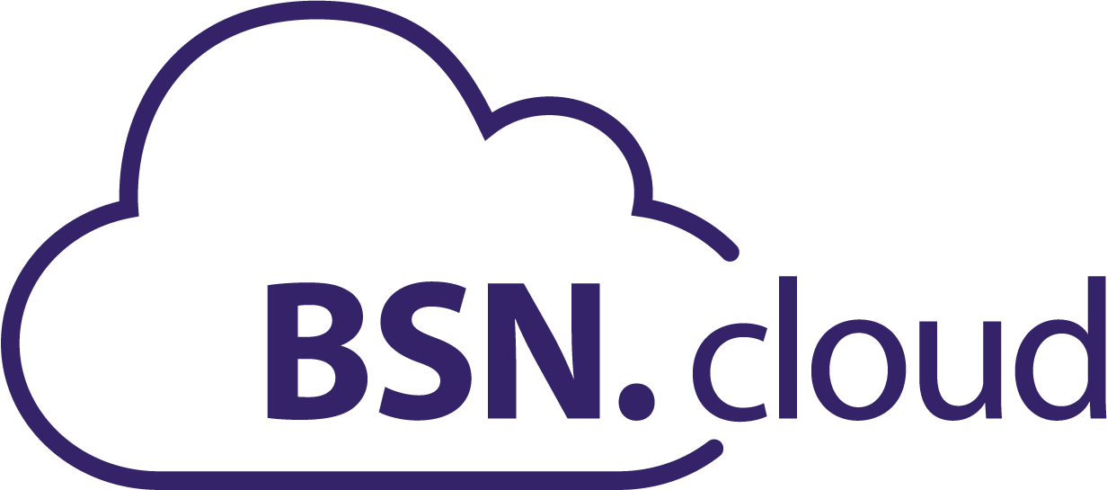
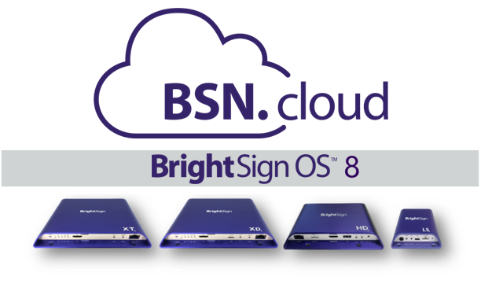
Cloud-Based Players Put you in Control
All BrightSign players include cloud-connectivity for free
BrightSign OS 8 enables the cloud-connected experience on all BrightSign players for real time player access anytime, anywhere
BSN.cloud is an innovative platform that delivers varying levels of player, network & content management services
Notes:
BrightSign has released a revolutionary new solution that connects BrightSign players to the cloud giving users control over their players for free. BrightSign OS 8 is the required operating system that enables this included cloud-connected experience on all series 3, series 4 and 4K (top hat) BrightSign players using state-of-the-art web technology via our new BSN.cloud platform. BSN.cloud is the evolution of BrightSign Network, but has been completely rebuilt as a new innovative platform that delivers varying levels of services for player, network and content management to deliver a digital signage solution to meet your needs. The BSN.cloud platform provides a free baseline service to deliver the crucial, direct access to real time player health and controls anytime, anywhere. This included level of service called Control Cloud is also unique in that it allows you to independently manage your real time player network from your CMS solution, thereby giving users the freedom to choose a CMS solution that best meets their needs.
OPTIONAL: A higher level of service BSN.cloud offers is the Content Cloud subscription. This is BrightSign’s own CMS solution for cloud-connected presentation authoring, publishing and management. It is offered as an annual subscription to those users who have not selected an integrated partner CMS solution.

Slide 3
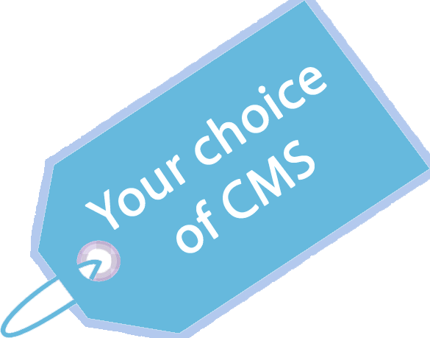
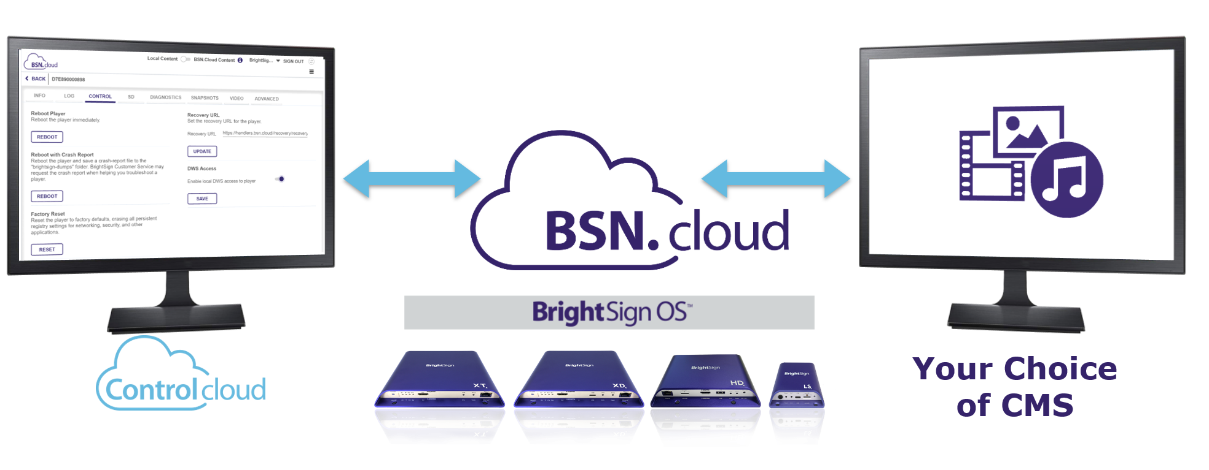
Free BSN.cloud Subscription for all Players
Cooperative digital signage solution offering real time player health & controls independently of your content management solution
control.BSN.cloud
Streamlined player setup easily provisions single, multi or mass sets of players & supports the CMS of your choice
Real time access to player health, diagnostics & controls at anytime, anywhere using the BSN.cloud Web UI
Your choice of CMS to create, publish & manage presentations
Notes:
As we mentioned, the BSN.cloud platform puts users directly in control of their players and at the included Control Cloud level of service, it also puts users in control of how to operate their digital signage network by offering a cooperative foundation that gives users this unique flexibility. Control Cloud separates real time player health and controls from content management thereby giving users the best of both worlds. Manage your real time player network independently on Control Cloud while also utilizing your choice of CMS to create, publish and manage presentations & your media library.
If we take a look at what the user’s operating environment is in this situation, this diagram shows that the real time player access is accessible vis the BSN.cloud web UI which can be separate from the CMS user solution and user interface. Despite this separation, they still cooperatively run on the BrightSign players.
This secure & scalable Control Cloud service of is included for free on all BrightSign players running BrightSign OS8 and provides 3 main features:
It provides a new streamlined player setup process which easily provisions a BrightSign player for both your Control Cloud account and the integrated CMS of your choice. BrightSign supports a multitude of integrated CMS solutions to choose from - including our own BrightAuthor:connected solution if so desired. The streamlined setup also supports provisioning of single, multi or mass sets of players with ease.
In addition, Control Cloud provides real time access to players anytime, anywhere via the BSN.cloud Web UI. You can view a player’s health & monitor its status, as well as perform real time diagnostics and controls such as applying OS updates and taking snapshots of what’s currently playing on-screen.
At the same time users can create, publish & manage presentations to run on their connected BrightSign players using the CMS of their choice which once again shows how Control Cloud puts users in control of their digital signage solution.

Slide 4
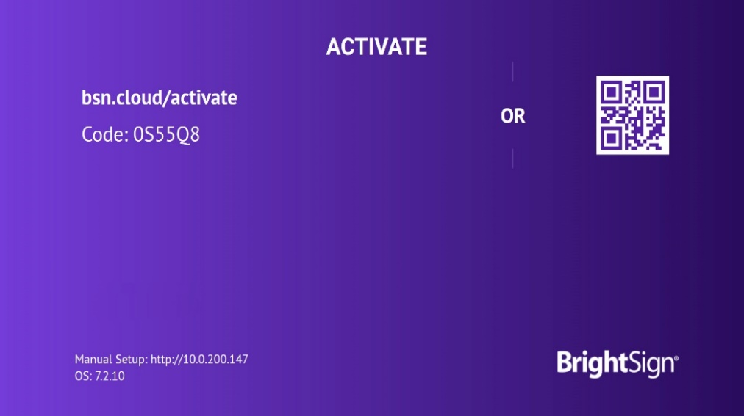
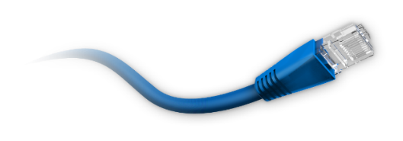
Streamlined setup Features
Easily provision single, multi or mass sets of players
Instantly sign up for a free Control Cloud subscription online
Activate your player following the simple on-screen instructions
Simply apply power to an Internet connected player with a blank SD card
Easily provision single, multi or mass sets of players
Customize player setup for the CMS of your choice
Notes:
Let’s go into more detail on the major features of the free Control Cloud subscription starting with the Streamlined Setup features. You can instantly sign up for a free Control Cloud subscription online using our Quickstart process that walks you through all the steps. Activating a player is made very easy by following the on-screen instructions after you power up a player that is Internet connected and has a blank SD card installed. Our process is optimized so that you can easily provision not only a single player, but multiple players or even mass sets of players at once. By default, this setup process is configured to support authoring presentations using BrightAuthor:connected however it can easily be customized to connect a player to the integrated CMS of your choice.

Slide 5
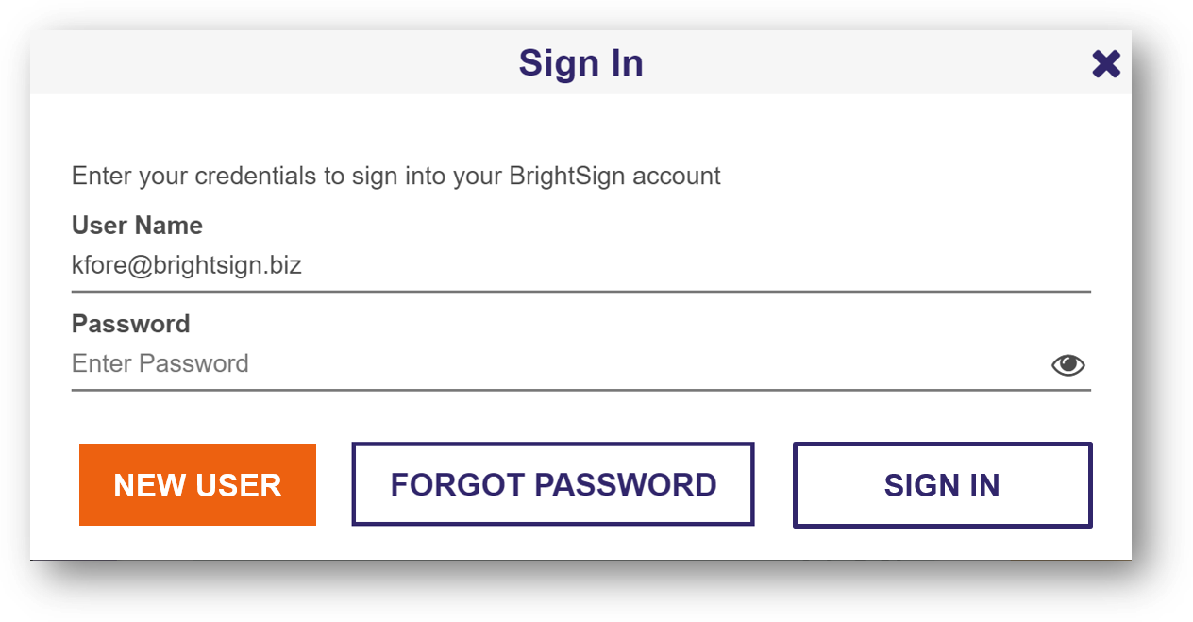
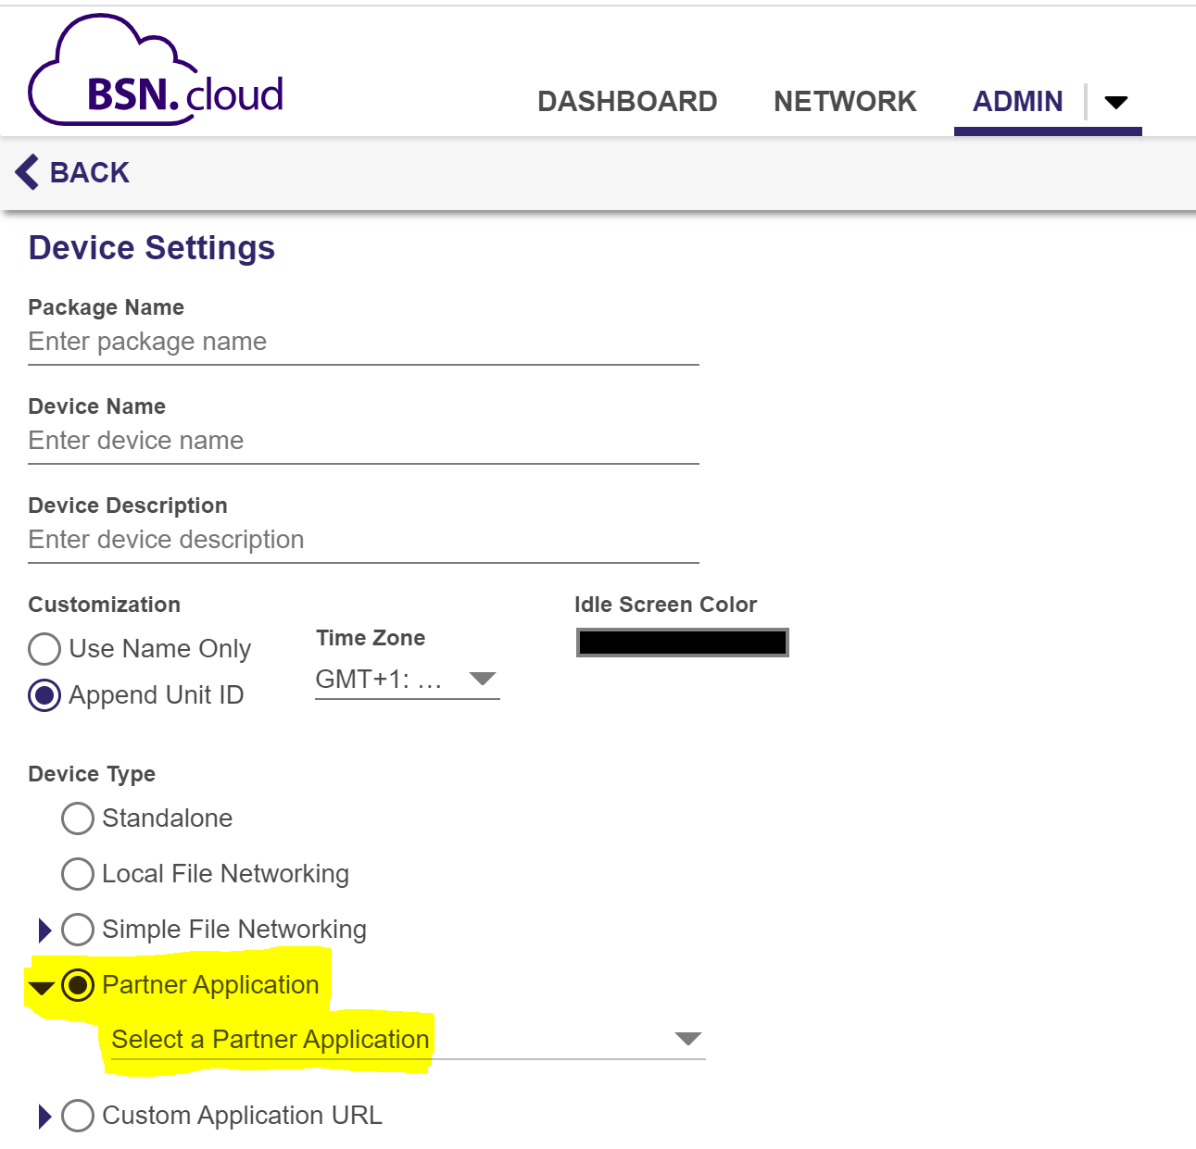
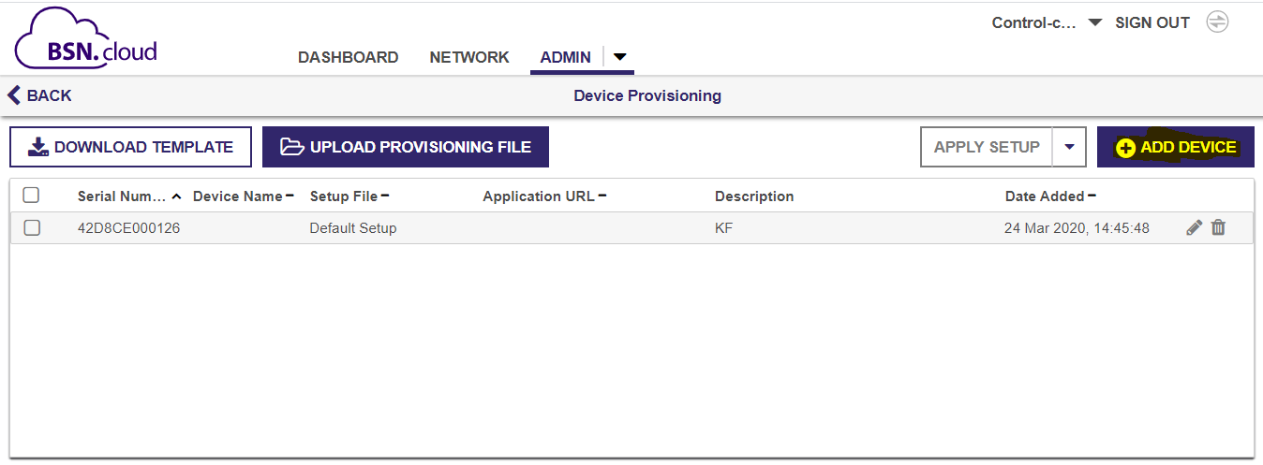
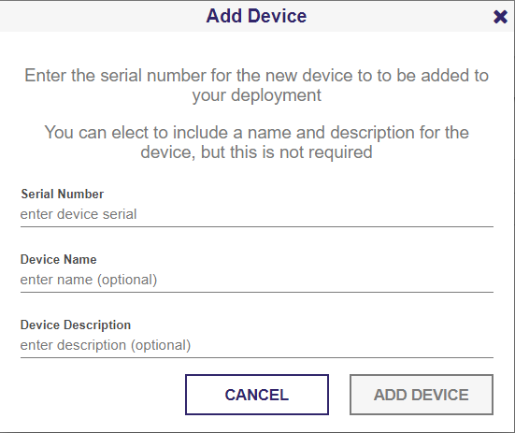
Streamlined setup Process for the CMS of your choice
Sign up for a free Control Cloud subscription at bsn.cloud or control.bsn.cloud selecting New User
Create a Default Device Setup package for the integrated CMS of your choice under the Admin Tab
Add your player(s) serial number to your account under the Device Provisioning section of the Admin Tab
Apply power to your Internet-connected player by with a blank SD card and follow the on-screen instructions to activate it
This process will first activate your player for your Control Cloud account, and then a secondary CMS partner activation process will begin
1
2
3
4
Notes:
The process to get a player setup for the CMS of your choice is now made super easy and customizable through the Control Cloud Admin tab
Create your free Control Cloud account online at bsn.cloud or control.bsn.cloud by choosing the New User selection. Both websites point to the same BSN.cloud platform, but one is branded as BrightAuthor:connected vs. BSN.cloud (NOTE: control.bsn.cloud also removes the ability to upgrade to Content Cloud under the Admin tab and does not ask you to open the BrightAuthor:connected desktop app when you launch the url)
Next create a custom Device Setup package for the CMS of your choice, by navigating to the Admin section & choosing Device Setup. We currently have 18 integrated CMS partner solutions and counting who take advantage of this efficient and seamless setup feature.
Once you have created your setup package, apply it to your player using the Device Provisioning selection under Admin. The same setup package can be used to mass provision a large set of players for an even more streamlined approach.
Finally apply power to your internet connected BrightSign player with a blank SD card inserted, and follow the on-screen activation instructions which will first link your player to your Control Cloud account & then a secondary activation process will occur for the selected integrated Partner CMS solution. Once all activations are complete, the real time player health and controls are ready to be accessed online at control.bsn.cloud or bsn.cloud & you can publish your first presentation using the CMS you have selected

Slide 6
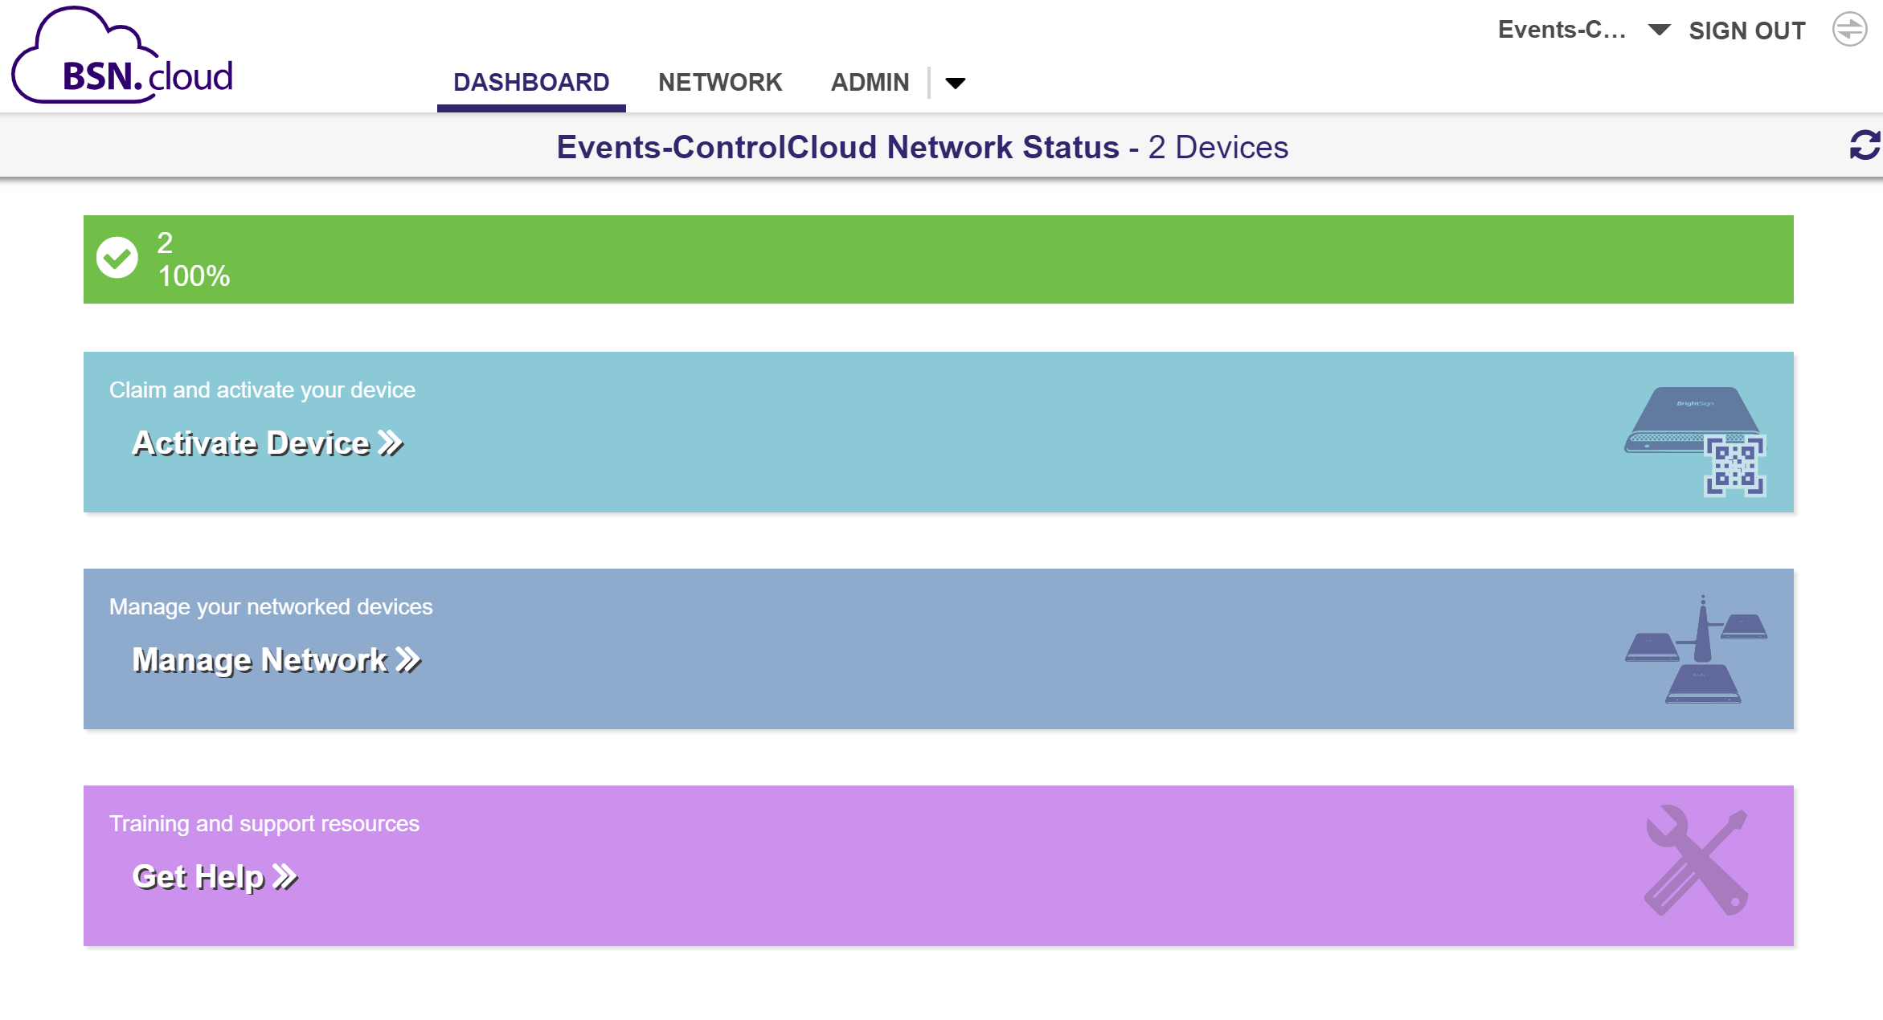
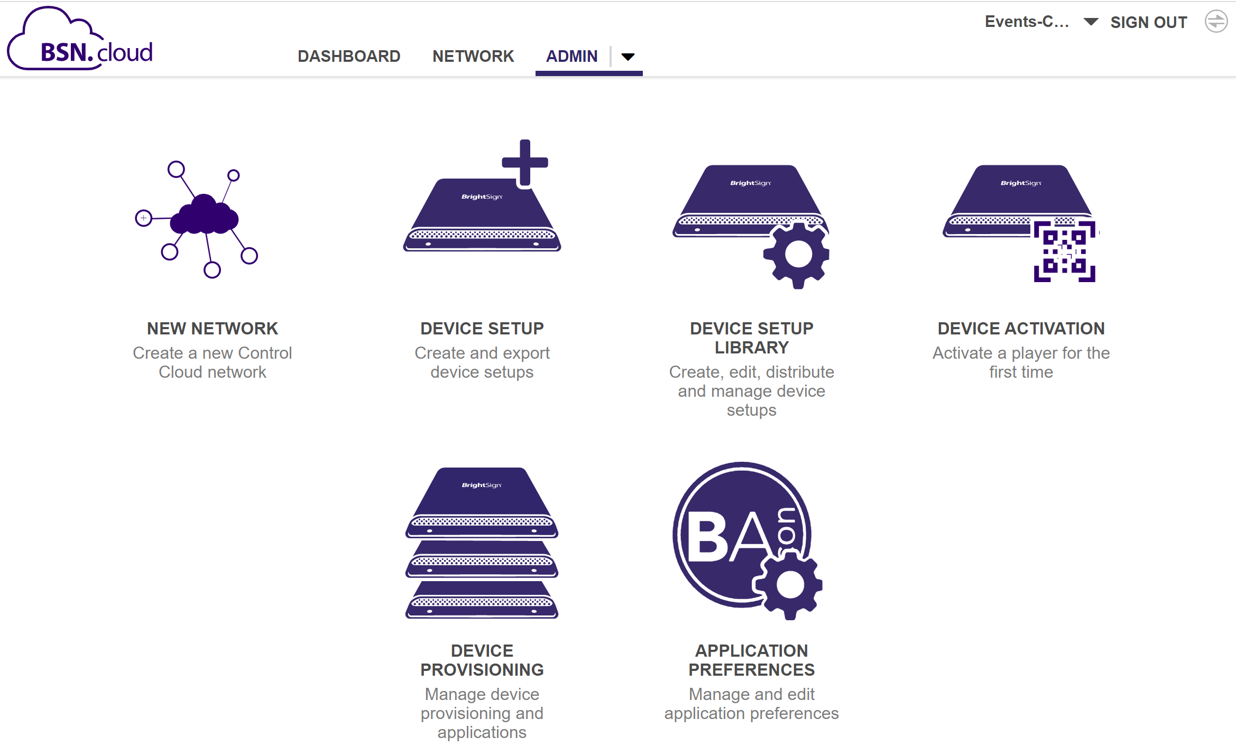
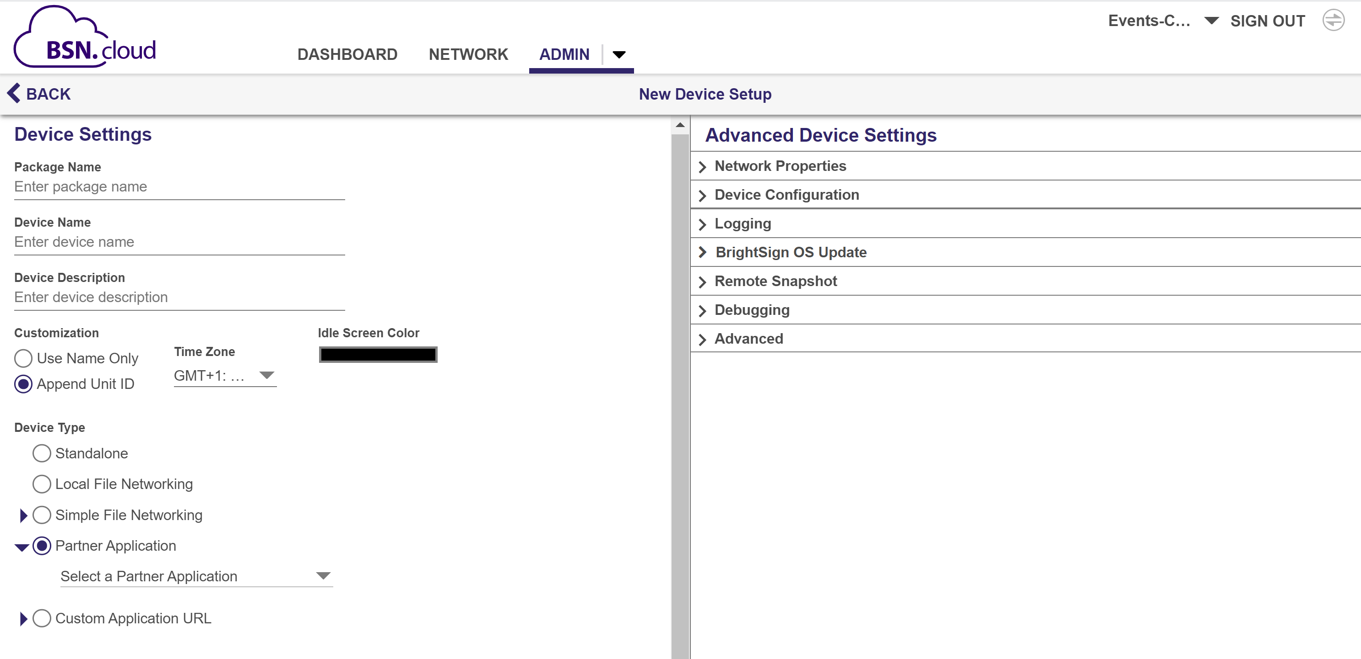
STREAMLINED PLAYER SETUP & ADMIN FUNCTIONS
Notes:
Here’s a closer look at what the user interface to Control Cloud. In the upper left you can see the Control Cloud dashboard which provides a quick look of your real time player health & provides quick access to key functions. On the right is a view of the administrative functions with includes the device setup we talked about. And in the middle we show the settings of that Device Setup function which is showing what’s available to provision a default setup file for an integrated partner CMS.

Slide 7
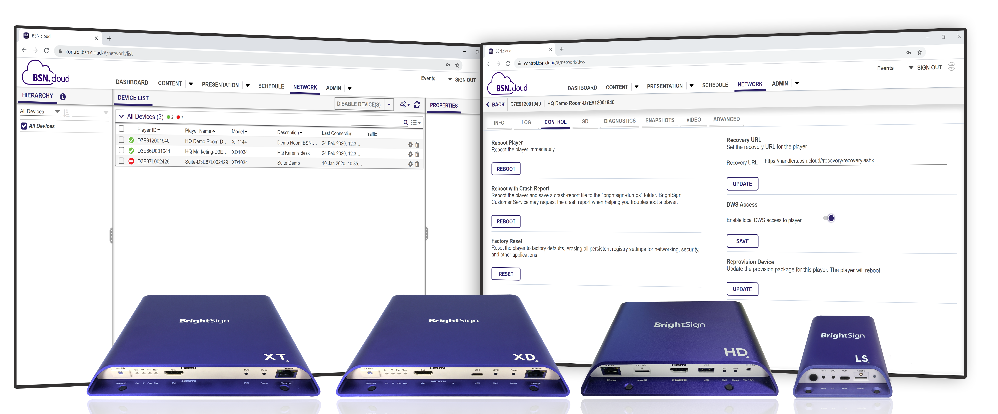
Real time Player access features
Monitor real time player health & control your player from anywhere, anytime
View and monitor real time player health from any location using the BSN.cloud Web UI
Access the remote diagnostic web server to view real time player data & log files & run diagnostics
Control players remotely by performing remote reboots, applying BrightSign OS updates, etc.
Initiate remote snapshots on demand to see what’s playing on-screen at that moment in time
Notes:
Now let’s take a closer look at the real time player features available with Control Cloud.
you can view & monitor player health from any location, at anytime using the BSN.cloud web UI.
You can also access a player’s remote diagnostic web server in real time without being on the same network and from any remote location! This is a huge improvement from our previous player access abilities before BSN.cloud was available. With Control Cloud you now can access detailed information on a player in real time – find out what OS version is running, what the player’s up-time is, the currently playing video resolution, the player IP address and more. You can also access log files and download them as well as run diagnostics to help troubleshoot any issues.
There are also many real time player controls that you can perform such as rebooting a player remotely, applying an updated BrightSign OS version, changing the video resolution playback and more.
And you can even use the Remote Snapshot feature which allows you to initiate an instant screen grab to see what’s playing at that moment in time on the player
The name of the service says it all – Control Cloud truly puts you in control of your player!

Slide 8
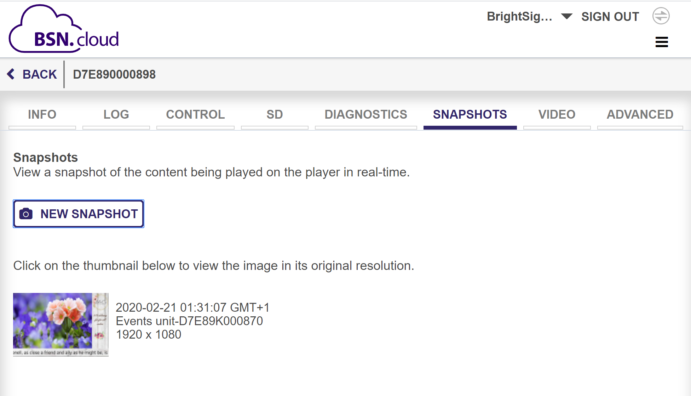
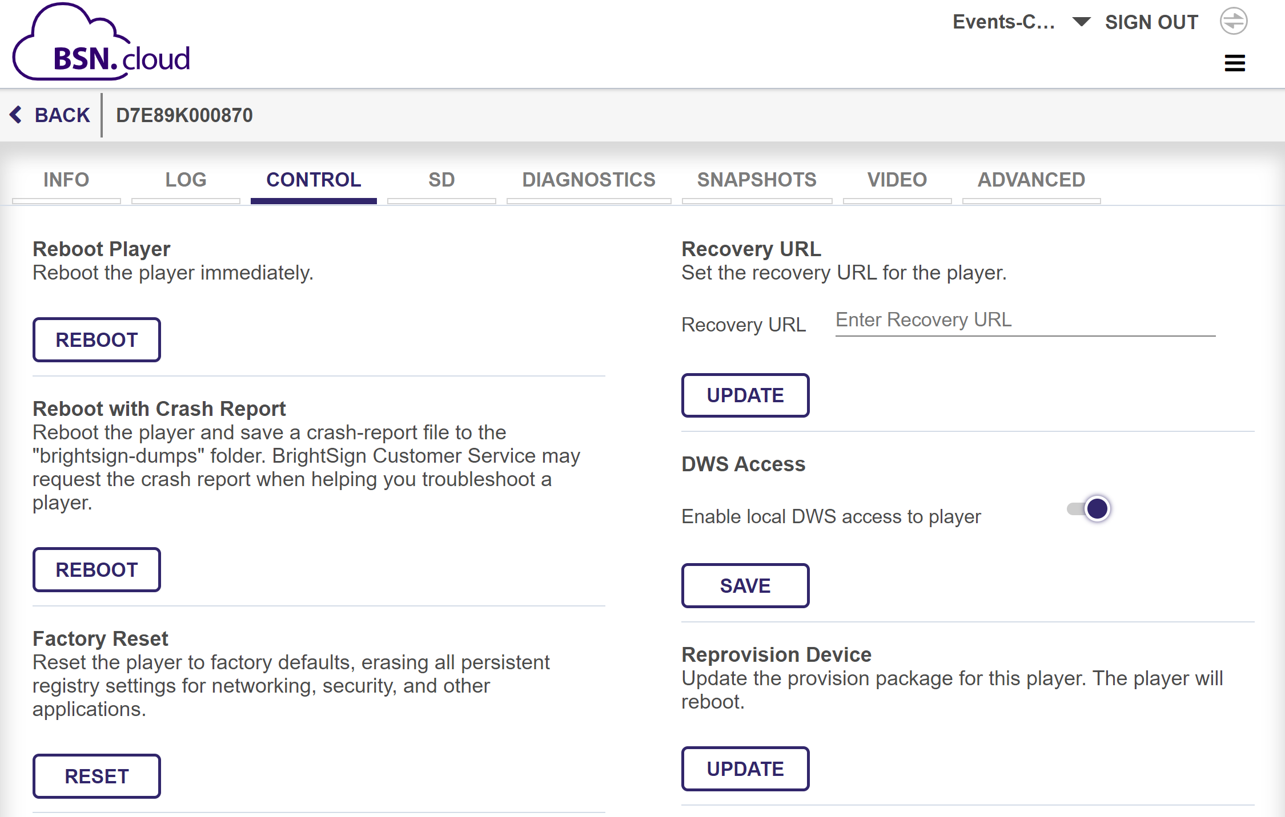
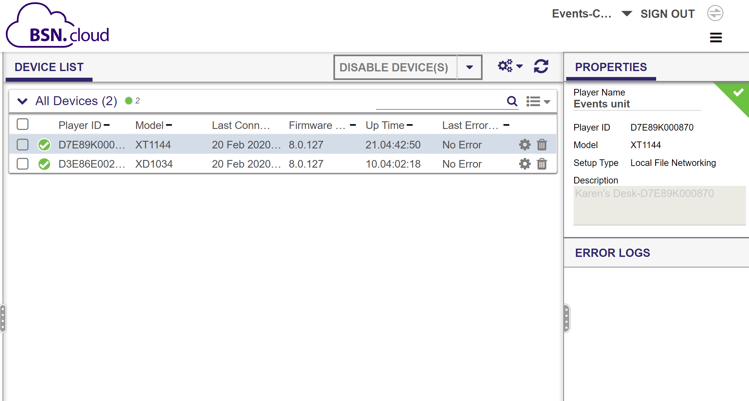
REAL TIME PLAYER HEALTH & CONTROLS
Notes:
Here is a closer look at the user interface for the real time player monitoring and control tools. The middle screenshot shows the player health at that particular moment in time, and if you select the cog icon next to a particular player, you can view its remote diagnostic webserver in real time as shown in the left and right screenshots. The left screenshot shows how you can take a snapshot of what’s playing right now on the player and on the right we have a view of the control functions such as rebooting the player.

Slide 9
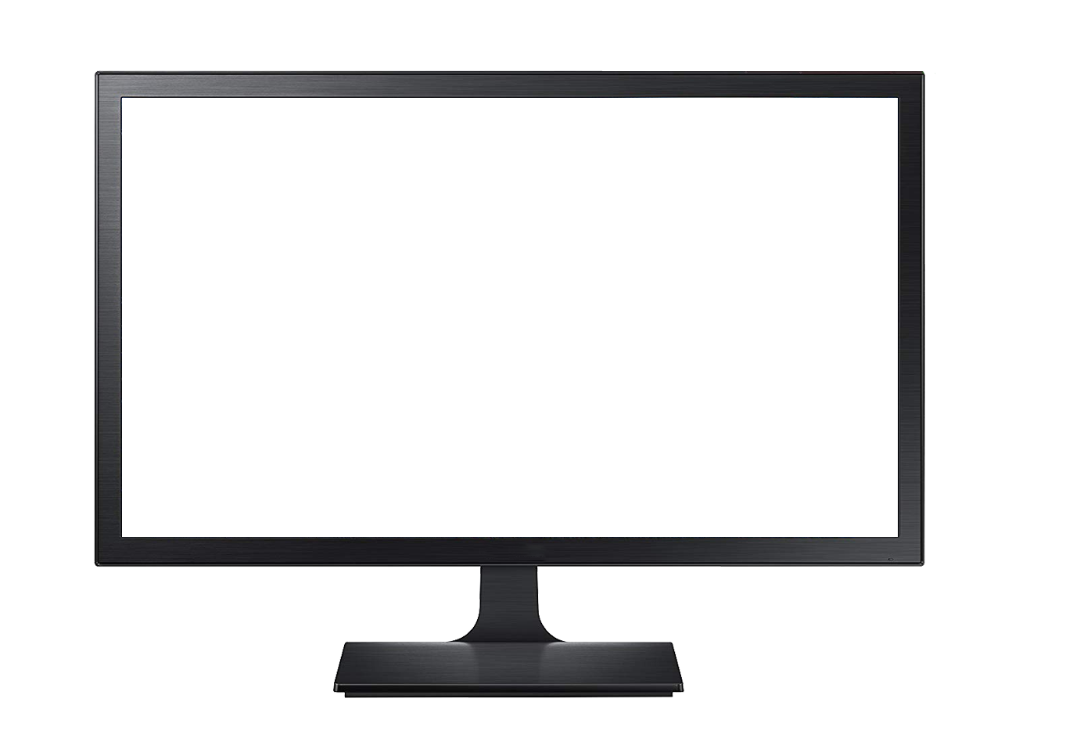
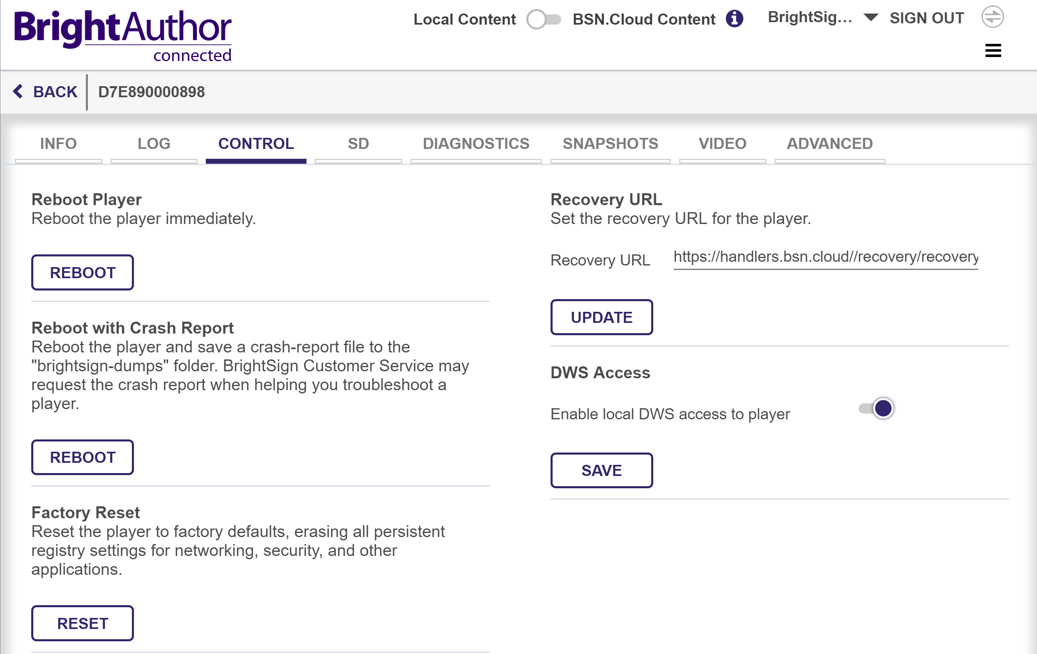
YOUR CHOICE OF CMS
Cooperative solution puts you in control of your signage operations
Independently access real time player controls from content management
Freedom to choose an integrated CMS & streamlines the entire setup process
Provides real time player health and controls on all connected BrightSign players which may not be available exclusively on a CMS solution
Supports multiple players connected to a mix of different CMS solutions on a single account
Opens the door to additional integration opportunities to support new player features & other tools BSN.cloud offers now and in the future
Your Choice
of CMS
Notes:
The third feature of Control Cloud is that you get to choose what CMS solution to use. The BSN.cloud platform uses WebSocket technology to provide the real time player access and controls that Control Cloud offers while also providing open APIs to CMS partners so that they can easily integrate with us at varying levels. Manage your real time player network independently on Control Cloud while also utilizing your choice of CMS to create, publish and manage presentations & your media library. Despite this separation, they still cooperatively run on the BrightSign players.
Integration of CMS partners at the Control Cloud level makes the provisioning process entirely seamless and uncomplicated as it both links the player to a Control Cloud account as well as to the CMS of your choice as we previously discussed. We currently have 18 integrated CMS partner solutions and counting, and a Control Cloud account can even support a fleet of BrightSign players connected to a mix of different CMS solutions for a truly versatile and custom solution. Our APIs even offer a way for our partners to integrate the real time player access and control tools found in Control Cloud within their own CMS user interface if so desired by the CMS partner. In addition, CMS partners can connect their content creation and distribution system to create unique workflows using our API set. BrightSign REST API’s will then issue the web calls so that the CMS partner doesn’t have to build the communications protocol from the cloud to the player.
As you can see there are many benefits to using the innovative new BSN.cloud platform who’s vital Control Cloud level of service truly puts users in control of their players and their digital signage network operation. Together with our integrated CMS partners, we deliver cooperative solutions that fit the varying and unique needs of our users. And it doesn’t stop there - BrightSign is known for continually improving upon and adding new capabilities to our products and services to ensure a highly reliable, best in class solution both now and into the future.

Slide 10
Thank you!

