Slide 1
AGENDA
BSN.cloud
Overview, advantages & subscriptions
Control Cloud & Content Cloud
Features, workflow & what’s new
BSN.cloud vs. BrightSign Network
Comparison & migration path
Exceptional cloud-connectivity for all BrightSign players
November 2021

Slide 2
BrightSign Leads the way in cloud-Based networks
Since 2008 BrightSign has led the industry in cloud-managed digital signage networks​
Thousands of accounts and players run on our cloud-based network service
Notes:
BrightSign is highly experienced in cloud-based networking for digital signage. We have been delivering cloud solutions since 2008, and we have thousands of accounts and players running in the cloud. Many big brands depend on us to run their digital signage networks in the cloud. They selected us because of the high level of security we offer which is embedded in our players and throughout our cloud services. We are also selected for our efficient networked player management capabilities, player status & control tools as well as our top notch service to support our customers.

Slide 3
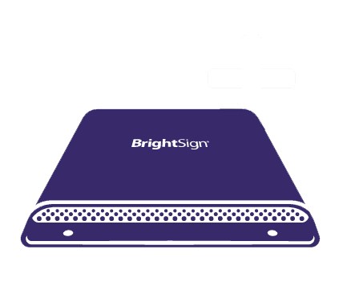
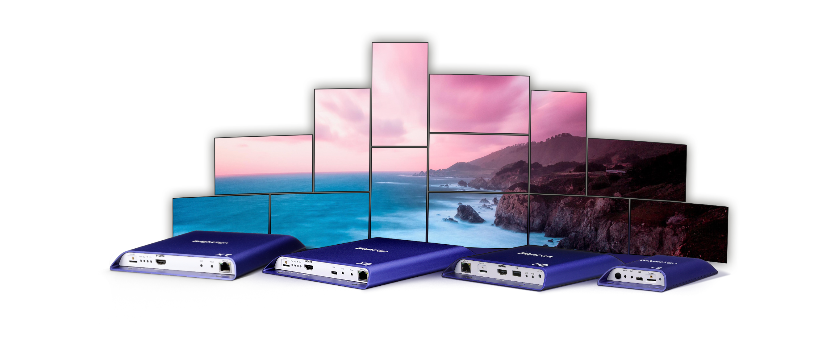
World-Class Media Players for any Signage application
Purpose-built for Signage
Ultra Reliable
Patented for Extreme Temps
Energy Efficient
Commercial-grade OS
Open APIs & Partnerships
Cloud-connectivity for all BrightSign players
Notes:
While BrightSign is fundamentally a hardware manufacturer, we have worked very hard to build a dedicated, commercial-grade operating system that connects all of our BrightSign players to our our new BSN.cloud platform. BSN.cloud isn’t your typical cloud-based solution for networking players, it is designed with leading-edge web socket technology to give you total control over your signage network from a remote location – something we all know has become more than essential given our recent experience with COVID and BSN.cloud gives you that ability for free on every player you purchase from BrightSign.

Slide 4
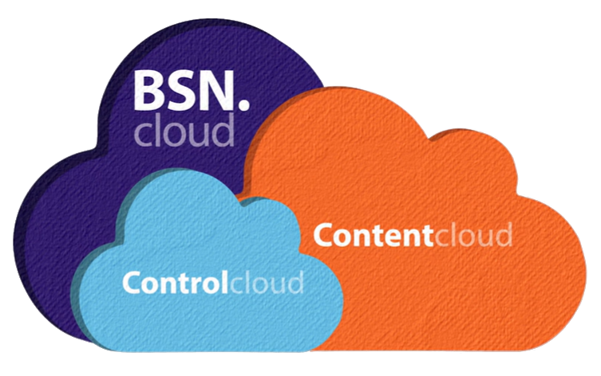
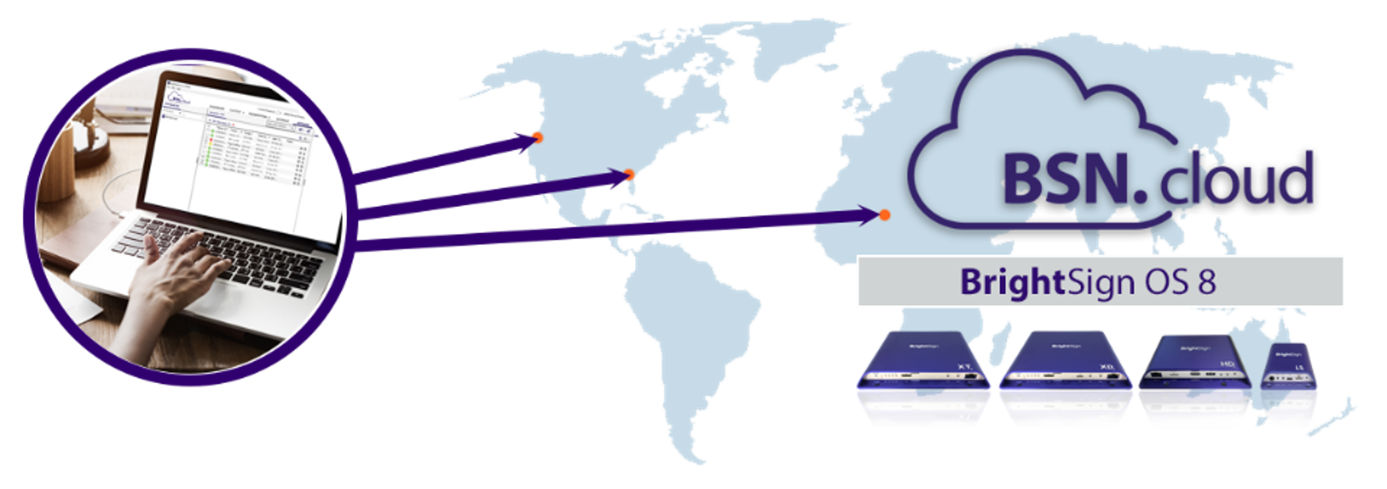
BSN.cloud puts you in control
for a total signage solution
Connect
Diagnose
Connecting BrightSign players to the cloud for network management and control
Real time player, health, diagnostics & controls from any location
Secure
Network
Secure, robust and scalable network and content management service
Networking options to match your connected environment
Deploy
Manage
Deploy, author and manage one player to thousands
Manage your presentations anywhere, anytime using BrightAuthor:connected or an integrated CMS
Notes:
BSN.cloud is our most recent innovation in cloud-based networking. It provides a platform that separates the ability to control players from the ability to playback content on that player for signage. This makes our solution very flexible & scalable. This new platform has been developed from the ground up with all the modern components and security features needed to deliver a reliable total signage solution that meets both current market needs and has the foundation to easily grow to support new capabilities and technologies that emerge.
BSN.cloud makes cloud-connectivity accessible to every one of our Series 3 & 4 players giving customers the capability to diagnose and monitor their player network from anywhere and at anytime.
This platform also allows our customers to operate to their players in the network environment that best meets their needs from free networking options to full cloud-based networking.
It also provides the ability to deploy not only a few players but a whole fleet of players with automatic provisioning tools. And it gives you the freedom to choose a content manager application that works best for you. Select our free BrightAuthor:connected solution or an integrated partner CMS. Since BSN.cloud separates player controls from content playback, it enables our CMS partners to focus on what they do best – content management - and let’s us do what we do best – controlling and managing player networks. So its a win/win situation for us, our partners and ultimate our customers.

Slide 5
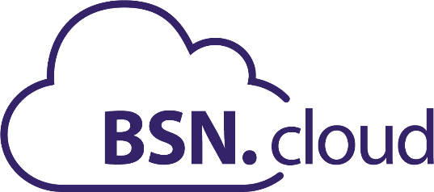
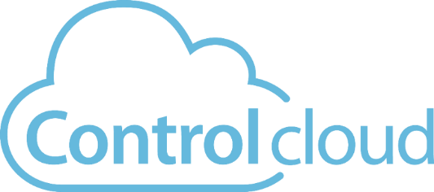
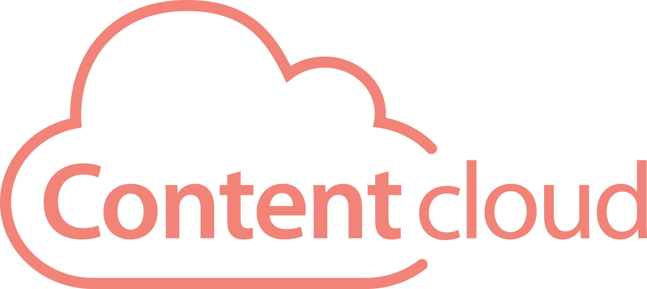
Choose your Subscription
Free subscription included with every BrightSign player
Streamlined player setup
Real time player health & controls
Your choice of CMS
Annual subscription
Includes Control Cloud services
Adds a complete set of content & network management tools
Free 30-day trial & then $99/player/year
Notes:
BSN.cloud offers 2 levels of service – a free Control Cloud subscription and an annual fee-based Content Cloud subscription.
Control cloud: is the free service included with all BrightSign players allowing you to access player health in real time as well as control players remotely. That means you can control them remotely to do things like apply OS updates and perform player maintenance or diagnose issues. This subscription allows our customers to support a fleet of players much more efficiently & effectively. And it gives users the freedom to choose the CMS that best fits their needs.
Content Cloud: is an annual subscription that includes all that Control Cloud offers and adds full cloud-based content management, presentation authoring & publishing via BrightAuthor:connected as well as robust networking management tools such as network grouping, tagging and reporting, and also network administrative and reporting tools.

Slide 6
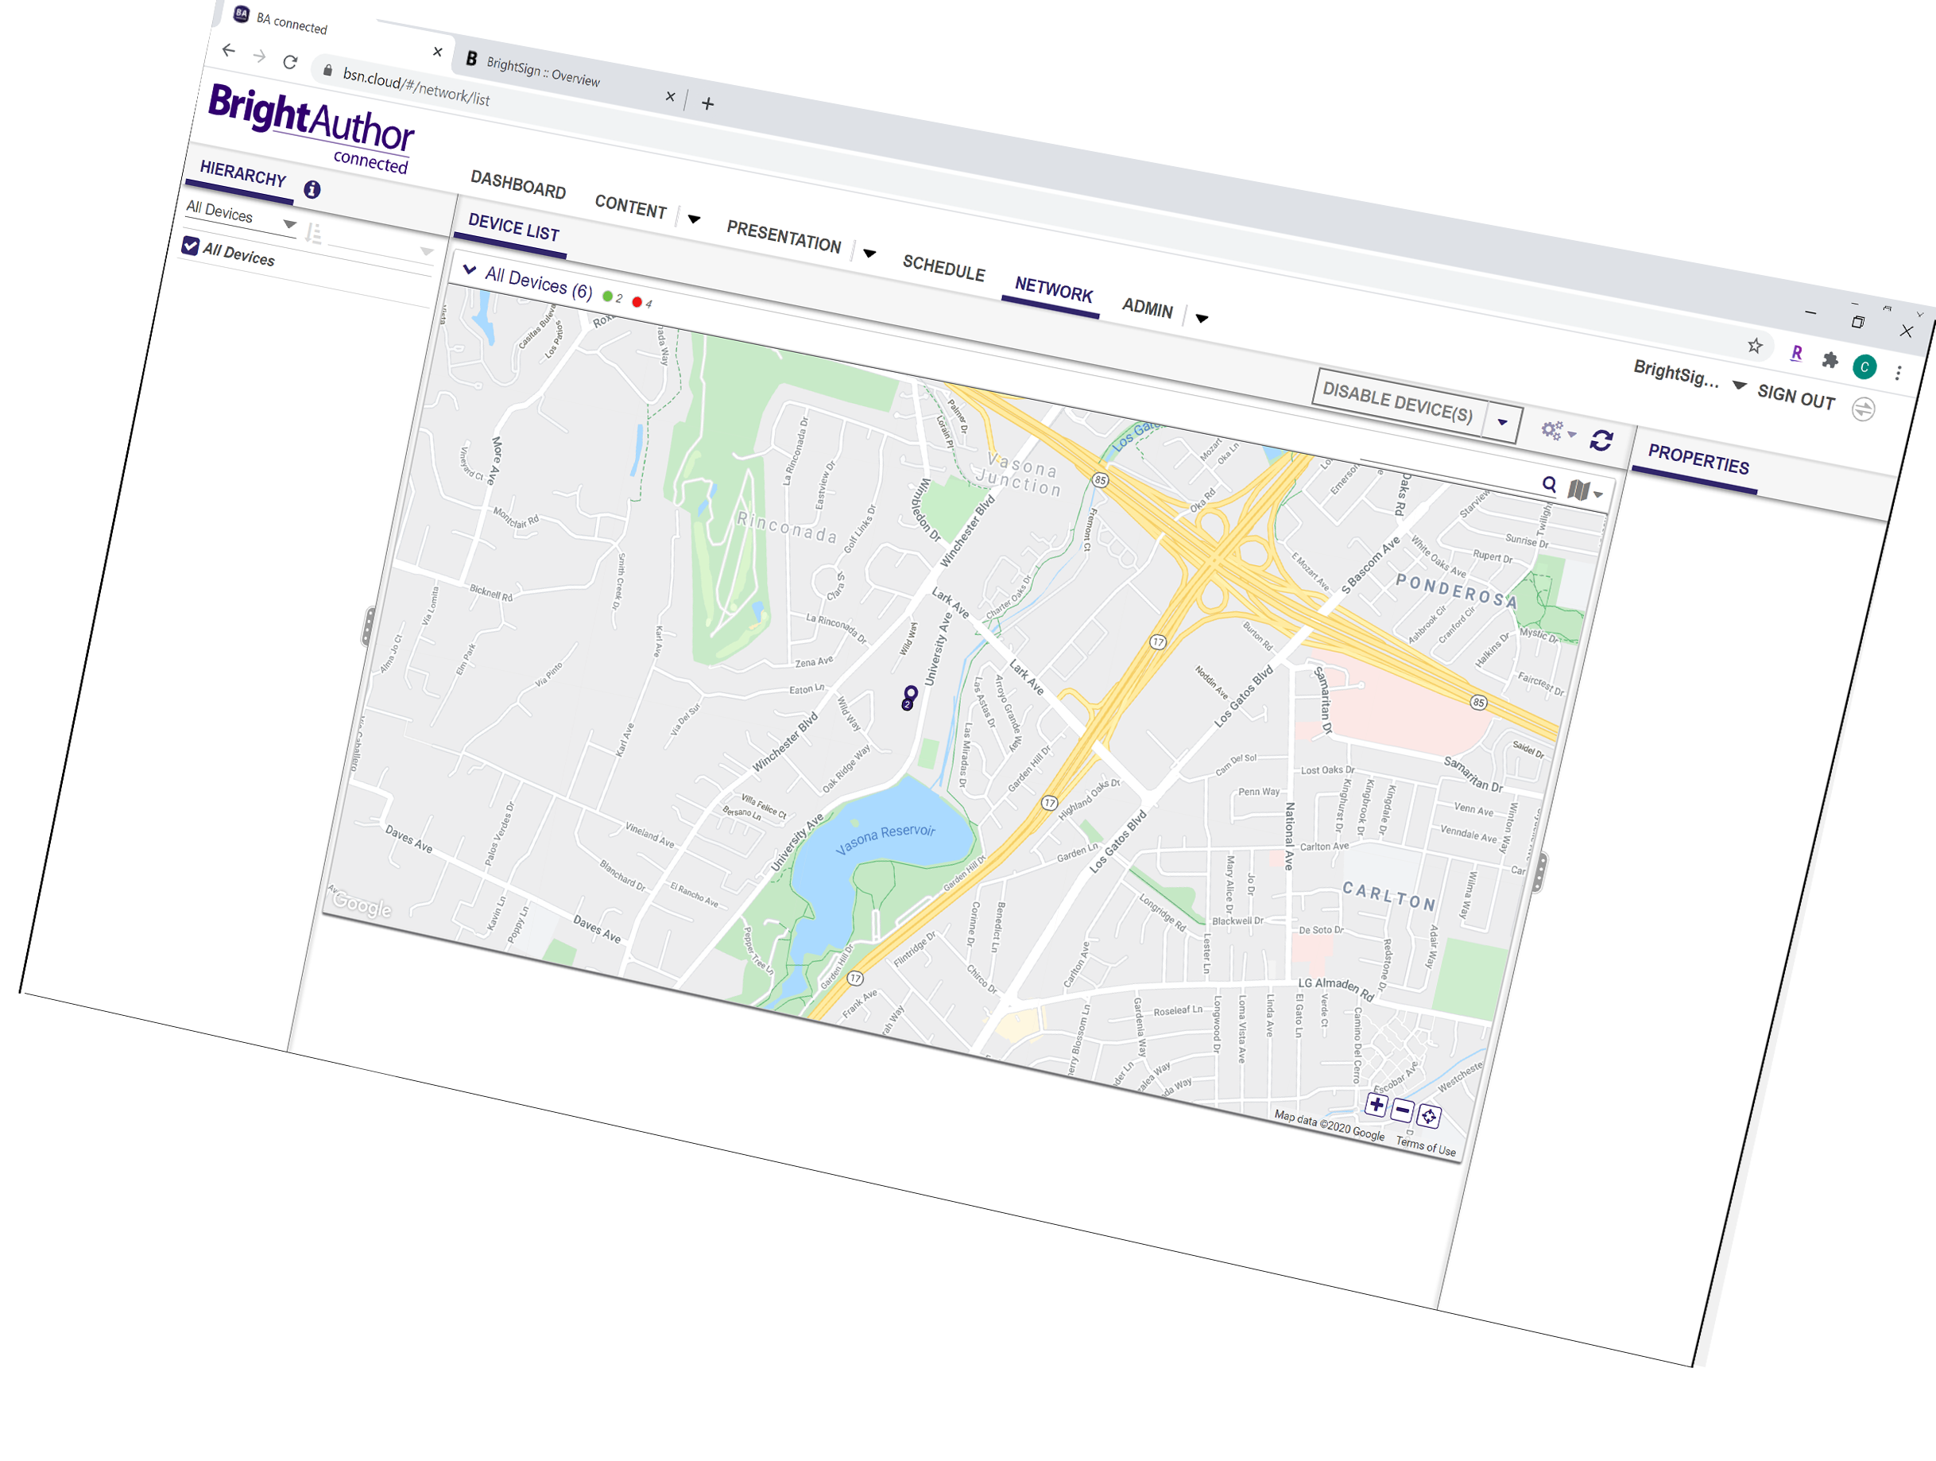
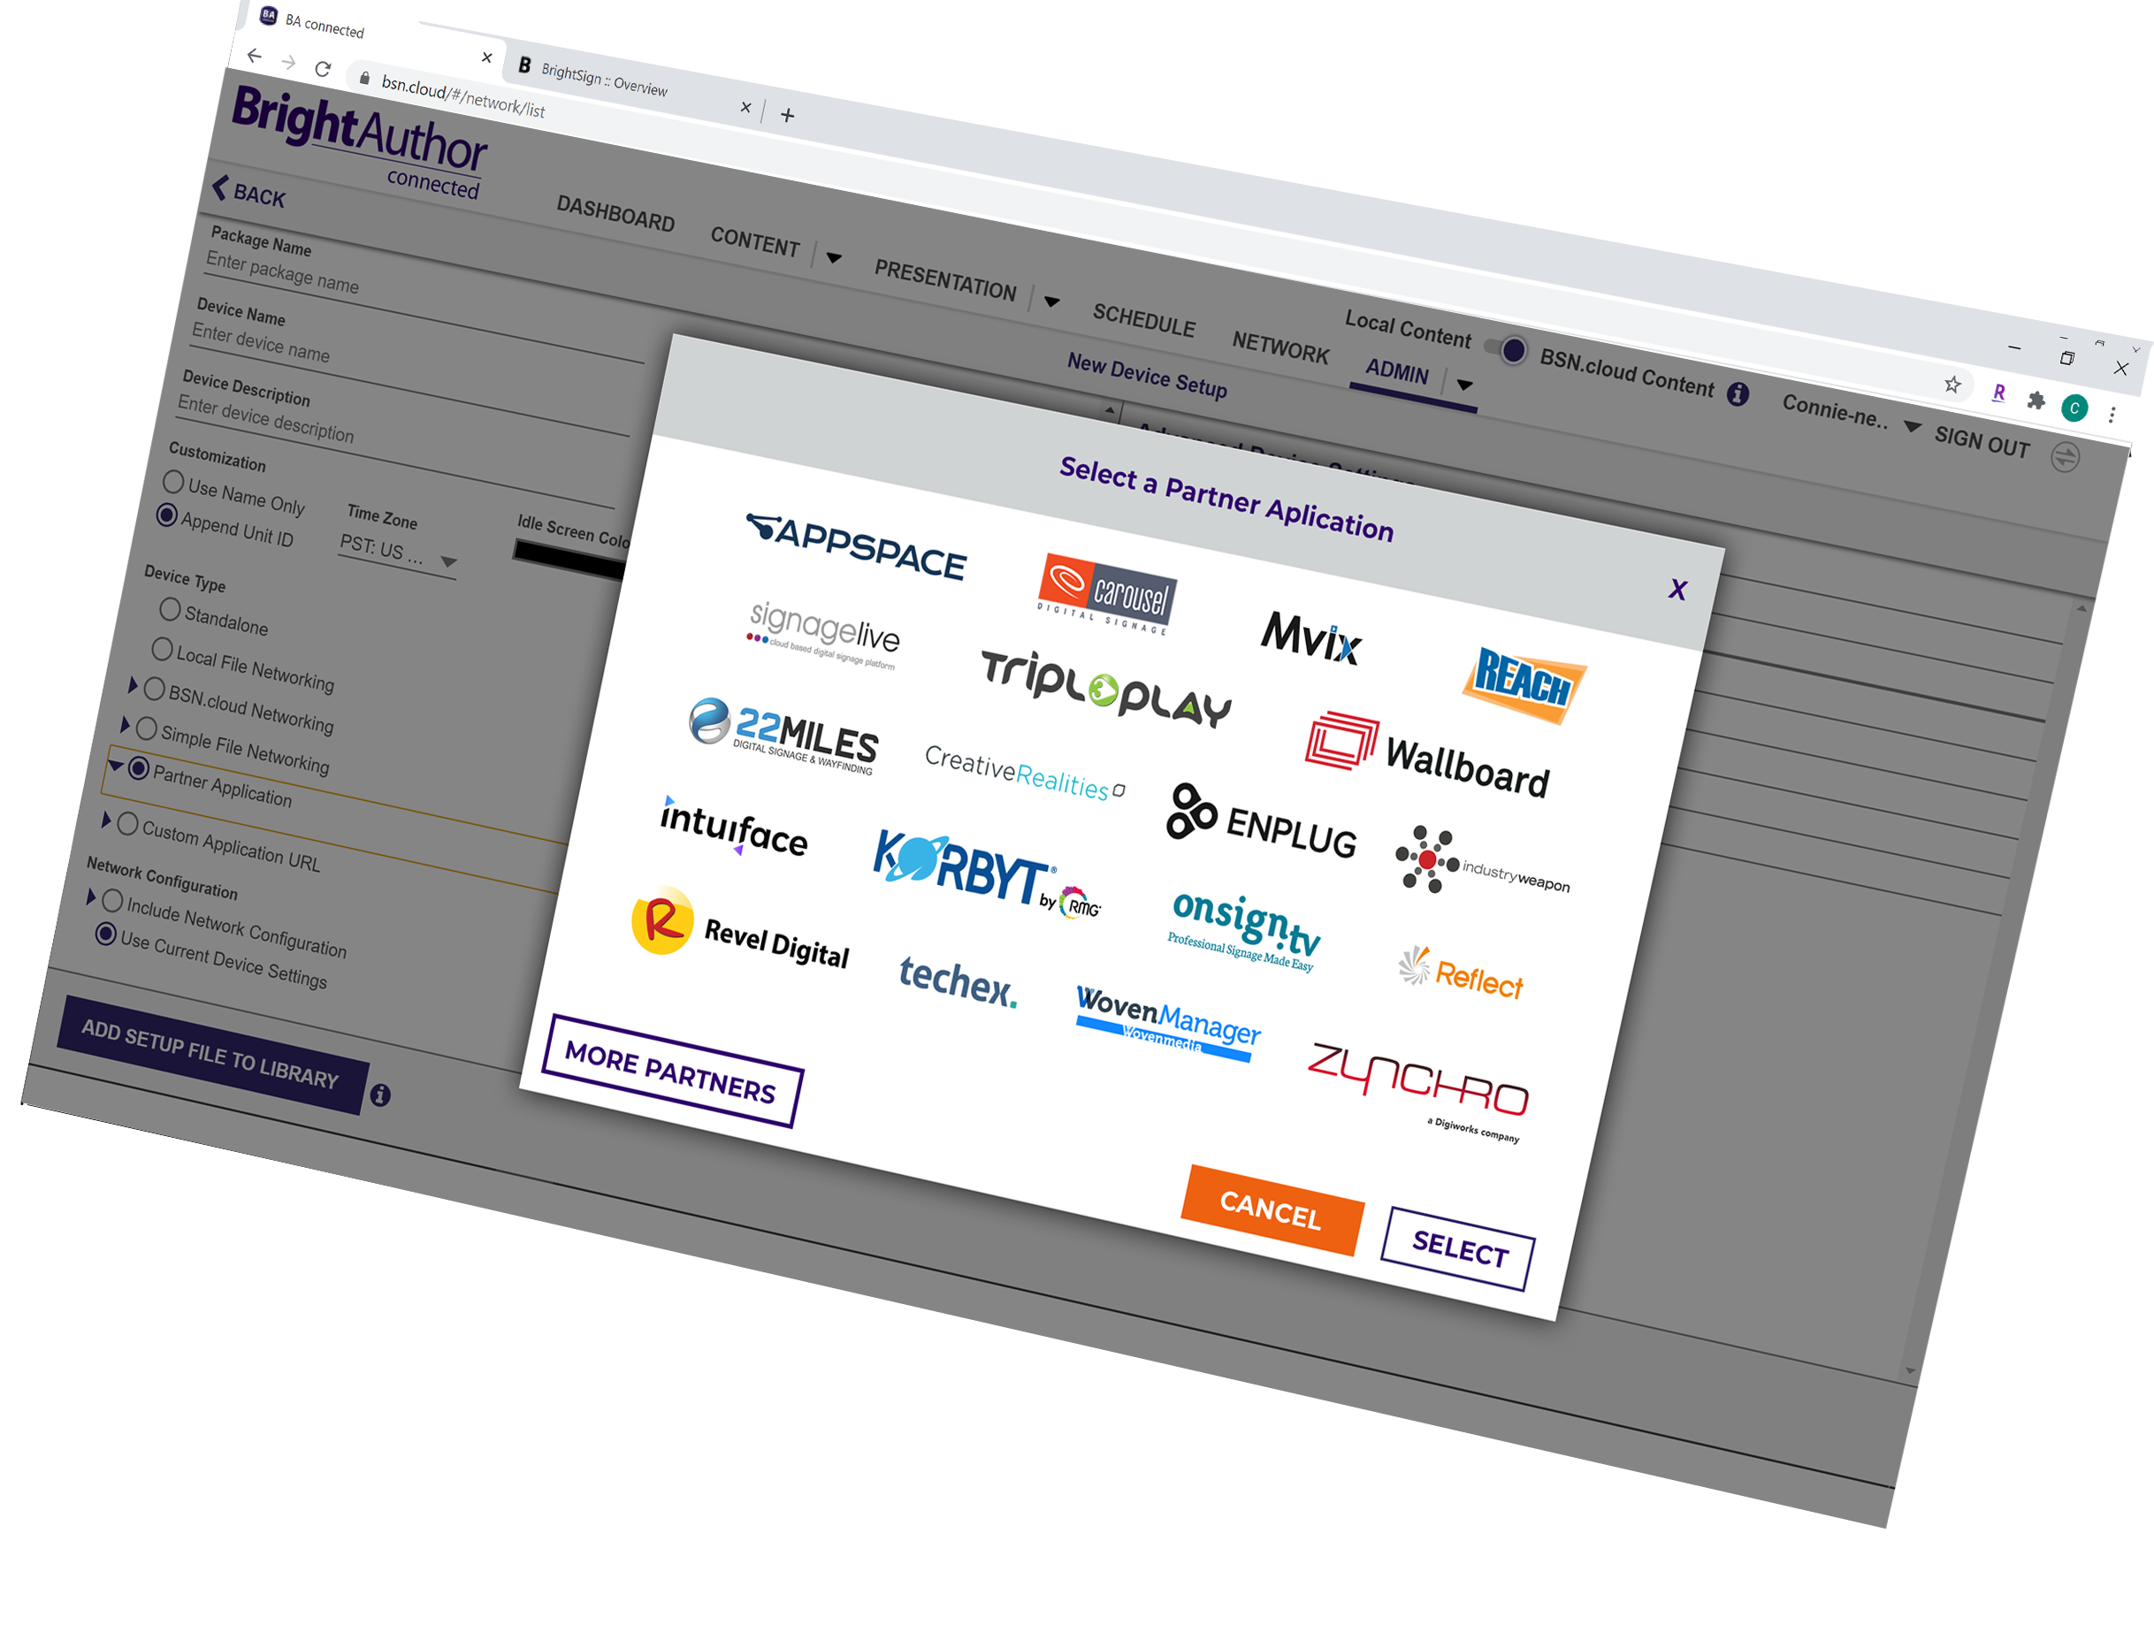
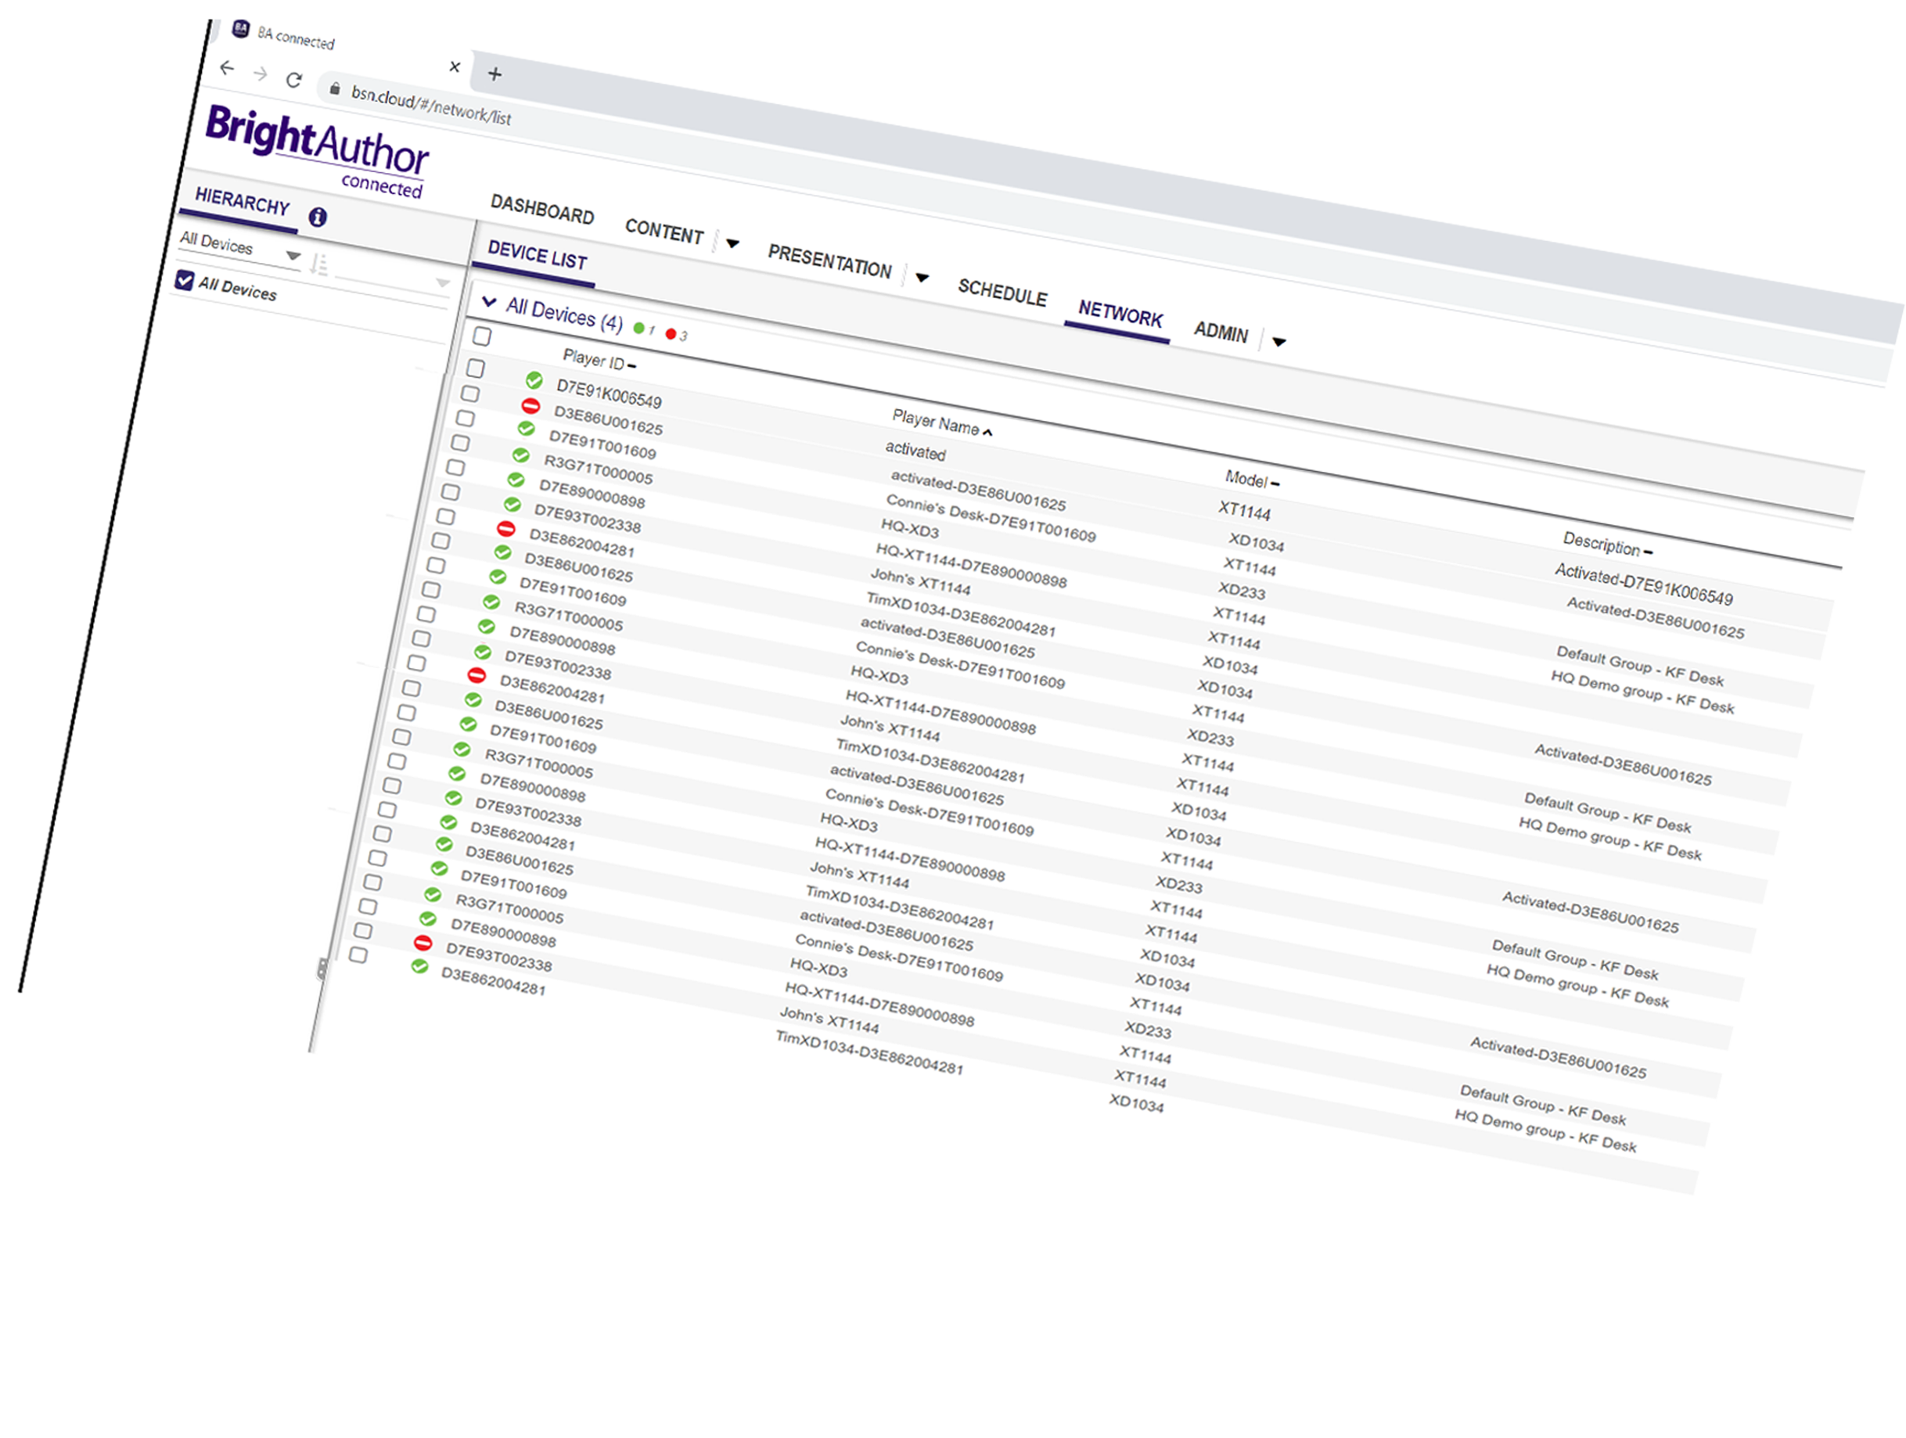
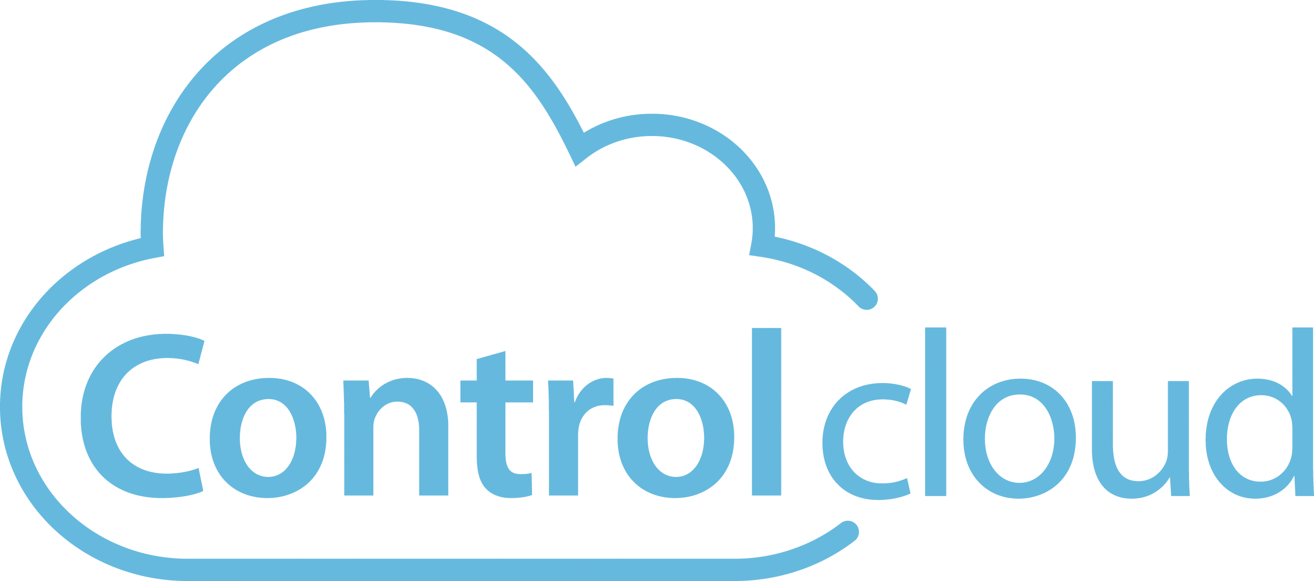
Cloud-Based Digital Signage Management
Streamlined player setup
Monitor & manage signage in real time
Instantly view what’s playing from afar
Control players remotely – anywhere, anytime
Notes:
CONTROL CLOUD
Now let’s take a closer look at what Control Cloud subscription gives you.
First of all it provides a new streamlined player setup process which easily provisions a BrightSign player for your free Control Cloud account and supports provisioning of single, multi or mass sets of players with ease. Not only that, the setup process can also provision your player for the integrated CMS of your choice. BrightSign supports a multitude of integrated CMS solutions to choose from - including our own BrightAuthor:connected solution if so desired.
Once connected, Control Cloud truly gives you the ability to monitor & manage players in real time with tools to show you the real time health and status of every player on your network. You can also remotely control them from afar using an array of tools that allow you to update firmware, view log files and update settings – all from a safe distance at any time and from anywhere.
Included with those real time controls is the ability to Instantly view what’s playing from afar by using the remote snapshot tool so you can ensure the content being played matches your expectations.
Control Cloud, like its name suggests, truly puts you in control of your digital signage network at all times and from anywhere

Slide 7
Notes:
Let’s take a look at what control cloud is capable of as shown in this example video.

Slide 8
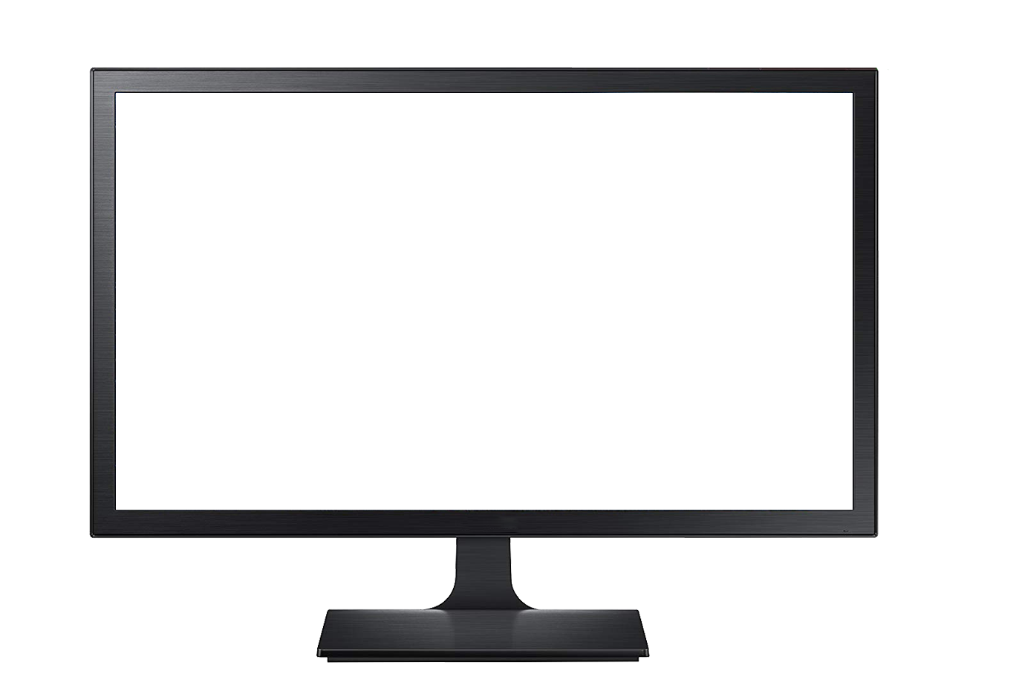
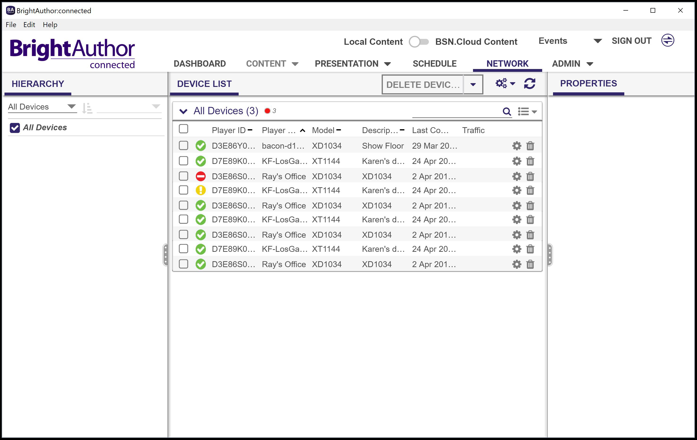
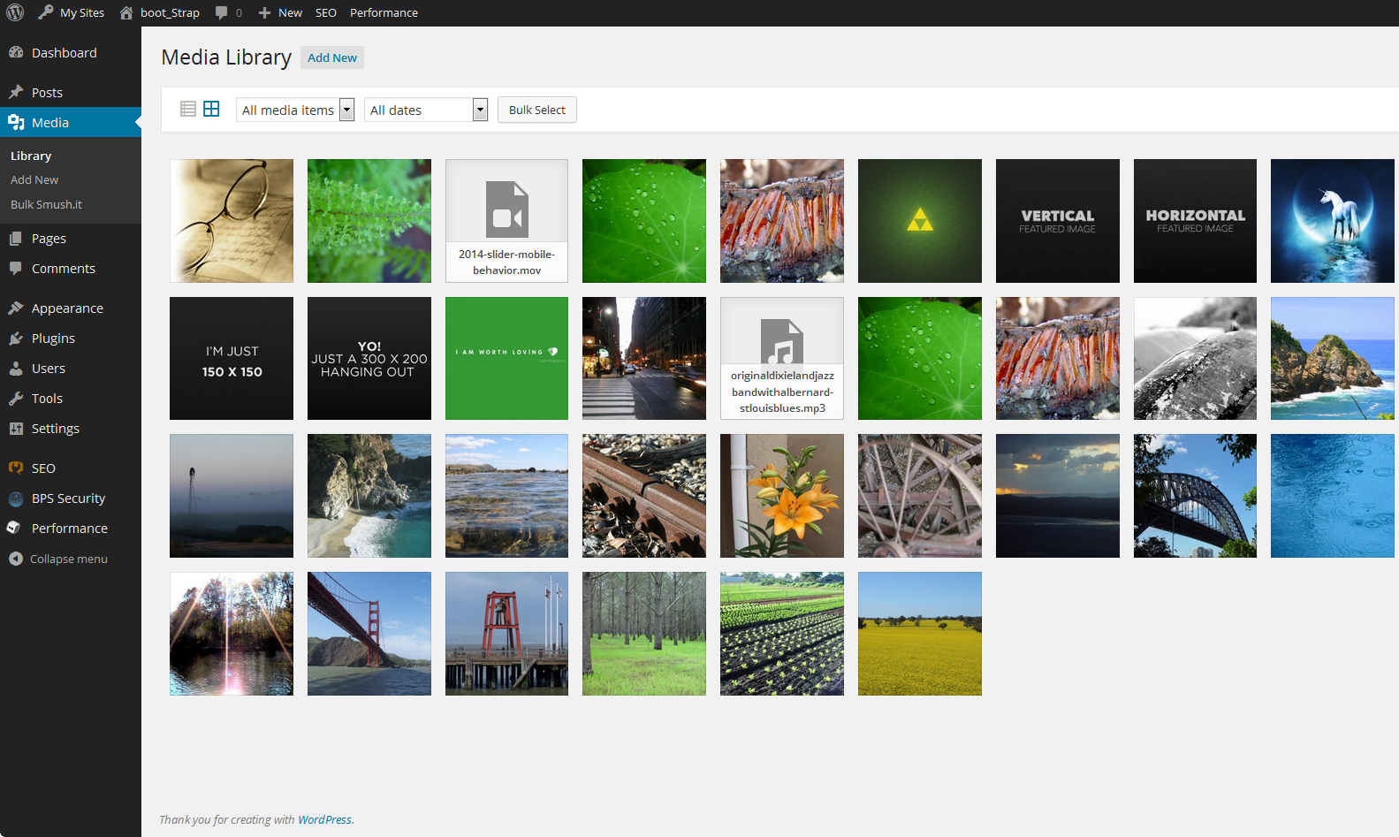
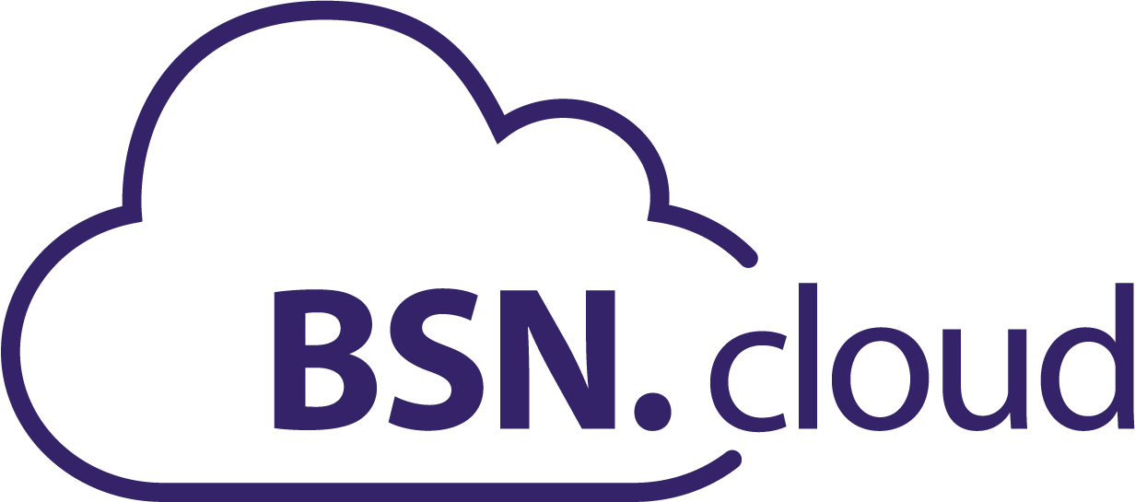
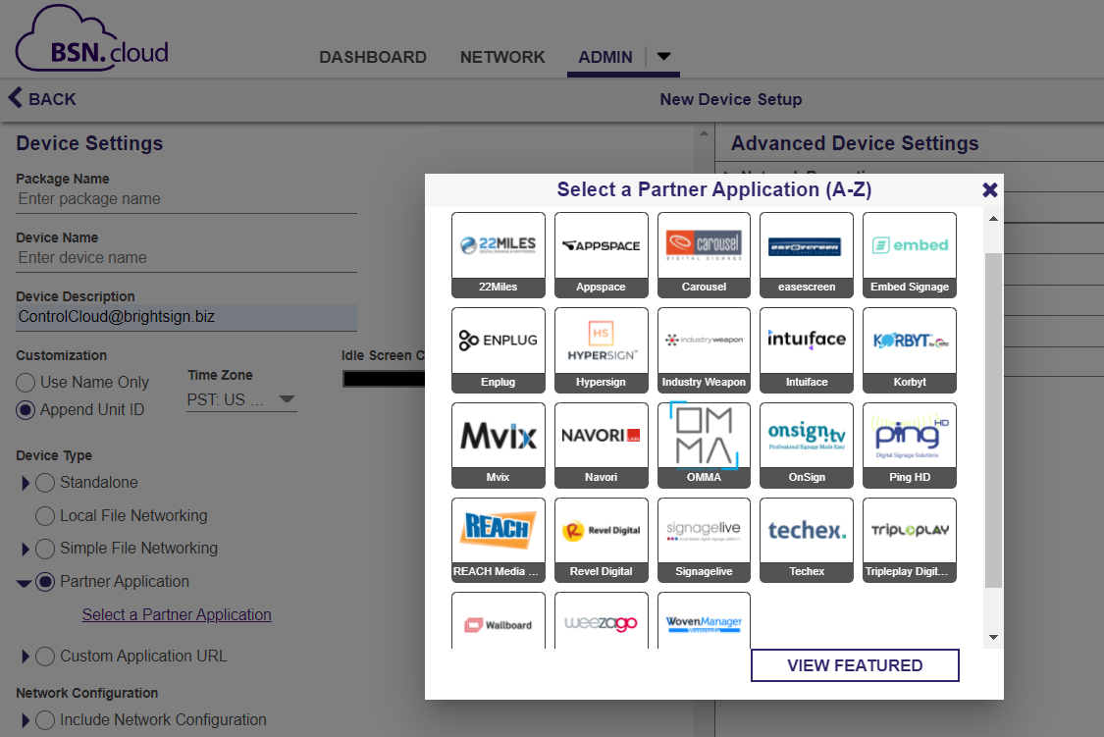
Workflow & Advantages
Real time player access is independent of content management
Integrated CMS
HEALTH
CONTROLS
Author
publish
Real-time Player Management
Your Choice of CMS
Streamlined dual provisioning
or
Integrated CMS
Dual Setup
Notes:
As you saw in the video, the free Control Cloud subscription truly puts our customers in control of their player network. And since the underlying foundation BSN.cloud provides separates player controls from content management, the workflow our users experience is unique. In this diagram you can see that you can manage your real time player network independently via the Control Cloud UI shown on the left while at the same time utilizing your choice of CMS to create, publish and manage content & presentations in a separate application as shown on the right. Now if you choose BrightAuthor:connected as your CMS, the experience becomes more unified, but the side/by/side experience is seamless as well.
Now to get to this point the player needs to be provisioned for both BSN.cloud’s Control Cloud as well as the CMS of your choice – and we offer that as an all in one automatic dual provisioning setup process. And the with the sophisticated controls that Control Cloud offers, you can adjust that CMS choice at any time and reprovision your player remotely and you can even support a mix of CMS solutions assigned to your fleet of players.

Slide 9
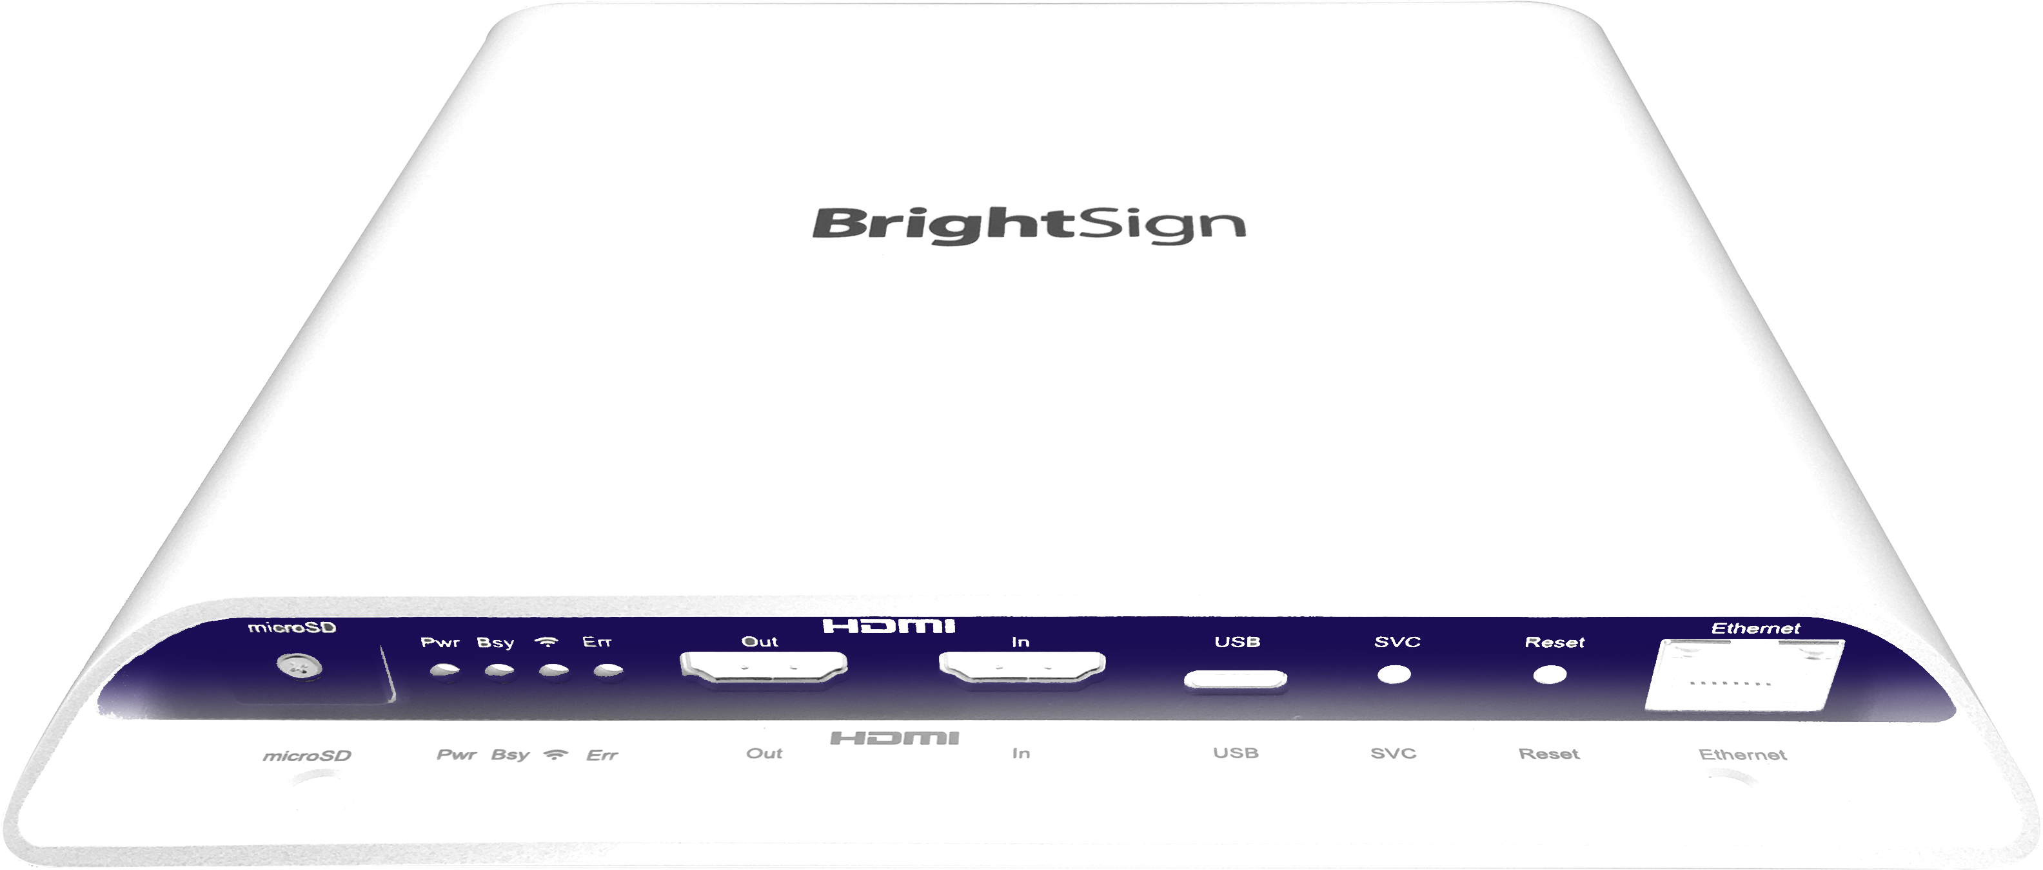
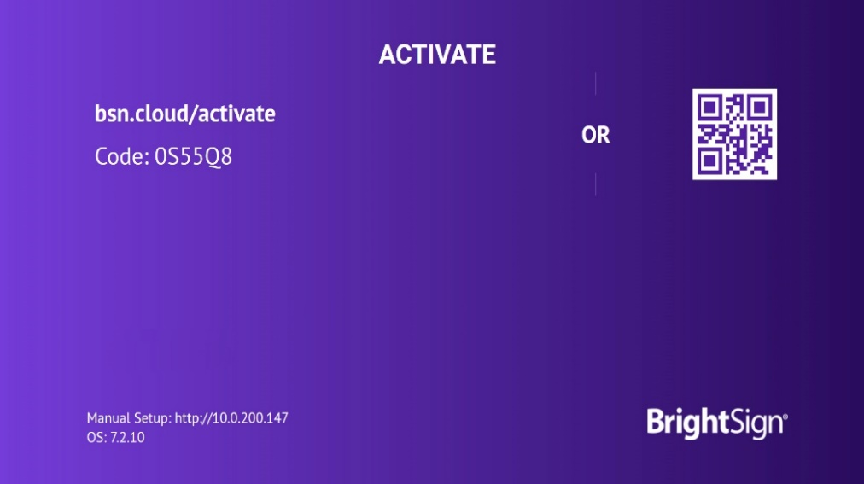
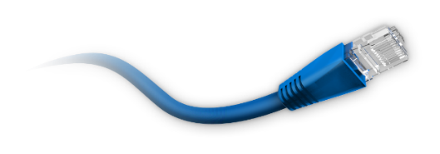
Streamlined Setup
Easily provision players in a matter of minutes
Sign up for a free Control Cloud subscription
Activate your player with default settings
power up with an Internet connection & blank SD card
follow the simple on-screen instructions
Options:
Customize setup with the CMS of your choice
Deploy a multitude of players at once
Multi-network port prioritization & redundancy
Support for BrightSign Mobile
WPA Enterprise/802.1x
Tagged VLAN support
New
Notes:
To discuss a bit further our provisioning features, BSN.cloud offers an extremely streamlined setup process that allows you to get your players up and running in a matter of minutes. To get started with our default setup, it’s a simple 2-step process of signing up for a free Control Cloud subscription online and following the on-screen instructions after you power up a player that is Internet connected and has a blank SD card installed. Beyond the default setup we offer a wide range of provisioning options including adding to the setup the CMS of your choice, choosing to apply settings to mass sets of players at once and now newly available, being able to select the settings you need for our new BrightSign Mobile service.

Slide 10
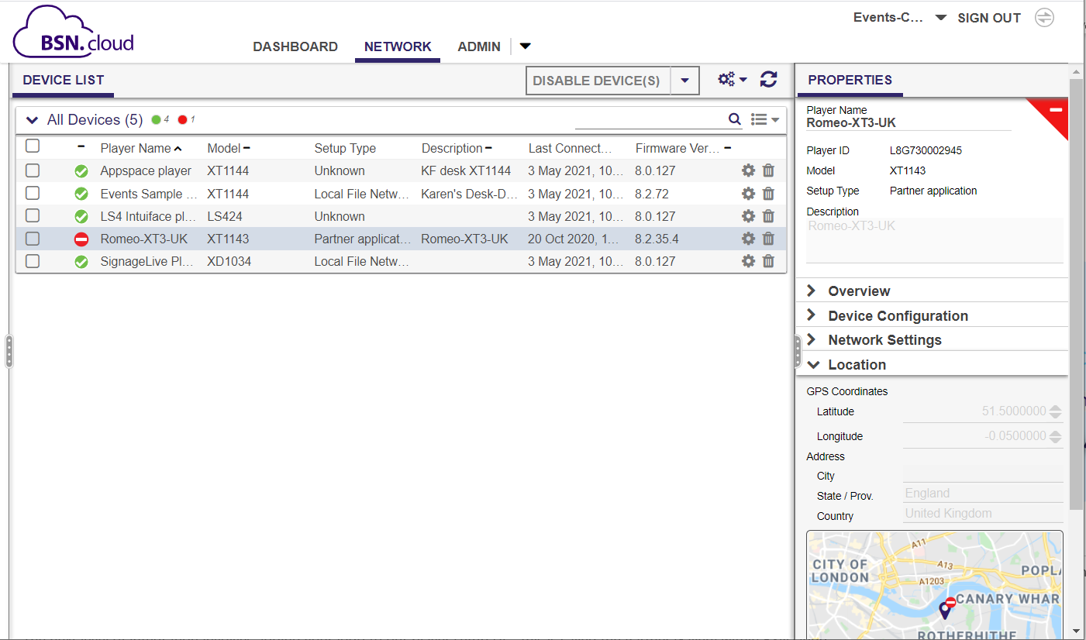
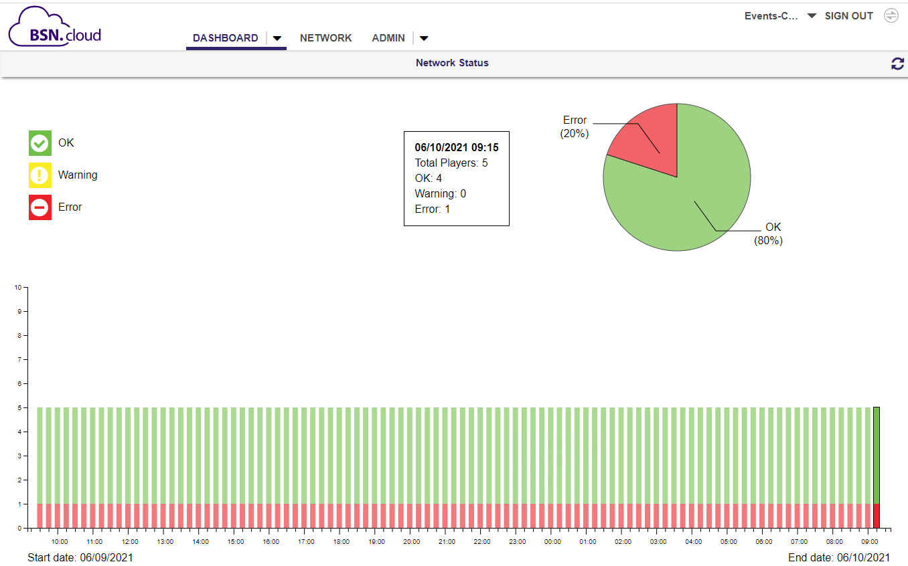
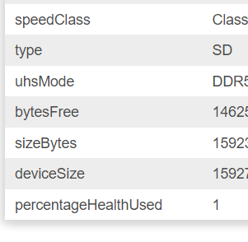
Real Time Player Health
anytime, anywhere
Player Status
Properties & Location
24-hour Health Report
Up time
SD Card Health
New
Notes:
Here’s a closer look at what at the vast array of real time tools you get with Control Cloud that apply to both player health and remote player controls.
What’s new:
reporting feature which offers a visual look at how your network of players have been operating over the last 24 hours. While this tool doesn’t provide specific player-level details it’s a great way to see the health of your entire network with a single click.
And you can now take advantage of our Smart Health Monitoring. View the SD card health and determine if it needs to be replaced. When the % health used reaches 90% we recommend you purchase a new BrightSign Micro SD card from us to replace the old one. Just make sure you player is running the latest OS 8.2.75 or higher and that you have a BrightSign purchased Micro SD card running on the player

Slide 11
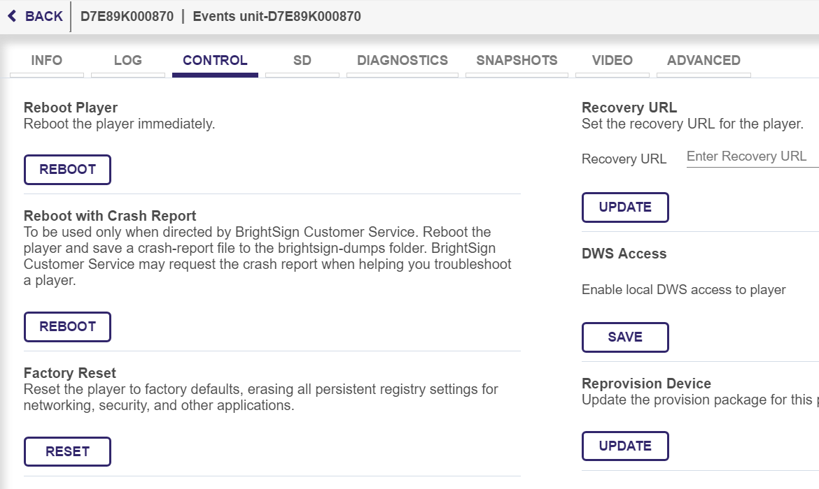
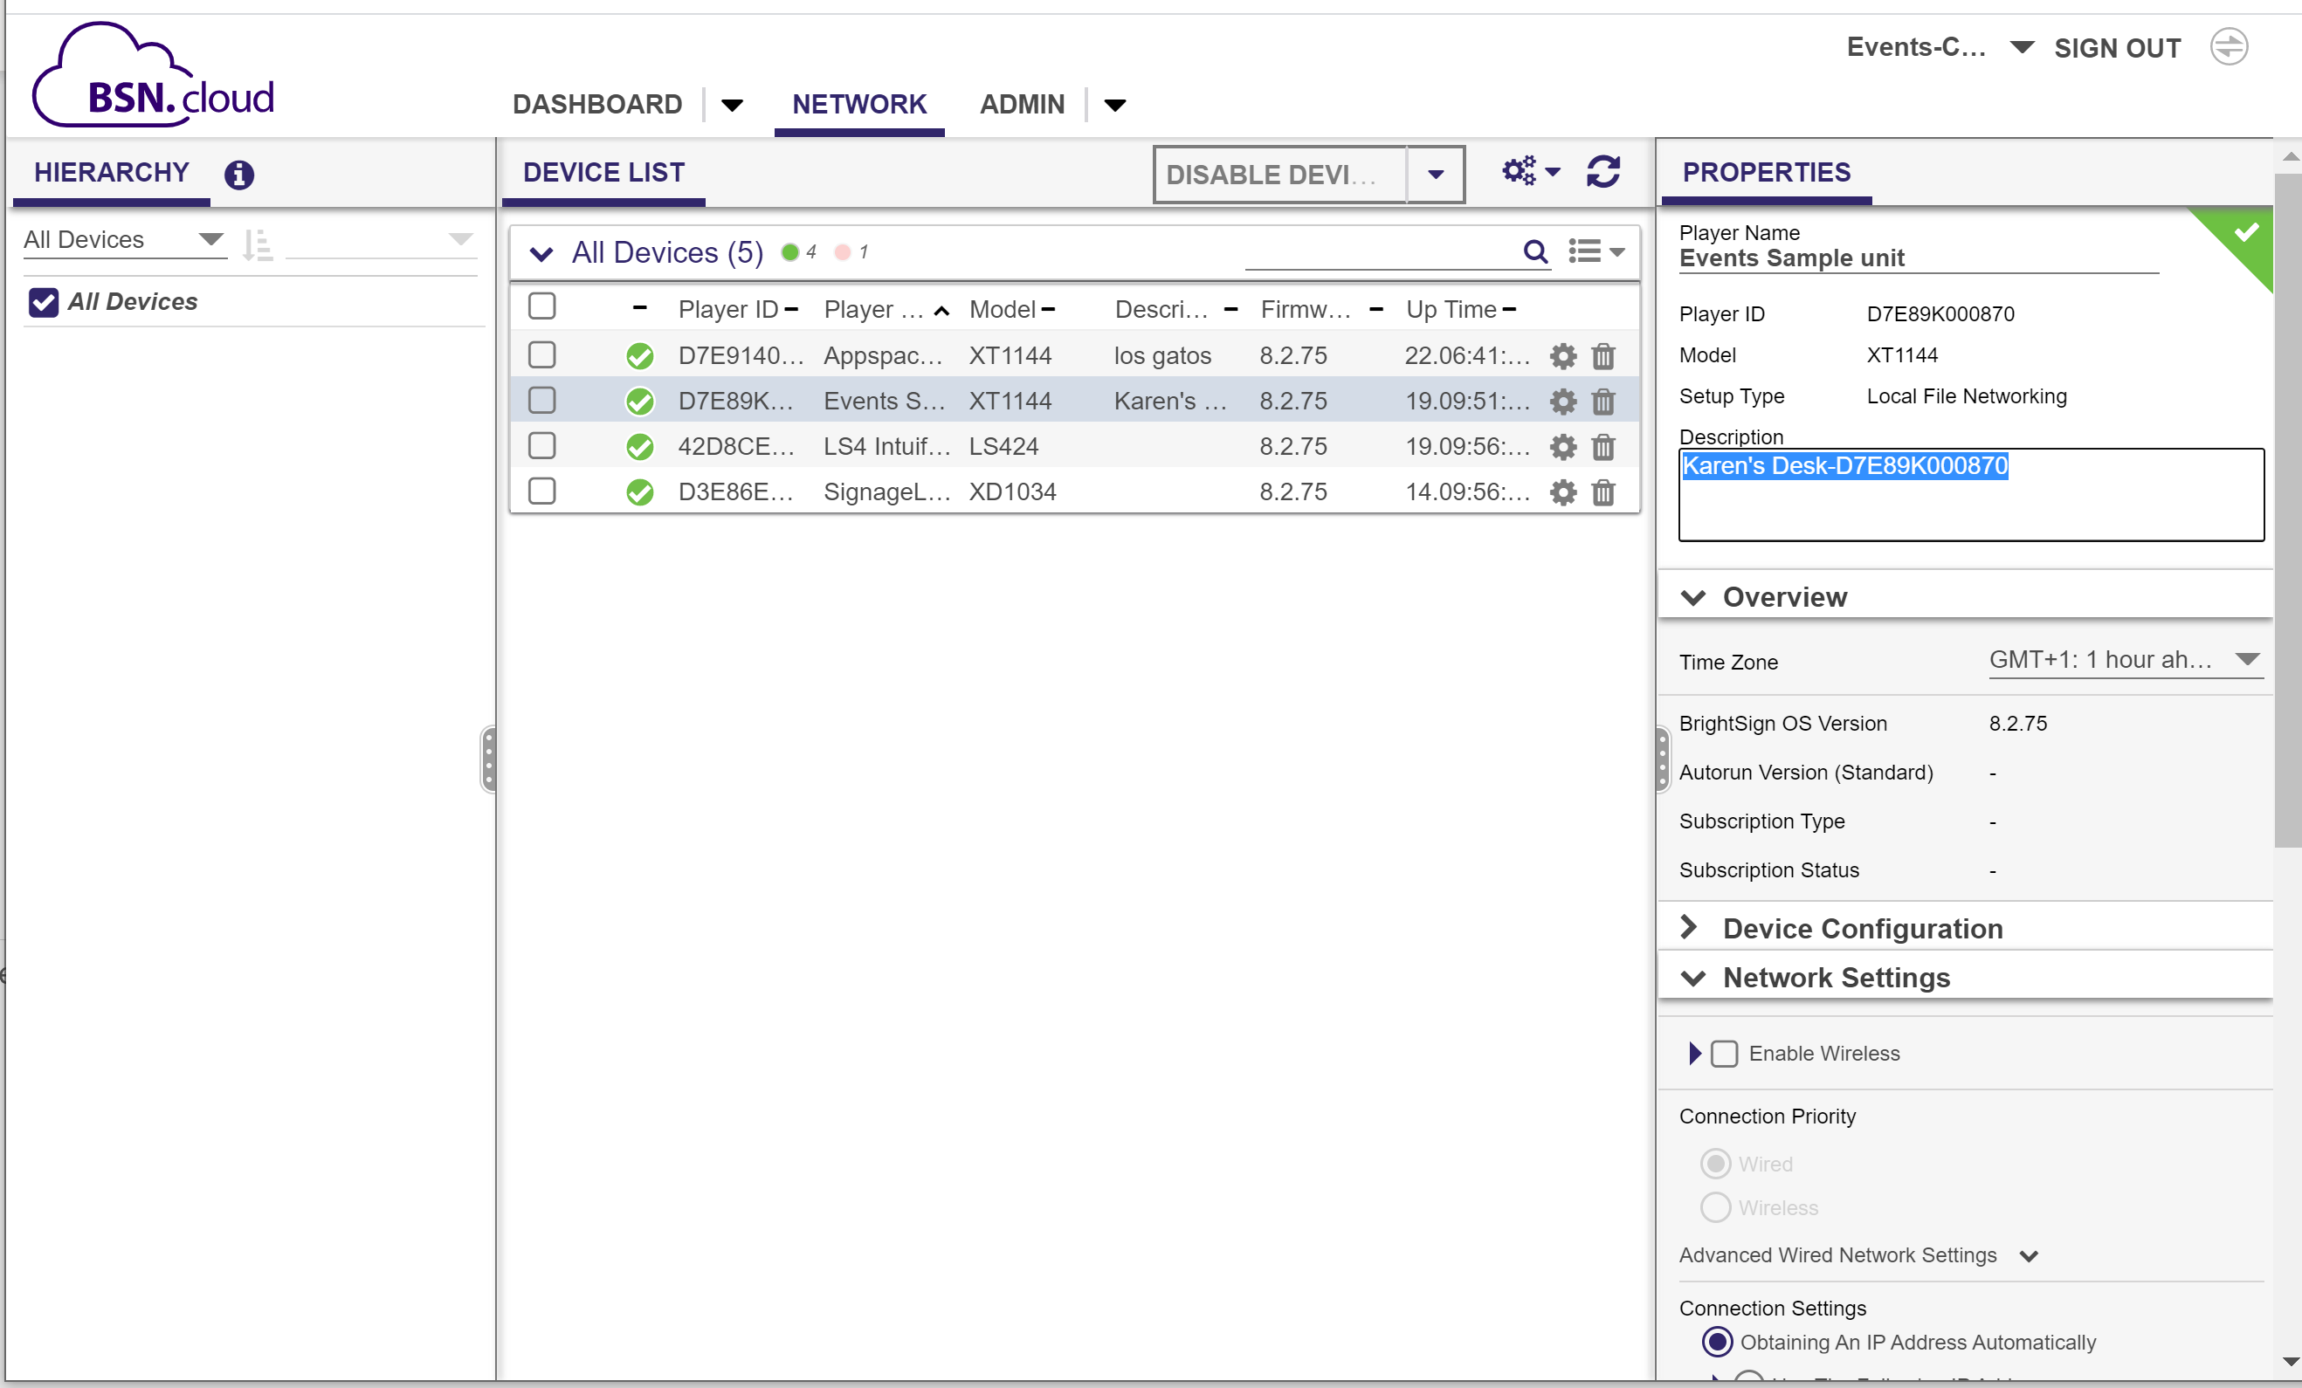
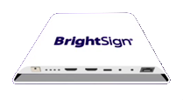
Real Time Player Controls
anytime, anywhere
Reboot, Reprovision & Reset
Update Network Settings
Adjust Network Priorities
Auto Network Config Rollback
Remote Snapshot
Set Video Mode
View Log Files
Edit Player Properties
Enable Diagnostic Webserver
Auto Network Discovery
Update OS
Run Diagnostics
New
Notes:
Here’s a closer look at what at the vast array of real time tools you get with Control Cloud that apply to both player health and remote player controls.
Some of the key new features that were recently updated and made available to all players for free are the abilities to edit player properties such as player name and description, adjust network settings including network configuration changes, network priorities and access to the diagnostic webserver – all in real time and all without reprovisioning the player. We can even automatically discover new network interfaces and configure them as well as ensure fail-safe operation with our automatic rollback to the last known valid network configuration.

Slide 12
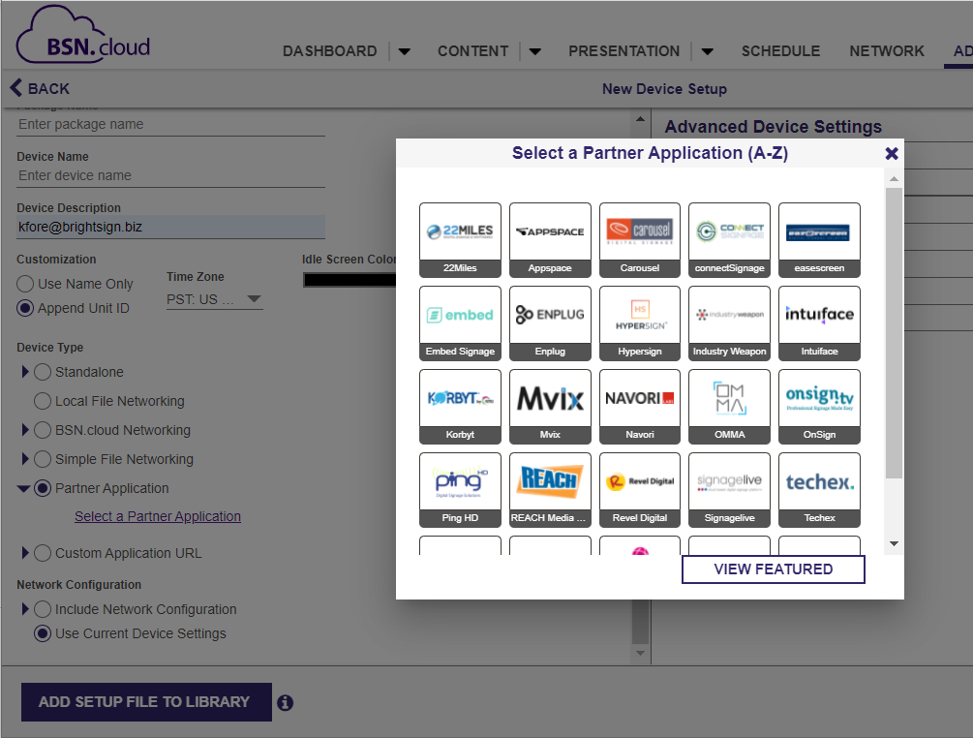
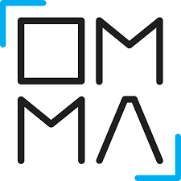
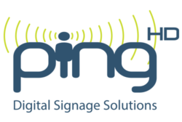
Integrated CMS Partners
Notes:
We have over 20 leading CMS partners that have integrated with BSN.cloud and that list continues to grow. View the popup list in our BSN.cloud interface under device setup for the latest list.

Slide 13
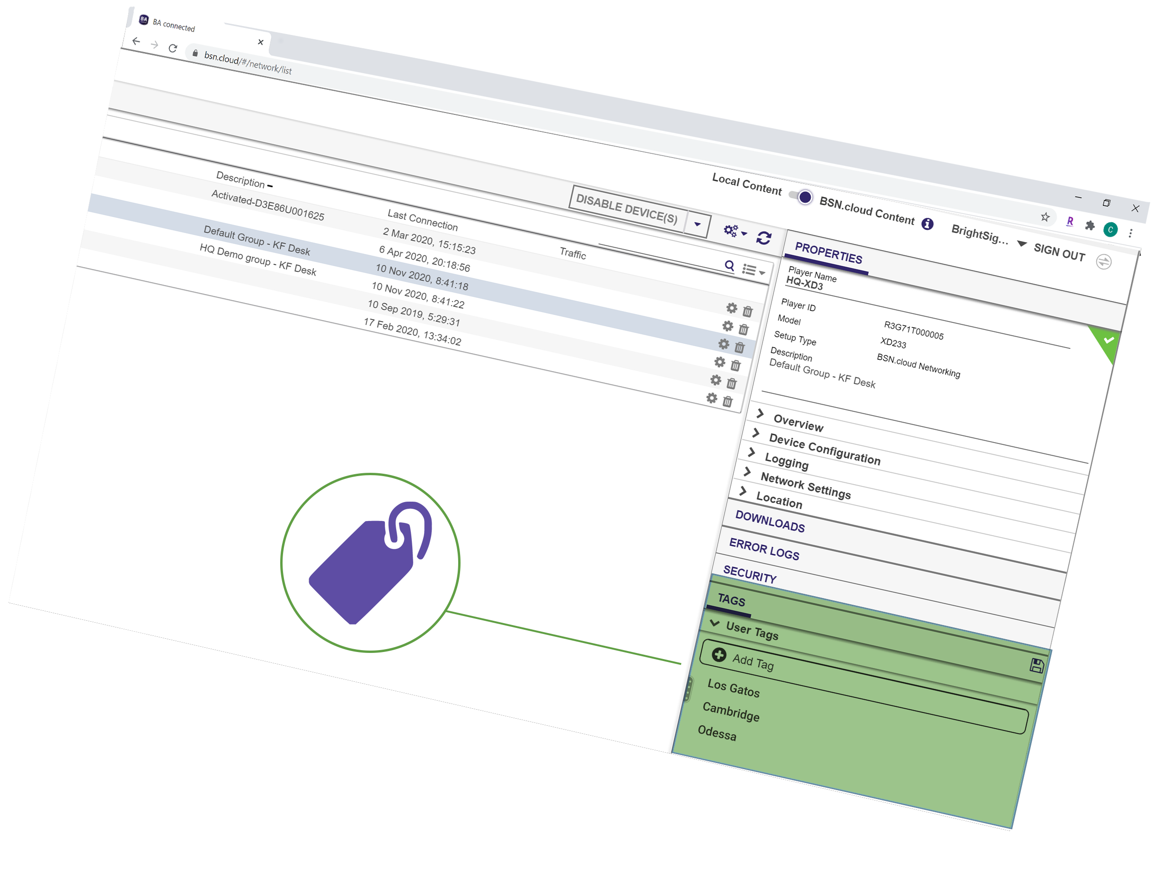
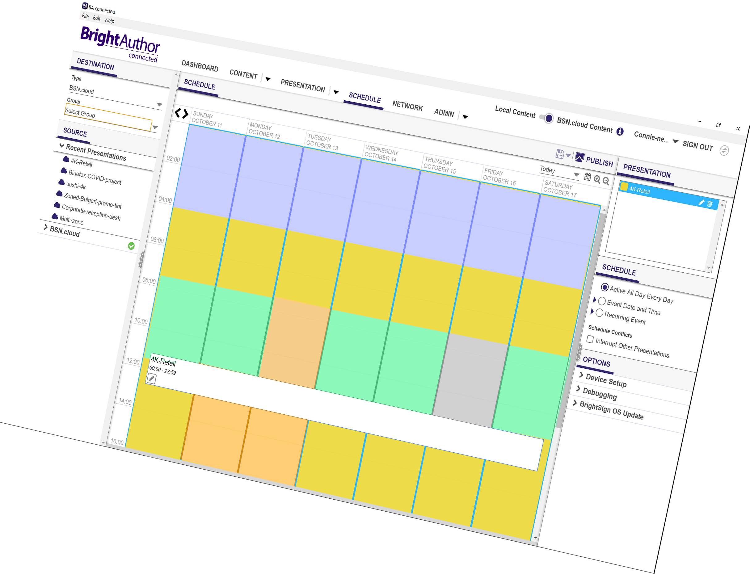
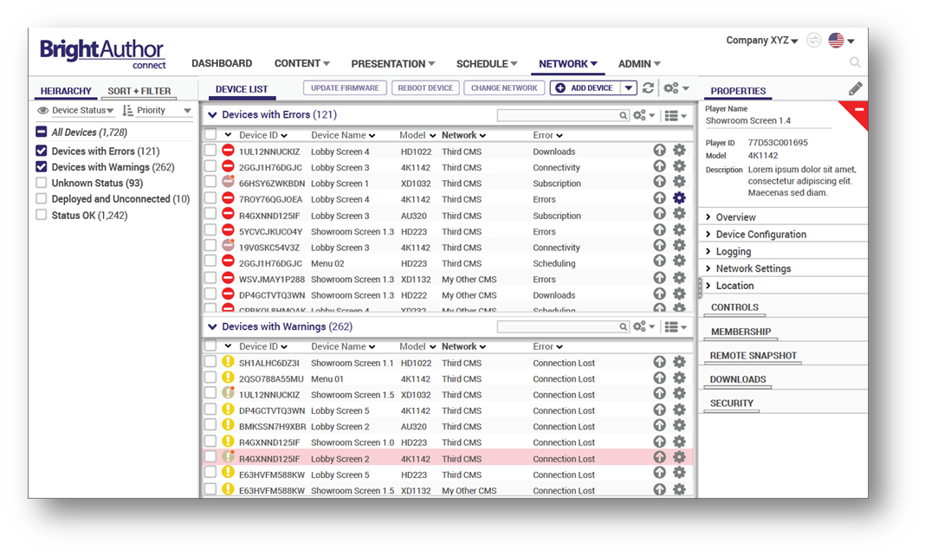
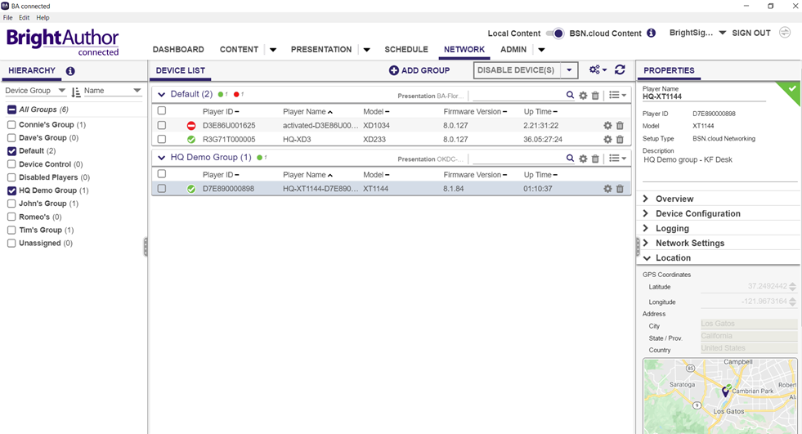
Cloud-Based Digital Signage Management
Delivers timely content updates instantly
Create network groups of players
Apply tags to delivery highly targeted content
Player data and reporting over time
Notes:
CONTENT CLOUD
With Content Cloud, you get all that Control Cloud offers plus
the ability to deliver timely content updates instantly without physically being onsite using our free BrightAuthor:connected which runs on a PC, MAC or from a Chrome web browser.
This level of service also adds the ability to create Network Groups of players
You can also apply tags to players and content to deliver highly targeted content automatically using tagged playlists
And finally you get access to player data and reporting over time including proof of play

Slide 14
Notes:
Now I’d like to show you a glimpse of what Content Cloud is capable by playing this example video.

Slide 15
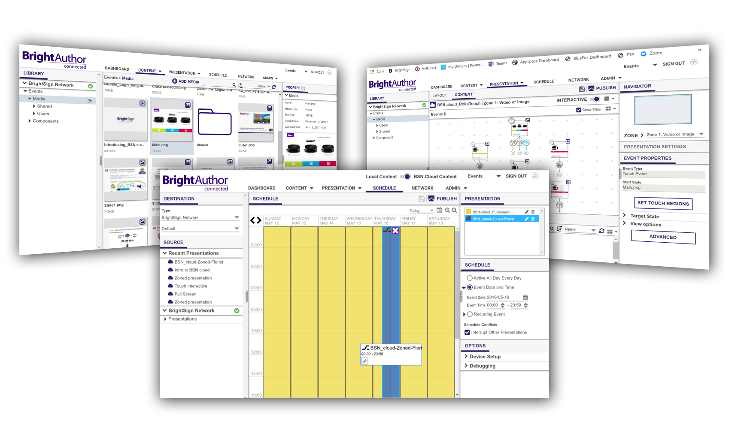
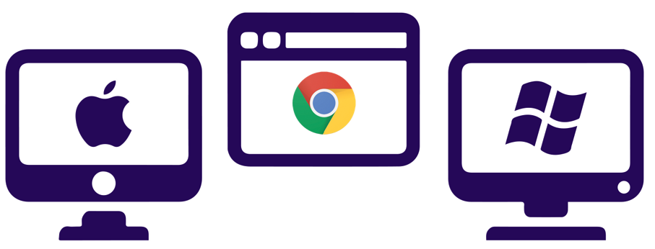
Cloud-based Content Management
Access every BrightSign content & authoring tool with our streamlined CMS interface
Notes:
To recap, here’s a look at some of the Content level functionality offered within BrightAuthor:connected.
You get presentation templates to choose from to build digital sign presentations and because you have a Content Cloud subscription, all presentations are stored in the cloud within your BSN.cloud account so they are accessible anywhere and at anytime.
You can view and manage your content library including the ability to sort media types including images, audio, video and HTML. You can even preview video playback of specific assets.
It supports looping and interactive playlist creation and gives access to each and every one of our BrightSign player authoring tools to create unique and interactive experiences that take advantage of cloud connectivity including dynamic playlists, live media feeds and much more.
BrightAuthor:connected also offers flexible presentation scheduling with content interrupts & dayparting so you can deliver you content over the cloud efficently to all your players at once.

Slide 16
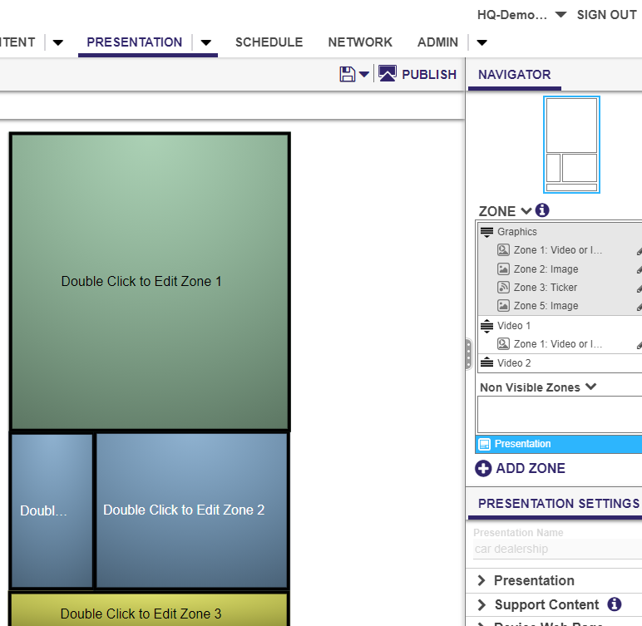
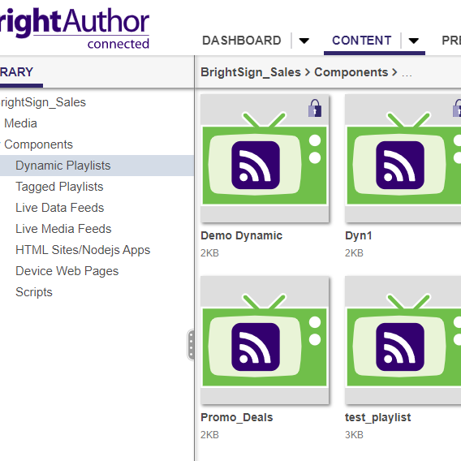
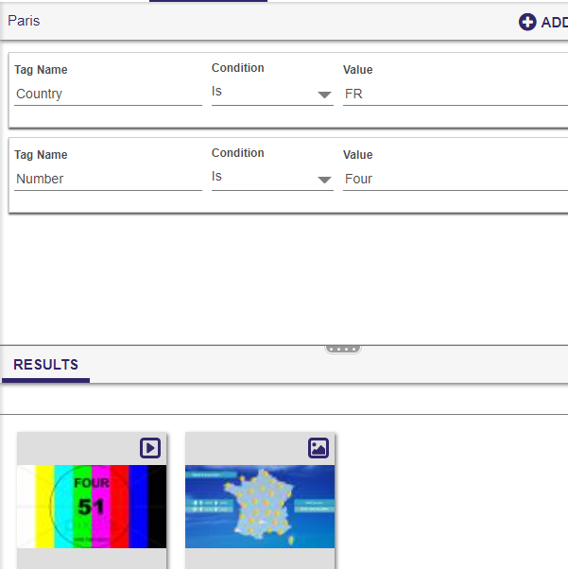
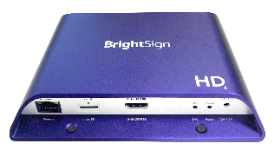
Authoring Workflow
Streamlined process to author, schedule & publish presentations
Create Feeds
Layout
Tag
Author
Schedule
Add Content
Play
Notes:
The Authoring workflow with BrightAuthor:connected is intuitive and streamlined allowing you to create, publish and playing presentations with ease. For Content Cloud subscribers, they standardize on using BrightAuthor:connected as their CMS vs. a partner solution. For these subscribers, BrightAuthor:connected operates in the cloud to host content media libraries, create zoned layouts, build playlists, author presentations, scheduling & publishing presentations in the cloud so you can work from any location at anytime. The BrightAuthor:connected workflow process in general is the same regardless of the level of service where you take content, author presentations and publish them to players using various player connected methods that meet your network environment & level of BSN.cloud service.
While Control Cloud users can utilize BrightAuthor:connected as their CMS, the workflow is done locally using the PC or MAC desktop versions and access to tagging, content feed creation is not possible.

Slide 17
Network Management
Administer your entire player network & users with ease
Player Groups
Player Tags
User Settings
Player Subscriptions
Notes:
In terms of the network management features Content cloud offers, one key capability that is supported is Player Network Groups. Organizing players into network groups makes managing your network of player & content publishing much more efficient. You need only publish a presentation once to a group and all the players in that group will receive it. You can also easily move players from one group to another without reprovisioning and streamline your OS updates as well.
Other network management tools this service supports is collecting and storing data about player performance over time which is important to network managers. It will also support proof of play for the DOOH market, more reporting and administrative functions such as pushing out email notifications when player issues arise, notifying you of subscription expirations and more

Slide 18
STREAMLINED PROVISIONING
REAL-TIME
HEALTH
ENABLED FOR ALL PLAYERS
PC, MAC & CHROME
BROWSER
SECURITY &
SCALABILITY
Advantages
NETWORK & CONTENT
MANAGEMENT
API
OPEN
ARCHITECTURE
Notes:
To recap, with the new BSN.cloud platform you get a plethora of advantages:
Streamlined player provisioning that not only sets up our players for BSN.cloud but also the CMS of your choice - all in a single setup process!
It is enabled on all BrightSign players for free via our Control Cloud subscription to access real time player communication for health status & remote control of players
It offers better Network Management, access to player data & advanced network administration
With the Content Cloud subscription we can also offer better Content Management that delivers a streamlined workflow, access to every one of playback and interactive features for creating presentations and it is available as PC & Mac desktop applications as well as a Chrome-based Web UI – all of which have a uniform interface, workflow and feature set access
This new platform also delivers an exceptionally secure due to its de-centralized design which also allows us to deliver improved network scalability
And it is built with an open architecture which we provide access to via open APIs that easily allow our partners to integrate with us.

Slide 19
BrightSign Network continues to be supported
The Network Platform of choice Now & beyond
Notes:
The BrightSign Network platform was the beginning of our cloud-based networking expertise, and while we will continue to fully support this service as it currently stands, our future is in our new BSN.cloud platform where will be developing and delivering new cloud services and capabilities that enable our customer’s networks to easily scale, evolve and continue to grow wherever the future takes us.

Slide 20
Comparing our Cloud-based Networking Solutions
BSN.cloud platform delivers varying levels of secure & scalable player, network & content management services
Free Control Cloud Subscription available on all BrightSign players offering streamlined setup, real time player health, remote player controls & your choice of CMS
Content Cloud Annual Subscription adds a complete set of content & network management tools with BrightAuthor:connected as your CMS
BrightSign Network is a cloud-based subscription service offering player, network and content management
BrightAuthor free PC desktop app performs presentation authoring, scheduling and publishing
The Web UI administers accounts, users and player networks as well as some cloud-connectd authoring features
Notes:
BrightSign offers 2 solutions for cloud-based digital signage networking. These 2 solutions are comparable to each other in many ways but operate separate from each other. In this section, we will provide an overview of the 2 solutions, compare them and help you determine what is the best solution for your networked environment.
Both BSN.cloud and BrightSign Network are cloud-based networking solutions, but the fundamental difference between them is that BSN.cloud is a PLATFORM that runs on BrightSign players and is offered at varying levels of services. In contrast, BrightSign Network is a SERVICE and a cloud-based platform.
BSN.cloud platform can be enabled on any BrightSign player that is running BrightSign OS 8. The baseline level of service for the BSN.cloud platform is Control Cloud which is a free subscription included for all players and offers streamlines setup, real time player health and controls & your choice of CMS – you can choose our own BrightAuthor:connected or an integrated partner CMS solution. The Content Cloud level of service for the BSN.cloud platform is an annual fee-based subscription which offers everything in Control Cloud plus adds content and network management in a secure cloud environment and uses free BrightAuthor:connected which runs as a desktop application on PCs and Macs as well as in a Chrome web browser all of which have a unified user interface with access to all features and capabilities which is different from BrightSign Network and BrightAuthor.
The BrightSign Network Service is comparable to the BSN.cloud Content Cloud service in that both are offered as fee-based subscriptions and include content and network management in the cloud. BrightSign Network uses free BrightAuthor software, which is a PC-based desktop application, as the CMS for presentation authoring, scheduling and publishing, while network management and administration tools are primarily performed in the Web UI.

Slide 21
Network Services Comparison
Real Time Player Management
Network
Management
Content
Management
Presentation
Authoring
OR
Publishing Methods
Local SD card
Local networking
Simple file networking
Cloud Networking
Cloud Networking
Private Networking
Notes:
Talking Points:
To compare the Network Services of BSN.cloud to our legacy BrightSign Network, it really comes down to whether or not the ability to access players and deliver content in real time is your goal. We have not plans to discontinue BrightSign Network, but our development efforts will be focused on the BSN.cloud platform and services as we move forward.
In terms of Real time player management BSN.cloud is the way to go. BrightSign Network offers a remote diagnostic webserver function to control players too, but you must be on the same local network as the players. For Network management, both offer network groups and tagging but Content Cloud is poised to offer more reporting with player data collected over time as well as proof of play For Content management, Control Cloud doesn’t offer real time publishing over the cloud unless you use an integrated CMS partner. Otherwise you locally manage your content on your computer and build presentations in our free BrightAuthor:connected and publish via sneaker net, free local network publishing or simple file network publishing. And for Presentation Authoring, Control Cloud offers the huge advantage by letting you choose your own CMS which really is unprecedented in today’s signage industry. And if you choose BrightAuthor:connected it runs on PC, MAC and Chrome which offers great flexibility. With Content Cloud you are bound to use BrightAuthor:connected and its abilities expand to give you full access to all networking, content and real time player functionality. BrightSign Network is tied to our BrightAuthor software which is a desktop PC application and it also has a Web UI with different functionality that is more administrative and network management focused.
In terms of the architecture comparing BSN.cloud to BrightSign Network, there are big differences. BSN.cloud has been built with a de-centralized platform and web socket technology that adds greater security, streamlines player setup almost to an automated process and delivers the ability to access players in real time to view health, remotely control them and manage your entire network. BrightSign Network on the other hand does have a secure architecture, but it doesn’t have the modern technologies and tools that put it on the same level of what BSN.cloud offers. Furthermore, it uses a polling methodology to communicate with players which is not real time and instead requires you to set time intervals in which the player checks in and communicates with the cloud which affects delivering content, firmware updates, and troubleshooting, etc. Therefore you don’t get the real time player management tools that BSN.cloud’s platform provides anytime, anywhere. In terms of network management both have the ability to support network groups, but with BSN.cloud’s Content Cloud you get geographic mapping of players to better visualize & organize your network & you can view player data over time with detailed reporting including proof of play and real time log views which will be coming soon. Both Content Cloud and BrightSign Network support tagging of content and players for targeted, intelligent playback, only Content Cloud supports Tagged playlists with media validity dates.
While we will continue to support BrightSign Network as it is today, BSN.cloud is the platform BrightSign is standardizing and basing its future development on, so adopting it early will ensure you are on the path that will take you into our future.

Slide 22
Comparison: Platform, Provisioning & Player Controls
Cloud Platform
WebSocket technology to enable robust real time player communication
Designed with de-centralized components that deliver exceptional security and scalability
Utilizes a polling methodology for player network communications
Secure & scalable
Streamlined Internet-connected player setup & standard offline player setup
Bulk player provisioning is supported for rapid deployment at any time
Streamlined player provisioning of integrated CMS
Support for multi VLANs
BrightSign Mobile & tagged VLAN support
WPA Enterprise/802.1x
Multi-network port redundancy & prioritization
Automatic rollback to valid network configuration
Automatic network discovery
Streamlined single setup for custom configurations + Partner CMS
Standard player setup for players with either online or offline connections
Bulk player provisioning using B-deploy for rapid deployment is supported the first time your network is launched
WPA Enterprise/802.1x
Player Setup
FREE real time player health on all players for better up time & lower ops costs
Real time, remote diagnostic web server to diagnose & control players: reboots, recoveries, factory resets, re-provisioning, log file views, etc.
Real time reporting player network health over past 24-hrs & SD card health
Real time edits to player properties, network settings, priorities & rate limiting
Real time auto discovery & provisioning of physically installed network interfaces
Snapshots: remote snapshots in real time | snapshots over time
Player health check frequency is configurable from every 5 minutes to every 24 hours
Remote OS updates, reboots & recoveries
Captures snapshots at set intervals & stores them for a historical look
Player Status & Controls
New
Scheduled
Notes:
Overall network functionality of BSN.cloud far exceeds that of BrightSign Network
What’s new:
Support for BrightSign Mobile which includes the ability to setup the BrightSign Mobile modem as a primary network interface
While VLAN support has been in BA:con for awhile (VLANs enable logical grouping of end-stations that are physically dispersed on a network. When users on a VLAN move to a new physical location but continue to perform the same job function, the end-stations of those users do not need to be reconfigured) we now support tagged VLAN which allows you to set up distinct VLANs on a single switch. Thus, VLAN tagging provides an alternative to physically separate networks which optimizes network scaling.
Real time editing of player properties & network settings in Control Cloud so you don’t have to reprovision players to do things like update a player name or description
24-hr player network health reporting accessible via the Dashboard.
Ability to view SD card health status on BrightSign purchased SD cards within the DSW
WPA Enterprise/802.1x support
This is a network security standard used by mostly enterprise customers to securely authenticate players on a network - WPA Enterprise is the standard for Wi-Fi & 802.1x is the standard for Ethernet networks
This is a feature parity capability with BrightSign Network/BA & allows you to very easily apply a certificate package within player setup UI which acts as a type of passport for the player so that when it connects to a network enterprise it will show its certificate which can then be authenticated by that network & if valid it will grant the player access to join the network
Ability to set multi-network priorities for all network ports (Ethernet, Ethernet with tagged VLAN, USB Modem and USB Ethernet)
This feature allows us to support all networking ports equally and apply priorities to each one along with applying additional configurations on how to function, all of which provides BSN.cloud users with much better control over their network operation than we ever could offer with BrightSign Network
With these new prioritization abilities we can now set primary and secondary network interfaces. For instance, a primary network interface can be Ethernet & backup interface could be your BrightSign Mobile modem should the primary one fail. And you can further setup how you want each interface to operate such as restricting content downloads over the secondary modem interface if the primary Ethernet interface is down.
Network redundancy Via multi-network prioritization which we just talked about
Rollback network configuration: we automatically saving & reverting to last known-good network configuration when/if needed so that we can ensure fail safe operation if can’t tap into BSN.cloud after – there is a doc with all the settings; if you make a change thru the property panel and if it cannot then it starts a timer of multiple hours and every time the player reboots it starts that time; if it exceeds that timer window then it will revert that change you made earlier.
Automatic network discovery: allows new network connections to be automatically detected and reports them to BSN.cloud so that it can be configured remotely

Slide 23
Comparison: Cloud Services
Create, manage & monitor network groups of players
Monitor & diagnose players & network groups in real time
Geographic mapping to visualize & organize your network
Real time remote reboots, recoveries, reprovisioning & OS updates
View player data over time with detailed reporting including proof of play and real time log views
Administration tools including management of user, roles, & app
Create & manage your library of device setups
Emails & alerts about player health, subscriptions
Create, manage & monitor network groups of players
Monitor player health at set intervals (every 5min, 24hr, etc.)
Remote reboots, recoveries & OS updates at next player check in
Generate reporting of various playback logs
Admin tools including management of user, roles and subscriptions
Email notifications about player health & subscriptions
Network Management
Comprehensive set of presentation authoring from simple looping to complex interactive playlists
Presentation scheduling & day-parting
Secure content library access & management in the cloud
Content & player tagging
Tagged playlists with media validity dates
Real time content & presentation updates including dynamic playlist
Comprehensive set of presentation authoring from simple looping to complex interactive playlists
Presentation scheduling & day-parting
Secure content library access & management in the cloud
Content & player tagging
Content update frequency at set intervals (every 5min, 24hr, etc.)
Content Management
Free BrightAuthor:connected desktop application for PC & MAC
Web UI via Chrome browser with unified UI & same features as desktop app
Intuitive, streamlined workflow for presentation authoring, publishing, content management and player/network management
Detachable property windows to improve authoring workflow
Free BrightAuthor available as PC-based desktop application for complete authoring abilities and limited network management
Web User Interface offers limited authoring abilities, full network management & administrative user and subscription functions
Authoring application
New
Scheduled
Notes:
In terms of network management, all of the network functionality BSN.cloud offers right now far exceeds BSN.com functionality.
Content Cloud offers the same abilities to create, manage and monitor network groups, but what is notably different is that the player communication is happening in real time vs at set intervals you can define. For instance you initiate real time player reboots from a remote location instead of having to wait for the next player checkin. With Content Cloud we have scheduled development of viewing even more player data over time vs the just the 24-hour player status report, and we will be adding the ability to support proof of playback and real time log views. Emails and alerts about player health and subscriptions are also scheduled for development but even without these features, the overall network management workflow has been improved greatly to allow you to be more responsive in your network management
The Content Management has also improved greatly because we have consolidated access to all content management features on each interface whether that’s on the MAC or PC desktop BrightAuthor: connected application or via the Chrome browser application. In BrightSign Network you have to alternate between the PC desktop app and Web UI in order to reach all the admin, content and other features which isn’t a smooth experience.
New this summer we are also offering improved UI enhancements when authoring so that you can easily access object and event properities when/where you need them.

Slide 24
The BSN.cloud advantage
State of the art platform with room to grow
Adds more security & scalability using a de-centralized platform
Includes new streamlined player setup that includes a vast array of new settings
Free real time player access, configuration & controls on every BrightSign player
Unified user interface across all platforms – PC, MAC & Chrome browser
Overall network functionality far exceeds that of BrightSign Network

Slide 25
BSN.cloud Feature Parity
Released
Scheduled
(dates TBD)
Planned
State import/export
Schedule import/export
Presentation Tree View
Tagged playlists with media validity dates
Media & player tagging
Custom object permissions
IR Port support*
WPA Enterprise/802.1x to securely authenticate players**
Detailed reporting including proof of play
Emails & alerts about player health, subscriptions, etc.
BrightWall
BSN.cloud Enterprise Edition
GPS event
Presentation Preview
Clock zones with BSN.cloud presentations
Remote snapshots over time
Localization of BrightAuthor:connected
Local Playlist state
* Exceeds capabilities of BrightSign Network
** Releasing November 2021
Notes:
Here we have a roadmap of sorts that outlines the BSN.cloud & BrightAuthor:connected feature parity to both BrightSign Network and BrightAuthor
Prioritized features for BSN.cloud can be found under the Scheduled section are below, but there is no specific release date set yet.
Logging/Alerting – this includes detailed reporting including proof of play as well as Emails/alerts about player health, subscriptions, etc
BrightWall

Slide 26
Making the Choice to Migrate to BSN.cloud
Migration Criteria | No | Yes
Player models on your network are supported in BSN.cloud | I have Series 2 XD, HD or LS models on my network | All my player models are Series 4, Series 3 or the Series 2 4K model
Authoring features for your use case are supported in BrightAuthor:connected (see roadmap slide) | Some or all of my presentations use features not yet implemented | All the authoring features I need are currently supported
Can physically access players to re-provision them for BSN.cloud | Some or all of my players are not physically accessible and/or I don’t have the manpower to support the required tasks onsite | All my players are physically accessible & I have the manpower to support the required tasks onsite
Player can connect to Internet | Some or all of my players will not be able to be Internet connected | Yes, all of my players can be Internet connected
Notes:
Some players that qualify in a BSN account can be migrated to BSN.cloud vs. moving the entire network over to BSN.cloud, but it is not recommended

Slide 27
Migration Path to BSN.cloud
BrightSign is committed to making migration as simple as possible
Migration Incentives
Migration Process
BrightSign protects your investment in current BSN subscriptions
We support operating both networks in parallel during migration process
Compelling hardware upgrade options will be available
An affordable BSN.cloud migration quote & plan for your entire network is available by contacting sales@brightsign.biz
BrightSign co-terms your subscriptions
Customer creates and configures their new BSN.cloud account
Customer migrates players onsite
Involves applying OS updates and other configurations
Bulk provisioning can be used when players reach a certain point in the process
Customer migrates content & presentations using BrightAuthor:connected
BrightSign will help close out your BSN account when migration is complete & satisfied
Notes:
BrightSign is fully committed to making migration to BSN.cloud as simple as possible. We offer co-term subscriptions which honors the full BrightSign Network subscriptions as a BSN.cloud subscription and run both in parallel. When the BrightSign Network sub expires, the renewal takes place on BSN.cloud and the BrightSign Network sub is terminated.

Slide 28
Thank You!

Slide 29
EXTRA SLIDES

Slide 30
What’s new with BSN.cloud
FREE Enhancement features implemented across the BSN.cloud server, BrightSign OS & BrightAuthor:connected
Notes:
BrightSign is happy to announce a substantial set of new features and functionality focused on improving our networking abilities to optimize workflow and provide greater flexibility and scalability to your player network. The enhancements have been implemented across the BSN.cloud server, BrightSign OS and BrightAuthor:connected software, and best of all these updates are all FREE to every one of our customers. We believe in continually improving our products to match and exceed market demands so that we can offer best in class products, service and support at all times.

Slide 31
BSN.cloud Enhancements
Highly configurable player setup
WPA Enterprise/802.1x
Tagged VLAN support
Support for BrightSign Mobile
Multi-network port prioritization & redundancy
Streamlined single setup for custom configurations with partner CMS
Notes:
These latest BSN.cloud enhancements have been made to the areas of player setup & player control, providing even more options to configure players and your player network than ever before to give you an optimized workflow that delivers control, flexibility and scalability. On the player setup side, the new features include:
WPA Enterprise/802.1x
This is a network security standard used by mostly enterprise customers to securely authenticate players on a network. It allows you to very easily apply a certificate package within the player setup UI. The certificate acts as a type of passport for the player so that when it connects to a network enterprise, it will show its certificate which can then be authenticated by that network & if valid it will grant the player access to join the network. This is a feature parity capability with BrightSign Network/BA
Tagged VLAN
While VLAN support has been in BA:con for awhile (VLANs enable logical grouping of end-stations that are physically dispersed on a network. When users on a VLAN move to a new physical location but continue to perform the same job function, the end-stations of those users do not need to be reconfigured) we now support tagged VLAN which allows you to set up distinct VLANs on a single switch. Thus, VLAN tagging provides an alternative to physically separate networks which optimizes network scaling.
BrightSign Mobile support: this new network services is now directly supported for player setup & configurable to meet your needs
Multi-network port prioritization & redundancy features provides BSN.cloud users with much better control over their network operation than we ever could offer with BrightSign Network
We now can set network priority settings for a multitude of network ports (Ethernet, Ethernet with tagged VLAN, USB Modem and USB Ethernet) thereby allowing customers to support all networking ports equally and apply priorities to each one along with configuring the data types for each which helps set not only the priority of the interface priorities but also how to handle various types of data. With these new prioritization abilities, we can now set primary and secondary network interfaces which provides network redundancy.
Example : you can set your primary network interface can be Ethernet & backup interface could be your BrightSign Mobile modem should the primary one fail. And you can further setup the types of data you want each interface to operate such as restricting content downloads over the secondary modem interface if the primary Ethernet interface is down or only keeping status updates running but stopping content downloads if your primary service goes down
Streamlined single setup for custom configurations with partner CMS
Now you can create a custom network configuration and include a CMS partner setup all in one setup file & download it onto SD card and sneaker net it to player. This is especially good if you have a requirement for a proxy server or a configuration that needs to be applied prior to the player reaching out to the internet because the nature of the proxy server requires you configure the player before it hits the internet.

Slide 32
BSN.cloud Enhancements
Optimized player status & controls
Real-time reporting of player network health over the past 24 hours
View SD card health in real time
Make real-time edits to player properties such as network settings, interface priority & data rate limiting
Auto-discovery & configuration of network interfaces
Automatic rollback to valid network configuration
Notes:
For the real time player status and control features, the enhancements made completely surpass what BrightSign Network is able to do. With the latest BSN.cloud enhancements real time player management is hugely elevated. The new features include:
Real-time reporting of player network health over the past 24 hours
a new reporting feature accessible from the BrightAuthor:connected dashboard which offers a visual look at how well your network of players has been operating over the past 24 hours. While this tool doesn’t provide specific player-level details it’s a great way to see the health of your entire network with a single click.
View SD card health in real time with Smart Health Monitoring
From the Device webserver’s SD tab, there is a new feature that allows you to view the % health used for BrightSign purchased Micro SD cards running on that player. When the % health used reaches 90% we recommend you purchase a new BrightSign Micro SD card from us to replace the old one
Make real-time edits to player properties such as network settings, interface priority & data rate limiting
Allows you to update player network settings including modifying the player name, description and even making device configuration changes in real time without reprovisioning
Auto-discovery & configuration of network interfaces
allows new network connections to be automatically detected and reports them to BSN.cloud so that it can be configured remotely
Automatic rollback of network configuration
With this new release, we automatically save & can revert back to last known-good network configuration when/if needed. This ensures fail safe operation even if the player can’t tap into BSN.cloud. For example, if you make a change thru the property panel and if it cannot apply it or has issues with that change, we start a timer & then will revert that change you made earlier to the last known-good configuration to automatically get you back up and running.

Slide 33
24-Hr Network Health Report
View a graphical representation of all your players over the last 24-hours
Notes:
A new reporting feature which offers a visual look at how well your network of players is operating over a 24 hour period of time. While this tool doesn’t provide specific player-level details it’s a great way to see the health of your entire network with a single click.

Slide 34
Real Time Edits of Player Settings
Update player settings & network configurations without reprovisioning
Update player name, description & time zone
Enable the diagnostic web server
Edit network settings of wireless & IP connections
Notes:
Next we have the new ability to update player network settings including modifying the player name, description and even making device configuration changes in real time without reprovisioning

Slide 35
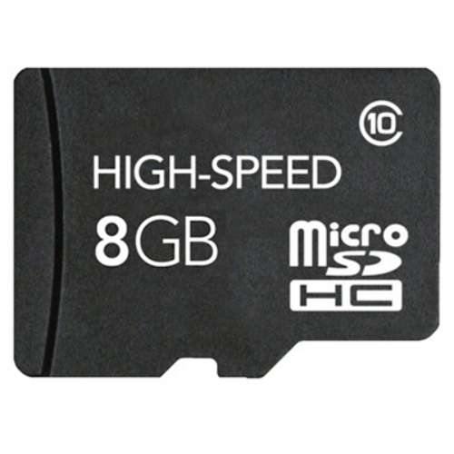
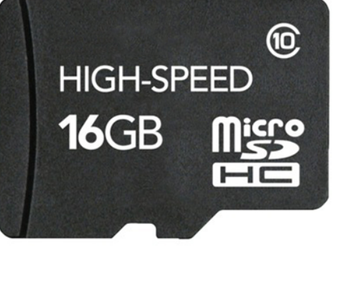
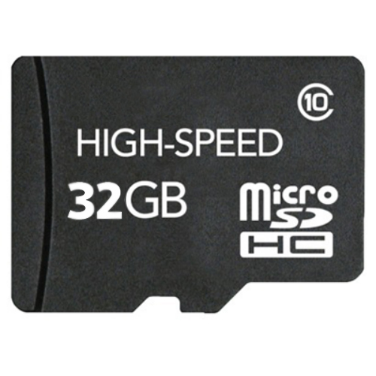
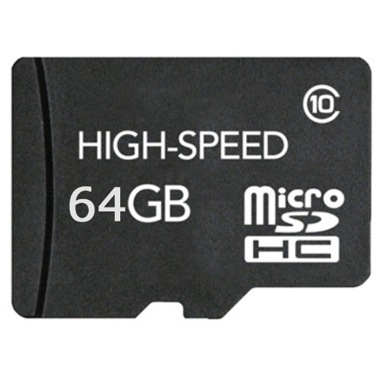
BrightSign Micro SD Card Smart Health
Reports the Health of a BrightSign purchased SD card
Features
How It Works
Remote access
DWS gives access to BrightSign Micro SD card health with OS 8.2.75+
Health monitoring
View % of BrightSign Micro SD card health at anytime
Replace when reaches 90%
Locate a player
Open DWS
Exclusive feature
Available on commercial-grade Micro SD cards sold by BrightSign
Select SD tab & View
View % health used
Notes:
SD cards have a life span, just like batteries, solar cells, your favorite fuzzy slippers… They will degrade over time with normal use.
What degrades?
The finite number of write cycles per memory cell.
BrightSign commercial grade SD cards are superior because:
They are commercial grade and qualified by BrightSign.
They will last much longer (i.e., handle more write cycles) than consumer grade cards.
High performance, high endurance, controlled BOM (build out materials).
And now… Smart Health Monitoring! Just make sure you player is running the latest OS 8.2.75 or higher and you have a BrightSign purchased Micro SD card running on the player.
When the % health used reaches 90% we recommend you purchase a new BrightSign Micro SD card from us to replace the old one

