Slide 1

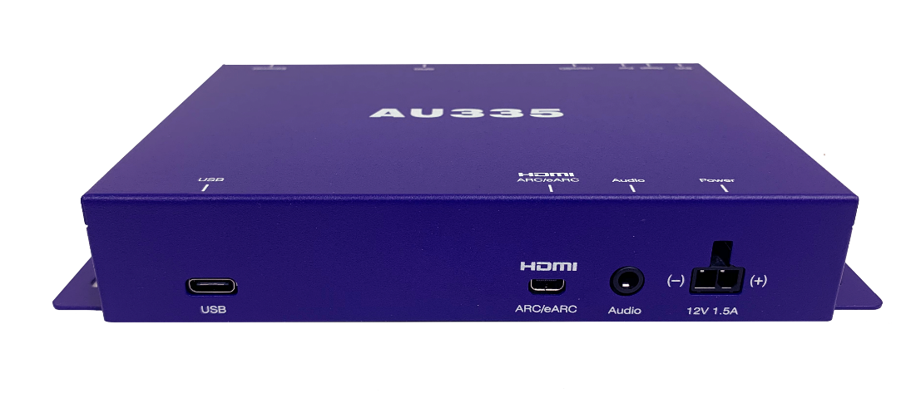
BrightSign AU335
Ultra-affordable High Bandwidth
Digital Audio Player
October 2021
Notes:
Our BrightSign AU335 is a very unique player as it is designed only to play audio – no video or images. It can play high-bandwidth audio including the latest sound technologies available today and as with all of our other players, it funs on a cloud-based platform that delivers BrightSign’s signature reliability due to its solid-state design. Additionally, it is offered at VERY low price point making it ideal for any audio only application from background music to controlling interactive speaker experiences and more. Let’s take a deeper dive to learn more about it.

Slide 2
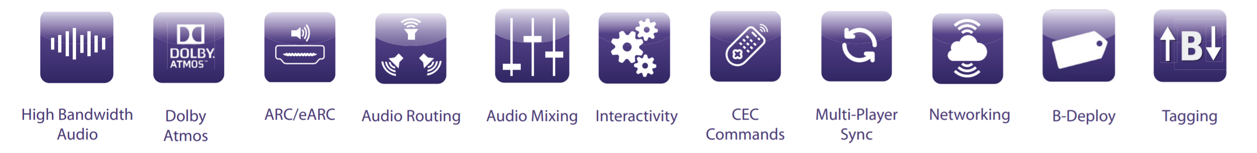
BrightSign AU335
Ultra-affordable, audio only player delivering high bandwidth sound
Distributes quality high bandwidth, 24-bit audio including Dolby Atmos®, Dolby Audio™ and PCM audio to ARC/eARC soundbars & AV receivers
Performs audio routing for individual audio file playback via the left or right channel*
Supports simultaneous playback of up to 3 audio files with audio mixing*
Controls interactive devices via USB, GPIO & Ethernet
(USB host mode supports firmware updates on connected devices)
Provides soundbar volume control and input switching via CEC commands
Synchronizes with additional BrightSign players, lighting and other devices to create unique experiences
Includes a free Control Cloud subscription to BSN.cloud for access to real time player health and remote player controls
Supports presentation authoring through free BrightAuthor:connected, BrightScript, JavaScript, and node applications
Integrates with your choice of a partner CMS solution
* Requires OS 8.3.46 & BrightAuthor:connected version 1.6.44 or higher
Notes:
The AU335 supports a wide range of features on a platform designed specifically to playback high quality digital and analog audio.
In terms of digital audio capabilities, it can support high bandwidth, 24-bit audio to soundbars and AV receivers which support the latest in sound technology via ARC and eARC – namely Dolby Atmos, Dolby Audio and PCM audio. ARC stands for Audio Return Channel & eARC stands for Enhanced Audio Return Channel which we will dive into in more detail later in this webinar.
Now with OS 8.3.46 & BrightAuthor:connected v1.6.44 and above, the AU335 is able to perform audio routing for individual audio file playback via the left or right channel – an example use case of this is playing one set of audio to room #1 via the left channel while also playing a different set of audio to room #2 using the right channel
OS 8.3.46+ & BrightAuthor:connected v1.6.44+ also adds support for playing 3 audio files simultaneously with audio mixing. The audio mixing zones can be routed to the ARC/eARC output or analog Stereo audio output. An example use case of this is to have background audio playing with a voice overlay message playing on top of it. Please note that advanced mixing only can be implemented via JavaScript
Interactive devices and controls are also supported through its USB, GPIO, and Ethernet connections allowing you to create solutions that not only provide an amazing sound experience but are also engaging for your audience. The USB port also is able to operate in a host mode, allowing updates of software to connected devices.
CEC commands provide the ability to control the volume of soundbars and speakers as well as allow for input switching which greatly simplifies the solution especially in retail applications.
The AU335 can also be used to simply distribute background music or other audio playlists.
And with its ability to synchronize with additional AU335 players, you can increase the audio distribution across a large venue. In addition the synchronize ability allows you to synch with other BrightSign players and even control lighting or other devices to create unique experiences within a location by combining the audio, video and lighting to playback together and create an immersive mood or tone for your application.
As with all of our BrightSign players, the AU335 includes a free Control Cloud subscription to our BSN.cloud service. This provides real time player health from any remote location as well as the ability to control the player including reboots, sending OS updates and much more to ensure your solution is playing and performing at all times.
Audio presentations are authored with the free BrightAuthor:connected software, additionally BrightScript, JavaScript and Node.js applications are supported. Or you can choose an integrated CMS solution.

Slide 3
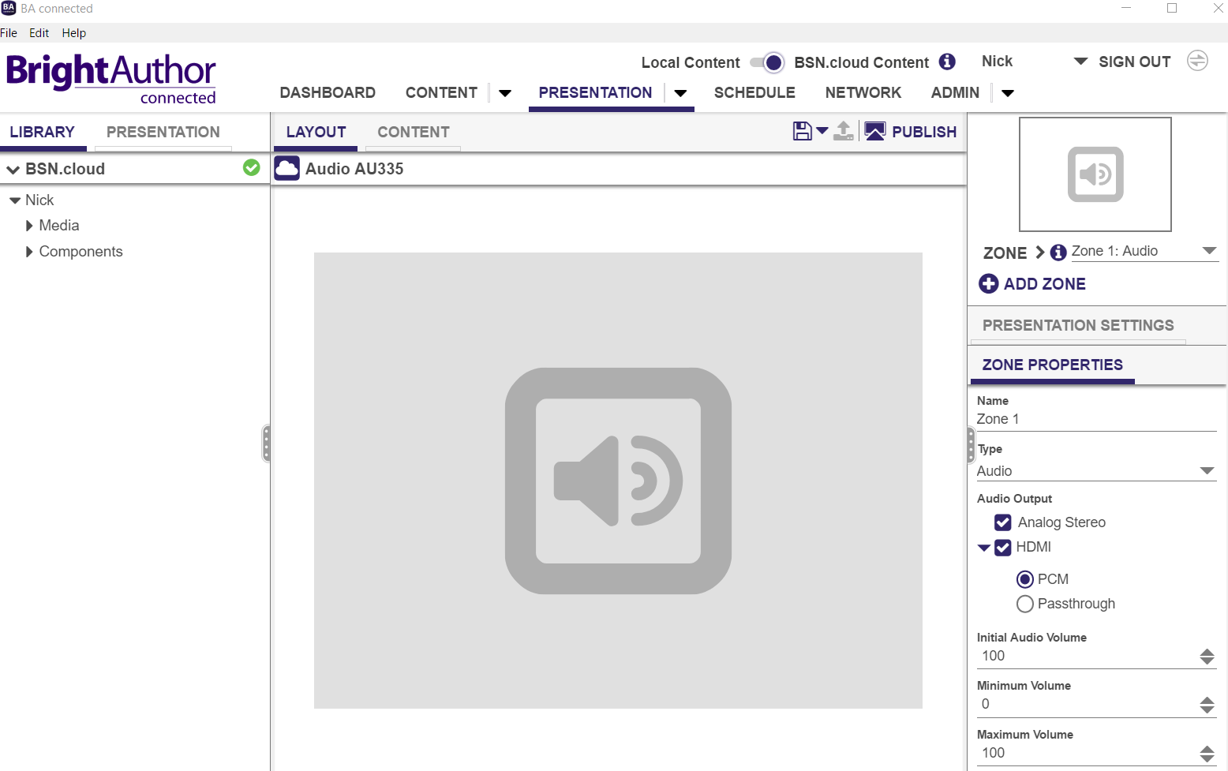
Audio Only Presentations
Easy to build with BrightAuthor:Connected

Slide 4
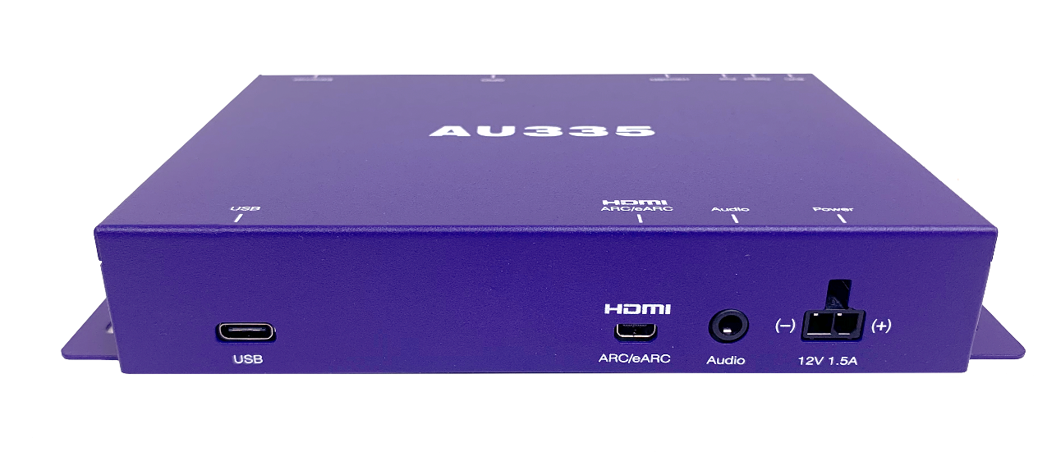
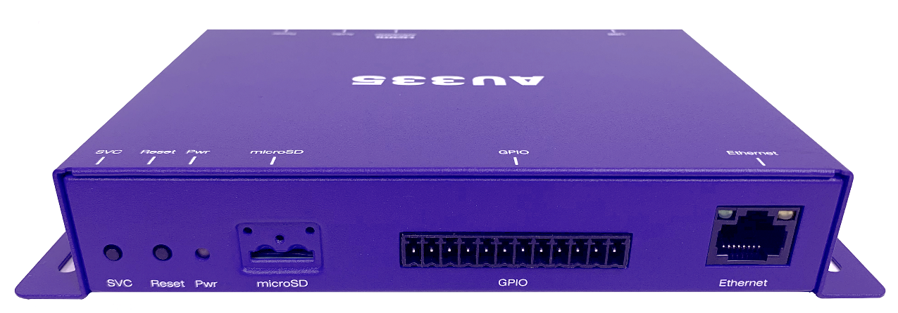
AU335 Hardware Overview
I/O Ports:
Micro-HDMI ARC/eARC output
Analog stereo audio output
USB Type C
Locking power
100baseT Ethernet
8-pin GPIO (+1 PWR & 2 GND)
Micro SD card slot
LED indicators
99.9mm
27.9mm
173.4mm
Notes:
In terms of the I/O ports available, the AU335 offers on its front face a micro-HDMI port outputs ARC and eARC digital audio to playback. The AU335 is the only player in our product line up that offers this level of digital sound playback supporting high bandwidth, 24-bit audio such as Dolby Atmos. Other ports on the front of the player include the analog stereo audio output, a USB type C port and a locking power connection. The backside of the player includes an Ethernet port, a 12-pin Phoenix GPIO port with 8 bi-directional GPIOs, a micro SD card slot with a cover to provide security. And finally a power status LED indicator as well as service and reset buttons. The sides of the player have built in “wings” if you will, to easily mount the to a surface or rack. In terms of size, the dimensions of the player are quite compact as you can see allowing it to easily be installed within or nearby your application. As with all of our players, this one is also solid-state based, meaning there are no moving parts to fail, it is energy efficient and runs cool, making it ideal for placement in locations that have limited ventilation.

Slide 5
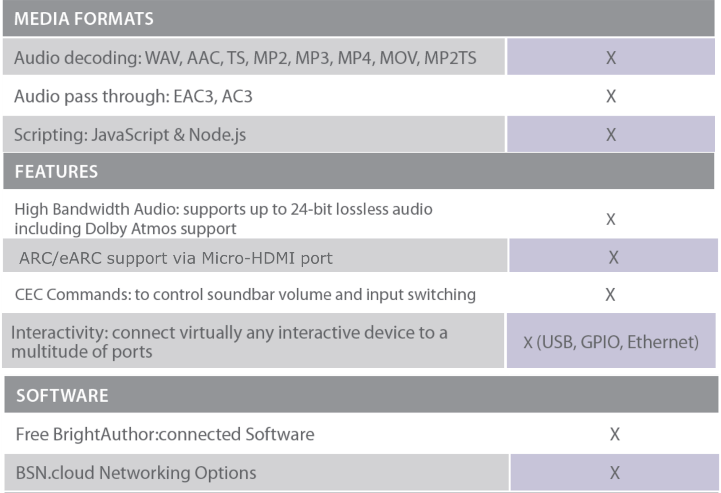
AU335 Noteworthy Specifications

Slide 6
Value of ARC/eARC* support
The ARC standard was designed specifically to replace S/PDIF digital audio outputs for high quality audio to a sound bar or AV receiver
Supports high quality audio over an HDMI 2.1 connection
Supports every audio format that would normally pass-through S/PDIF including Dolby Audio, DTS and PCM audio
eARC supports higher bitrate audio playback allowing you to send higher-quality audio
Feature | S/PDIF digital audio | ARC | eARC
Connection | 3.5mm audio port | HDMI 2.1 (micro HDMI on AU355) | HDMI 2.1 (micro HDMI on AU355)
Max Audio Bandwidth | ~384 Kbits/second | ~1 Mbits/second | 37 Mbits/second
High Bitrate audio up to 192kHz, 24-bit | No | No | Yes
Audio formats | Dolby Audio, DTS & PCM audio | Dolby Audio, DTS & PCM audio | Dolby Audio, PCM audio, Dolby Atmos
* ARC/eARC stands for Audio Return Channel / Enhanced Audio Return Channel

Slide 7
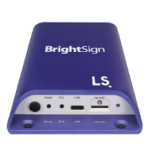
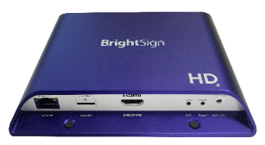
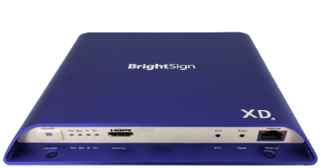
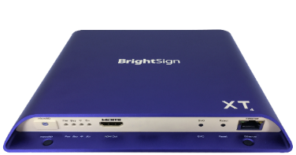
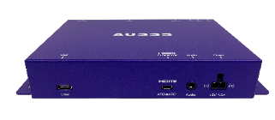
Ultra-Affordable Pricing
XT
XD
HD
LS
AU
Entry Level
Mainstream
Advanced
Enterprise
Audio Only
$150
$275
$375-$475
$475-$575
$575-$875
Notes:
On to pricing, which is yet another very attractive feature of this player. The AU335 is ultra-affordable with an MSRP of only $135 AND tiered pricing for the channel is also provided.
While we are launching this new player today, it will be available worldwide in about 2 weeks. As you can see, adding this new model to our player line up really opens up a new level of sales opportunities without skimping on features, high quality playback, remote player management or event our signature reliability.

Slide 8
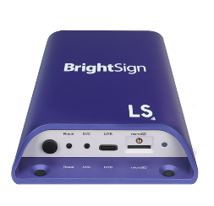

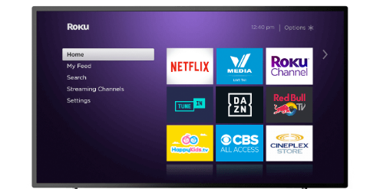






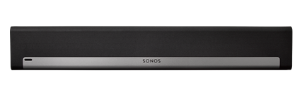
AU335 Streamlines ARC/eARC Setups
BEFORE AU335
A TV was required to send ARC/eARC audio to AV receivers & soundbars even if a display wasn’t need for the application
AFTER AU335
AU directly sends audio to the AV receivers & soundbars
HDMI
HDMI
Micro HDMI
HDMI

Slide 9
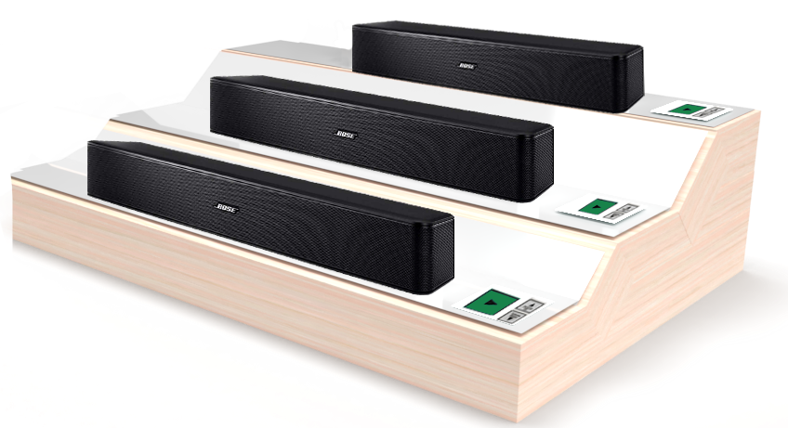
AU335 Applications
Soundbar retail displays
Deliver Dolby ATMOS and other high bandwidth audio via eARC
Enable Soundbar volume and source control with CEC commands
Provide player updates and control device modes for interactive components with dual role USB host mode
Notes:
RETAIL SOUNDBAR PRODUCT DEMOS
Create engaging retail soundbar displays to show off the latest in audio technology. The AU335 has ARC and eARC support that supports playback of up to 3 audio files at once including high bandwidth, 24-bit sound to play Dolby Atmos®, Dolby Audio™ and PCM audio. Audio routing and audio mixing are also supported along with interactive controls through USB, GPIO, and Ethernet to engage your audience, while CEC command support simplifies the solution with its volume and input controls. The USB port also operates in host mode to deliver updates to connected soundbars and AV receiver devices.

Slide 10





AU335 Applications
Background audio distribution
Distributes audio to your venue cost-effectively including ARC/eARC support
Routes up to 3 individual audio files simultaneously
Delivers audio mixing for applications such as voice message overlays on top of background music
Extends audio distribution with multi-player synchronization support
Supports a JavaScript programming environment
Notes:
MUSIC DISTRIBUTION
Distribute background audio and music to any venue using the ultra-affordable AU335 which supports stereo audio alongside ARC/eARC, Audio routing is supported which allows you to play different audio tracks simultaneously via the left and right audio channels. You can also perform audio mixing to deliver voice messages overlaid on top of background music. Extend your audio distribution by synchronizing multiple AU335 players together. The free Control Cloud subscription to BSN.cloud gives access to real time player health and controls allowing you to easily monitor players remotely.

Slide 11
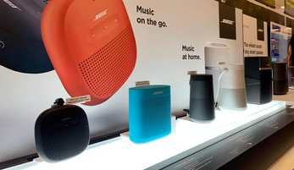

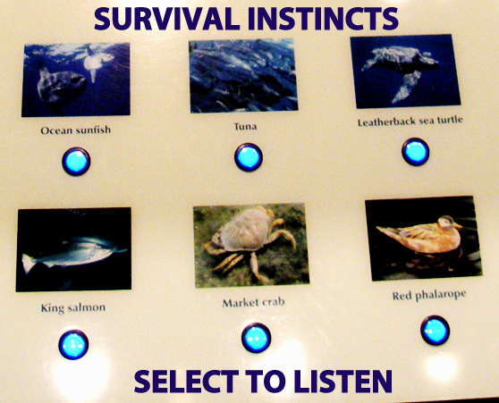

AU335 Applications
Interactive & immersive experiences
Add audio to exhibits & experiences
Engage audiences with interactive sound selections
Use synchronization to expand audio sources
Link audio to control lighting & visuals
Create immersive experiences
Notes:
INTERACTIVE AUDIO EXHIBITS
Deploy engaging audio museum exhibits with a plethora of interactive controls that can connect to USB, GPIOs or Ethernet. Control lighting and other devices to create unique experiences and even synchronize to other BrightSign players that are running digital signage. Presentation authoring is done via free BrightAuthor:connected, BrightScript, JavaScript, and node applications, or your choice of an integrated CMS solution.

Slide 12
Thank you!

