Slide 1
4G
Product Informational
Universal connectivity with low-cost plans built for signage
Currently Available in the USA, Canada & Europe
May 5, 2022

Slide 2
Universal Connectivity
with low-cost plans built for signage
Notes:
BrightSign Mobile offers reliable player connectivity where Internet access is a challenge and delivers it as an all-in-one solution that is fully integrated with BrightSign products and services. It is a unique product in that it includes a low-profile USB modem and your choice of data plans which are custom-designed for signage with affordable & flexible purchasing options that are exclusive to BrightSign. ​ It is currrently available only in the USA initially, but will expand to other regions and countries soon.
​
​

Slide 3
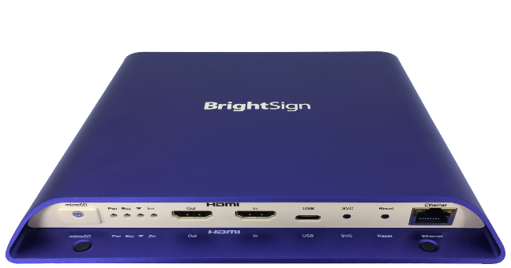
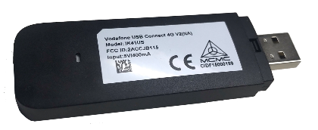
Product Overview
4G
Notes:
So let’s get into more detail about what exactly BrightSign Mobile is. As I mentioned it is an all-in-one solution which includes a USB regional modem that has a regional SIM card installed in it (currently only available in the USA). That USB modem is then paired with a 4G cellular data service plan of your choice which are affordable and tailor made for signage and supported by BrightSign.
With BrightSign Mobile you get internet connectivity over a mobile networking service so that you can easily connect to whatever services you need to player your digital signage content and manage your player. For instance you can use the service to deliver the content for your live data feeds like news and weather within your digital signage presentations, you can also use the service to connect to BSN.cloud and get real time player data and controls with Control Cloud as well as publish presentations and update content via Content Cloud and other integrated partner CMS solutions.
The reason mobile service is not often used for digital signage today is because of: 1. High service cost, 2. Multiple vendors relationship, 3. Complex global deployments, and 4. Inflexible data plans​. But with BrightSign Mobile, we address each of these challenges and on top of that deliver a reliable mobile networking so your signage will always be connected. ​

Slide 4
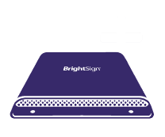
Universal Connectivity​
Delivers reliable player connectivity where access is a challenge​
Stellar Coverage​
Supplies 4G performance across USA, Canada & Europe with two Tier 1 carriers per country ​
All-in-One Solution​
Includes a low-profile USB regional modem paired with a mobile data service supported by BrightSign​
Affordable Plans​
Offers three low-cost, 6-month data plans with low minimum data requirements designed for signage
Flexible Data Options​
Supports month-to-month services and fixed data prices for both overages & extra data purchases​
Fully BrightSign-Integrated​
Provides plug & play modem setup with full support on BSN.cloud, BrightAuthor:connected & integrated partner CMS solutions​
Advantages
Notes:
To further explain how BrightSign Mobile is different and adds value to signage, let’s walk through it primary features and benefits.
First off is its Universal Connectivity - It’s not always easy to get your digital signage connected to the internet – sometimes hard wired Ethernet drops are not possible and WiFi may not always be an option or reliable. Therefore, mobile networking is a great option to get reliably connected.
Not only that, BrightSign Mobile delivers stellar 4G coverage on prominent Tier 1 networks with two or more carriers in every country.
USA: T-Mobile (primary) and AT&T (secondary)
Canada: primary carriers = Telus , Canada Bell & Canada Saskatchewan Telecom
Europe: primary carrier = Vodaphone + additional carriers which may change per country
Only BrightSign offers an all-in-one solution for mobile networking that includes the USB modem with an installed SIM card that matches your region and pairs it with a data plan of your choice that is exclusively offered by BrightSign.
Our data plans are offered worldwide with low-cost entry points on a 6 month contract that then changes to month-to-month service. Low-cost entry points easily support Control Cloud services while added data supports signage content updates. Low minimum data requirement with a fixed overage cost allows our customers to use the most data in the way that fits their business and signage application. Therefore data overages or scheduled data purchases are all made at a fixed price. In addition, our robust service ensures strong coverage with two or more carriers in every country.
We are the only digital signage company to offer a single sourced, fully integrated solution that includes a USB modem with a SIM card that can easily be activated with your purchased plan for a plug and play solution. It is fully integrated with our BrightSign OS, BSN.cloud and BrightAuthor:connected which gives the modem interface priority and supports device configurations for data type and download rate controls.

Slide 5
Large Volume Retail
Large Volume Ad Networks
Stadiums & Venues
Target Applications
Ideal for any signage placement that has connectivity challenges
Tradeshows
& Conferences
High Security Locations
Notes:
BrightSign Mobile is ideal for applications where signage placement has challenges in getting a physical internet connection or a strong wireless signal to it. This situation can occur in a number of market verticals across a variety of applications. Some of the more common applications are:
Large volume Retail: applications that have large number of players and critical need to get players online, but have challenges getting internet access ex: Walmart has network access in building, but hard to get it to physically cable drops to the retail display & WiFi is not ideal
Large volume Ad Networks: these applications are usually in very diverse locations where universal network connections are not available. Ex: PatientPoint signage is installed in medical building lobbies, waiting rooms and exam rooms and have to be connected regardless of where they are placed as they require frequent updates and proof of play
Moderate/Small Volumes = Stadiums/Venues/Tradeshows, Restaurants that have challenging locations & High security locations (such as government or financial buildings where you can’t use their network– courtrooms, military bases, etc)

Slide 6
USB Modem
Low-profile USB-A connected regional modem with an installed SIM card for:
North America (USA + Canada): SKU: MDM-USB Connect 4G v2 NA
Europe: SKU: MDM-USB Connect 4G v2 EU
Compatible on all BrightSign Series 3 & 4 players with a USB port & BrightSign AU335
$120 MSRP
Notes:
Purchase this USB modem directly from BrightSign or via channel sales partners - Dealer discounts and volume pricing apply up to 25%
It will not be on our webstore

Slide 7
Data Plan Pricing
DATA PLANS | USA | EUROPE | CANADA
500 MB/MONTH PLAN | $13/GB | $13/GB | $26/GB
Initial 6-month contract | $39 | $39 | $78
Monthly pricing thereafter | $6.50 | $6.50 | $13
Hard Cap: Additional 500 MB data | $6.50 | $6.50 | $13
Soft Cap: Overage costs | $0.013/MB | $0.013/MB | $0.026/MB
1 GB/MONTH PLAN | $11/GB | $11/GB | $25/GB
Initial 6-month contract | $66 | $66 | $150
Monthly pricing thereafter | $11 | $11 | $25
Hard Cap: Additional 500 MB data | $5.50 | $5.50 | $12.50
Soft Cap: Overage costs | $0.011/MB | $0.011/MB | $0.025/MB
2 GB/MONTH PLAN | $10/GB | $10/GB | $24/GB
Initial 6-month contract | $120 | $120 | $288
Monthly pricing thereafter | $20 | $20 | $48
Hard Cap: Additional 500 MB data | $5 | $5 | $12
Soft Cap: Overage costs | $0.010/MB | $0.010/MB | $0.024/MB
NOTES:
All pricing in is USD & does not include taxes or VAT
After the first 6-months of the initial contract, plans automatically change to month-to-month charges
When data limits are reached, service continues & overage pricing is automatically charged to your account
Notes:
BrightSign offers 3 Levels of Data Plans starting at $6.50/player/month with no discounts, and the higher the plan you pick the better your overage rates – our Top-Level plan gives the best fixed rate for overage data purchases. All of these plans require payment upfront to cover the first six months of data usage, then your plan automatically moves to month to month plan. Each plan also has a Soft Cap which means that when data limits for the month are reached, service will continue, and you will be charged automatically at the fixed rates shown. As mentioned, the pricing for our data plans have a Soft Cap, but we also do offer a Hard cap plan option as well if needed.
Soft cap plan : fixed overage cost equal to the initial data price per MB - this plan will automatically kick in when you are over your allotted data. So your service will continue and you will be charged the fixed data price per MB
Hard cap plan: For Hard cap plans, your data service is terminated when you reach your data limit however you can purchase 500MB of more data at the fixed price of $6.50 ; only for customers that are worried about overspending without realizing it.
$13/GB plan is our base-Level plan that has a minimum data purchase of 500MB/mo. After the initial 6-month contract expires, your plan will move automatically to a month-to-month plan. As an example, this plan will support real time health monitoring and an OS update once per month on a mainstream player application, but most likely will not include sending content updates or supporting any live content feeds
The $11 per GB plan is our mid-Level plan with 1GB of data/mo minimum purchase. A usage example for this plan is that it would support all that the baselevel plan support plus allow you to send infrequent content updates to the player in the form of publishing a standard presentation of content containing video and images. Or it could support a presentation that contains some live feeds that update on a regular basis such as a weather widget, news ticker, social media posts, etc.
Our top-Level plan is called the $10 per GB plan which requires a 2GB /mo minimum data purchase and gives our best per GB pricing. This plan will allow you to add more frequent content updates depending on the size of content updates & do real-time streaming of content playing on the player.
With these very competitive prices which are tailor made for signage and exclusive to BrightSign, you can run your signage network in a way that meets your business and maximizes your data usage very affordably.

Slide 8
Supported Countries
Austria | Latvia
Belgium | Lithuania
Bulgaria | Luxembourg
Canada | Malta
Croatia | Netherlands
Cyprus | Norway
Czech Republic | Poland
Denmark | Portugal
Estonia | Romania
Finland | Slovakia
France | Slovenia
Germany | Spain
Greece | Sweden
Hungary | Switzerland
Ireland | United Kingdom
Italy | United States of America
Plans can be purchased from any supported country and then used in another supported country
The correct regional USB modem must match the region in which it will be operating.

Slide 9
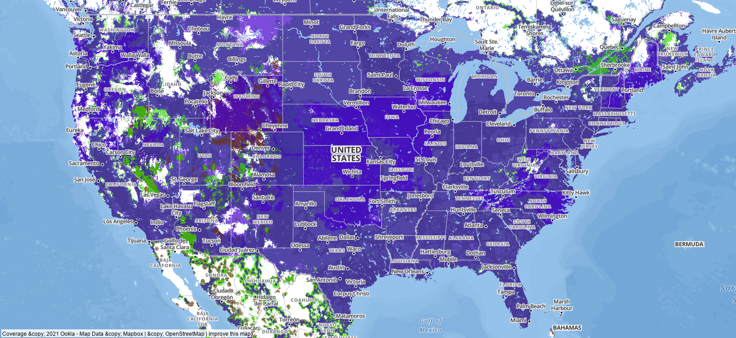
USA Combined Coverage 4G + 3G + 2G
Notes:
BrightSign Mobile supports 4G, 3G and 2G coverage. This map shows the combined coverage provided across the USA for all 3 technologies.

Slide 10
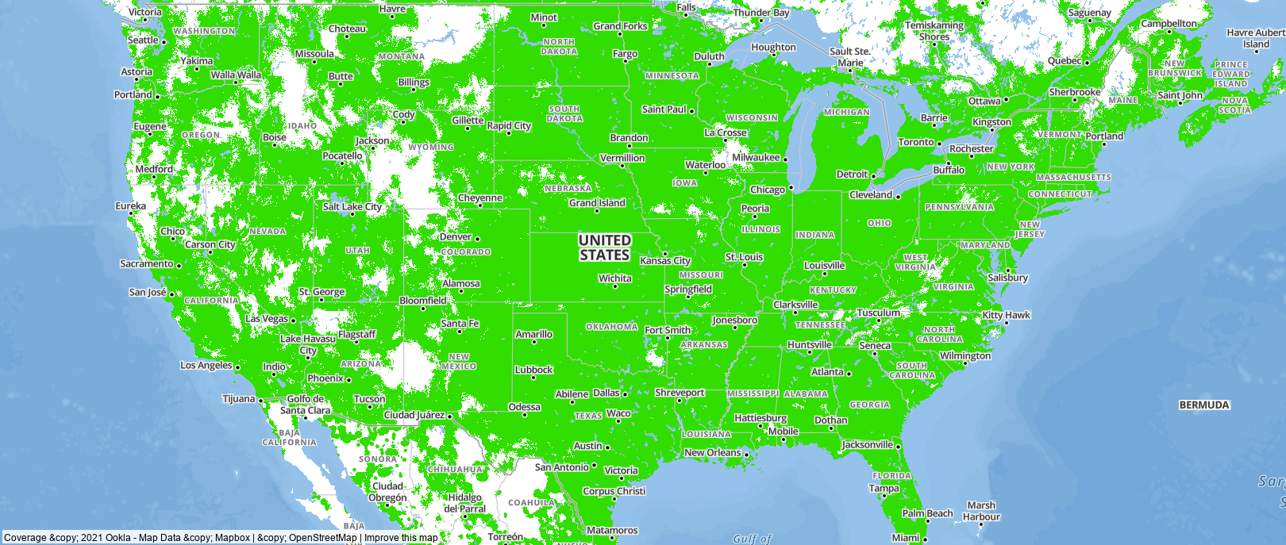
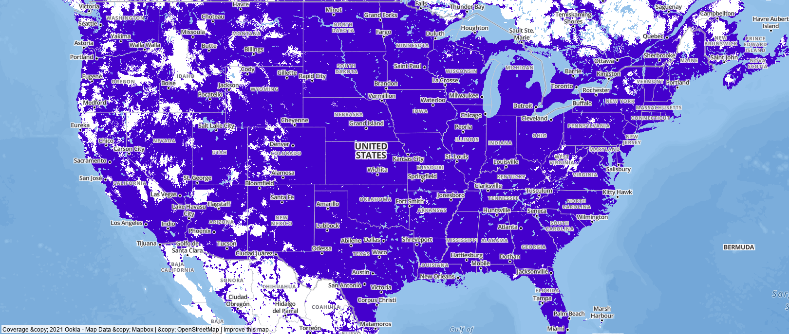
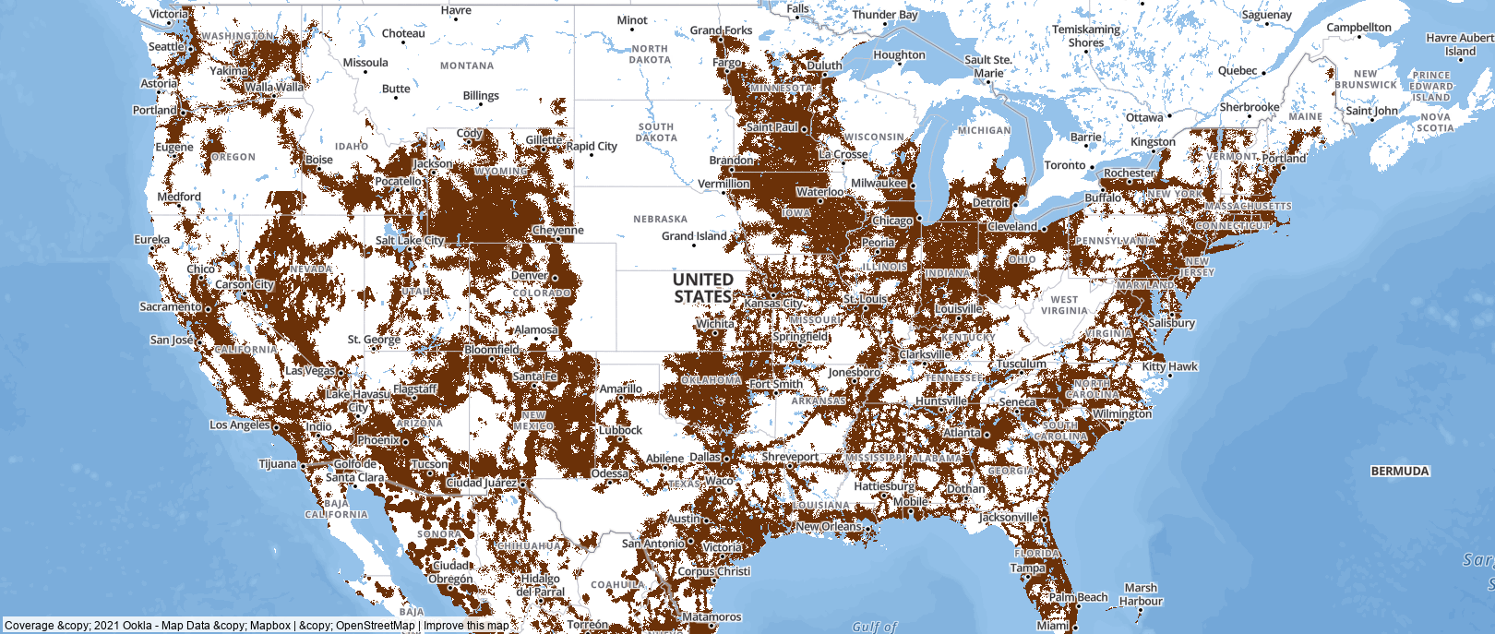
USA Coverage by Generation
3G
4G
2G

Slide 11
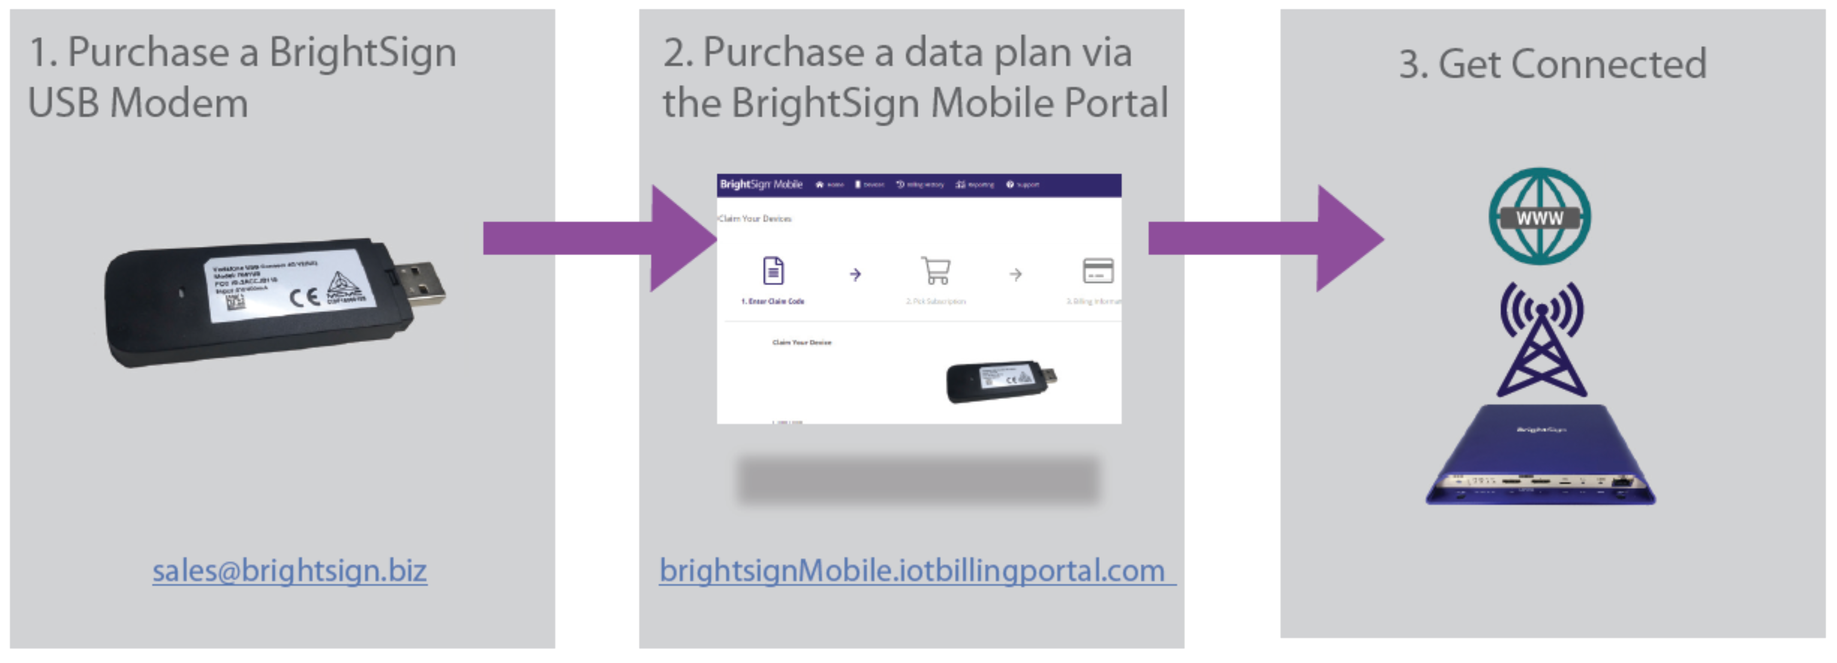
Getting Started

Slide 12
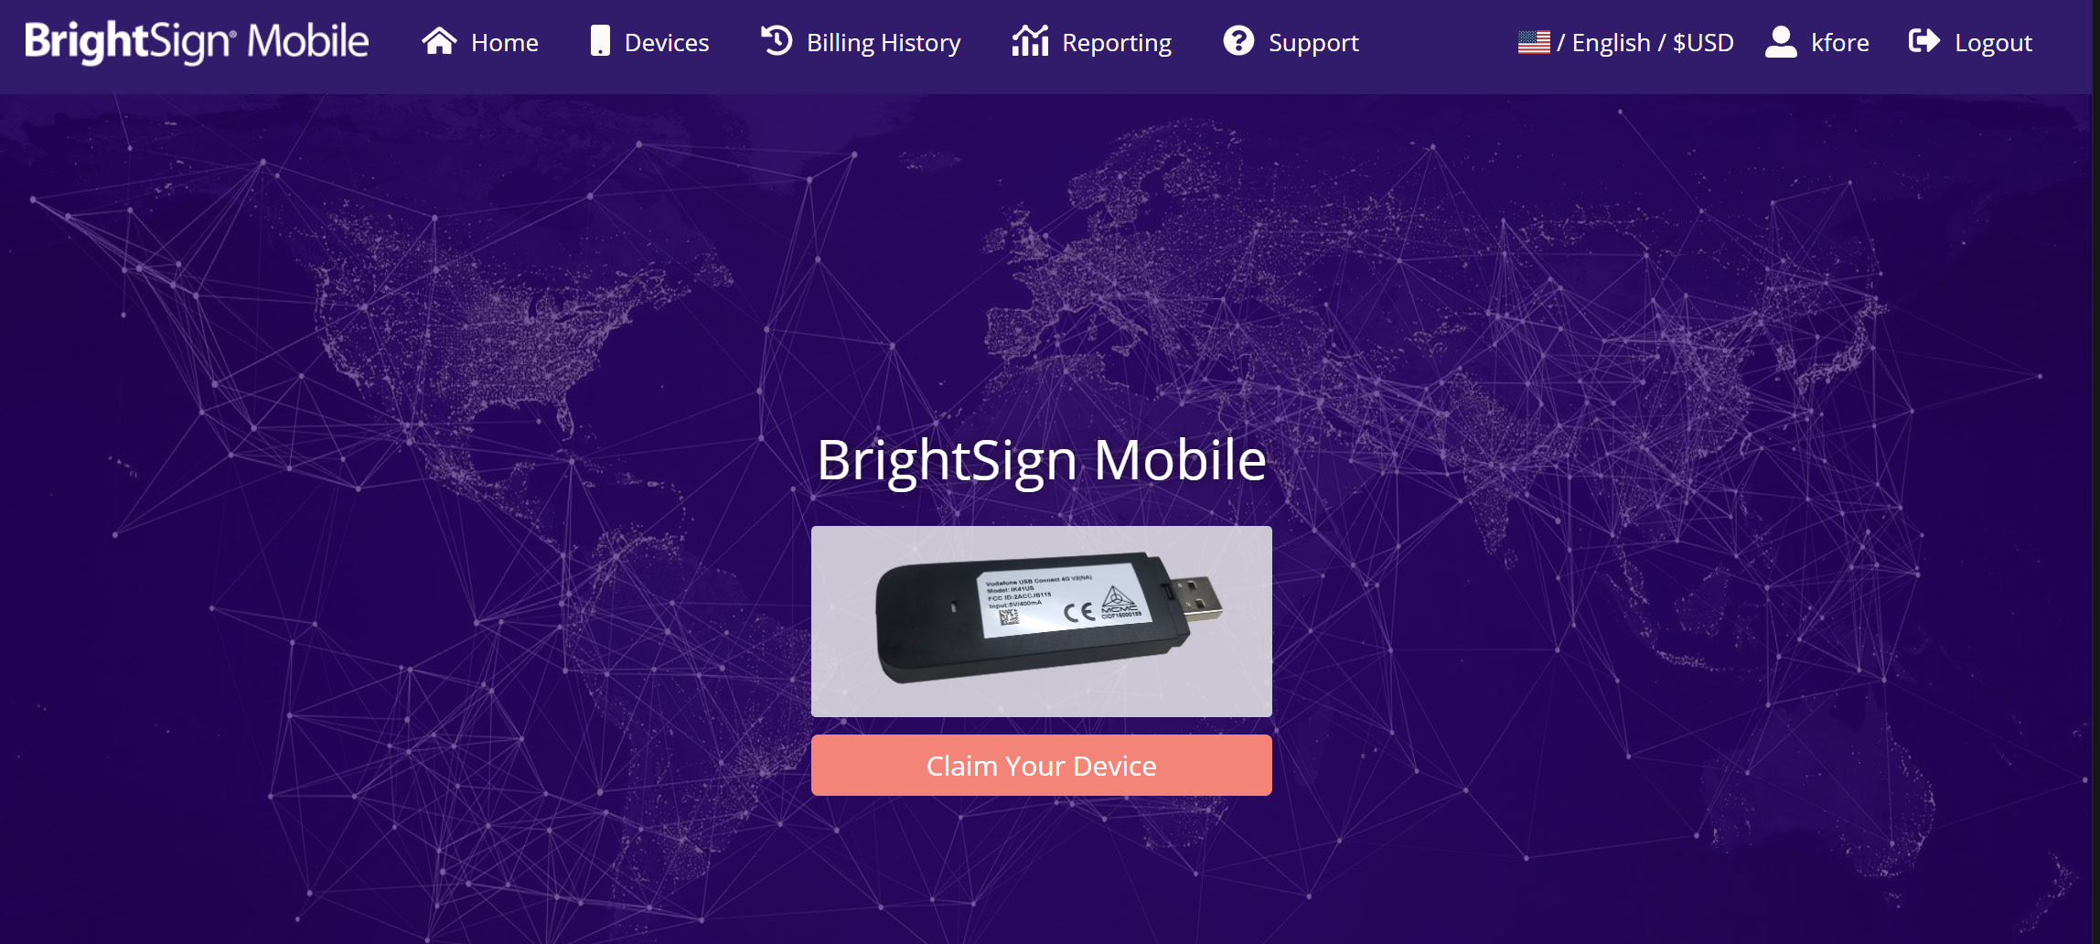
https://brightsignmobile.iotbillingportal.com/

Slide 13
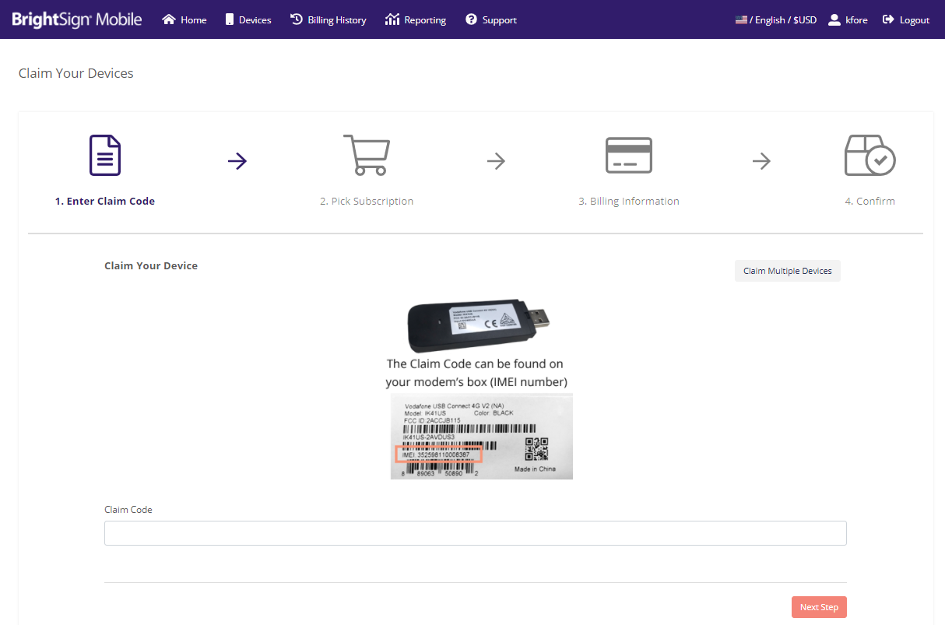

Slide 14
Thank you!
4G

