Slide 1
Micro SD Cards with
Smart Health Monitoring

Slide 2
Benefits of BrightSign Micro SD Cards
BrightSign require commercial-grade Micro SD cards with a class 10 rating due to frequent & quick processing of massive amounts of content & data
Commercial Grade
Long Lasting
Class 10 Performance
Fixed
BOM
Smart Health Monitoring
Notes:
BrightSign micro SD cards have always been a huge value and now are even better.
Now with SMART health monitoring on top of being Commercial Grade and offering a Fixed BOM
BrightSign commercial grade SD cards are superior because:
They are commercial grade and qualified by BrightSign.
They will last much longer (i.e., handle more write cycles) than consumer grade cards.
They offer very high performance
Our SD cards also offer a Fixed BOM (bill of materials). What’s so good about Fixed BOM?
With Fixed BOM micro SD cards, all critical components that make up the product – the memory silicon, controller and firmware – are locked down.
We are better able to control and manage procurement.
Fixed BOM can better guarantee performance of products.
Guaranteed continuity – the product’s performance has been tested and approved.
And now… Smart Health Monitoring!

Slide 3
Micro SD Card Facts
Degrade over time with normal use
Support a finite number of write cycles
Operate longer when it is commercial-grade
Perform faster with a Class 10 rating
Notes:
microSD cards have a life span, just like batteries and car tires. They will degrade over time with normal use.
What degrades?
There are a finite number of read/write cycles per memory cell.
Consumer grade micro SD cards wear out a lot faster.
BrightSign knows the impact of worn-out microSD cards on signage!
We sell more then 1 million micro SD cards a year.
Players can read/write a microSD Card every few seconds if programed to do so.
We have several customers with over 100,000(+) units in a single deployment.
We see customer problems related to ill-advised decisions to purchase consumer grade micro SD cards all the time.

Slide 4
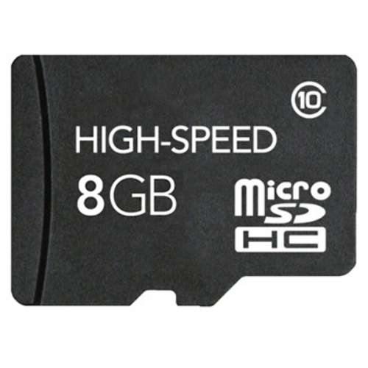
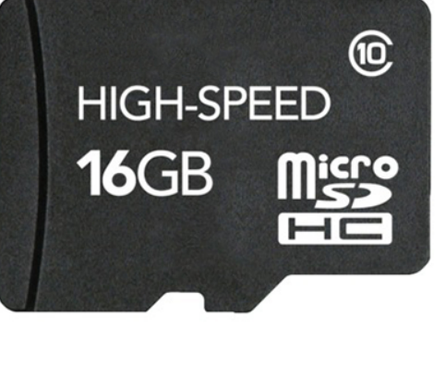
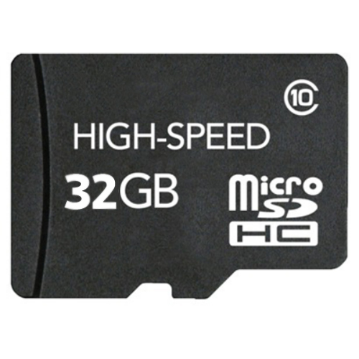
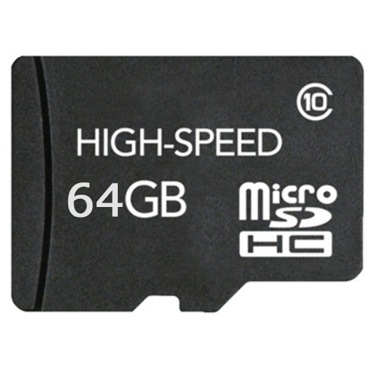
Smart Micro SD Health Monitoring
Remote access
Control Cloud gives real-time access to your Micro SD card
Only offered on BrightSign commercial-grade Micro SD Cards
Health monitoring
View your Micro SD card % of health anytime, anywhere
Exclusive feature
Available on commercial-grade Micro SD cards only sold by BrightSign
Signage Savings
Prevent down time & save on service calls by proactively monitoring & replacing worn cards
Notes:
knowing the health of your cards and being able to proactively replace them will save you “thousands” in service calls and help prevent non-working displays from happening

Slide 5
How It Works
Step 1
Step 2
Step 3
Step 4
Locate a player in the device list
Open the remote DWS
Select the SD tab & View button
View current % of SD card health

Slide 6
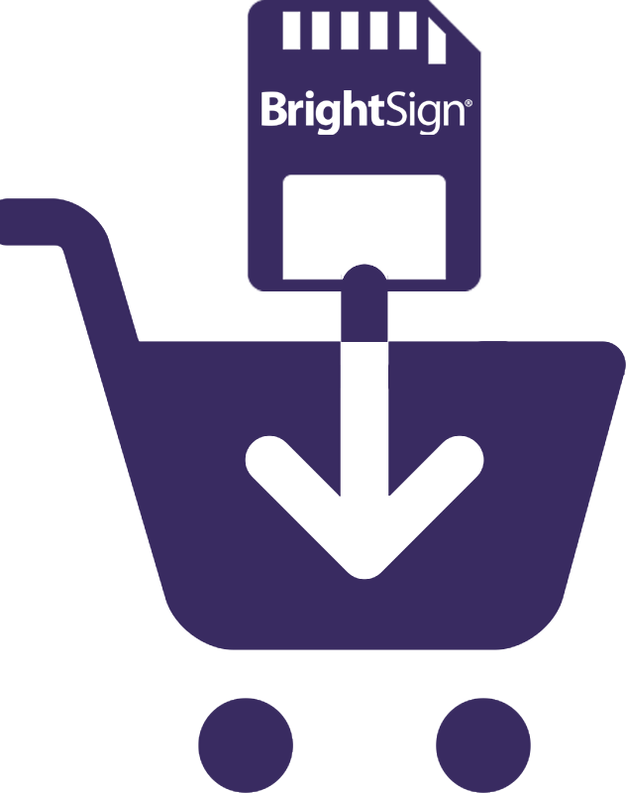
When to Act
Re-order BrightSign Micro SD cards when the health approaches 90%
90%
Notes:
Useful new feature to check the health status of your BrightSign micro SD card.
Summary:
Only works on BrightSign qualified commercial grade micro SD cards.
Easy to check status via Control Cloud
Stay tuned for other features tied to this capability!

