Slide 1
The Power of Purple
April-21-2023

Slide 2
LONG TERM SUCCESS
VISUALIZE THE OUTCOME
Will ‘good enough’ deliver results today & tomorrow?
How much risk are you willing to take?
Do I want a complete solution or just a screen?
Notes:
Before digital signage came to be, we had printed posters – basically signs that were consumables which served a distinct purpose but had to be ripped out and replaced when a new message need to be conveyed. When digital signage entered the arena, it changed what we all think about when we hear the word ‘sign’ as we no longer expect it to be static and unchangeable, we expect it to be dynamic and engaging. Yet the consumable perception of signage has continued for many and replacing the technology out every couple of years has becoming normal to some. But signage doesn’t have to be that way. The industry is evolving and putting an emphasis on reduce consumerism and embracing the trends of longevity and sustainability to obtain long term success. Thinking critically about how to make your signage succeed in the long run means that broadening your expectations to not only what serves the purpose you have today, but also what will serve your future needs that have yet to be defined while mitigating the risks that are certain to arise after deployment.
Showcase your vision by not settling for “good enough’. Invest in a solution that can perform simple to sophisticated applications and grow with your needs.
Somewhat secure and moderate uptimes are costly. Solutions that are built for near 100% uptimes & 8+ years of longevity by design ensures you never have to stop your business to replace a product that was just “ok”.
Invest in a lifetime of quality, value, flexibility & scalability. Settling for the “quick fix” solution shortchanges your deployment in the long run.
A solution solves not only your current needs, it also evolves, adapts and anticipates your future needs.

Slide 3
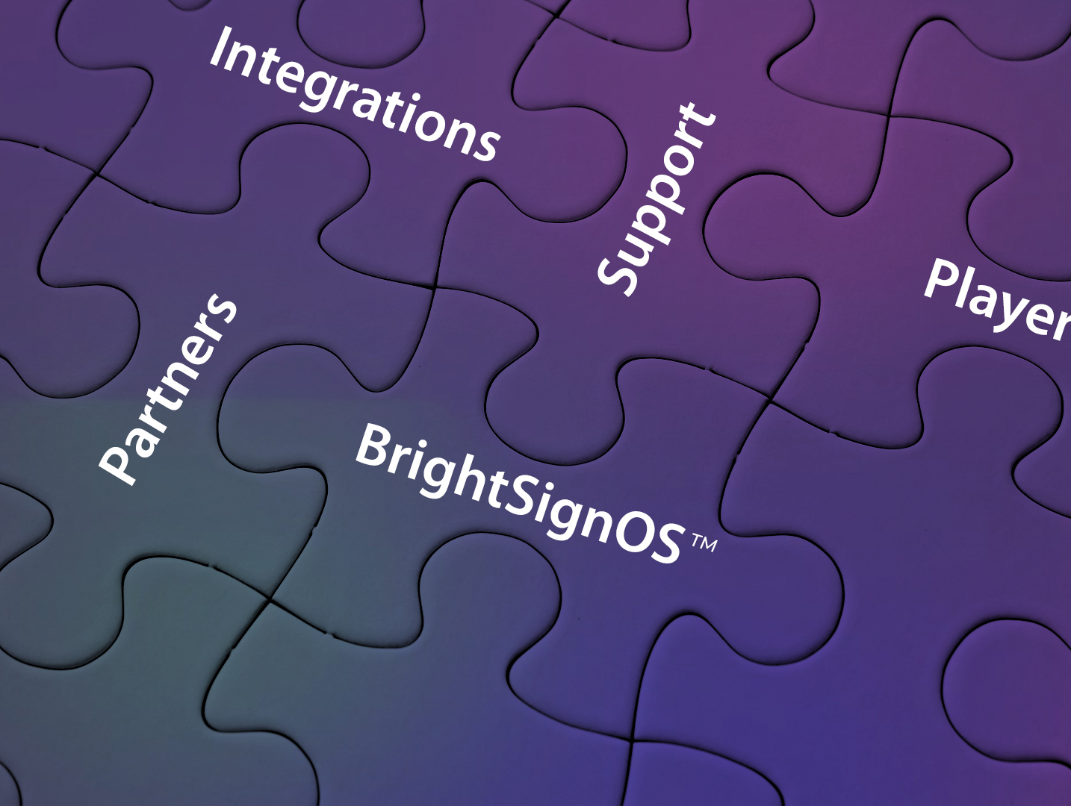
The BrightSign Ecosystem
BrightSignOS™
The only purpose-built operating system bringing unrivaled security and signage power to every BrightSign player.
Players
Expansive lineup delivering legendary reliability, security & performance with an unparalleled commitment to excellence & innovation.
Integrations & Add-ons
Our players can be customized to fit any application using a wide range of leading CMS solutions, software, and add-on peripherals.
Partners
Our global network of authorized resellers, integrators, and technology providers ensures success for every customer.
Support
We deliver solutions at every step from pre-sales consulting and engineering to flexible training options, online resources and direct support
Notes:
BrightSign has evolved over the years too and what we have learned is that delivering products that offer long term success ultimately wins the race. This is exactly how we have carved out the leading position we have in the industry today as being the most trusted and capable player that just won’t quit. We have built our BrightSign Ecosystem over close to 2 decades now and its purpose is to take the pain points out of signage to deliver long-term success. BrightSign’s ecosystem solves your challenges from what we design into our BrightSignOS, players and integrations, to how serve our customers through a deeply cultivated global network of partners and through our expert support that starts pre-sale and continues from there.
In this talk will be focusing primarily on the design principals around the foundation of makes BrightSign so unique - our BrightSignOS.

Slide 4
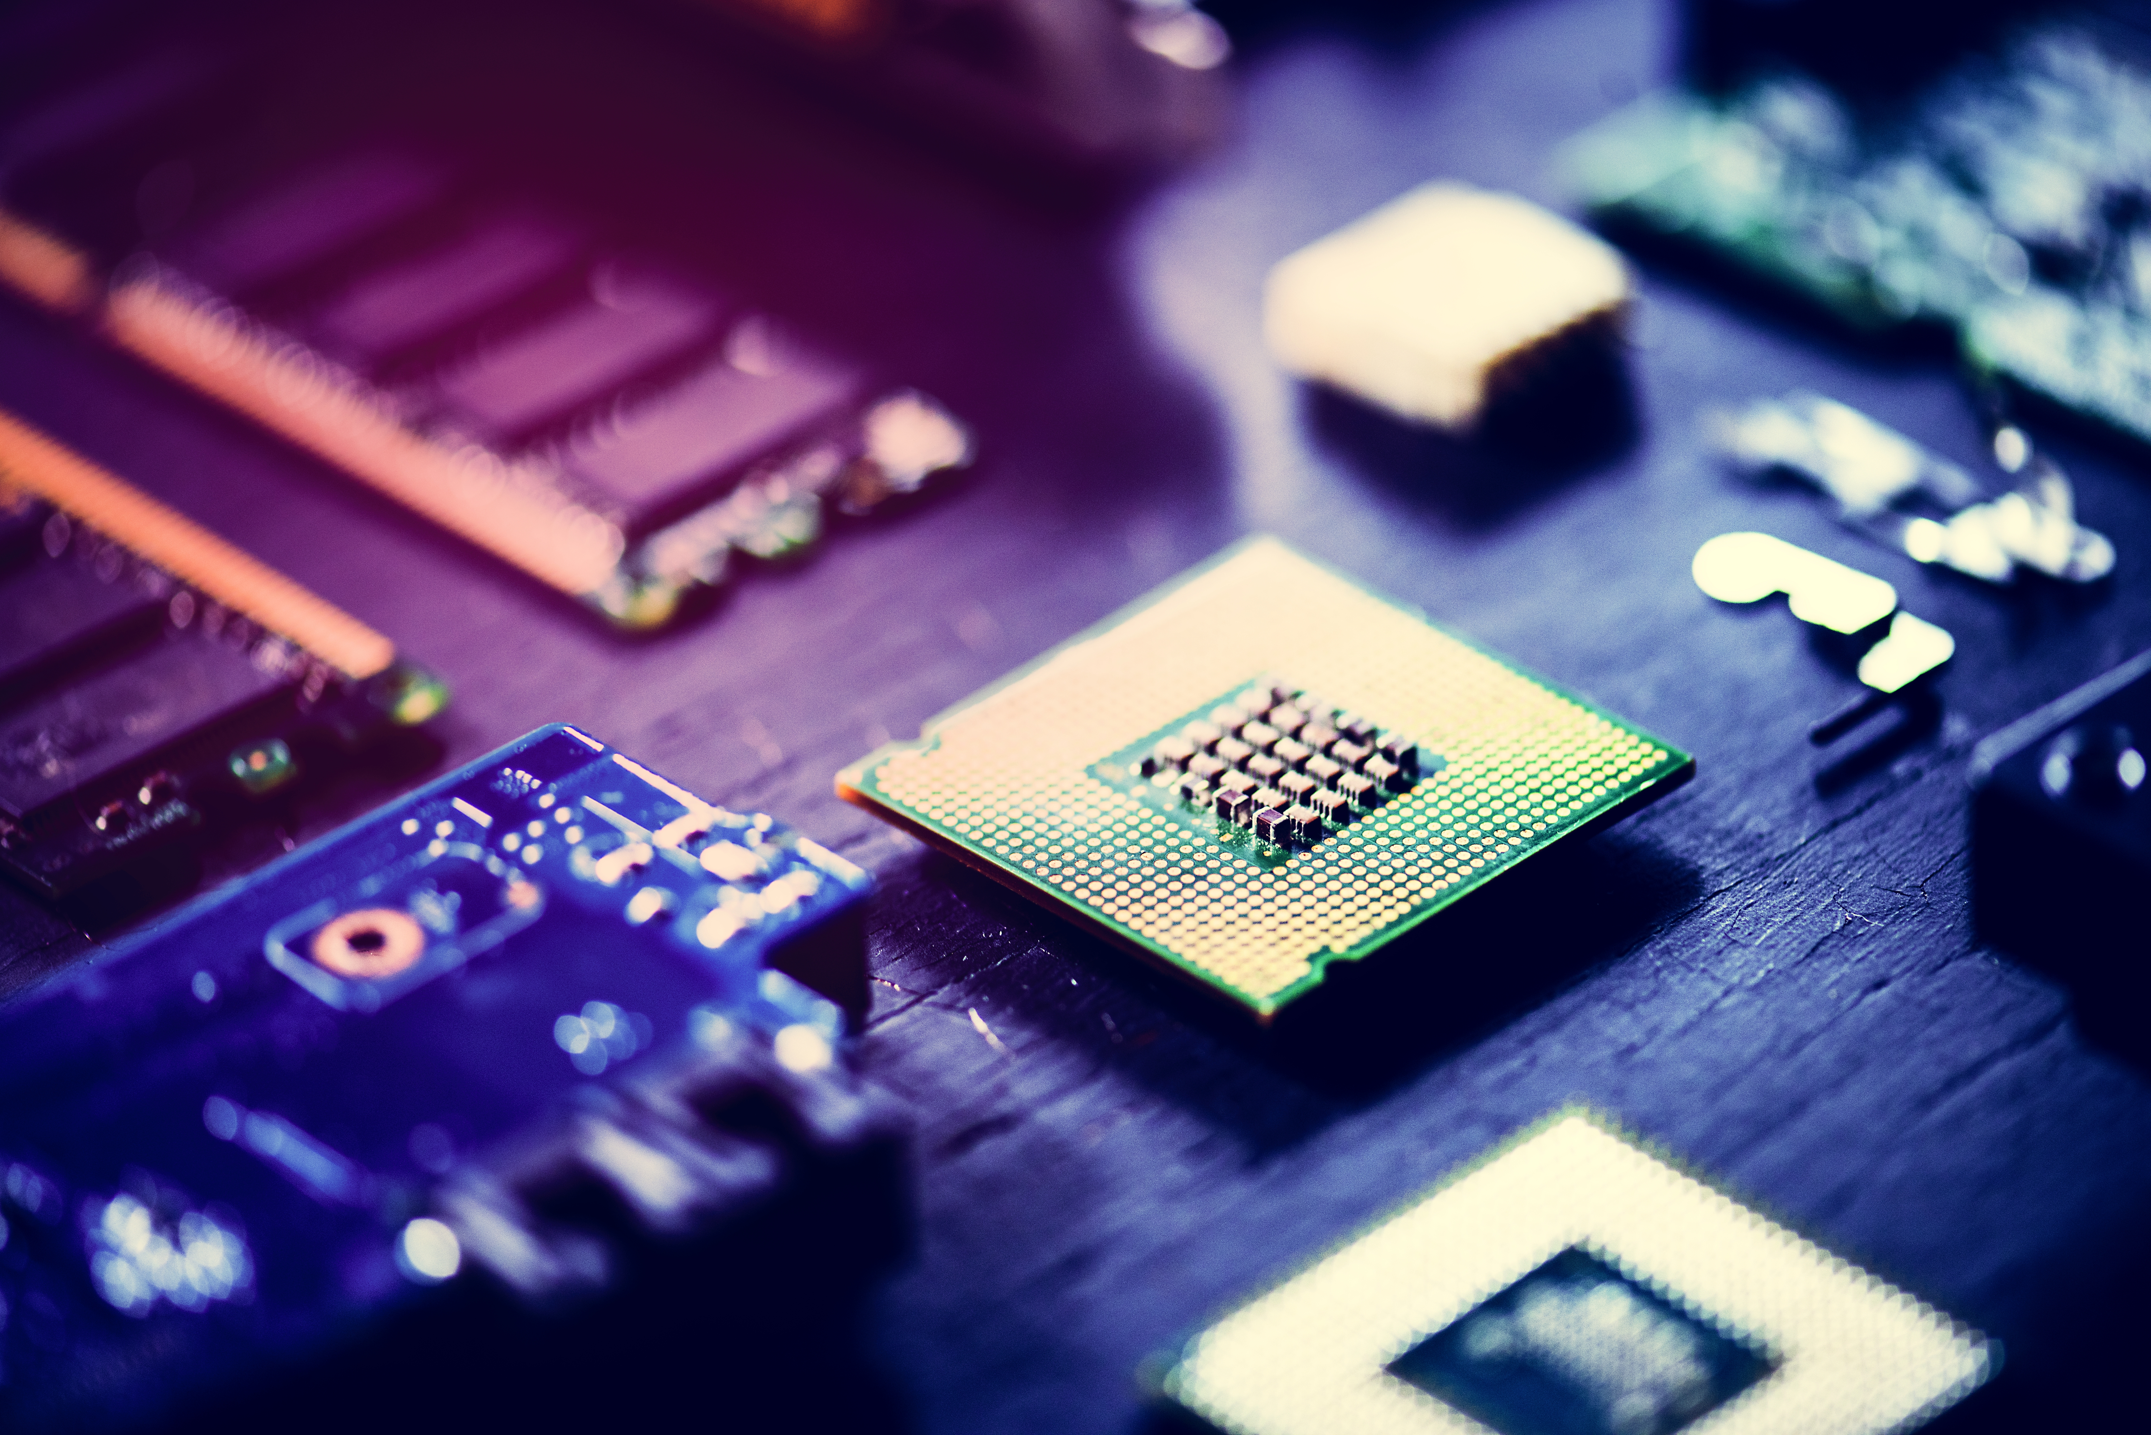
BrightSignOS™
The Power of Purple Unveiled
Notes:
BrightSignOS is what brings unrivaled security and signage power to every BrightSign player. So let’s unveil the secret behind its power and the design principals it was developed on.

Slide 5
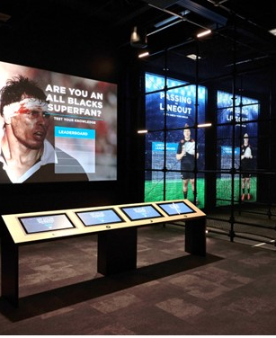
BrightSignOS
THE POWER BEHIND EVERY BRIGHTSIGN PLAYER
SECURE
RELIABLE
SUPERIOR
SUSTAINABLE
Notes:
Only a BrightSign player can run BrightSignOS - the secret to our over-the-top performance, extensive signage capabilities & unmatched uptimes. Purpose-built only for signage, our operating system unlocks the power of our player hardware and delivers our legendary reliability, rock-solid security, maintainability, ease-of-use and unsurpassed performance.
----
Secure: Reduces risk to near zero with a purpose-built file system that is un-hackable and configurable to any security standard.
Reliable: Legendary reliability boasting a < 0.1% failure rate across millions of players with self-healing & remote controls that saves time & money.
Superior: Runs any content type, resolution, connected device, and technology integration with easy-to-use tools for simple to sophisticated experiences.
Sustainable: Easy to maintain, power efficient, built to last and scalable with free updates that leave no player behind.

Slide 6
Secure
Reduces risk to near zero with a purpose-built file system that removes vulnerabilities and is configurable to any security standard.
OS
BrightSignOSTM is the custom-built power behind every player
Cryptographically signed operating system
Configurable for any type of security standard
Security spans across CMS solutions
Notes:
BrightSign players are custom built appliances, not a general built computer or device. All BrightSign players are cryptographically signed only to run BrightSignOS which is a read-only operating system that can’t be modified and won’t allow our players to run anything else which reduces all attack vectors.
BrightSignOS is the custom-built power behind every player
Our players are built to only to run BrightSignOS – nothing else
BrightSignOS is built on top of our own custom version of Linux which only includes what is needed for signage experiences which reduces all the possible attack points & makes them un-hackable
Cryptographically signed root system that is read only and can’t be hacked
Impossible to run arbitrary executables or viruses - Reduced vector of attack because it doesn’t run all the packages a standard Linux build would run
Has a security profile that runs only applications signed by BrightSign
File system itself that runs on the player is not modifiable - There is no admin login to players to change the OS
Only attack risks are physically replacing the SD card or exposing the player or presentation to the Internet
Configurable for any type of security standard
Supports fixed, self encrypting SSD storage
Uses authentication protocols to ensure content downloads are authorized
Customizable player settings to ensure your signage is secure including WPA Enterprise/802.1x, multi-network port priorities & redundancy.
Security spans across CMS solutions
Whether you use BrightAuthor or a partner CMS, our players remain secure because they run BrightSign OS
Standardizing on BrightSign players removes the risks SoC & PC solutions can’t address

Slide 7
Reliable
Legendary reliability boasting a < 0.1% failure rate across millions of players with self-healing & remote management that saves time & money.
Unmatched uptimes
Self-healing
Remote management for all players
Removable storage avoids rip/replace
Notes:
Unmatched Uptimes
Solid state, longer life power supplies & higher quality components overall resulting in <.1% failure rates
Commercial-grade design & manufacturing processes
BrightSignOS is designed only to run signage applications
Perceived downtime is greatly reduced with running BrightSign
Self healing for the unexpected
Players run unattended – they always play the presentation published. There is no other player designed to run this way
SoC solution, android, iOS, windows, etc. have other applications that want to be in control of the device
Automatically reboot when something goes wrong resulting in less than 1 minute of downtime
Reverts to the last known good published presentation on cloud-connected players
Remote management for all players
Apply updates on your terms
Reboot and re-configure players anywhere, anytime
Monitor SD card health & reformat SD cards remotely
Connect via the dws or control cloud
Removeable storage avoids rip/replace
Memory is a consumable that needs to be maintained
Easy to replace or upgrade as capacity needs increase
---------
Example customer: PatientPoint: their uptimes are in high 90s
Competition:
BrightSignOS is the leading and one of the very few commercial-grade operating systems built and designed only to run signage.
SoC and PC solutions that run OS are foundationally built for non-signage purposes
Free Cloud-connectivity for real-time player health & controls without putting boots on the ground
Removeable storage is a benefit as it is a consumable and reduces the need to rip/replace. Examples of consumables: Cars have tires to replace periodically, fans on a PC need to be serviced/replaced, but our players don’t have them.

Slide 8
Superior
Runs any content, resolution, connected device, and technology integration with easy-to-use tools for simple to sophisticated experiences.
Long life cycle support
Vast & flexible signage features
Free authoring software
Highly extensible
Notes:
Unrivaled Performance
BrightSignOS is built specifically to get the most out of the hardware designed into our players; we invest heavily in optimizing the hardware
utilizes hardware acceleration & dynamically manages memory to play any content you can imagine
We build in bleeding edge technology that ensure player longevity – 8K, 3D WebGL transforms, etc.
We offer a number of different players that deliver varying performance hardware to match your application – SoC has one and only one choice
Vast & Flexible Signage Features
Culmination of 16+ years in the business of bring the brightest ideas into reality
The unique feature we create are built into our OS and made available to our players
We offer open APIs to those feature for partners to integrate
Samsung can’t support serial connections or GPIO or audio playback capabilities that we have
Free Authoring Software
available as a desktop application for PCs & MACs and as a Web interface.
Vast sets of controls using triggers, events and immersive technologies integrated natively and with partners
Highly Extensible
Plugins
Set up players as web servers
Connect to 3rd party solutions
Partners
------
Example customer : Meta lands – its not always about the power, its about the overall quality & value the solution

Slide 9
Sustainable
Easy to maintain, power efficient, built to last, and scalable with free updates that leave no player behind.
High Performance Appliance
Unprecedented Longevity
Purple Goes Green
Flexible CMS Choice
Notes:
High Performance Appliance
A BrightSign player is an appliance (purpose-built for a task of signage).
They simply don’t fail
Components are long lived & are selected for bleeding-edge high performance that ensures relevance in content support for many years to come
Unprecedented Longevity
A BrightSign player’s useful life is maintained thru free/cross-compatible OS updates that leave no player behind
Free updates: Free updates include more than fixes they offer new capabilities to leverage for growth & avoid rip/replace
We provide free OS updates for a minimum of 5 years from a product release.
Every player gets free updates & not just bug fixes, but new features to keep up with market trends which results in incomparable longevity in the field that our competitors cannot touch.
Updates include updates to core technologies used to develop signage (Node and Chromium), security updates, and feature enhancements.
Unprecedented Cross compatible OS: BrightSign player hardware isn’t locked to OS versions – we offer current releases across generations of players
All BrightSign players running our OS have the same core.
While individual product capabilities may vary (such as 4K support or 8K support), Chrome, Node, Streaming, and APIs are all consistent across each device.
with SoC you have to match the OS to the hardware with no upgrade path except rip & replace.
Scalable to grow with your needs
We also offer free BrightAuthor:connected and BSN.cloud updates
we build leading edge performance (8K, HTML performs) into our high-end players to keep them relevant for a longer life
add new solutions when you need them such as optional BSN.cloud & integrated partner solutions
Competition
SoC – their embedded player is locked to the OS it ships with, which means you have to rip & replace the screen to gain new capabilities or when it simply stops working because it is unreliable and unsecure for long term use. SOC displays all have the same core components until the new models are released & they are locked to their OS version upon delivery. So no updates to Chrome and Node once you install it. Once a SOC display is installed, it starts to age and rip/replace it only way to upgrade to features or get fixes.
Signage that runs Chrome OS takes the opposite approach. The update is monthly. This causes changes that are hard to adapt to for digital signage and also causes signage solutions that run Chrome to drop support for devices much more quickly because they can’t keep up with all the OS updates and adjust them to run for signage. – you can’t opt out!
Purple goes green
Power efficient saves on operational utilities - BrightSign players run off 6x less power than a PC
PCs get cycled every 3-4 years and BrightSigns live for at least 6 years and often up to 9
CEC controls to control powering screens on/off to reduce operating expenses
Players can be repurposed because they are built to last for an unprecedented number of years (we have players that are running in the field for over 10 years)
Flexible CMS choices
Unique to BrightSign is the support of many CMS solutions – we support 100+ integrated CMS partner solutions
BrightSign supports multiple CMS partner solutions on a single network
All features available in our OS are offered as open APIs so that an integrated CMS partner can them to add support our features in their solutions.

Slide 10
Reducing risk to save $ on signage
Total cost of Ownership
Purchase Cost
Downtime Costs
Maintenance Costs
Operational Costs
HIDDEN COSTS
Upgrade Costs
Replacement Costs
Downtime is the most expensive investment in signage
Notes:
The most expensive investment in signage is the risk. The most expensive investment in signage is the risk. All the BrightSignOS pillars we just described greatly reduce the major risks involved with signage and delivers overall cost savings to your investment. With an investment in BrightSign, you mitigate the risks and saves on the true total cost of ownership.
Higher quality & purpose-built hardware & p OS that are more capable, durable, secure & performant
Vast set of players to choose from so you can purchase at the price point that fits your needs. SoC solutions only offer 1 choice and it
maintenance cost savings due to BrightSign’s <1% failure rate due to its solid-state hardware
Close to 0% downtime due to ultra high reliability of OS, self healing & rock-solid security
Reduced operational costs due to its power efficiency results in utility cost savings & without the need for costly temperature controlled & ventilated operating environments you save even more
Free tools
Free Player Networking options: Local area networking & simple file networking or go with tried and true SD card publishing with SneakerNet
Free Control Cloud subscription for real time access to player health and remote controls
Free BrightAuthor:connected free standalone CMS with access to hundreds of signage specific features needed to create and publish captivating presentations.
Longevity for BrightSign is unrivaled at 5-8 years. BrightSignOS & solid-state platform – they have a longer life cycle & can be repurposed because we keep them up to date with OS releases
Free upgrades of BrightSignOS for over 5 years guaranteed and not just for bug fixes, but also for new features allowing your signage to grow over time
Repurpose players for new applications – there is no end of life to a BrightSign player
Always connected - There is basically no need to put boots on the ground to service players that don’t fail, don’t stop playing and are always connected with remote control
highly efficient cloud-based network solutions to send content updates and monitors player and network health from a remote location.

Slide 11
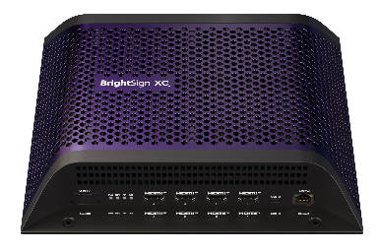
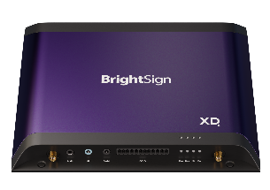
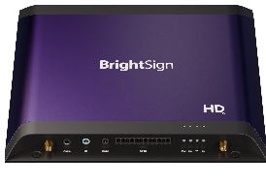
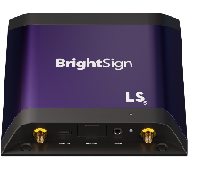
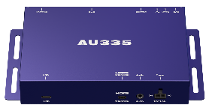
BrightSign Series 5
content and connections at every level and price point
XC5
XT5
XD5
XC2055
XC4055
HD5
XT245
XT1145
XT2145
LS5
XD235
XD1035
AU5
HD225
HD1025
LS425
LS445
AU335
Shipping Now
$300-$400
April 2023
$500-$600
Shipping Now
$600-$700
Shipping Now
Coming
June 2023*
$1200-$1700
Shipping Now
Notes:
Series 5 also has made great strides in adding leading edge technology to support the highest level of content available – namely 8K and PC-class HTML – as well as additional connectivity options that include Multiple HDMI outputs to support multiple screens from a single player. All of these advancements are found on our Premium level players.
And in terms of HTML content, BrightSign is seeing strong market trends in signage that are hugely focused on HTML and motion graphics. This type of content relies heavily on performance at the edge- meaning the player or PC must animate the motion graphics during playback and respond to interactions with that content during use. Hence we have built the BrightSign Series 5 players to address this trend by focusing on their ability to run super high performing HTML and motion graphics across the entire range of players so that super smooth & responsive experiences can be achieved and exceed what a signage PC can deliver.
AU335 was our very first series 5 product that was released in September 2020 and was designed for audio playback offering high bandwidth audio and support for ARC/eARC. It also has many audio distribution features and can control other devices for interactive and immersive sound experiences
LS5 line offers 2 models in the affordable mainstream signage category but surpasses the competition with its unmatched dependability & uptimes, its powerful content support & unrivaled set of signage features to tackle more applications than others in this category including SoC solutions. The 2 models differ in that 1 model supports HD 1080p resolution & the other supports 4K. Otherwise both have the same connectivity options which have expanded from LS4 to include a dedicated digital audio port, a locking power supply & support for an optional dual antenna wireless module. Available Spring 2023
HD5 line has an increased in its video & HTML content performance to a more advanced level and its 4K content support surpasses that of LS5 with its ability to support rotation of 4K videos. This line is the ideal starting point for interactive experiences due to its plethora of connectivity options that aren’t available on LS5 – namely GPIO, serial, & IR. Available Spring 2023
XD5 line is the ideal starting point if motion graphics are a part of your experience. It can handle powerful interactive & multitouch motion graphic applications and provides plenty of room to grow which is why we believe it will be our most popular line of choice and the best option to future proof your single screen applications. This line also has added POE+ support to streamline implementations. Available Early Spring 2023
XT5 line will have 3 models to choose from all of which are built for premium 8K content support. The XT245 offers standard I/O connectivity, the XT1145 adds expanded I/O connectivity plus an HDMI input and the XT2145offers 2 HDMI outputs to power 2 screens at once – all in a streamlined & thinner industrial design. Coming Summer 2023.
XC5 line is our flagship product line delivering PC-class performance that you can rely on and scale with. The 2 models offer virtually the same I/O for interactivity including GPIO, IR, Serial & 2 USBs but differ in their HTML performance levels and HDMI outputs - the XC2055 has 2 HDMI outputs for dual screen experiences and an Expert level of HTML performance while the XC4055 offers 4 HDMI outputs and an Elite level of HTML performance making it our most powerful and versatile player ever. Available Now

Slide 12
Transforming the world of digital signage through an ecosystem of excellence and cutting-edge technology that empowers businesses to connect and communicate in dynamic and impactful ways.
Thank you

