Slide 1
May 16, 2023

Slide 2
LONG TERM SUCCESS
VISUALIZE THE OUTCOME
Will ‘good enough’ deliver results today & tomorrow?
How much risk are you willing to take?
Do I want a complete solution or just a screen?
Notes:
BrightSign has been a leader in digital signage since 2009. As leaders, it’s important to take a step back from time to time and reflect on how we got here. How are we perceived in the marketplace and why? In doing that, what we’ve learned from talking to our partners is that they use us when it’s unique and complicated, but they may use something else when it’s good enough. That the decision to lead with BrightSign was based on content, but that is not our core value prop. Majority of Brightsign business is rip and replace, which means, that other product wasn’t actually good enough. But why? Why do they rip it out and replace it with BrightSign? Maintenance, management and security and that is what our true customer value proposition is. It’s BrightSign Ecosystem and our dedicated BrightSignOS. A good enough solution, will cost you more in the long run. Failure happens after deployment and that is what we solve for. Mitigation of risk so that you have long term success within your signage platform.
- Good to start and end with risk mitigation; what deems a signage deployment to be successful happens after it is installed.

Slide 3
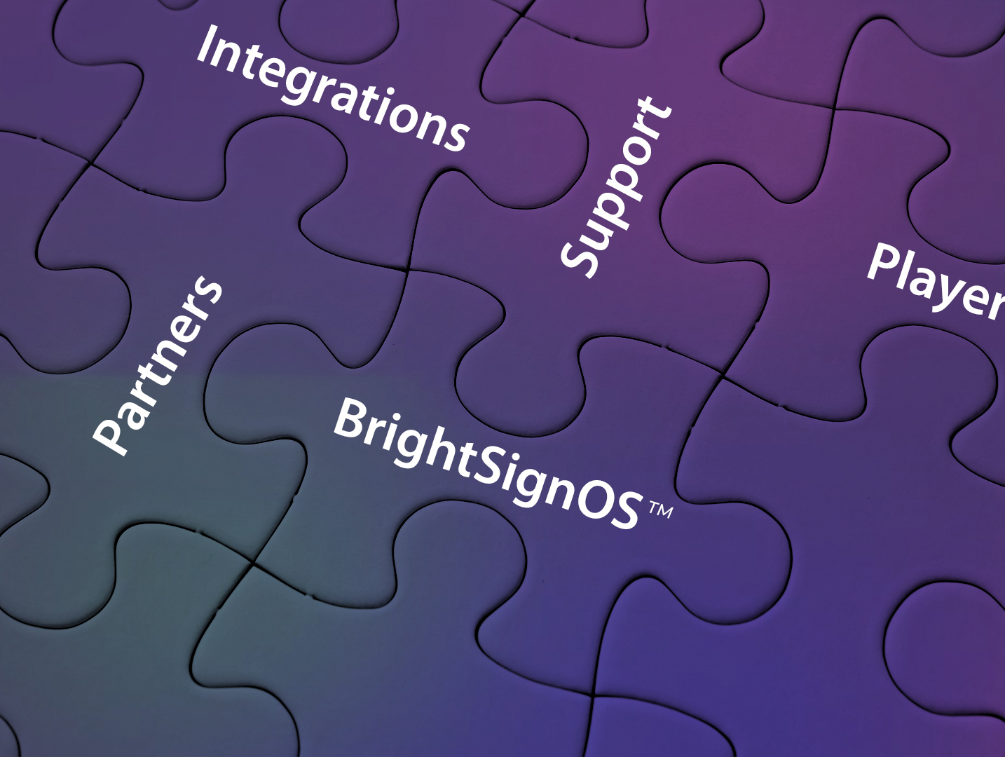
The BrightSign Ecosystem
BrightSignOS™
The only purpose-built operating system bringing unrivaled security and signage power to every BrightSign player.
Players
Expansive lineup delivering legendary reliability, security & performance with an unparalleled commitment to excellence & innovation.
Integrations & Add-ons
Our players can be customized to fit any application using a wide range of leading CMS solutions, software, and add-on peripherals.
Partners
Our global network of authorized resellers, integrators, and technology providers ensures success for every customer.
Support
We deliver solutions at every step, from pre-sales consulting and engineering to flexible training options, online resources and direct support.
Notes:
And risk mitigation starts with our BrightSign Ecosystem. BrightSign has pioneered digital signage, and over the past 16+ years of experience in the industry, we have learned that simply building players isn’t enough. It takes an entire ecosystem to ensure the success of our customers. Our BrightSign Ecosystem is focused on greatly reducing the pain points of signage along every step of the way from pre-sales and initial deployment to maintenance, support and improvement of your experience for many years beyond. Our ecosystem is the basis for how we have become the leader and most trusted brand in digital signage. So while we are known for our players, the core of our ecosystem is actually our operating system - BrightSignOS.

Slide 4
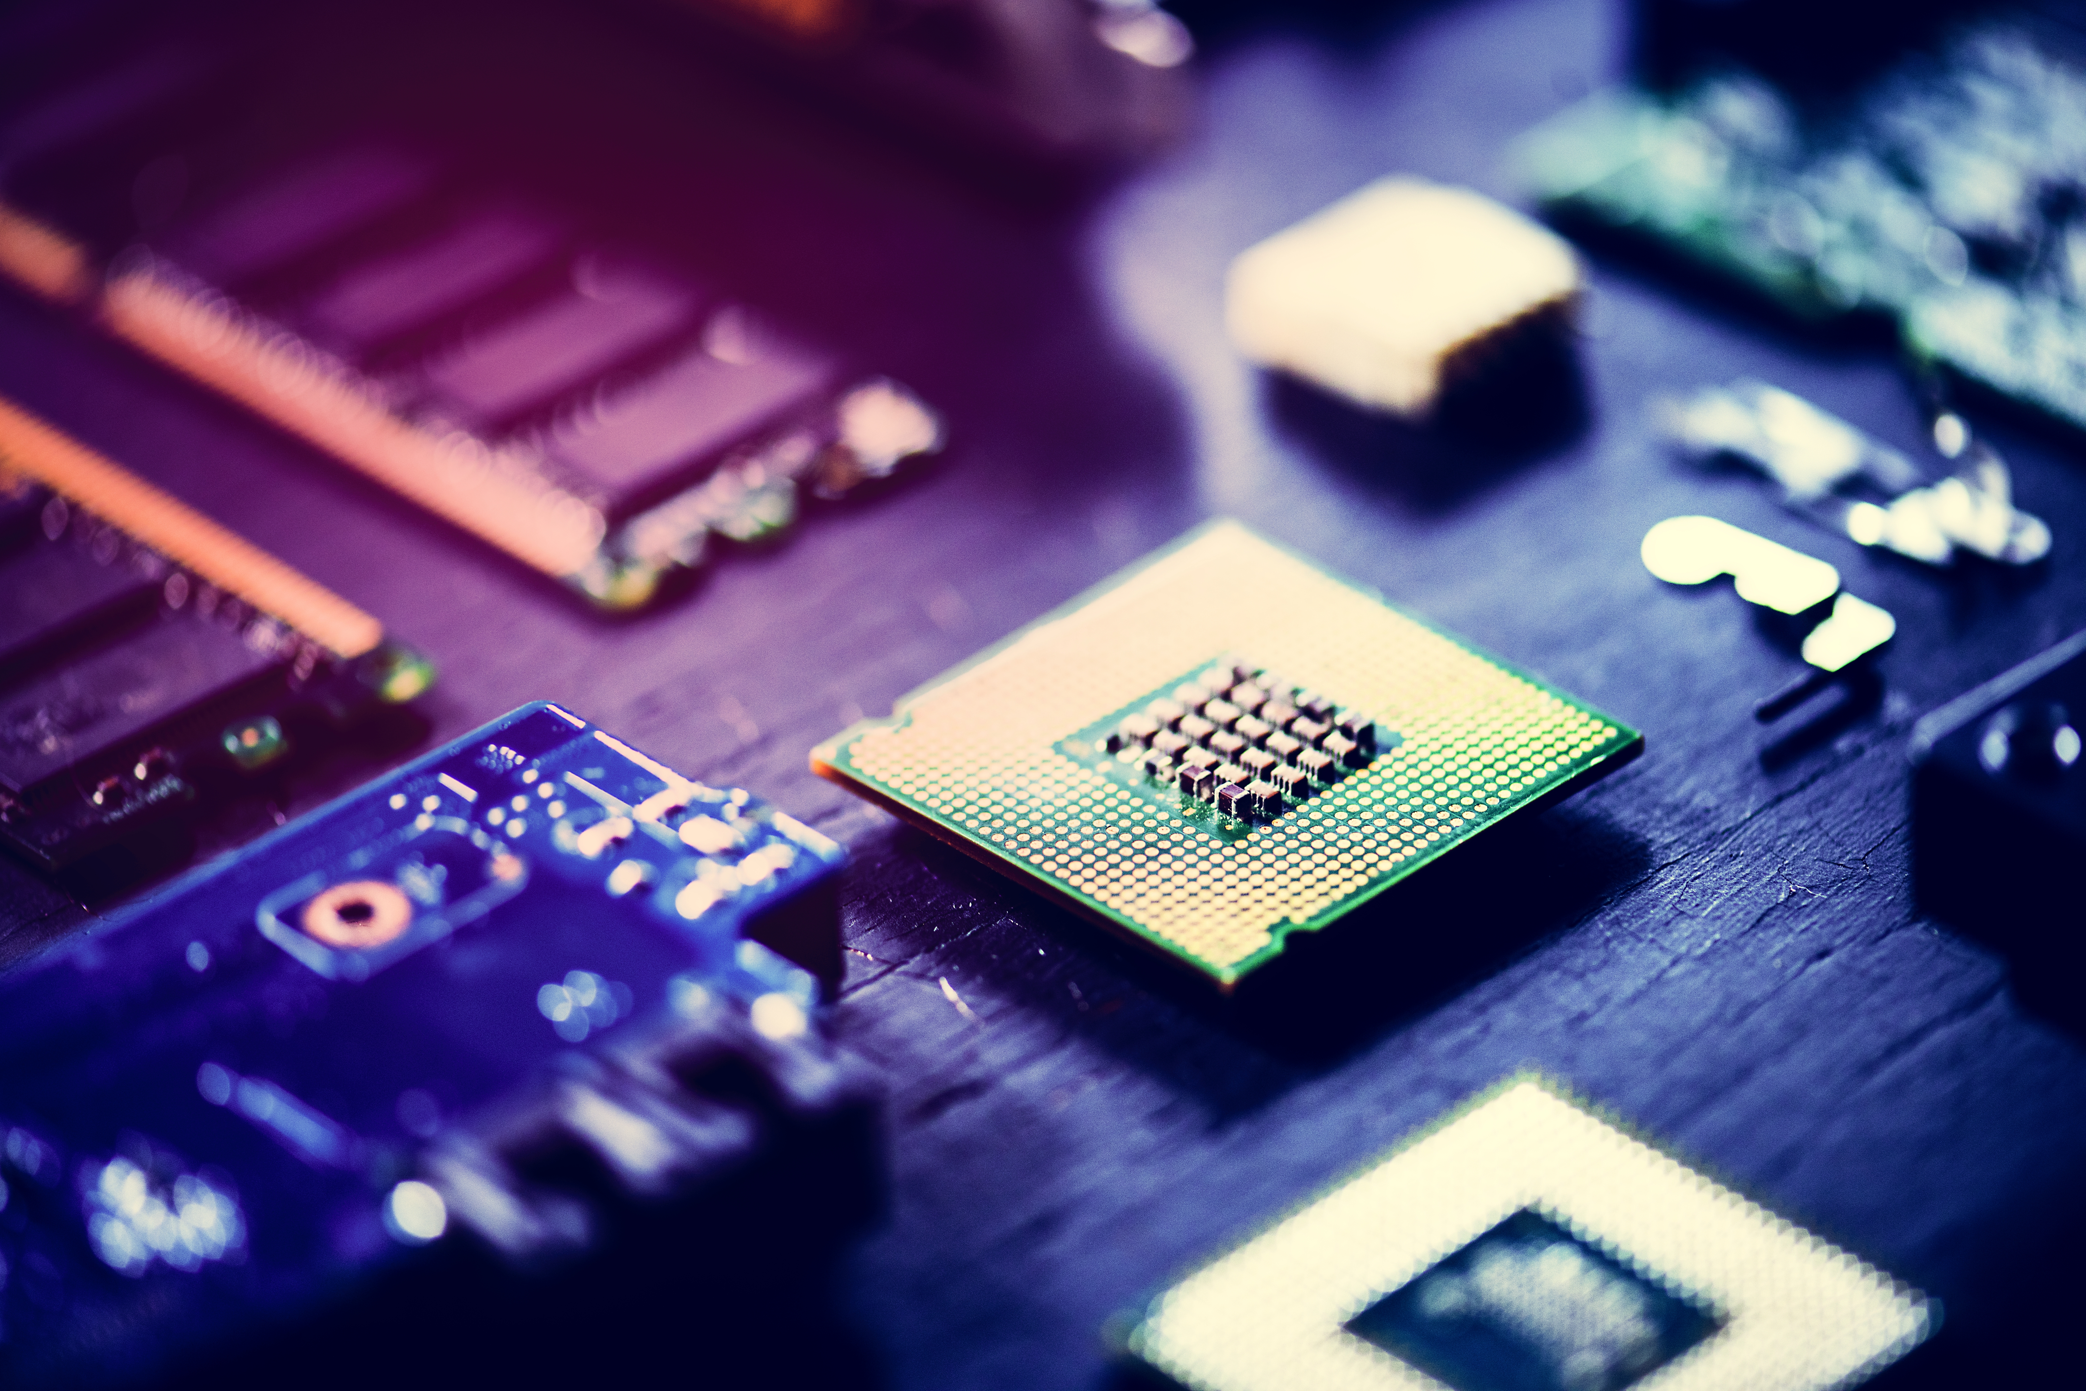
BrightSignOS™
The Power of Purple Unveiled
Notes:
BrightSignOS is the power behind every BrightSign player. This presentation will focus on how this underlying foundation strongly has been designed to take control of mitigating risk while also delivering powerful signage performance that achieves successful results both initially and for the life of your experience. So let’s unveil the secret behind this ‘Power of Purple’

Slide 5
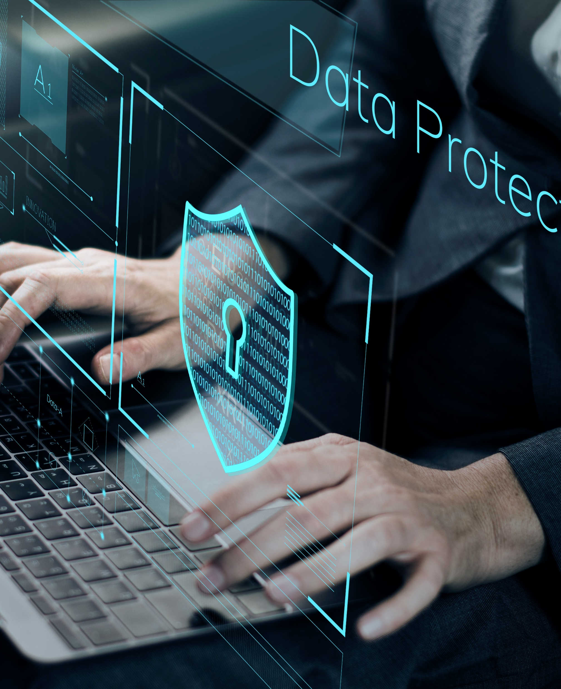
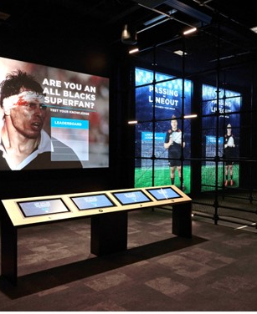
BrightSignOS™
THE POWER BEHIND EVERY BRIGHTSIGN PLAYER
SECURE
RELIABLE
SUPERIOR
SUSTAINABLE
Notes:
BrightSignOS is the soul of BrightSign bringing unrivaled security, reliability, superior results and sustainability to every BrightSign player. It is purpose-built for signage and will only run only on BrightSign players.
----
Summary talking points if only using this slide vs. zooming into each one:
We talk all the time that we offer a purpose built device but BrightSignOS is what makes us truly different. It breaks down into these 4 design principals it was built to achieve.
First off it is Secure. It reduces risk to near zero with a purpose-built operating system that removes vulnerabilities and is configurable to any security profile.
Next it is Reliable. BrightSignOS delivers legendary reliability boasting a < 0.1% failure rate across millions of players with self-healing & remote management that saves time & money.
It also delivers Superior results by running all content at any resolution, supporting virtually any connected device and technology integration, and being highly extensible using easy-to-use software and tools for simple to sophisticated experiences.
And finally it is Sustainable through its power efficiency and virtually maintenance free operation. It is built to last offering unprecedented free updates that that leave no player behind and allows them to be repurposed for emerging needs and alternate CMS choices.

Slide 6
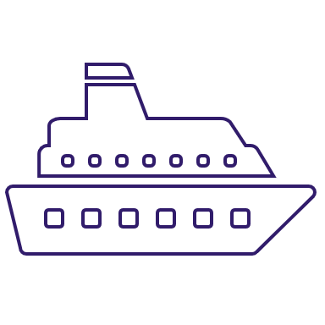
Reducing risk to save $ on signage
Total cost of Ownership
Purchase Cost
Downtime Costs
Maintenance Costs
Operational Costs
HIDDEN COSTS
Upgrade Costs
Replacement Costs
Downtime is the most expensive investment in signage
Notes:
So what does all of that mean? All the efforts put into the design principals of our BrightSignOS ultimately is about mitigation of risk. Statistics show that the number one reason why the customer doesn’t move forward with a purchase or is hesitant to pull the trigger, is due to risk of failure. Failure doesn’t happen at implementation, failure happens after. Failure happens after you install your project. Everything we are solving for with our BrightSignOS comes after implementation. Assessing the total cost of ownership includes planning for the hidden costs because downtime is the most expensive investment in signage. BrightSignOS greatly reduces the major risks involved thereby delivering huge cost savings throughout the long life of your player.
Here’s an example to learn from: We had a customer wanting to split a project between SoC and BrightSign because they thought the SoC cost less, but that is just the initial cost without considering the total cost of ownership and risk mitigation. Yes your content is going to run well on both systems, but all the hidden fees are in maintenance and downtime. Because that SoC display will become obsolete once it is installed, its memory will eventually fail and it isn’t upgradeable so trucks will need to be sent out sooner rather than later to either repair it or rip it out and replace it, and that is hugely expensive.
____
The most expensive investment in signage is the risk. All the BrightSignOS pillars we just described greatly reduce the major risks involved with signage and delivers overall cost savings to your investment. With an investment in BrightSign, you mitigate the risks and saves on the true total cost of ownership.
Higher quality & purpose-built hardware & p OS that are more capable, durable, secure & performant
Vast set of players to choose from so you can purchase at the price point that fits your needs. SoC solutions only offer 1 choice and it
maintenance cost savings due to BrightSign’s <1% failure rate due to its solid-state hardware
Close to 0% downtime due to ultra high reliability of OS, self healing & rock-solid security
Reduced operational costs due to its power efficiency results in utility cost savings & without the need for costly temperature controlled & ventilated operating environments you save even more
Free tools
Free Player Networking options: Local area networking & simple file networking or go with tried and true SD card publishing with SneakerNet
Free Control Cloud subscription for real time access to player health and remote controls
Free BrightAuthor:connected free standalone CMS with access to hundreds of signage specific features needed to create and publish captivating presentations.
Longevity for BrightSign is unrivaled at 5-8 years. BrightSignOS & solid-state platform – they have a longer life cycle & can be repurposed because we keep them up to date with OS releases
Free upgrades of BrightSignOS for over 5 years guaranteed and not just for bug fixes, but also for new features allowing your signage to grow over time
Repurpose players for new applications – there is no end of life to a BrightSign player
Always connected - There is basically no need to put boots on the ground to service players that don’t fail, don’t stop playing and are always connected with remote control
highly efficient cloud-based network solutions to send content updates and monitors player and network health from a remote location.

Slide 7
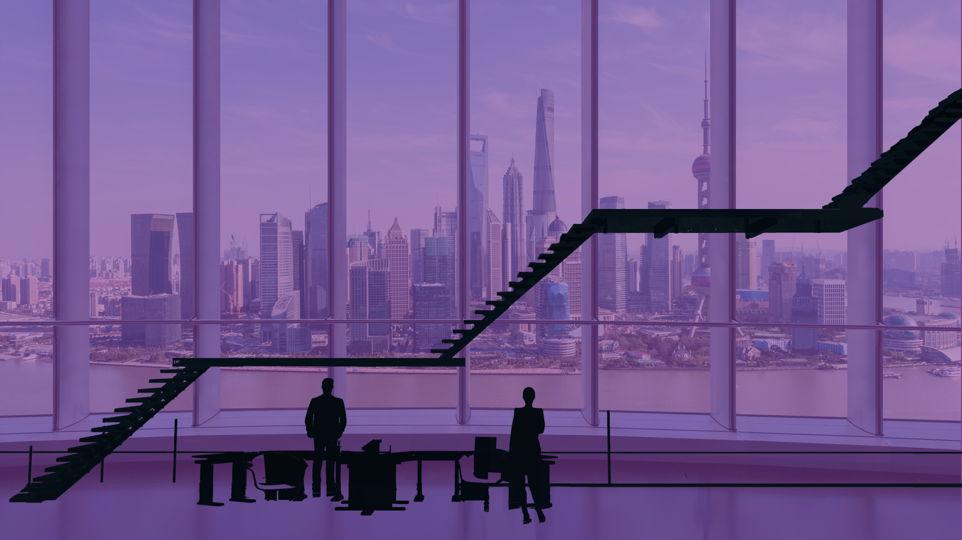
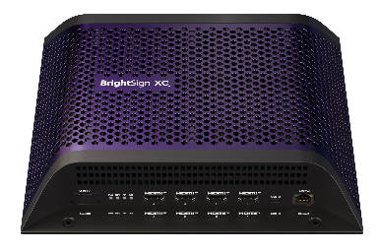
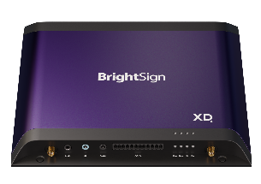
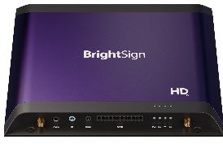
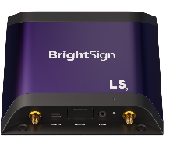
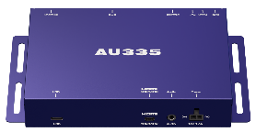
BrightSign Series 5
content and connections at every level and price point
XC5
XT5
XD5
XC2055
XC4055
HD5
XT245
XT1145
XT2145
LS5
XD235
XD1035
AU5
HD225
HD1025
LS425
LS445
AU335
$165
Shipping Now
$300-$400
Shipping Now
$500-$600
Shipping Now
$600-$700
Shipping Now
Coming
June 2023*
$1200-$1700
Shipping Now
Notes:
The power of purple at its core is our BrightSignOS. And that purple power is of course running on our newest set of players – BrightSign Series 5. This new series reaches new heights in running leading edge technology to support the highest level of content available – namely 8K and PC-class HTML. And they also offer even more connectivity options that include Multiple HDMI outputs to support multiple screens from a single player.
And in terms of HTML content, BrightSign is seeing strong market trends in signage that are hugely focused on HTML and motion graphics. This type of content relies heavily on performance at the edge- meaning the player or PC must animate the motion graphics during playback and respond to interactions with that content during use. Hence we have built the BrightSign Series 5 players to address this trend by focusing on their ability to run super high performing HTML and motion graphics across the entire range of players so that super smooth & responsive experiences can be achieved and exceed what a signage PC can deliver.
AU335 was our very first series 5 product that was released in September 2020 and was designed for audio playback offering high bandwidth audio and support for ARC/eARC. It also has many audio distribution features and can control other devices for interactive and immersive sound experiences
LS5 line offers 2 models in the affordable mainstream signage category but surpasses the competition with its unmatched dependability & uptimes, its powerful content support & unrivaled set of signage features to tackle more applications than others in this category including SoC solutions. The 2 models differ in that 1 model supports HD 1080p resolution & the other supports 4K. Otherwise both have the same connectivity options which have expanded from LS4 to include a dedicated digital audio port, a locking power supply & support for an optional dual antenna wireless module.
HD5 line has an increased in its video & HTML content performance to a more advanced level and its 4K content support surpasses that of LS5 with its ability to support rotation of 4K videos. This line is the ideal starting point for interactive experiences due to its plethora of connectivity options that aren’t available on LS5 – namely GPIO, serial, & IR.
XD5 line is the ideal starting point if motion graphics are a part of your experience. It can handle powerful interactive & multitouch motion graphic applications and provides plenty of room to grow which is why we believe it will be our most popular line of choice and the best option to future proof your single screen applications. This line also has added POE+ support to streamline implementations.
XT5 line will have 3 models to choose from all of which are built for premium 8K content support. The XT245 offers standard I/O connectivity, the XT1145 adds expanded I/O connectivity plus an HDMI input and the XT2145offers 2 HDMI outputs to power 2 screens at once – all in a streamlined & thinner industrial design. Coming Summer 2023.
XC5 line is our flagship product line delivering PC-class performance that you can rely on and scale with. The 2 models offer virtually the same I/O for interactivity including GPIO, IR, Serial & 2 USBs but differ in their HTML performance levels and HDMI outputs - the XC2055 has 2 HDMI outputs for dual screen experiences and an Expert level of HTML performance while the XC4055 offers 4 HDMI outputs and an Elite level of HTML performance making it our most powerful and versatile player ever.

Slide 8
Transforming the world of digital signage through an ecosystem of excellence and cutting-edge technology that empowers businesses to connect and communicate in dynamic and impactful ways.
Thank you

Slide 9
Secure
Reduces risk to near zero with a purpose-built file system that removes vulnerabilities and is configurable to any security profile.
OS
BrightSignOSTM is the custom-built power behind every player
Cryptographically signed operating system
Configurable for any type of security profile
Security spans across CMS solutions
Notes:
BrightSign builds security into the very core of our system. That means our system is designed to only run our operating system. In addition, our operating system is designed only to run one single application. If you compare that to other devices like a MAC or Windows laptop or even an android or chrome device, they all run consumer operating systems. Those consumer operating systems as you very well know, have a home screen & you can add many different types of applications to them. Since we live on these consumer-built devices every day, we want them to do many different and diverse things so we want lots of applications to run on them. But every time you add an application to your device, you create a way for viruses and other things to run and defeat the security mechanisms of your device. With BrightSignOS, it is built to only run one application which means that you simply cannot put another application on our players and this alone raises the security level dramatically because we do not allow the addition of any other apps. The way we keep out other apps from running except our own is that we cryptographically sign our operating system and when the BrightSign player starts up, it checks for a digitally encrypted signature to make sure that the software of the BrightSignOS has not been hacked or that there is nothing else running within that software. If it passes the encrypted signature test, BrightSignOS will run. And if it doesn’t pass this test it will not run. In the open source world, people could actually take open source tools and applications and literally build an operating system to make it look like it is our BrightSignOS, however it would not be signed and therefore our players will absolutely not run it. This is primarily how we keep out the major security risks and it raises the bar incredibly high on being able to hack our players. As proof of how secure our players are, you need only to look at where our players have been deployed. They can be found in extremely high secure markets like banking and on some of the most secure networks in the world. For example every US Navy ship has BrightSign players on them for ship-to-ship communications.
The other area of security that we have the ability to address through our BrightSignOS is to configure the security profile and make them even more secure. In some institutions such as government and finance, they don’t allow any external I/O to be accessed so we have ways to configure the system where the USB ports for example are deactivated. We can also disable the SD card slot in which case you would use a self-encrypting SSD storage option that is installed internally on the player resulting in a super secure and high-capacity storage solution. So our base level of security is very high to begin with and we can increase it many ways to make it even more secure.
And our security doesn’t stop there. If you are running a partner CMS solution with our players, our security level applies to them as well.
With BrightSignOS, we deliver an amazing level of baseline security across the whole platform and we have built in that security from the bottom up.
___
BrightSign players are custom built appliances, not a general built computer or device. All BrightSign players are cryptographically signed only to run BrightSignOS which is a read-only operating system that can’t be modified and won’t allow our players to run anything else which reduces virtually all attack vectors.
BrightSignOS is the custom-built power behind every player
Our players are built to only to run BrightSignOS – nothing else
BrightSignOS is built on top of our own custom version of Linux which only includes what is needed for signage experiences which reduces all the possible attack points & makes them un-hackable
Cryptographically signed root system that is read only and can’t be hacked
Impossible to run arbitrary executables or viruses - Reduced vector of attack because it doesn’t run all the packages a standard Linux build would run
Has a security profile that runs only applications signed by BrightSign
File system itself that runs on the player is not modifiable - There is no admin login to players to change the OS
Only attack risks are physically replacing the SD card or exposing the player or presentation to the Internet
Configurable for any type of security profile
Supports fixed, self encrypting SSD storage
Uses authentication protocols to ensure content downloads are authorized
Customizable player settings to ensure your signage is secure including WPA Enterprise/802.1x, multi-network port priorities & redundancy.
Security spans across CMS solutions
Whether you use BrightAuthor or a partner CMS, our players remain secure because they run BrightSignOS
Standardizing on BrightSign players removes the risks SoC & PC solutions can’t address

Slide 10
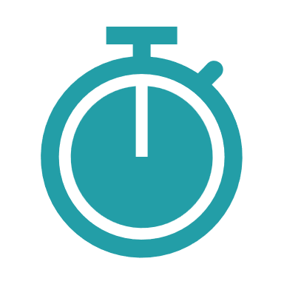
Reliable
Legendary reliability boasting a < 0.1% failure rate across millions of players with self-healing & remote management that saves time & money.
Unmatched uptimes
Self-healing
Remote management for all players
Removable storage avoids rip/replace
Notes:
While having a secure system adds to our reliability, it is not the only contributing factor that results in the extremely low failure rates and unmatched uptimes our customers rely on. Since BrightSignOS is designed for only one thing – to run digital signage – we are able to hyper focus its abilities by building in protocols to ensure our players keep running and defeat any obstacles that show up along the way.
Our very high uptimes are made possible by the technologies we have built into our BrightSignOS to monitor various systems within the device to make sure they are functioning correctly. And if they aren’t functioning the right way, it triggers self-healing actions to go into effect. The player may reboot or go offline for 30seconds to fix itself which is a very short time and allows the players to get back up and correctly run the application. To illustrate how this self-healing works, on a computer when you open a browser like chrome or an application it has at its base an HTML rendering engine that runs. And sometimes it locks up while you are using system. The reality is, is that your computer knows that it is having problems, but it doesn’t know how to fix it. You may have an excel spreadsheet open and a browser open at the same time and the OS doesn’t know what to do and what application is more important so it can’t fix itself. So what do you do? You manually close that browser page or the application and then manually restart it. You may even have to do a force quit to fix it – all because it is running a consumer operating system vs. one dedicated to signage. So in our case with BrightSignOS it also has an HTML rendering engine but we only have one application running it. We know it’s function and that signage is the priority so we can fix it without intervention. We are able to sense an issue and shut down the HTML rendering engine and restart it back up. And if that doesn’t work, then we can reboot the device and see if that fixes it. And if that doesn’t work then we can actually delete all the content and go back to the server and pull down the last known good content. And if that doesn’t work, then we can completely remove the OS and rebuild or reinstall it over the network without putting boots on the ground. The great thing about this fail-safe set of protocols, is that it is all done automatically without user intervention. So if you compare that to a device running Windows for example, when that rendering engine goes down it doesn’t know what to do – it just stops or it crashes and puts up a blue screen which means it needs user intervention and someone will need to go and touch the device to fix it.
With BrightSign we aren’t saying that you never have to physically touch the device to resolve an issue, but it is incredibly rare. If the self healing doesn’t fix the problem, the next line of defense is to use our secure remote management to go remotely go in to diagnose and resolve the issues. BrightSignOS offers a secure real time connection to the player that is tied to a remote management system called Control Cloud. This allows you to electronically reach in and securely touch the device remotely to perform a whole set of diagnostics on our players as well as do things like analyze the network connection. This allows you to save on having to make an in-person trip to service the unit.
If you take these two things into account – the self healing and remote management - most visits on site are eliminated vs. a lot of other systems that would need to send a person to diagnose and resolve an issue. And those site visits are costly at about $200-$400 minimum. So if you look at the cost of our platform and what our reliability gives to you, it is dramatically reducing the total cost of ownership.
And last but not least, all of the devices today use flash memory as a way of storing content. When you think about that, flash memory is a consumable entity in digital signage – it degrades over time due to all the reading & writing that happens to play a presentation. So that memory needs to be accessible in order to change it out when necessary. This is why BrightSign makes our players with removeable SD card slots so that you can access the one thing that we all know degrades over time. A good analogy for this is a car’s tires. You wouldn’t buy a car with tires that you could never change out because once they wear out you have to buy a new car. And the same is true for digital signage with fixed memory. Since the memory is the first thing to go bad, if you can’t swap it out because it is soldered to the board, you have to rip out and replace the whole screen just to fix a simple memory issue.
To give you a deeper understanding of how flash memory degrades, at the lowest level what happens is that when one block has too many reads/writes, it moves the content to a new block. And if you wear out all the blocks then you have to replace the storage media. So if you are using an SD card you have to physically replace it which is why having it accessible to replace is a good thing. Replacement costs for an SD card memory is relatively cheap at about $20-30 and they do last a long time if you buy commercial-grade class cards. To compare this to an SoC solution which has fixed memory, their memory is not replaceable - it is soldered down on the circuit board. When its memory goes out you’re not replacing an SD card you are replacing the whole display. In addition to this, using large capacity storage makes the life of your storage even longer because there are more memory blocks to wear out as the data keeps moving to a known good block in the memory. So in doing the math, if your content is 4GB and your total flash memory storage is 8GB – which is the typical storage capacity of an SoC solution, that memory capacity will degrade quickly. Whereas in a BrightSign you can put in a 64GB card to play that same 4GB of content and it gives you exponentially more life because there are more memory blocks to use. In addition, BrightSign supports adding an internal, self-encrypting SSD memory card on some models which supports a whopping 256GB of memory which adds not only security. Even though you can’t remove SSD memory as easily, it still is indeed removeable and replaceable and it gives you a way to add more storage life which extends the reliability of your player.
So with our self healing, remote management and removeable storage combined we can deliver unmatched uptimes resulting in amazing reliability made possible with our dedicated BrightSignOS operating system.
____
Unmatched Uptimes
Solid state, longer life power supplies & higher quality components overall resulting in <.1% failure rates
Commercial-grade design & manufacturing processes
BrightSignOS is designed only to run signage applications
Perceived downtime is greatly reduced with running BrightSign
Self healing for the unexpected
Players run unattended – they always play the presentation published. There is no other player designed to run this way
SoC solution, android, iOS, windows, etc. have other applications that want to be in control of the device
Automatically reboot when something goes wrong resulting in less than 1 minute of downtime
Reverts to the last known good published presentation on cloud-connected players
Remote management for all players
Apply updates on your terms
Reboot and re-configure players anywhere, anytime
Monitor SD card health & reformat SD cards remotely
Connect via the dws or control cloud
Removeable storage avoids rip/replace
Memory is a consumable that needs to be maintained
Easy to replace or upgrade as capacity needs increase
---------
Example customer: PatientPoint: their uptimes are in high 90s
Competition:
BrightSignOS is the leading and one of the very few commercial-grade operating systems built and designed only to run signage.
SoC and PC solutions that run OS are foundationally built for non-signage purposes
Free Cloud-connectivity for real-time player health & controls without putting boots on the ground
Removeable storage is a benefit as it is a consumable and reduces the need to rip/replace. Examples of consumables: Cars have tires to replace periodically, fans on a PC need to be serviced/replaced, but our players don’t have them.

Slide 11
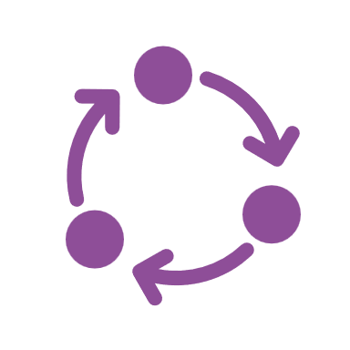
Superior
Runs content, resolution, connected device, and technology integration with easy-to-use tools for simple to sophisticated experiences.
Long life cycle support
Vast & flexible signage features
Free authoring software
Highly extensible
Notes:
Next up, what we routinely get told by our customers is that they continually get superior results when they use BrightSign. Well that goes into several things. First there is our long life cycle support – we typically support our OS for 6 years after we have shipped the last unit and we allow you to apply those updates when you want and if you want. Comparing this to a consumer operating system like Windows, you also get long life cycle support however it is being jammed down your throat. They automatically update whether you like it or not with a lot of consumer features even if you aren’t using them and want to only run digital signage. This is because to Microsoft, digital signage is a trivial part of their business so they focus on adding consumer features to their Windows OS and what that does is add a lot of bloat-wear to the computer. All these features that you are never going to use, get installed on the device anyway and it makes the device get slower and slower over time. This same thing is what also contributes to the quick replacement of PCs every 3-4 years by consumers – not because the hardware isn’t working but because so many new features that have been added and they are taking up memory and processing and making the computer act slow and crash alot. BrightSign’s long life time cycle support allows you to take the updates or not and apply them yourself when you want to. Our updates often provide improved security patches and new features and are solely for the purpose of bettering the digital signage application you are running – nothing else.
Now if we compare this to SoC solutions, when they ship an SoC display, the OS version that ships with it is the one and only version you get as they don’t update it. For digital signage applications, deployments can take some time to do especially for large installations. So you may have 3-4 different versions of their OS running on your network. This makes things very complicated to maintain and it extends to your CMS that you are running. That CMS will need to support multiple OS versions, but what’s even worse is that you’re not going to be able to use the latest and greatest features of that CMS. Because some of your SoC displays are running an older operating system, you end up locking into the oldest operating system in the network because it is the only way you can keep a standard across all the devices.
With BrightSignOS our operating system originated from Roku and when we split that was the operating system we took with us. While Roku also took that OS core, they continued to add lots and lots of consumer streaming features. While we took that core OS and designed in more and more digital signage features into it. Its been almost a decade and a half since we split from Roku, so we have added an enormous amount of core features into our BrightSignOS allowing our customers to build virtually anything they can dream up. And with that we are also able to support not only our BrightAuthor:connected and BSN.cloud software, but we also can support all of our CMS partners. We have added all these great features into our OS that we leverage with our free authoring software, but we also expose all of them through open APIs to our CMS partners so they can easily take advantage of them and integrate them into their solution.
And last but not least, I talked about our BrightSignOS being very focused and dedicated to digital signage, yet we also have the ability to add extensions. For example there is a lot of video recognition technology such as facial recognition which we don’t include support for in BrightSignOS because they are very specialized and if you aren’t using them, then you don’t want them running. But if you need them we have the ability to add extensions for them and our extensions all go into the same process of being cryptographically signed so that not anyone can just add one to our platform. So it is a very secure and measured way that we add the extensibility to our players and support specialized technology so that our customers don’t need them do not have to have the burden of running these extensions and those customers that do need them can easily get them added in.
***CMS partners pitch: BrightAuthor:connected is replaced with ‘Dedicated partner support’ which means that we have a dedicated engineering group to support them as they integrate with BrightSignOS, our players and our features. We also offer joint marketing support to spread the word about the benefits of our integration through PR, our website, marketing programs and events.
___
Unrivaled Performance
BrightSignOS is built specifically to get the most out of the hardware designed into our players; we invest heavily in optimizing the hardware
utilizes hardware acceleration & dynamically manages memory to play any content you can imagine
We build in bleeding edge technology that ensure player longevity – 8K, 3D WebGL transforms, etc.
We offer a number of different players that deliver varying performance hardware to match your application – SoC has one and only one choice
Vast & Flexible Signage Features
Culmination of 16+ years in the business of bring the brightest ideas into reality
The unique features we create are built into our OS and made available to our players
We offer open APIs to those feature for partners to integrate
Samsung can’t support serial connections or GPIO or audio playback capabilities that we have
Free Authoring Software
available as a desktop application for PCs & MACs and as a Web interface.
Vast sets of controls using triggers, events and immersive technologies integrated natively and with partners
Highly Extensible
Plugins
Set up players as web servers
Connect to 3rd party solutions
Partners
------
Example customer : Meta lands – its not always about the power, its about the overall quality & value the solution

Slide 12
Sustainable
Easy to maintain, power efficient, built to last, and scalable with free updates that leave no player behind.
Low Power, High Performance
Unprecedented Longevity
Purple Goes Green
Flexible CMS Choice
Notes:
The last part of our BrightSignOS is our sustainability. The green movement is coming to signage and the first thing that BrightSign does well on this front is that we simply use less power. Our players offer very high performance for a very low power device. On average our players use about 10 watts of power while PCs typically run at about 60 watts of power. So our players give you basically the same performance but 6x less power consumption which adds up to a significant amount of cost savings.
Secondly, our players last a very long time from both the software side because we aren’t adding a lot of features to slow down the device and also because we designed the hardware to be long-lasting with a lot of commercial grade component technology we have included at the hardware level. PCs get replaced in 3-4 years and our players are on average used 6+ years with some still operating at 9 years because of both the hardware and the software with free updates the give you more life out of the player. So just think about how many times you have to replace other hardware which goes into a landfill and with BrightSign we reduce that waste greatly. In addition to this, our packaging is recyclable and we try to minimize waste throughout our manufacturing and operations.
Last but not least, we give you a flexible CMS choice which contributes to the longevity. When you deploy with a CMS, you often have a specifically configured device to deploy with that CMS. And if the user later decides not to continue using that CMS for whatever reason, most of the times what they would have to do is discard the device and put in a new one because it can’t be reconfigured. But if that device is running BrightSignOS, you can reprovision it and switch out the CMS over the network easily because we support so many. For example if you have a whole network of BrightSign players running a single CMS and you want to change a subset of them to a new CMS, all you have to do is reprovision our player and put a new CMS on top of it and continue to use it. This shows that we are not only sustainable by reprovisioning, but that we are unique in that we can run multiple CMS solutions on the same network. And the re-provisioning can be done without putting boots on the ground – once again saving on cost and the environment by reducing travel.
So in summary the core of our sustainability is that our products operate with a very low amount of power, they last a lot longer due to our core hardware choices, OS updates and reprovisioning abilities to any CMS remotely. And as a company our manufacturing and operations embrace sustainable practices.
_____
High Performance Appliance
A BrightSign player is an appliance (purpose-built for a task of signage).
They simply don’t fail
Components are long lived & are selected for bleeding-edge high performance that ensures relevance in content support for many years to come
Unprecedented Longevity
A BrightSign player’s useful life is maintained thru free/cross-compatible OS updates that leave no player behind
Free updates: Free updates include more than fixes they offer new capabilities to leverage for growth & avoid rip/replace
We provide free OS updates for a minimum of 5 years from a product release.
Every player gets free updates & not just bug fixes, but also new solutions to combat security risks and new features to keep up with market trends which results in incomparable longevity in the field that our competitors cannot touch.
Updates include updates to core technologies used to develop signage (Node and Chromium), security updates, and feature enhancements.
Unprecedented Cross compatible OS: BrightSign player hardware isn’t locked to OS versions – we offer current releases across generations of players
All BrightSign players running our OS have the same core.
While individual product capabilities may vary (such as 4K support or 8K support), Chrome, Node, Streaming, and APIs are all consistent across each device.
with SoC you have to match the OS to the hardware with no upgrade path except rip & replace.
Scalable to grow with your needs
We also offer free BrightAuthor:connected and BSN.cloud updates
we build leading edge performance (8K, HTML performs) into our high-end players to keep them relevant for a longer life
add new solutions when you need them such as optional BSN.cloud & integrated partner solutions
Competition
SoC – their embedded player is locked to the OS it ships with, which means you have to rip & replace the screen to gain new capabilities or when it simply stops working because it is unreliable and unsecure for long term use. SOC displays all have the same core components until the new models are released & they are locked to their OS version upon delivery. So no updates to Chrome and Node once you install it. Once a SOC display is installed, it starts to age and rip/replace it only way to upgrade to features or get fixes.
Signage that runs Chrome OS takes the opposite approach. The update is monthly. This causes changes that are hard to adapt to for digital signage and also causes signage solutions that run Chrome to drop support for devices much more quickly because they can’t keep up with all the OS updates and adjust them to run for signage. – you can’t opt out!
Purple goes green
Power efficient saves on operational utilities - BrightSign players run off 6x less power than a PC
PCs get cycled every 3-4 years and BrightSigns live for at least 6 years and often up to 9
CEC controls to control powering screens on/off to reduce operating expenses
All features available in our OS are offered as open APIs so that an integrated CMS partner can them to add support our features in their solutions.
Easy to Reprovision / Flexible CMS Choice
Since players are built to last for an unprecedented number of years (we have players that are running in the field for over 10 years), we make them easy to be repurposed for new or different applications
This applies also to repurposing them to run a different CMS solution.
BrightSign is unique in our vast support of many CMS solutions – we support 100+ integrated CMS partner solutions
If a customer wants a CMS change on BrightSign, it is simple and quick to do. Rather than ripping out and replace the player, our re-provisioning process is quick and easy and can even be done remotely.
BrightSign supports multiple CMS partner solutions on a single network

